Slide 1
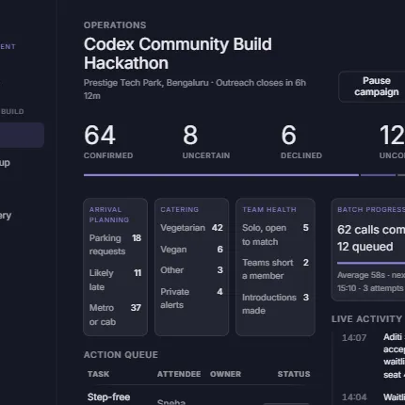
RALLY
Event readiness
that turns RSVP data
into an action plan.
A voice-assisted operations console for organisers who need confidence before the event starts.
Hackathon reviewer walkthrough
Frontend + deployed Express API
RALLY / HACKATHON REVIEW
1

Slide 2
THE PROBLEM
Registration is not event readiness.
A full RSVP list still leaves organisers guessing who will arrive, what they need, and what to do when plans change.
The gap
Attendance uncertainty
Attendee data is static. The operational plan is not.
A registered attendee may still be a no-show.
Operational details arrive late
Teams typically chase confirmations, parking requests, food needs and cancellations in separate channels—too late to make clean decisions.
Parking, arrival, food and access needs are often scattered.
Cancelled seats go unused
Waitlisted guests need a fast, consent-aware recovery flow.
RALLY / HACKATHON REVIEW
2

Slide 3
HOW RALLY WORKS
Rally closes the loop from outreach to action.
The product turns individual confirmations into a shared plan that organisers can act on.
01
02
03
Import & configure
Collect readiness signals
Act on the plan
Create a campaign, bring in attendees, and choose the questions Rally should ask.
Record consent-aware responses for attendance, arrival, parking, food and access.
Prioritise follow-ups, adjust operations, and recover released seats from the waitlist.
CAMPAIGN SETUP
READINESS RESPONSES
OPERATIONS & RECOVERY
RALLY / HACKATHON REVIEW
3

Slide 4
WHAT REVIEWERS CAN EXPLORE NOW
A complete operations journey, not just a dashboard.
The current build covers the pre-event readiness workflow from campaign setup through final recovery.
CAMPAIGN CONTROL
READINESS VIEW
SEAT RECOVERY
Configure
Understand
Recover
Event details, outreach questions, consent safeguards and import mapping.
Live activity, attendee answers, action queue and preference summaries in one place.
Release declined seats with consent and route offers through a visible waitlist queue.
Every screen is driven by an API-ready data adapter, so mock content can be replaced by live campaign data.
RALLY / HACKATHON REVIEW
4

Slide 5
BUILT FOR A REAL EVENT WORKFLOW
The frontend is connected to a deployed backend contract.
Rally’s interface composes campaign operations from focused APIs instead of relying on a hardcoded dashboard payload.
Rally frontend
Express API
Campaign data
Campaigns · attendees
operations · waitlist
Deployed on Vercel
Preferences · tasks
call activity · seat offers
The API adapter composes six endpoints for the operations view, with local mock fallback available for design and development.
RALLY / HACKATHON REVIEW
5

