Slide 1
Conclusion: problems addressed
Sampling problems
strategy
sampling rate e.g. samples per pixel
Error
bias (careful judgement)
variance
convergence (depends on application)

Slide 2
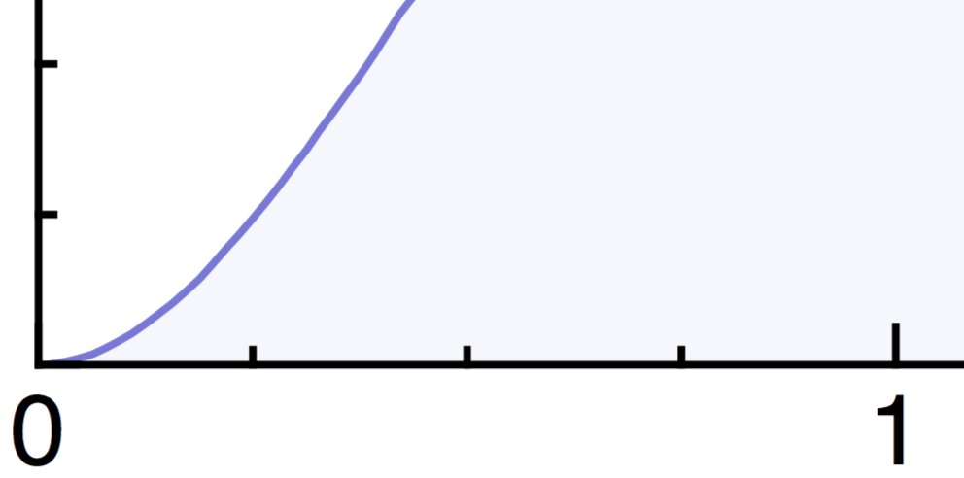
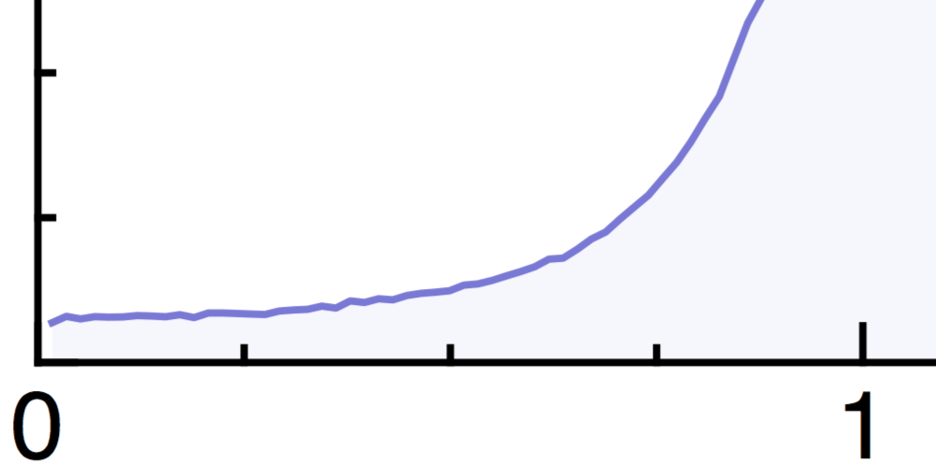
Conclusion: insight from Fourier analysis
Error prediction useful in determining sampling decisions
Different assessment criteria for reconstruction and integration
Low-frequency zone of sampling spectra

Slide 3
Conclusion: insight from Fourier analysis
Error prediction useful in determining sampling decisions
Different assessment criteria for reconstruction and integration
Low-frequency zone of sampling spectra
converges faster but higher error
converges slower but lower error

Slide 4
Opportunities
convergence analysis without homogenization

Slide 5
Opportunities
convergence analysis without homogenization
analysis of quasi-Monte Carlo sampling

Slide 6
Opportunities
convergence analysis without homogenization
analysis of quasi-Monte Carlo sampling
convergence analysis without homogenization

Slide 7
Opportunities
convergence analysis without homogenization
analysis of quasi-Monte Carlo sampling
convergence analysis without homogenization
tailor sampling strategy to integrand

Slide 8
Questions?
Course website:
Git repository: coming soon …

