Slide 1
Unit 3
Queues
Objectives
Upon completion you will be able to
Explain the design, use, and operation of a Queue
Implement a queue using a linked list structure
Understand the operation of the queue ADT
Data Structures: A Pseudocode Approach with C

Slide 2
3.1 Basic Queue Operations
The Queue concept is introduced and three basic Queue operations are discussed.
3.2 Queue Linked List Implementation
In this section we present a linked-list design for a Queue. After developing the data structures, we write pseudocode algorithms for the Queue ADT.
3.3 C Language Implementations
This section presents a simple non-ADT implementation of a Queue. We develop a simple program that inserts random characters into the Queue and then prints them.
3.4 Queue ADT
Begins the discussion of the Queue ADT with a discussion of the Queue structure and its application interface. We then develop the required functions.
3.5 Queue Applications
Data Structures: A Pseudocode Approach with C

Slide 3
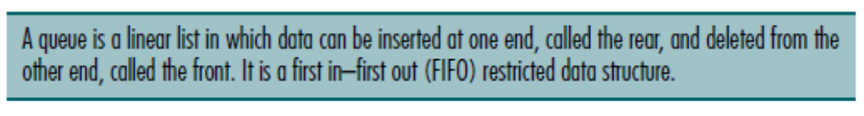
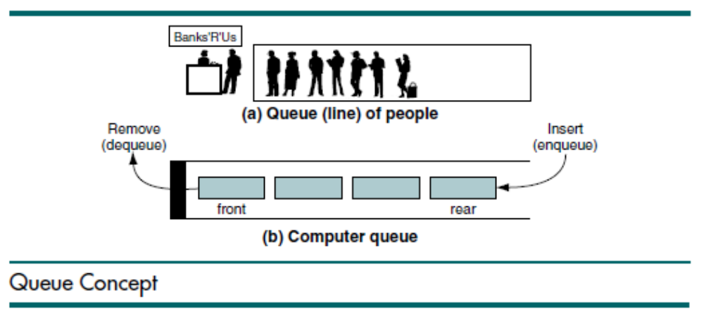
Data Structures: A Pseudocode Approach with C

Slide 4
3.1 Basic Queue Operations
The Queue concept is introduced and three basic Queue operations are discussed.
3.2 Queue Linked List Implementation
In this section we present a linked-list design for a Queue. After developing the data structures, we write pseudocode algorithms for the Queue ADT.
3.3 C Language Implementations
This section presents a simple non-ADT implementation of a Queue. We develop a simple program that inserts random characters into the Queue and then prints them.
3.4 Queue ADT
We begin the discussion of the Queue ADT with a discussion of the Queue structure and its application interface. We then develop the required functions.
3.5 Queue Applications
Three basic application problems-parsing, postponement, and backtracking-are discussed and sample programs developed. In addition, several other Queue applications are presented, including the classic Eight Queens problem.
3.6 How Recursion Works
This section discusses the concept of the Queue frame and the use of Queues in writing recursive software
Basic Queue Operations
The Queue concept is introduced and four basic Queue operations are discussed.
Enqueue
Dequeue
Queue Front
Queue Rear
Data Structures: A Pseudocode Approach with C

Slide 5
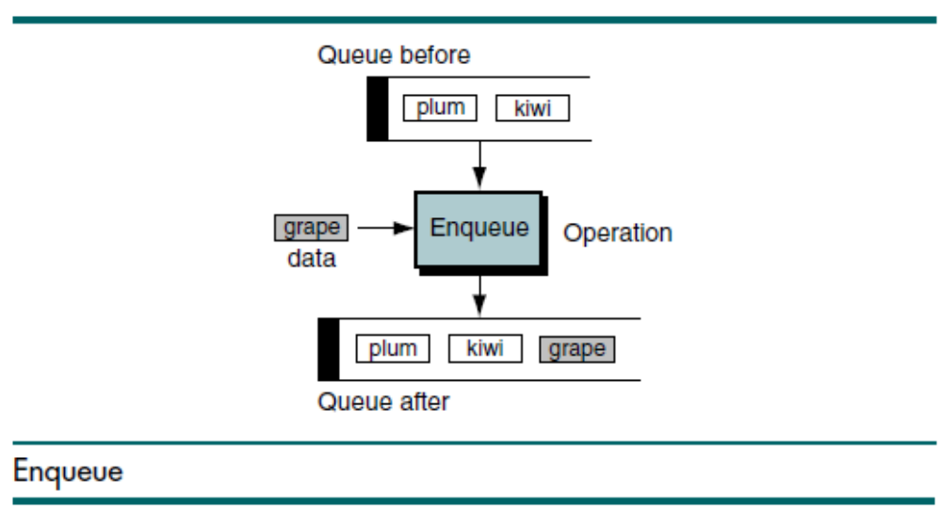
Data Structures: A Pseudocode Approach with C

Slide 6
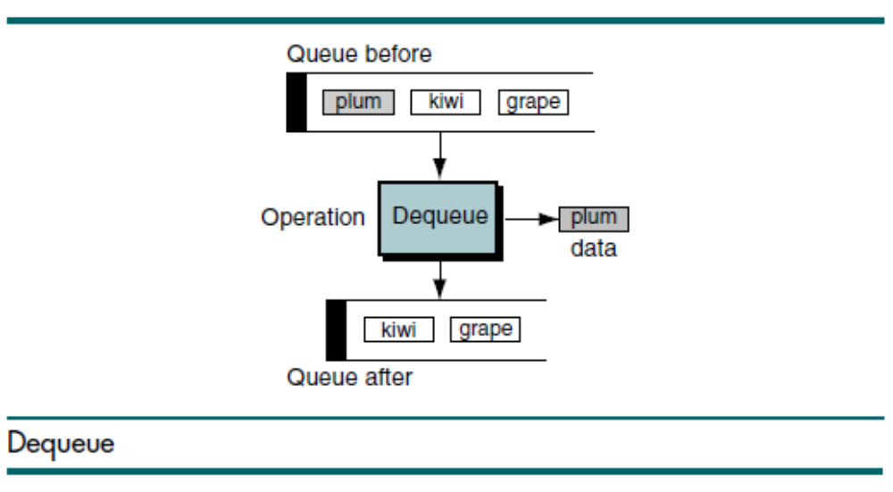
Data Structures: A Pseudocode Approach with C

Slide 7
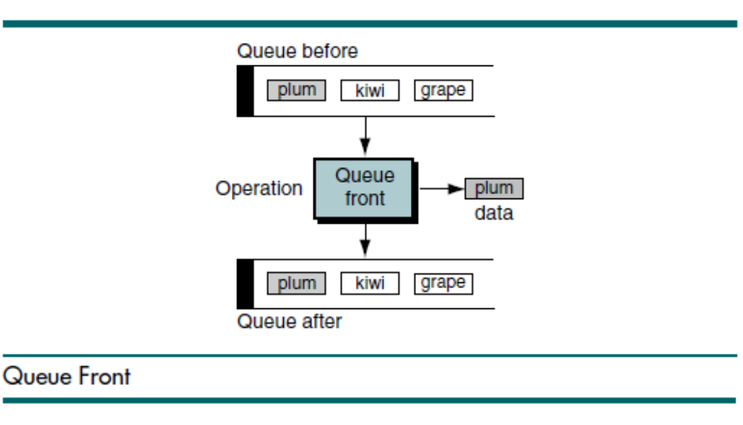
Data Structures: A Pseudocode Approach with C

Slide 8
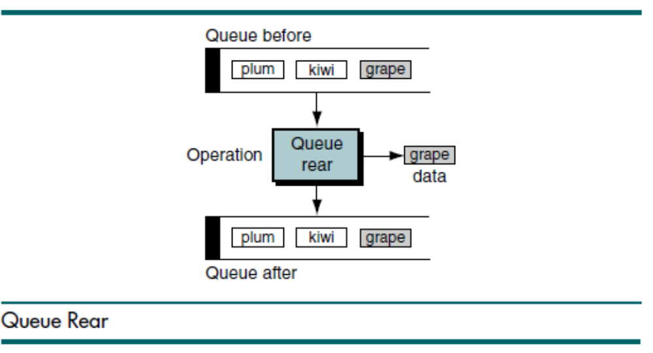
Data Structures: A Pseudocode Approach with C

Slide 9
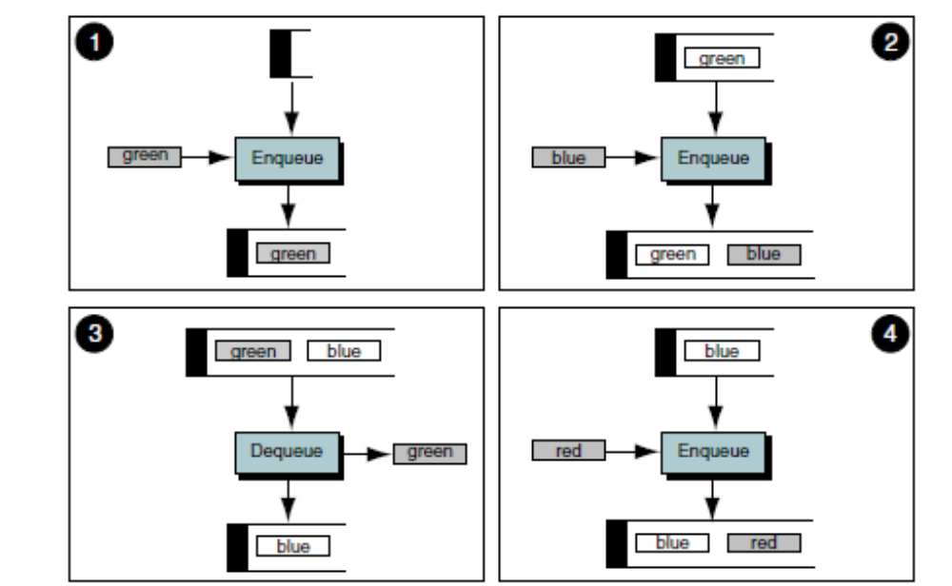
Queue Operations Example

Slide 10
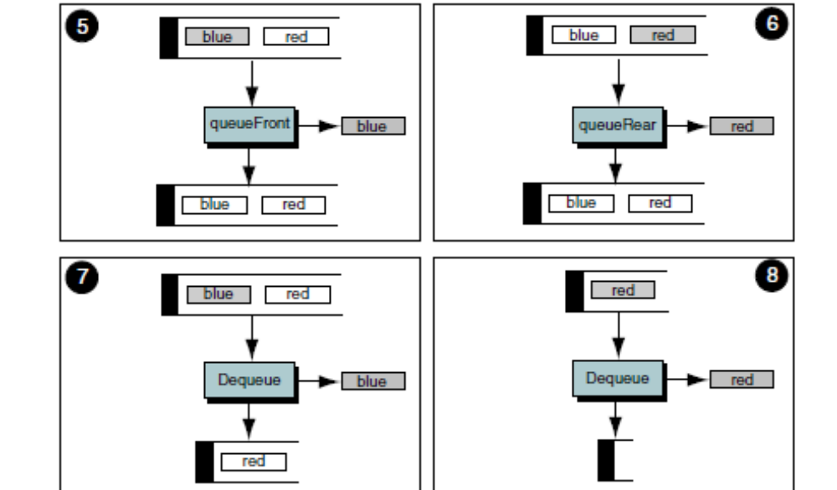
Queue Operations Example

Slide 11
Queue Linked List Implementation
In this section we present a linked-list design for a queue. After developing the data structures, we write pseudocode algorithms for the Queue ADT.
Data Structure
Algorithms
Data Structures: A Pseudocode Approach with C

Slide 12

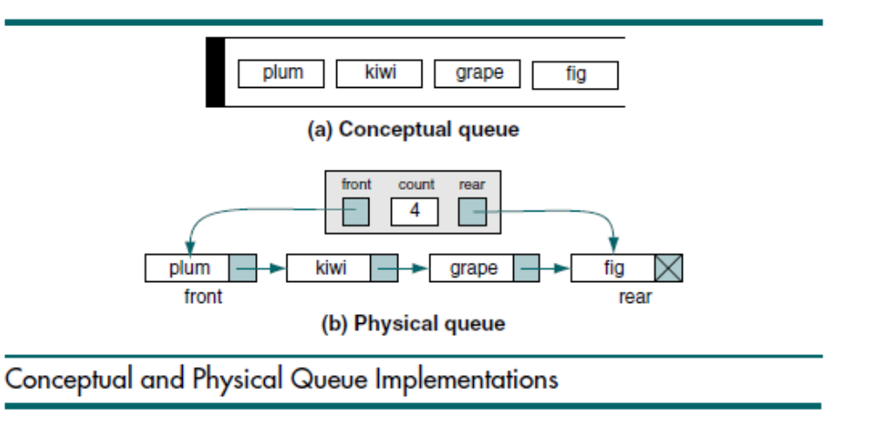
Data Structures: A Pseudocode Approach with C

Slide 13
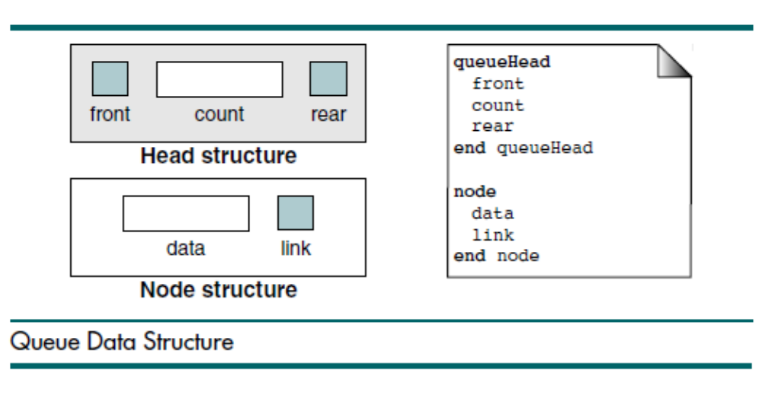
Data Structures: A Pseudocode Approach with C

Slide 14

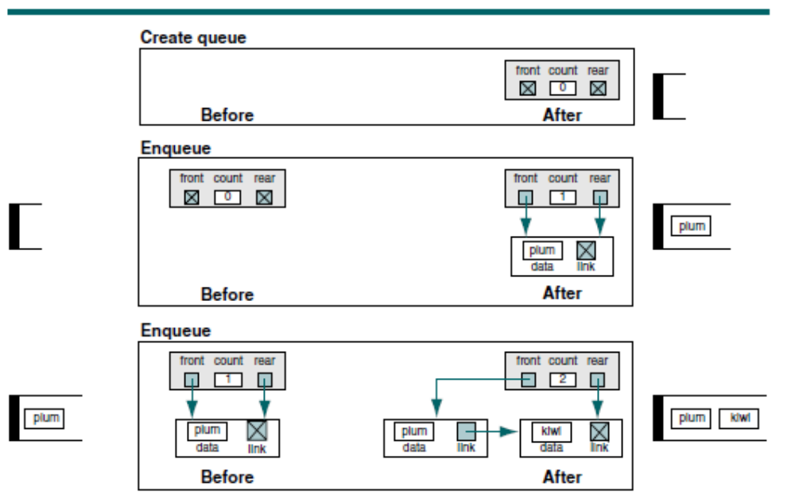
Data Structures: A Pseudocode Approach with C

Slide 15
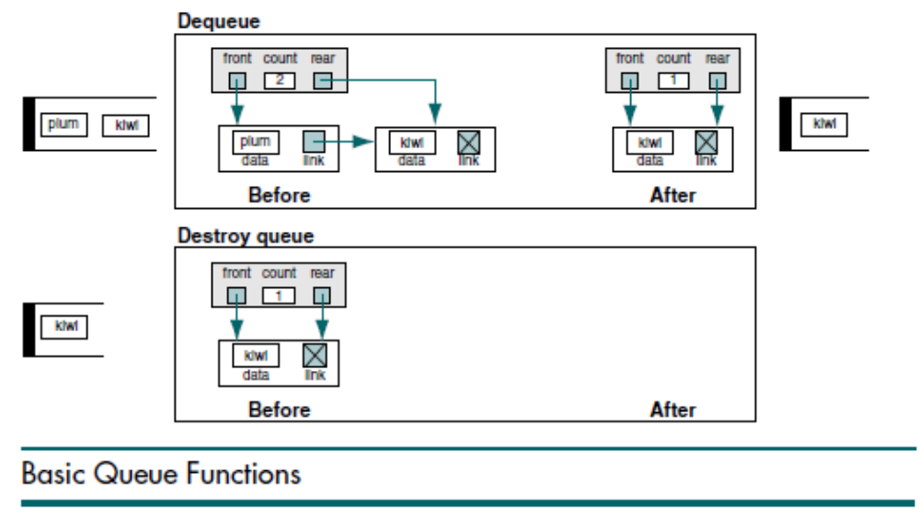
Data Structures: A Pseudocode Approach with C

Slide 16
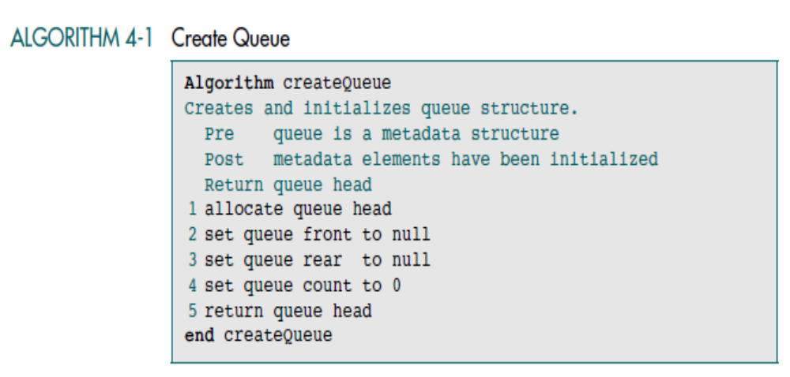
Data Structures: A Pseudocode Approach with C

Slide 17
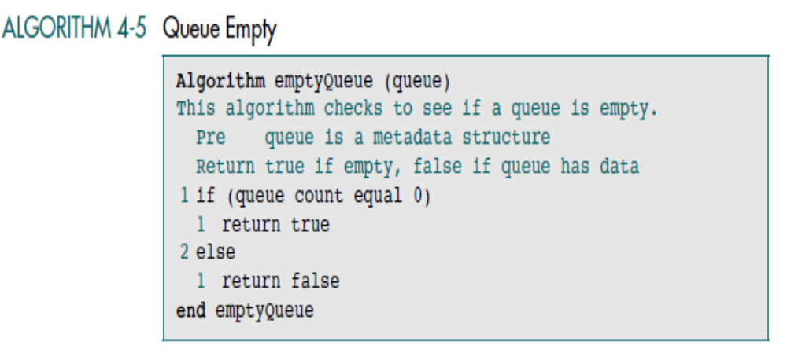
Data Structures: A Pseudocode Approach with C

Slide 18
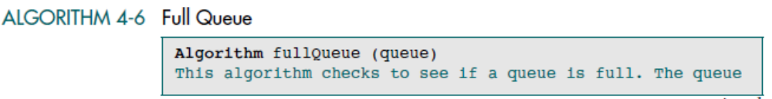
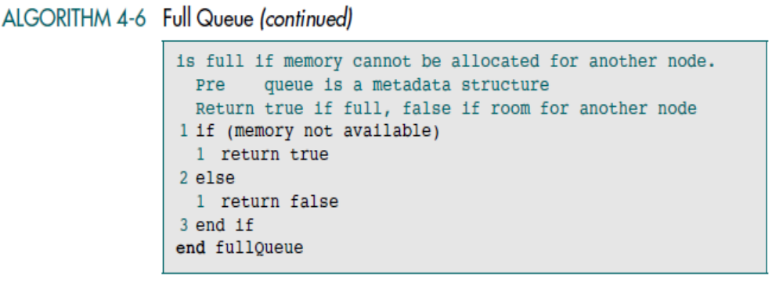
Data Structures: A Pseudocode Approach with C

Slide 19
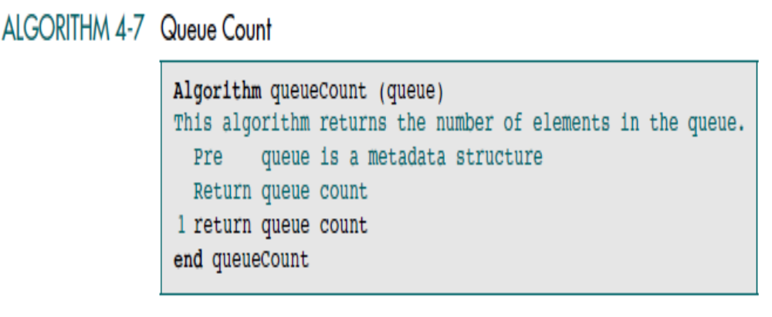
Data Structures: A Pseudocode Approach with C

Slide 20
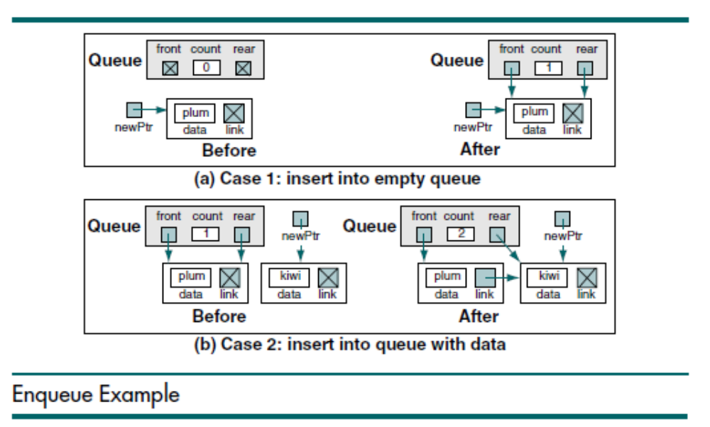
Data Structures: A Pseudocode Approach with C

Slide 21
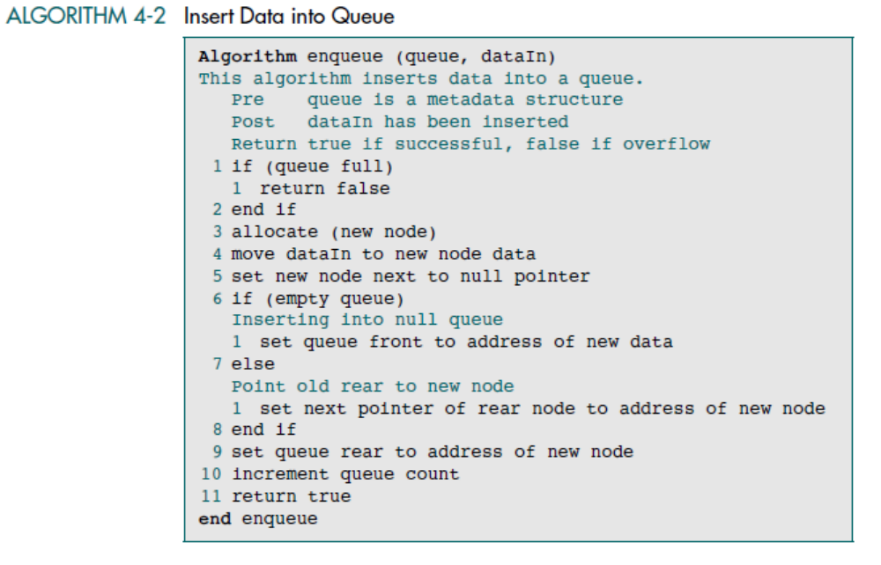
Data Structures: A Pseudocode Approach with C

Slide 22
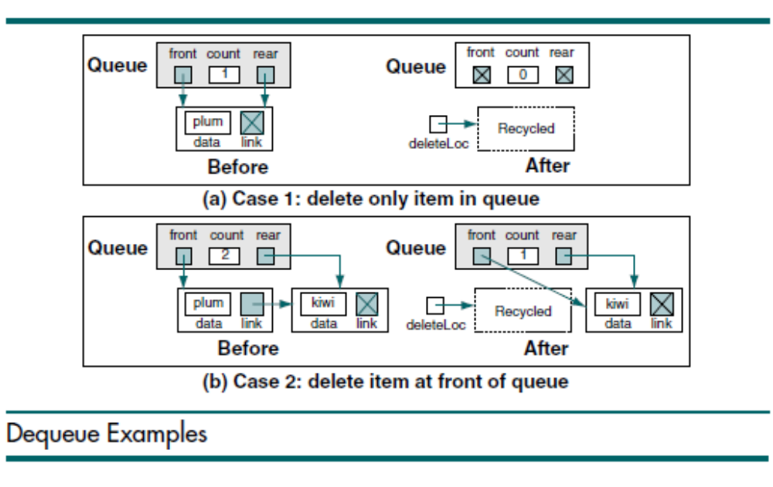
Data Structures: A Pseudocode Approach with C

Slide 23
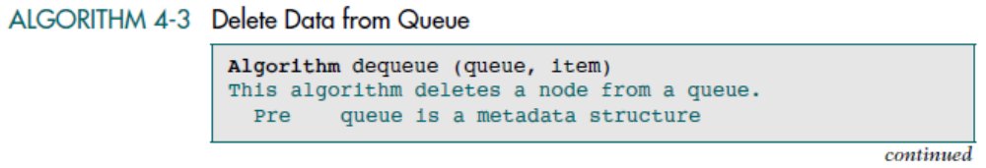
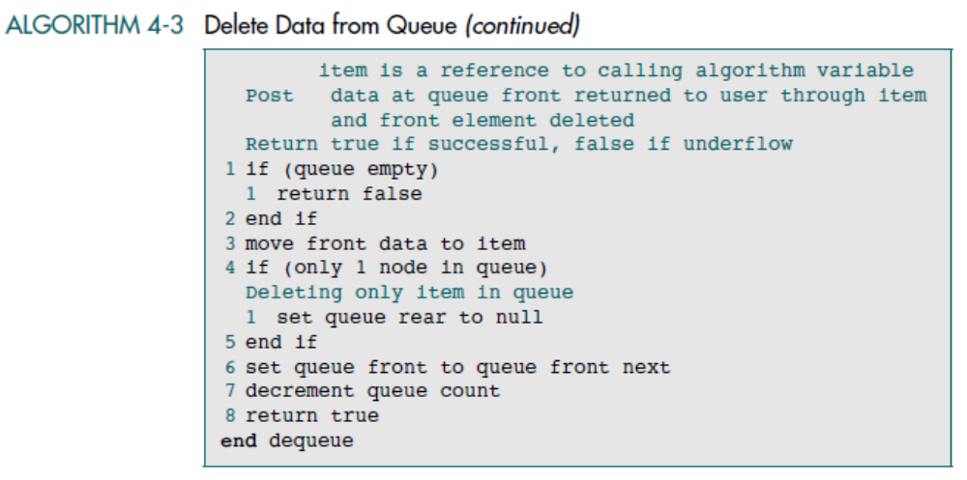
Data Structures: A Pseudocode Approach with C

Slide 24
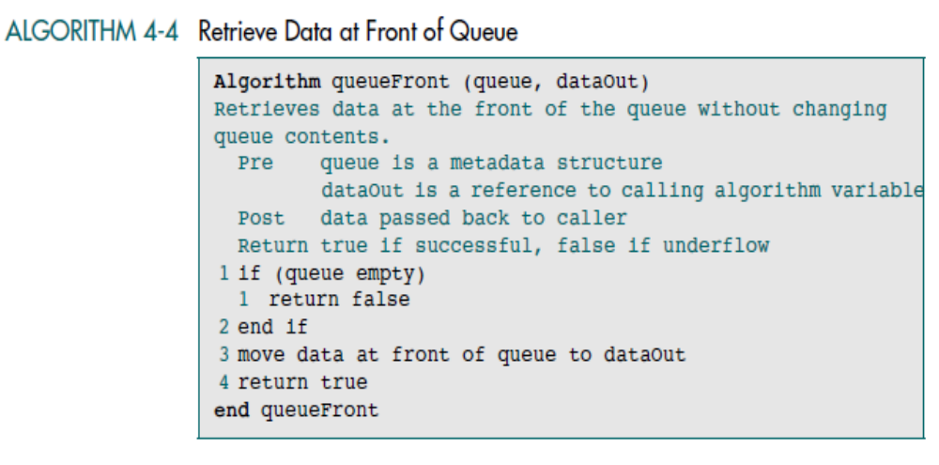
Data Structures: A Pseudocode Approach with C

Slide 25
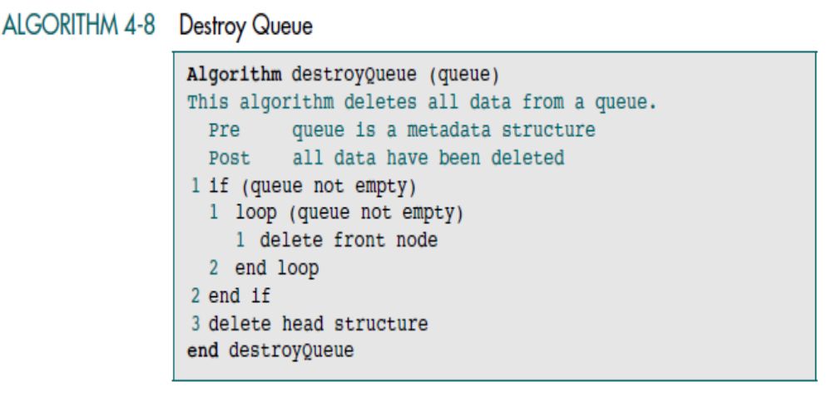
Data Structures: A Pseudocode Approach with C

Slide 26
C Language Implementations
This section presents a simple non-ADT implementation of a Queue. We develop a simple program that inserts random characters into the Queue and then prints them.
Data Structures: A Pseudocode Approach with C

Slide 27
Queue ADT
We begin the discussion of the Queue ADT with a discussion of the Queue structure and its application interface. We then develop the required functions.
Data Structure
ADT Implemenation
Data Structures: A Pseudocode Approach with C

Slide 28
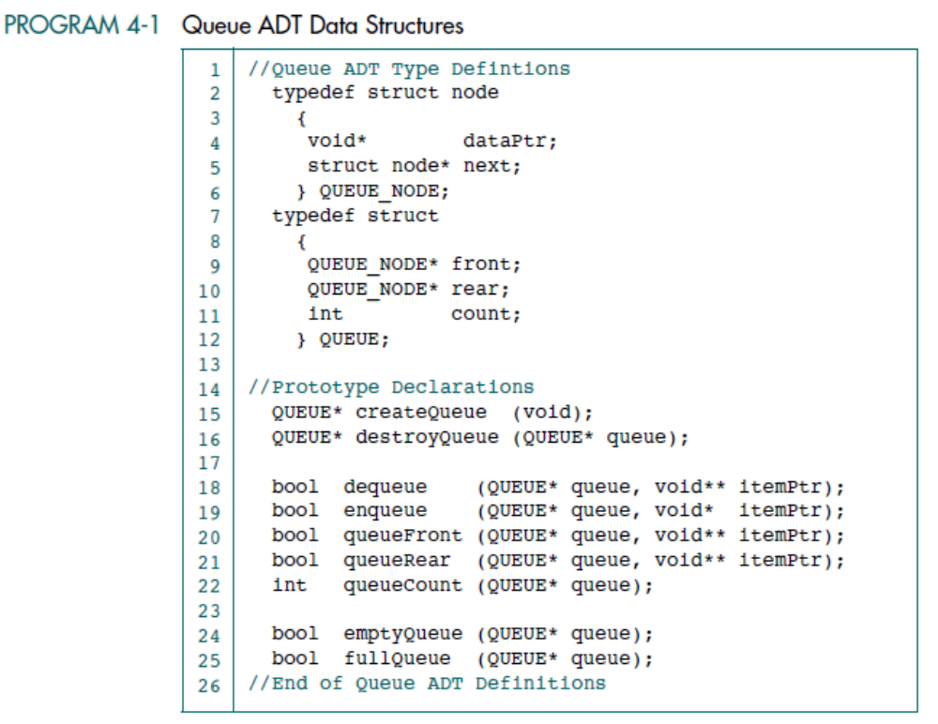
Data Structures: A Pseudocode Approach with C

Slide 29
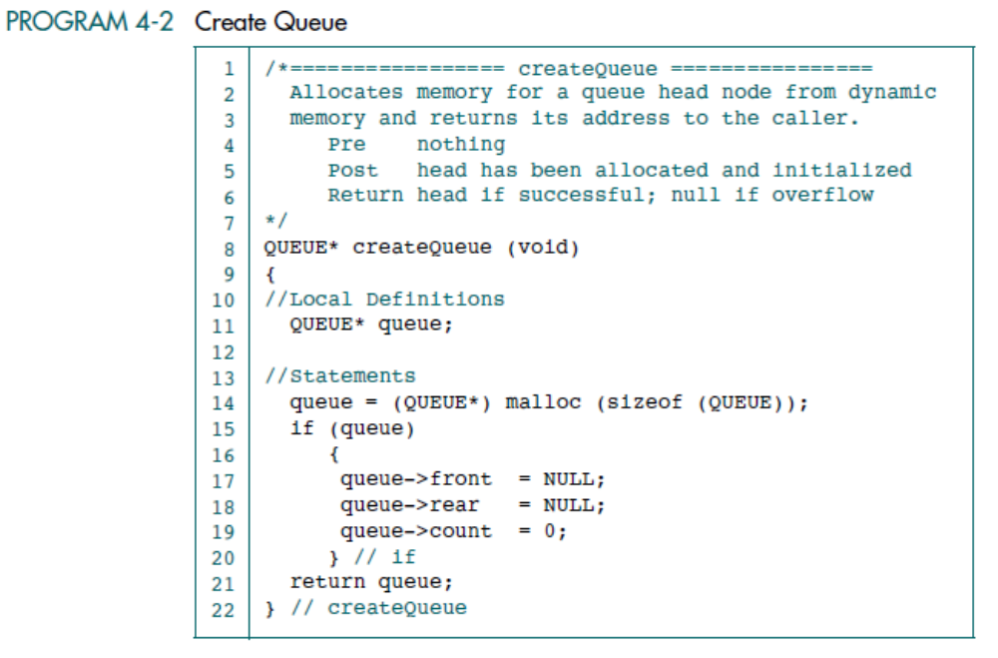
Data Structures: A Pseudocode Approach with C

Slide 30
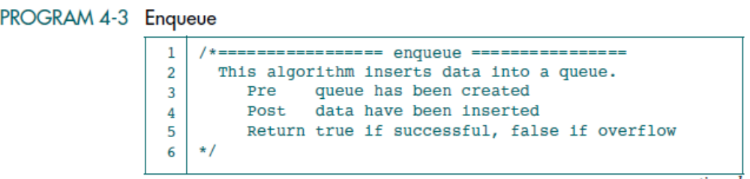
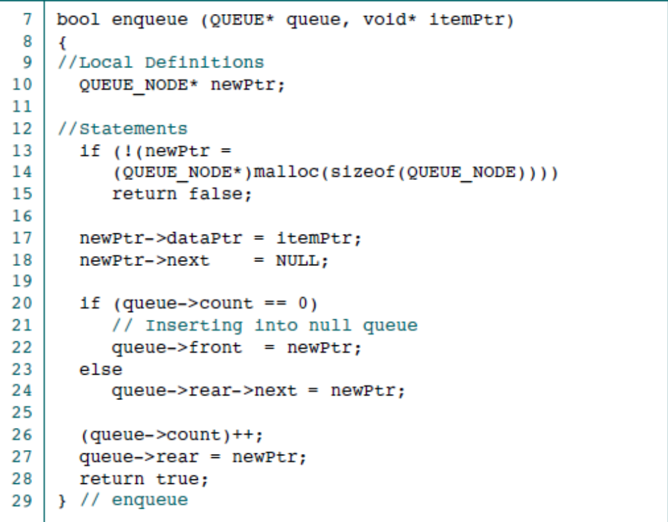
Data Structures: A Pseudocode Approach with C

Slide 31
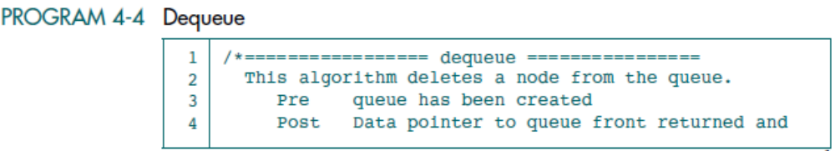
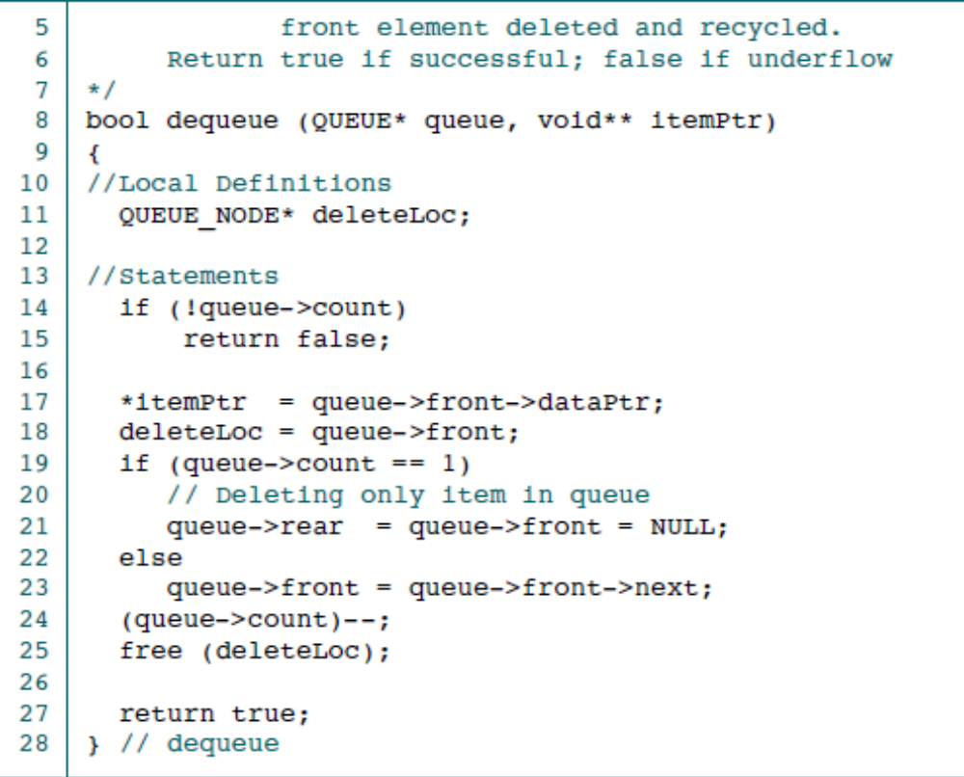
Data Structures: A Pseudocode Approach with C

Slide 32
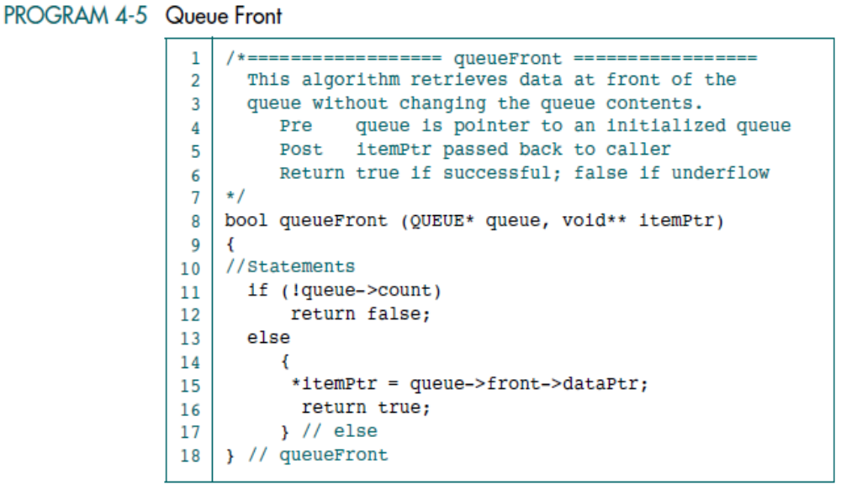
Data Structures: A Pseudocode Approach with C

Slide 33
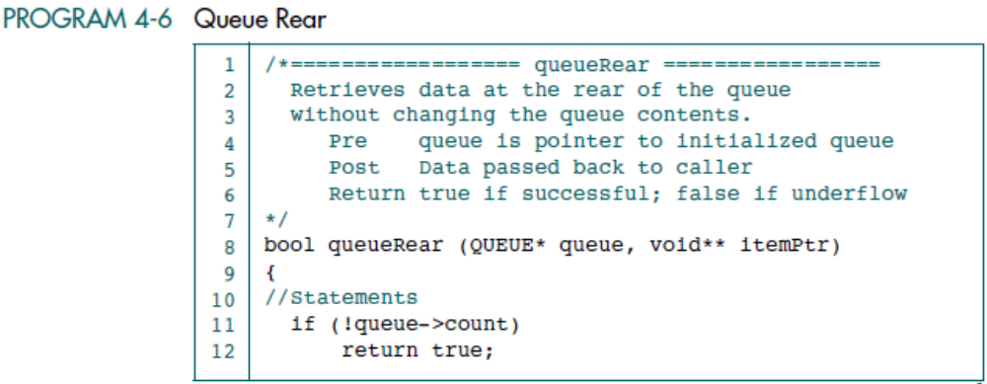
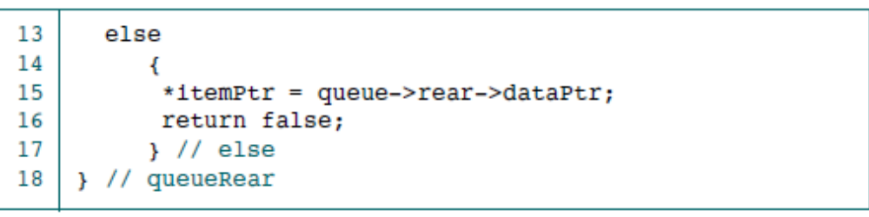
Data Structures: A Pseudocode Approach with C

Slide 34
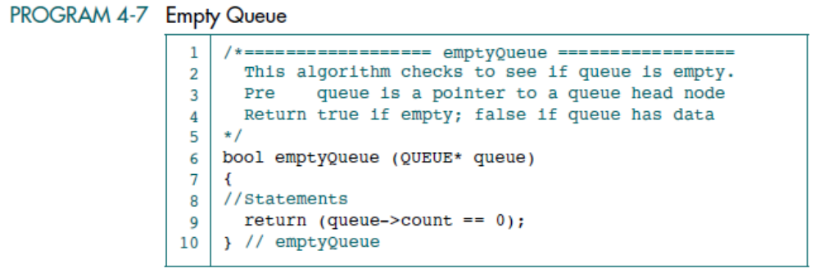
Data Structures: A Pseudocode Approach with C

Slide 35
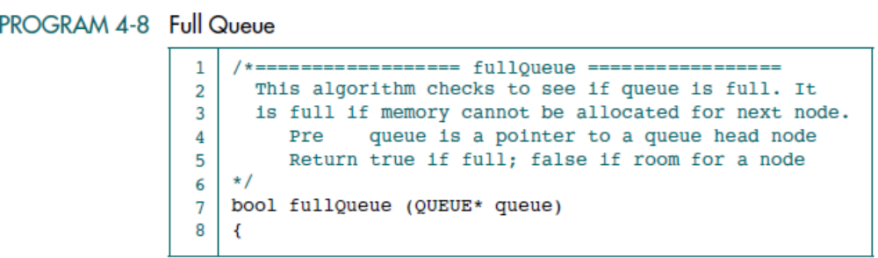
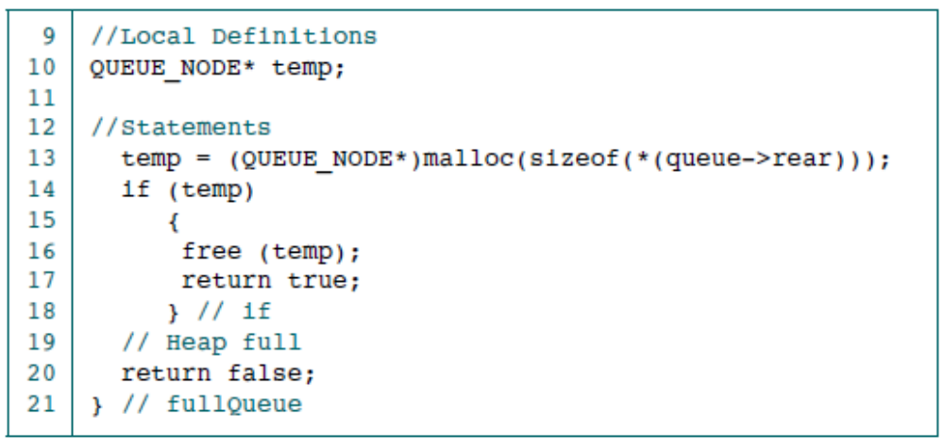
Data Structures: A Pseudocode Approach with C

Slide 36
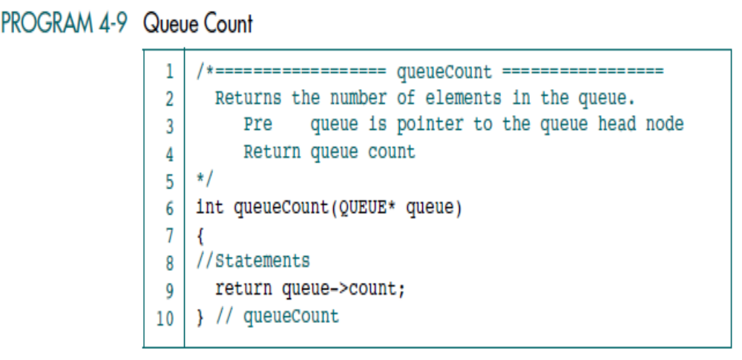
Data Structures: A Pseudocode Approach with C

Slide 37
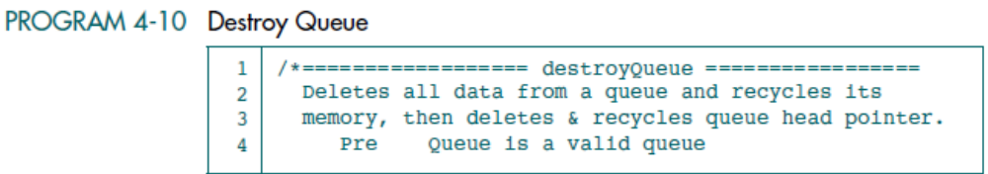
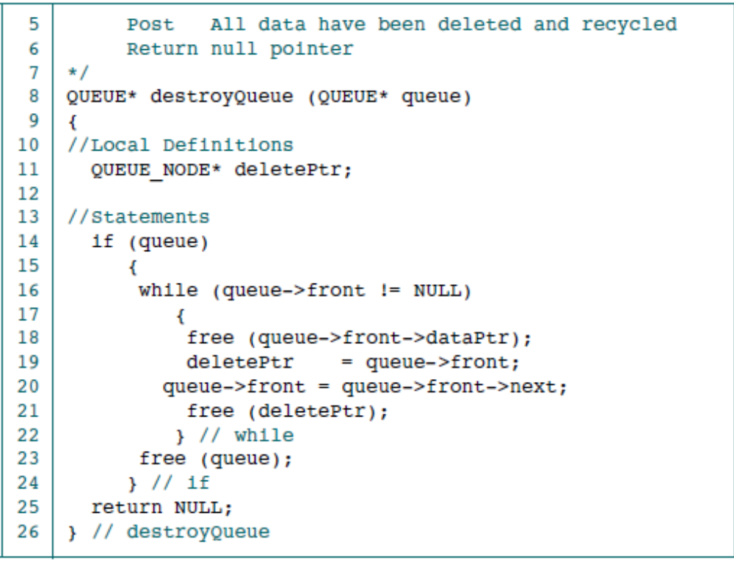
Data Structures: A Pseudocode Approach with C

Slide 38
3.1 Basic Queue Operations
The Queue concept is introduced and three basic Queue operations are discussed.
3.2 Queue Linked List Implementation
In this section we present a linked-list design for a Queue. After developing the data structures, we write pseudocode algorithms for the Queue ADT.
3.3 C Language Implementations
This section presents a simple non-ADT implementation of a Queue. We develop a simple program that inserts random characters into the Queue and then prints them.
3.4 Queue ADT
We begin the discussion of the Queue ADT with a discussion of the Queue structure and its application interface. We then develop the required functions.
3.5 Queue Applications
Three basic application problems-parsing, postponement, and backtracking-are discussed and sample programs developed. In addition, several other Queue applications are presented, including the classic Eight Queens problem.
3.6 How Recursion Works
This section discusses the concept of the Queue frame and the use of Queues in writing recursive software
Queue Applications
They are found in virtually every operating system and every network and in countless other areas. For example, queues are used in business online applications such as processing customer requests, jobs, and orders. In a computer system, a queue is needed to process jobs and for system services such as print spools.
Data Structures: A Pseudocode Approach with C

Slide 39
3.1 Basic Queue Operations
The Queue concept is introduced and three basic Queue operations are discussed.
3.2 Queue Linked List Implementation
In this section we present a linked-list design for a Queue. After developing the data structures, we write pseudocode algorithms for the Queue ADT.
3.3 C Language Implementations
This section presents a simple non-ADT implementation of a Queue. We develop a simple program that inserts random characters into the Queue and then prints them.
3.4 Queue ADT
We begin the discussion of the Queue ADT with a discussion of the Queue structure and its application interface. We then develop the required functions.
3.5 Queue Applications
Three basic application problems-parsing, postponement, and backtracking-are discussed and sample programs developed. In addition, several other Queue applications are presented, including the classic Eight Queens problem.
3.6 How Recursion Works
This section discusses the concept of the Queue frame and the use of Queues in writing recursive software
Categorizing Data
We want to categorize them into four different groups:
• Group 1: less than 10
• Group 2: between 10 and 19
• Group 3: between 20 and 29
• Group 4: 30 and greater
Data Structures: A Pseudocode Approach with C

Slide 40
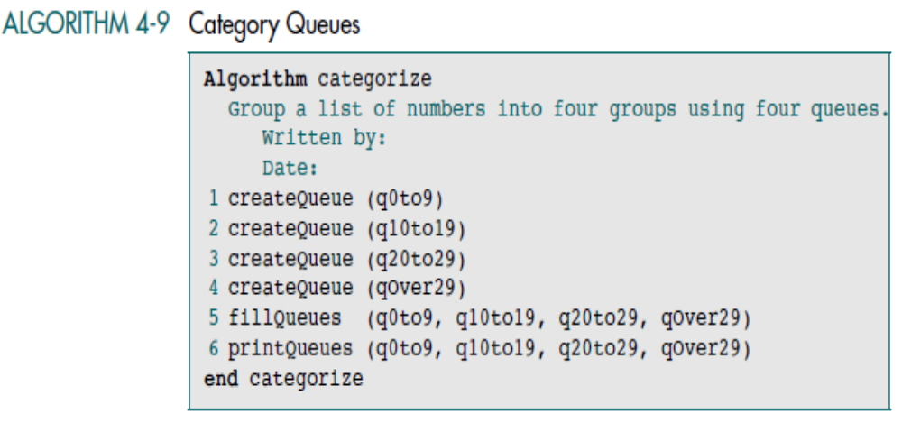
Data Structures: A Pseudocode Approach with C

Slide 41
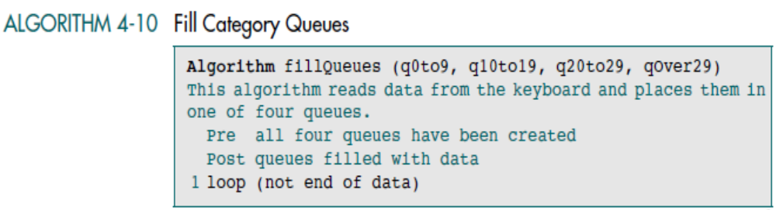
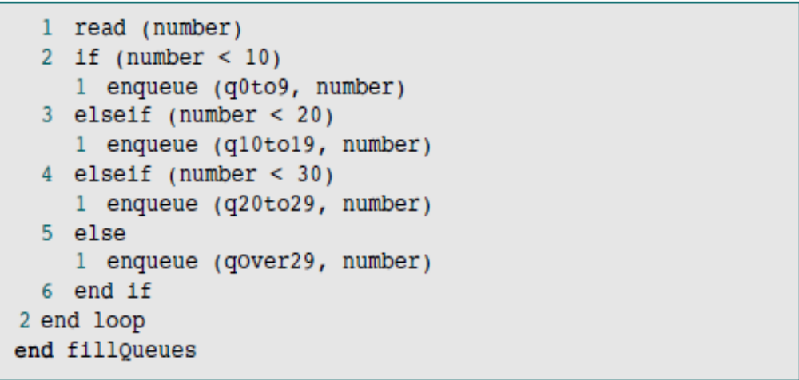
Data Structures: A Pseudocode Approach with C

