Slide 1
Unit 3
Stacks
Objectives
Upon completion you will be able to
Explain the design, use, and operation of a stack
Implement a stack using a linked list structure
Understand the operation of the stack ADT
Data Structures: A Pseudocode Approach with C

Slide 2
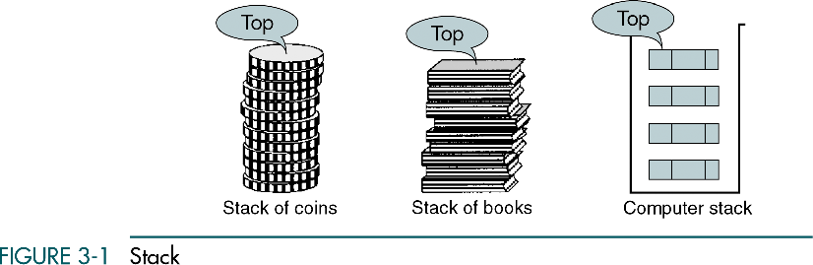
Data Structures: A Pseudocode Approach with C

Slide 3
3.1 Basic Stack Operations
The stack concept is introduced and three basic stack operations are discussed.
3.2 Stack Linked List Implementation
In this section we present a linked-list design for a stack. After developing the data structures, we write pseudocode algorithms for the stack ADT.
3.3 C Language Implementations
This section presents a simple non-ADT implementation of a stack. We develop a simple program that inserts random characters into the stack and then prints them.
3.4 Stack ADT
Begins the discussion of the stack ADT with a discussion of the stack structure and its application interface. We then develop the required functions.
Data Structures: A Pseudocode Approach with C

Slide 4
3.1 Basic Stack Operations
The stack concept is introduced and three basic stack operations are discussed.
3.2 Stack Linked List Implementation
In this section we present a linked-list design for a stack. After developing the data structures, we write pseudocode algorithms for the stack ADT.
3.3 C Language Implementations
This section presents a simple non-ADT implementation of a stack. We develop a simple program that inserts random characters into the stack and then prints them.
3.4 Stack ADT
We begin the discussion of the stack ADT with a discussion of the stack structure and its application interface. We then develop the required functions.
3.5 Stack Applications
Three basic application problems-parsing, postponement, and backtracking-are discussed and sample programs developed. In addition, several other stack applications are presented, including the classic Eight Queens problem.
3.6 How Recursion Works
This section discusses the concept of the stack frame and the use of stacks in writing recursive software
3-1 Basic Stack Operations
The stack concept is introduced and three basic stack operations are discussed.
Push
Pop
Stack Top
Data Structures: A Pseudocode Approach with C

Slide 5
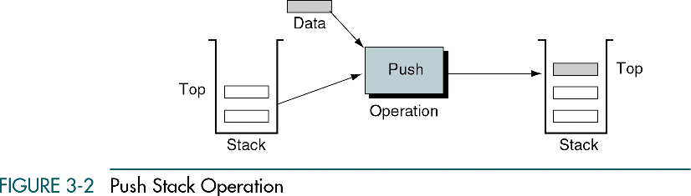
Data Structures: A Pseudocode Approach with C

Slide 6
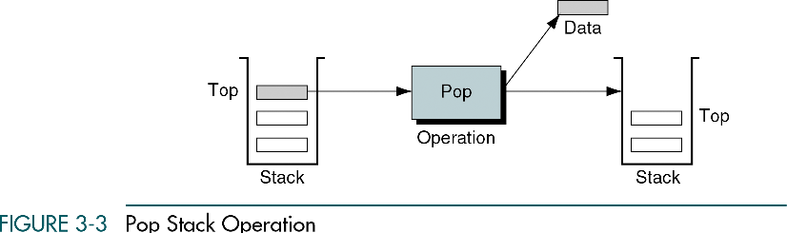
Data Structures: A Pseudocode Approach with C

Slide 7
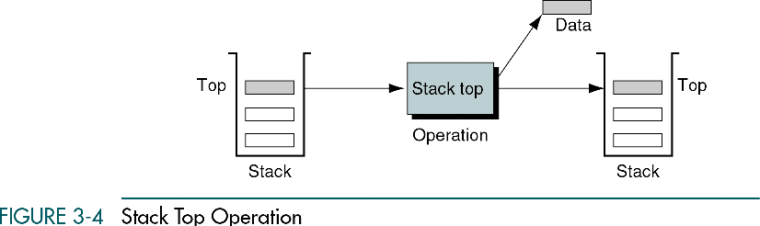
Data Structures: A Pseudocode Approach with C

Slide 8
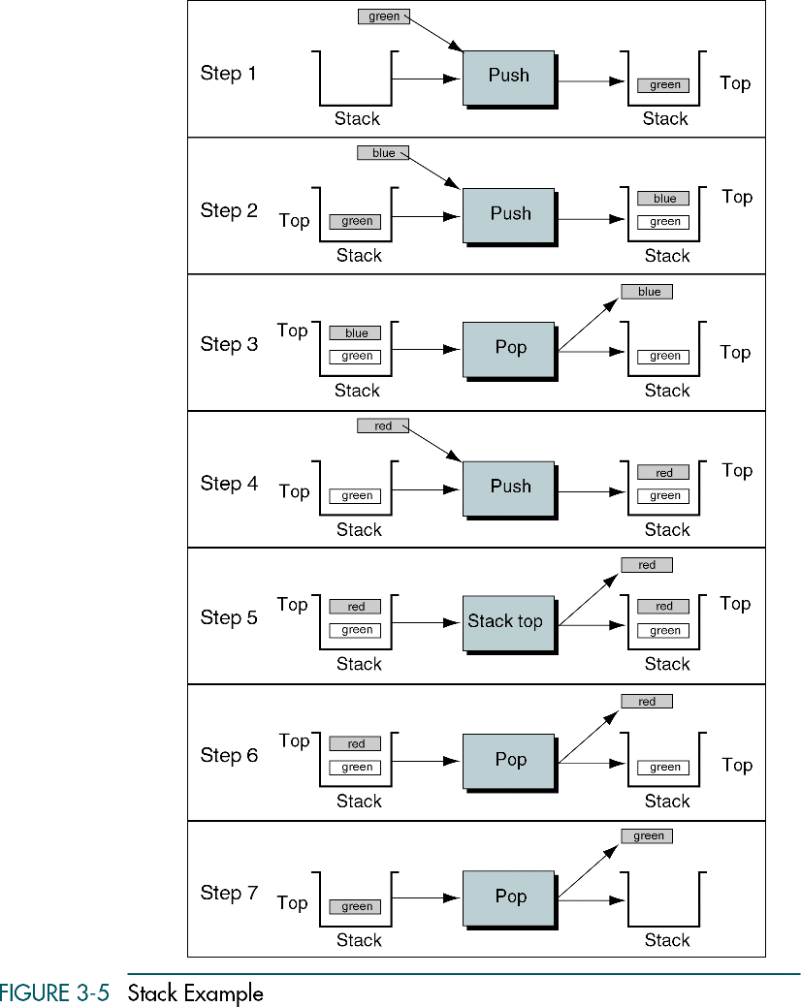
Data Structures: A Pseudocode Approach with C

Slide 9
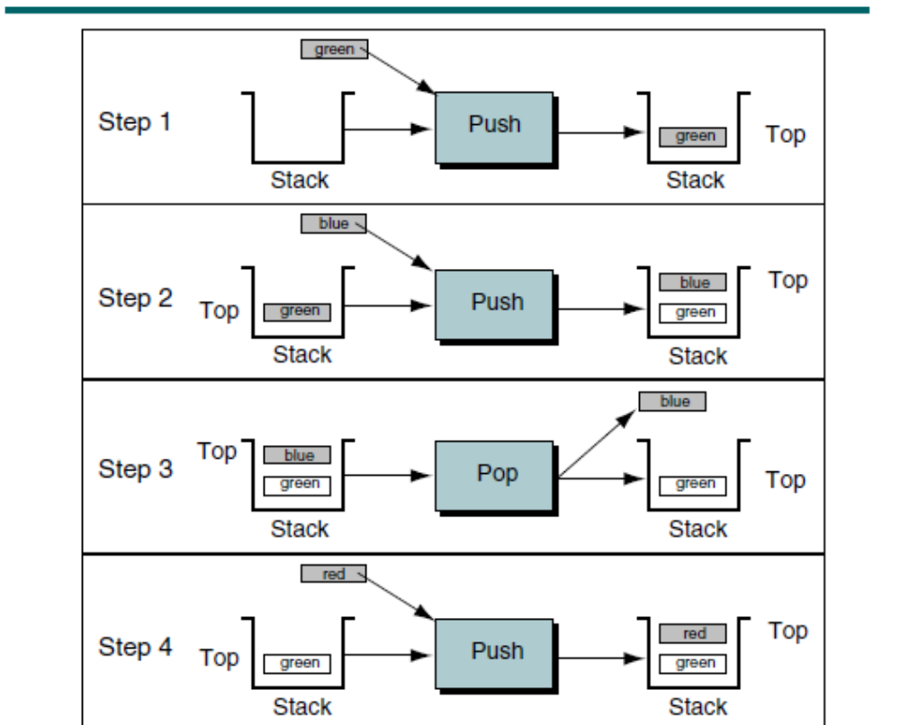
Data Structures: A Pseudocode Approach with C

Slide 10
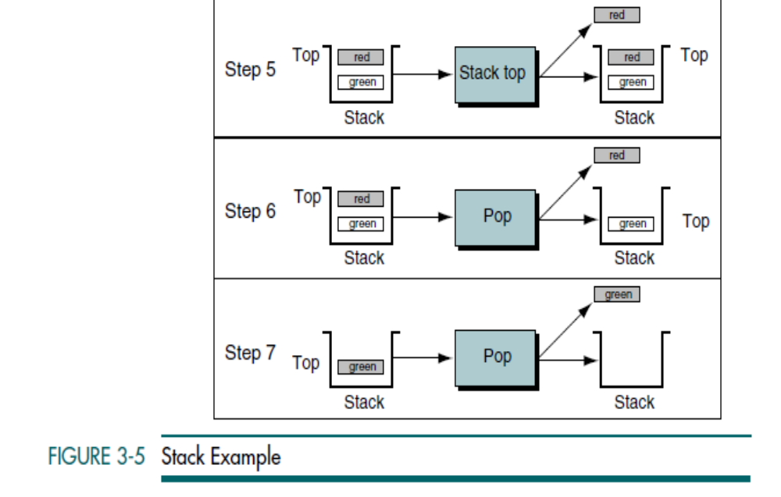
Data Structures: A Pseudocode Approach with C

Slide 11
3-2 Stack Linked List Implementation
In this section we present a linked-list design for a stack. After developing the data structures, we write pseudocode algorithms for the stack ADT.
Data Structure
Algorithms
Data Structures: A Pseudocode Approach with C

Slide 12
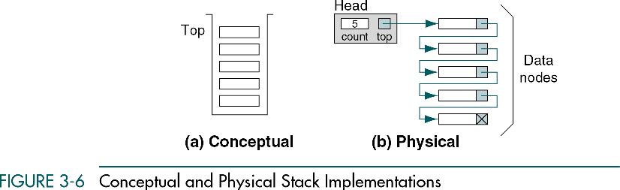
Data Structures: A Pseudocode Approach with C

Slide 13
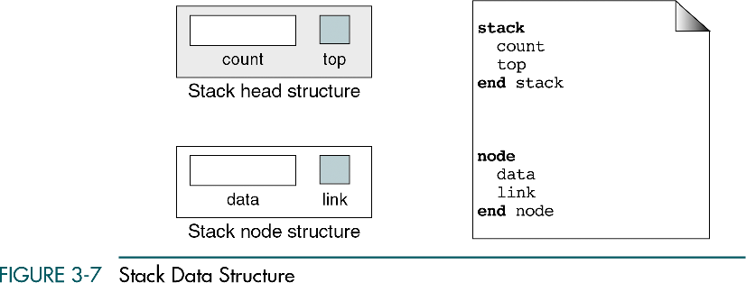
Data Structures: A Pseudocode Approach with C

Slide 14
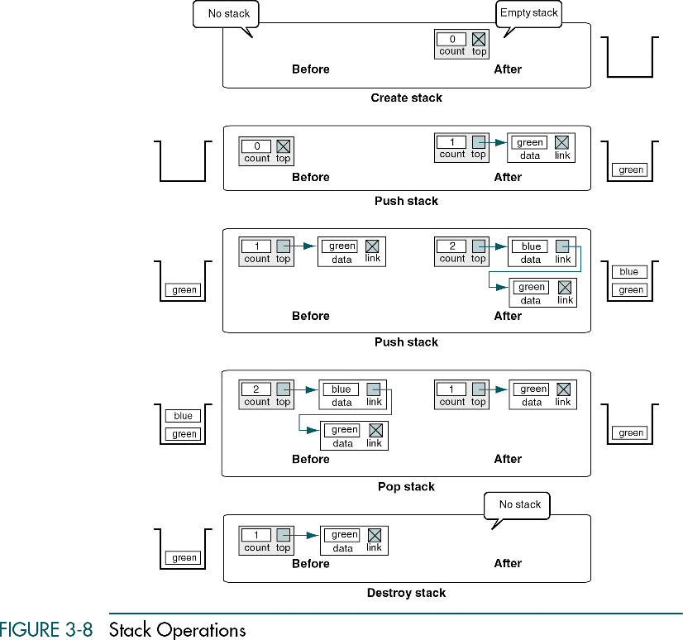
Data Structures: A Pseudocode Approach with C

Slide 15
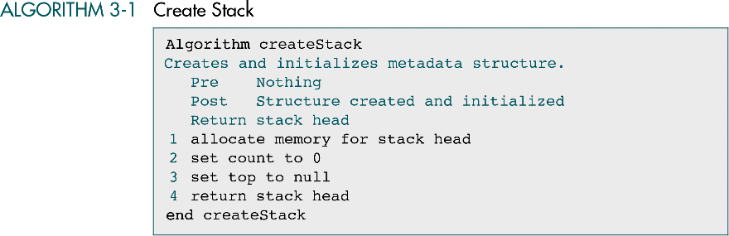
Data Structures: A Pseudocode Approach with C

Slide 16
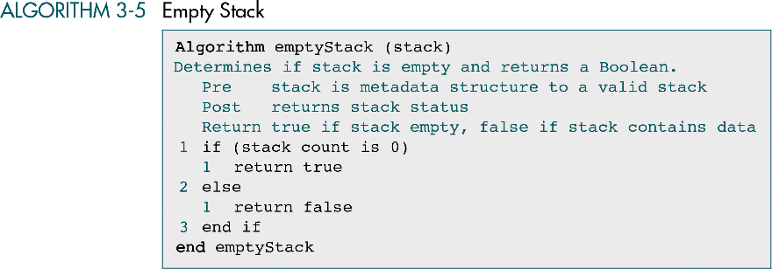
Data Structures: A Pseudocode Approach with C

Slide 17
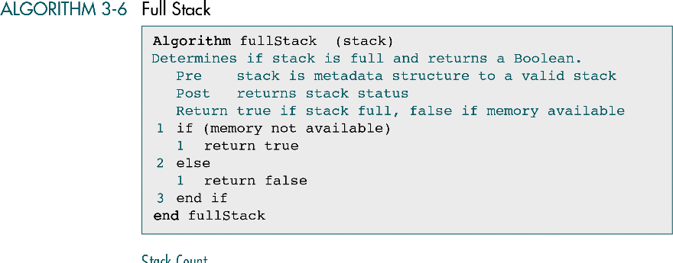
Data Structures: A Pseudocode Approach with C

Slide 18
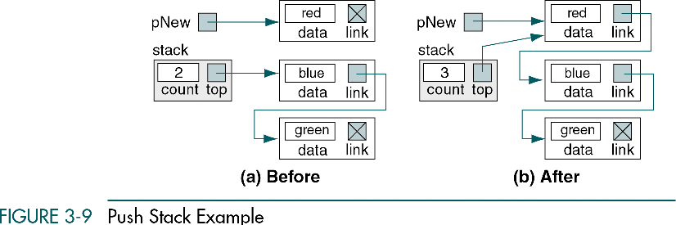
Data Structures: A Pseudocode Approach with C

Slide 19
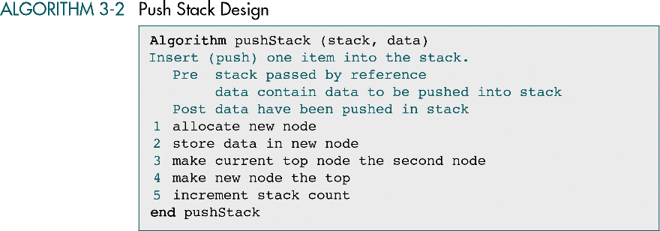
Data Structures: A Pseudocode Approach with C

Slide 20
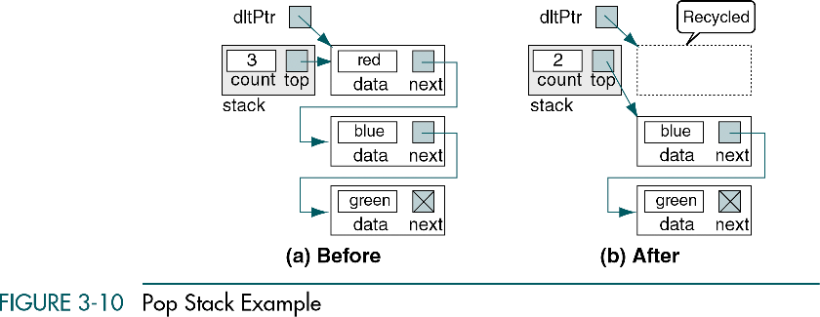
Data Structures: A Pseudocode Approach with C

Slide 21
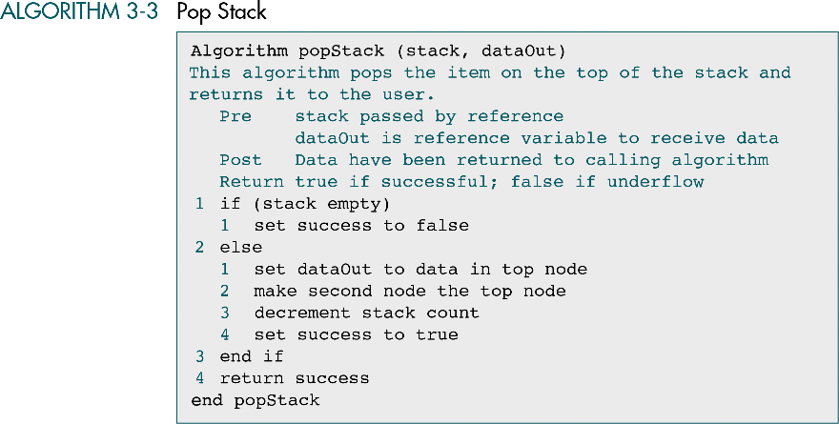
Data Structures: A Pseudocode Approach with C

Slide 22
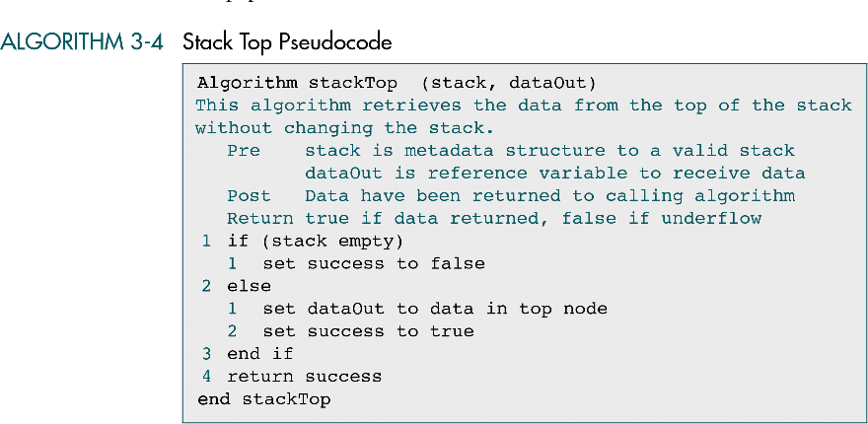
Data Structures: A Pseudocode Approach with C

Slide 23
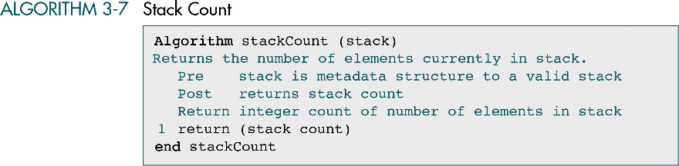
Data Structures: A Pseudocode Approach with C

Slide 24
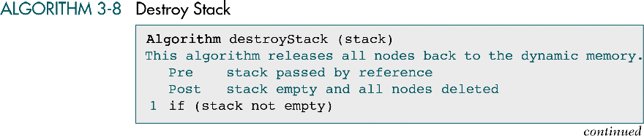
Data Structures: A Pseudocode Approach with C

Slide 25
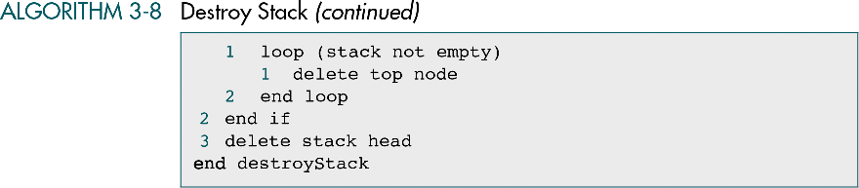
Data Structures: A Pseudocode Approach with C

Slide 26
3-3 C Language Implementations
This section presents a simple non-ADT implementation of a stack. We develop a simple program that inserts random characters into the stack and then prints them.
Data Structures: A Pseudocode Approach with C

Slide 27
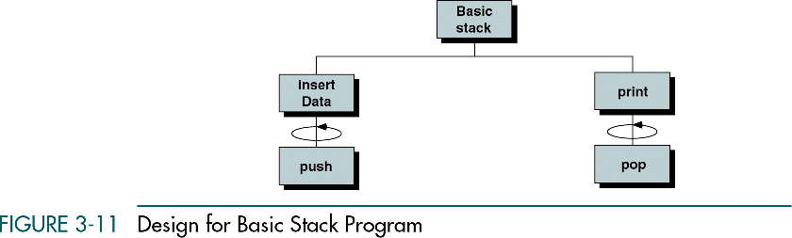
Data Structures: A Pseudocode Approach with C

Slide 28
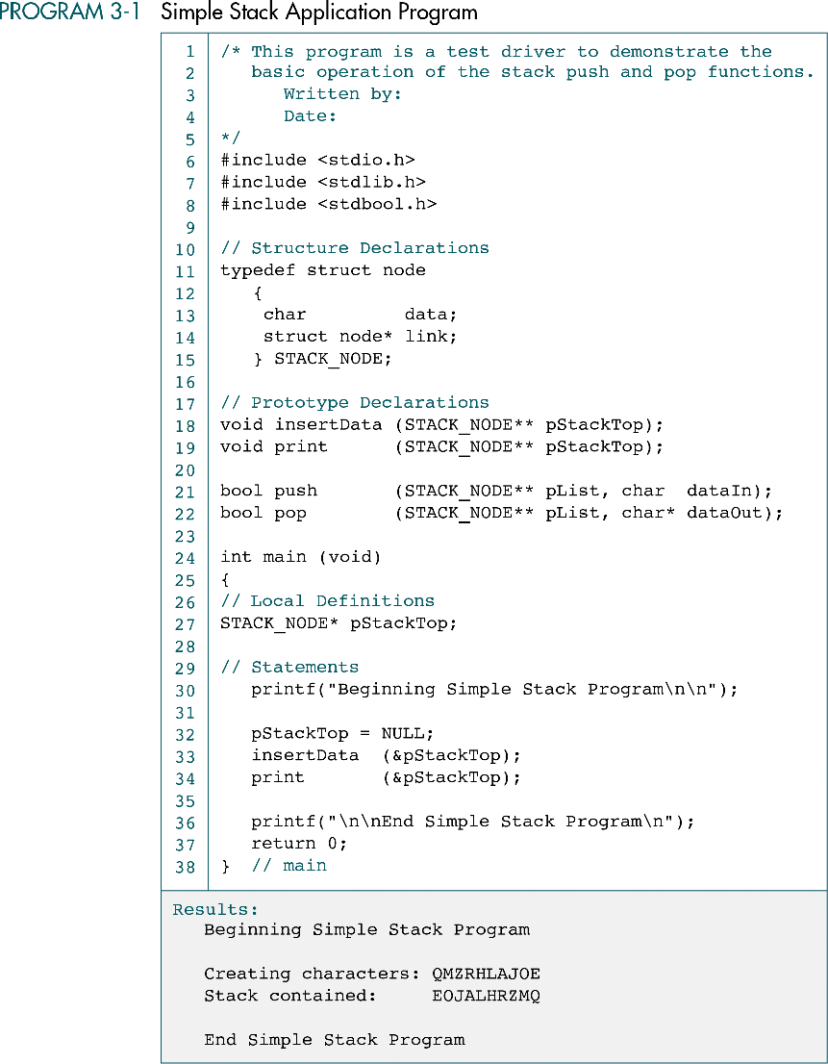
Data Structures: A Pseudocode Approach with C

Slide 29
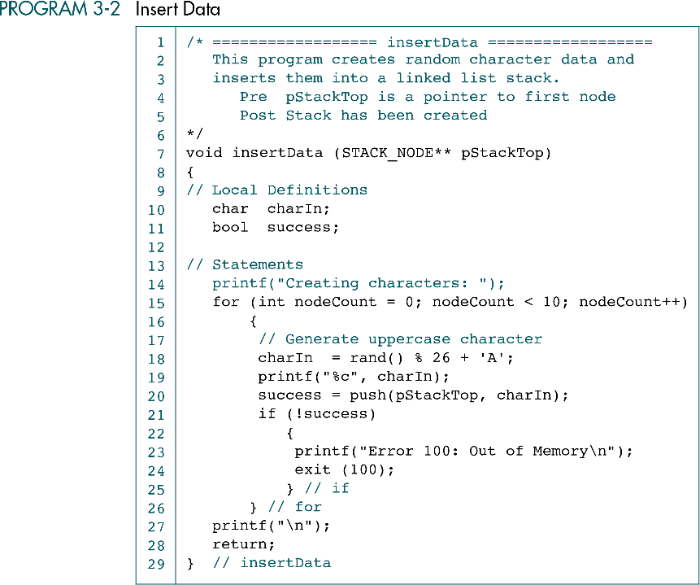
Data Structures: A Pseudocode Approach with C

Slide 30
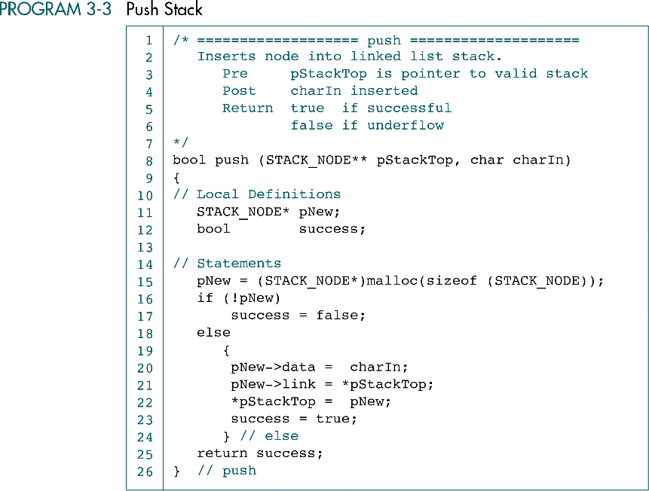
Data Structures: A Pseudocode Approach with C

Slide 31
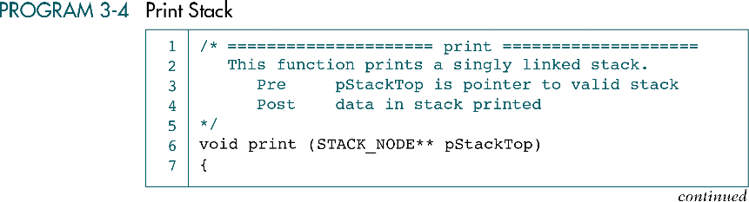
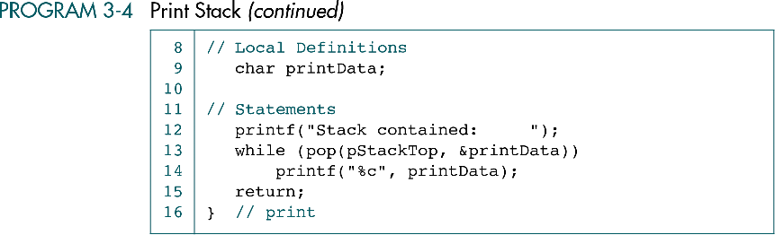
Data Structures: A Pseudocode Approach with C

Slide 32
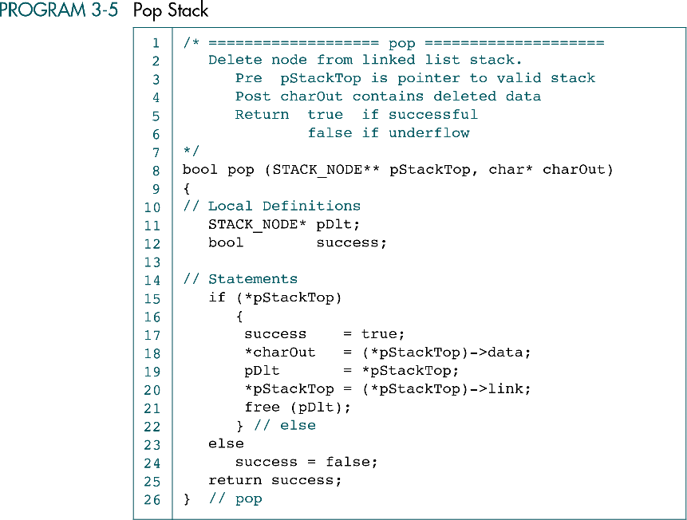
Data Structures: A Pseudocode Approach with C

Slide 33
3-4 Stack ADT
We begin the discussion of the stack ADT with a discussion of the stack structure and its application interface. We then develop the required functions.
Data Structure
ADT Implemenation
Data Structures: A Pseudocode Approach with C

Slide 34
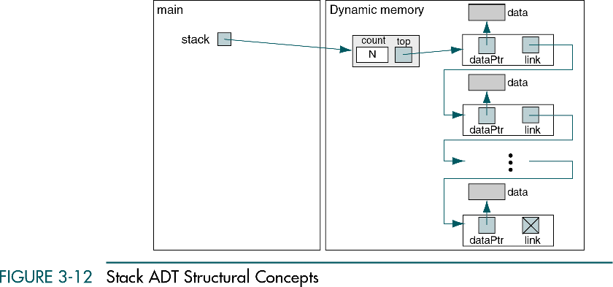
Data Structures: A Pseudocode Approach with C

Slide 35
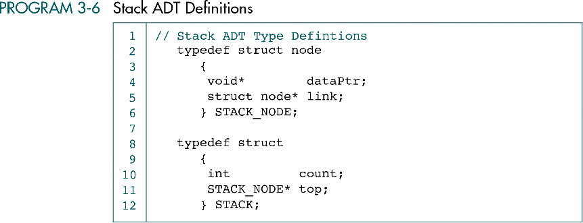
Data Structures: A Pseudocode Approach with C

Slide 36
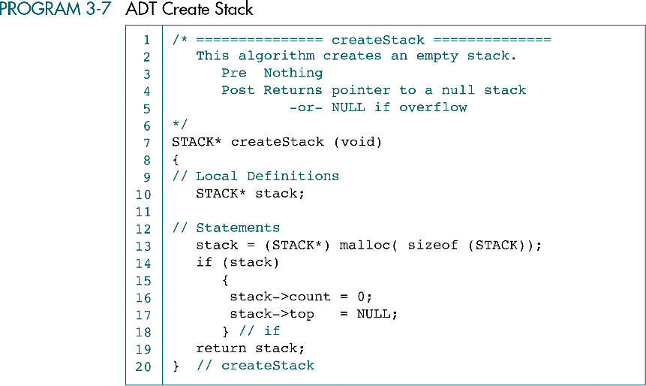
Data Structures: A Pseudocode Approach with C

Slide 37
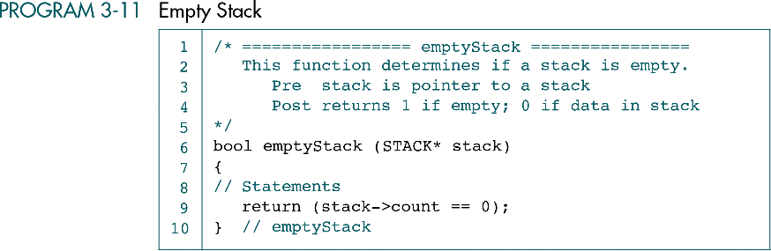
Data Structures: A Pseudocode Approach with C

Slide 38
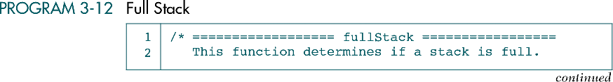
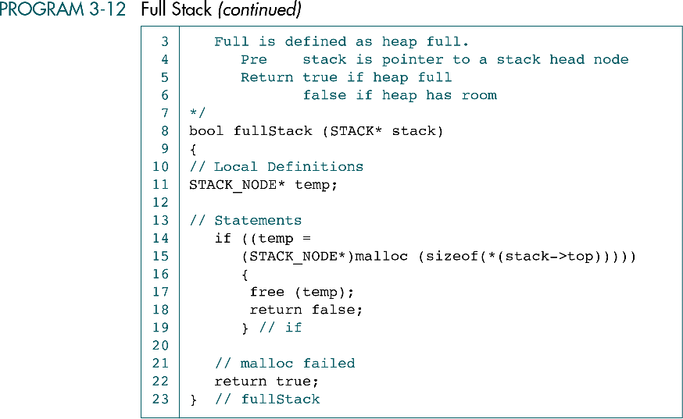
Data Structures: A Pseudocode Approach with C

Slide 39
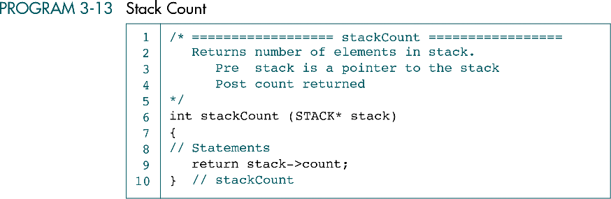
Data Structures: A Pseudocode Approach with C

Slide 40
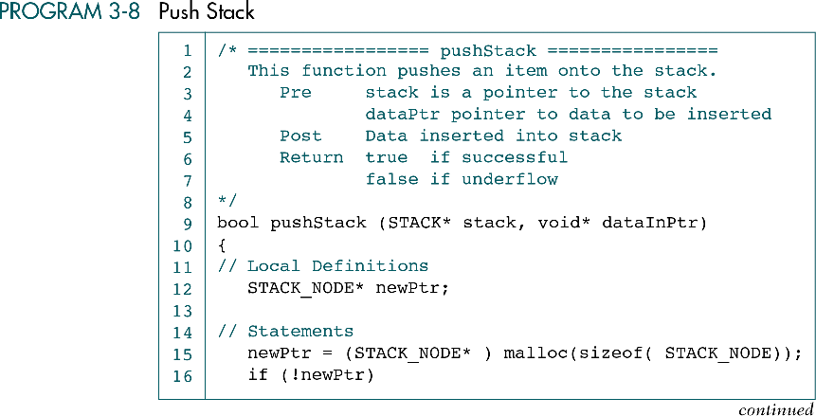
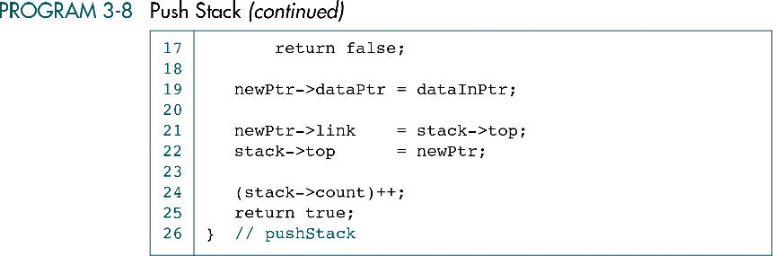
Data Structures: A Pseudocode Approach with C

Slide 41
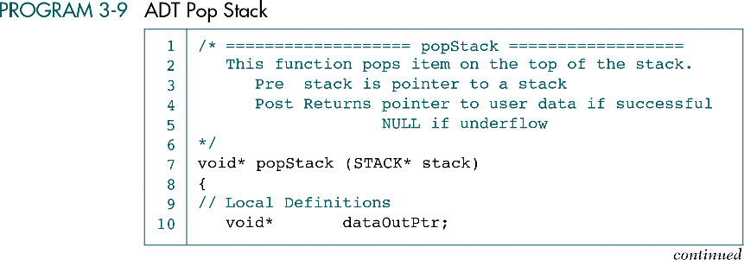
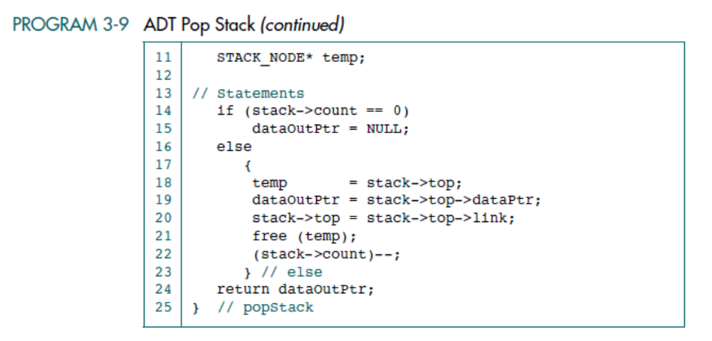
Data Structures: A Pseudocode Approach with C

Slide 42
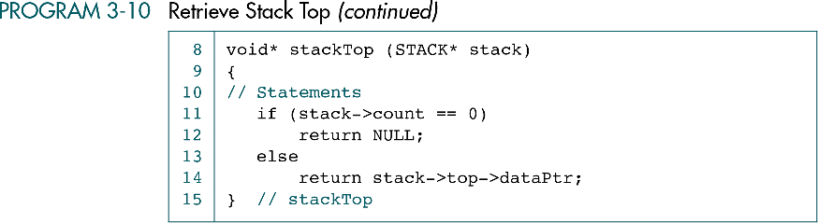
Data Structures: A Pseudocode Approach with C

Slide 43
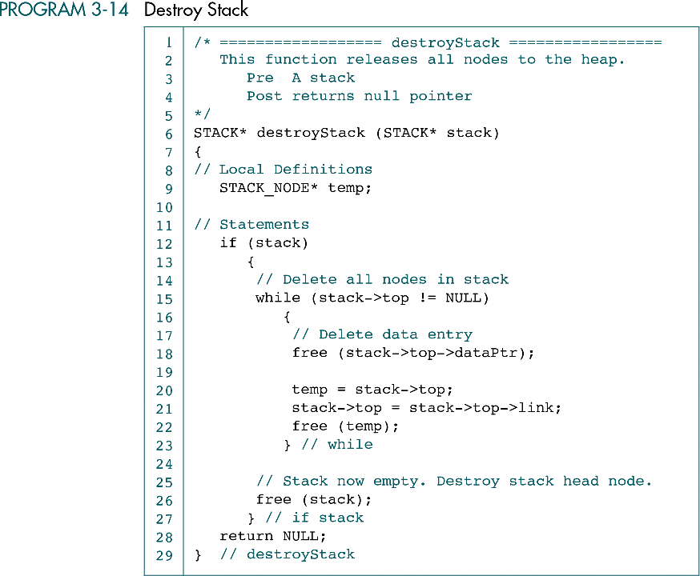
Data Structures: A Pseudocode Approach with C

