Slide 1
PGC MINI PROJECT
OpenMP vs MPI for Data Processing
Same dataset operations, three implementations: sequential, shared-memory (OpenMP) and distributed-memory (MPI)
OpenMP
MPI
Parallel and GPU Computing (26ECAC304)
Notes:
Theme: OpenMP vs MPI for data processing. Same operation, three implementations. Colour code used on every graph: blue = OpenMP, orange = MPI.

Slide 2
Problem and dataset
Operations (one pass over the array)
47.2 M
378 MB
Mode 0, light: count, min, max, mean, std, trips over 10 miles, histogram
Mode 1, heavy: Mode 0 plus log-transform mean and std
trip-distance records
binary array of doubles
4 files
122
Why two modes?
Mode 1 does about 10x more arithmetic per byte than mode 0. That lets us test when parallelism pays off.
NYC Yellow Taxi, 6.9 GB CSV
invalid rows removed
Sequential baseline: read the file, one loop over all N values, update the running statistics.
Notes:
Dataset: four months of NYC yellow-taxi CSVs (Jan 2015, Jan-Mar 2016). Only trip_distance was extracted into one binary file of 47,248,723 doubles. Results are identical across sequential, OpenMP and MPI, which validates the parallel versions.

Slide 3
Parallel design and setup
OpenMP: shared memory
MPI: distributed memory
All threads see one array in memory
Loop split among threads
Partial results merged at the end
No data movement
Rank 0 reads the file
Scatter: array split across processes
Each process computes on its chunk
Reduce: partial results sent back to rank 0
EXPERIMENT SETUP
Intel i5-12450H (12 logical CPUs), 7.6 GB RAM, WSL2 Ubuntu 24.04, GCC 13.3 -O2, Open MPI 4.1.6. Sizes: 1, 5, 10, 25, 47.2 M records. Workers: 1, 2, 4, 8, 12. Every point is the mean of 5 runs. Parallel time excludes file reading; MPI time includes scatter, compute and reduce.
Notes:
Key design difference: OpenMP threads already share the array; MPI must scatter 378 MB from rank 0 to the other processes. That scatter is a serial cost that does not shrink as processes are added.

Slide 4
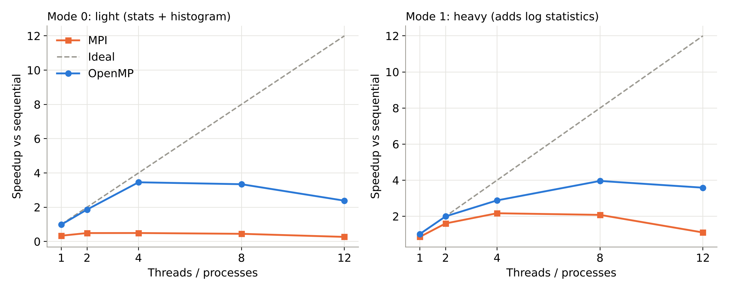
Speedup vs sequential
OpenMP peaks at 3.96x (heavy, 8 threads) and 3.45x (light, 4 threads)
MPI peaks at 2.17x (heavy, 4 procs) and is slower than sequential on the light operation
Notes:
Full dataset, mean of 5 runs. Speedup = sequential time / parallel time. MPI never exceeds 0.49x in the light mode.

Slide 5
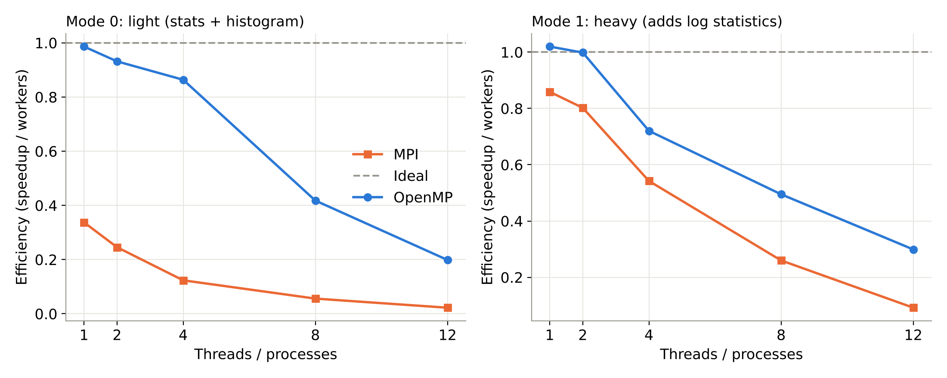
Efficiency
OpenMP heavy: 49% efficient at 8 threads; MPI: only 26%
Both fall at 12 workers: the CPU has 8 physical cores (4 performance + 4 efficiency) with 12 threads
Notes:
Efficiency = speedup / workers. At 12 workers, hyperthreads and efficiency cores add little.

Slide 6
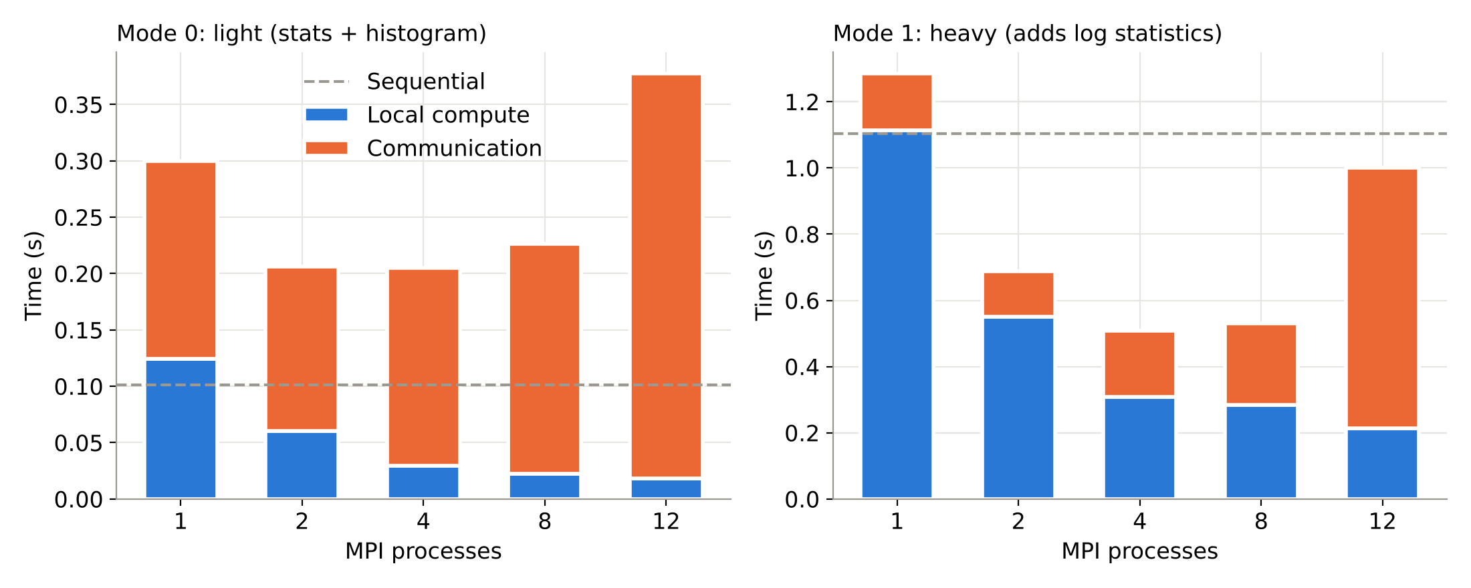
Where MPI loses time
Local compute keeps shrinking (heavy: 1.11 s to 0.21 s) but communication does not
At 8 processes, communication is 47% of MPI time (heavy) and 90% (light)
Notes:
Rank 0 must send all 378 MB regardless of process count, which acts as a serial fraction (Amdahl). At 12 processes communication rises to 0.79 s in heavy mode because processes outnumber physical cores.

Slide 7
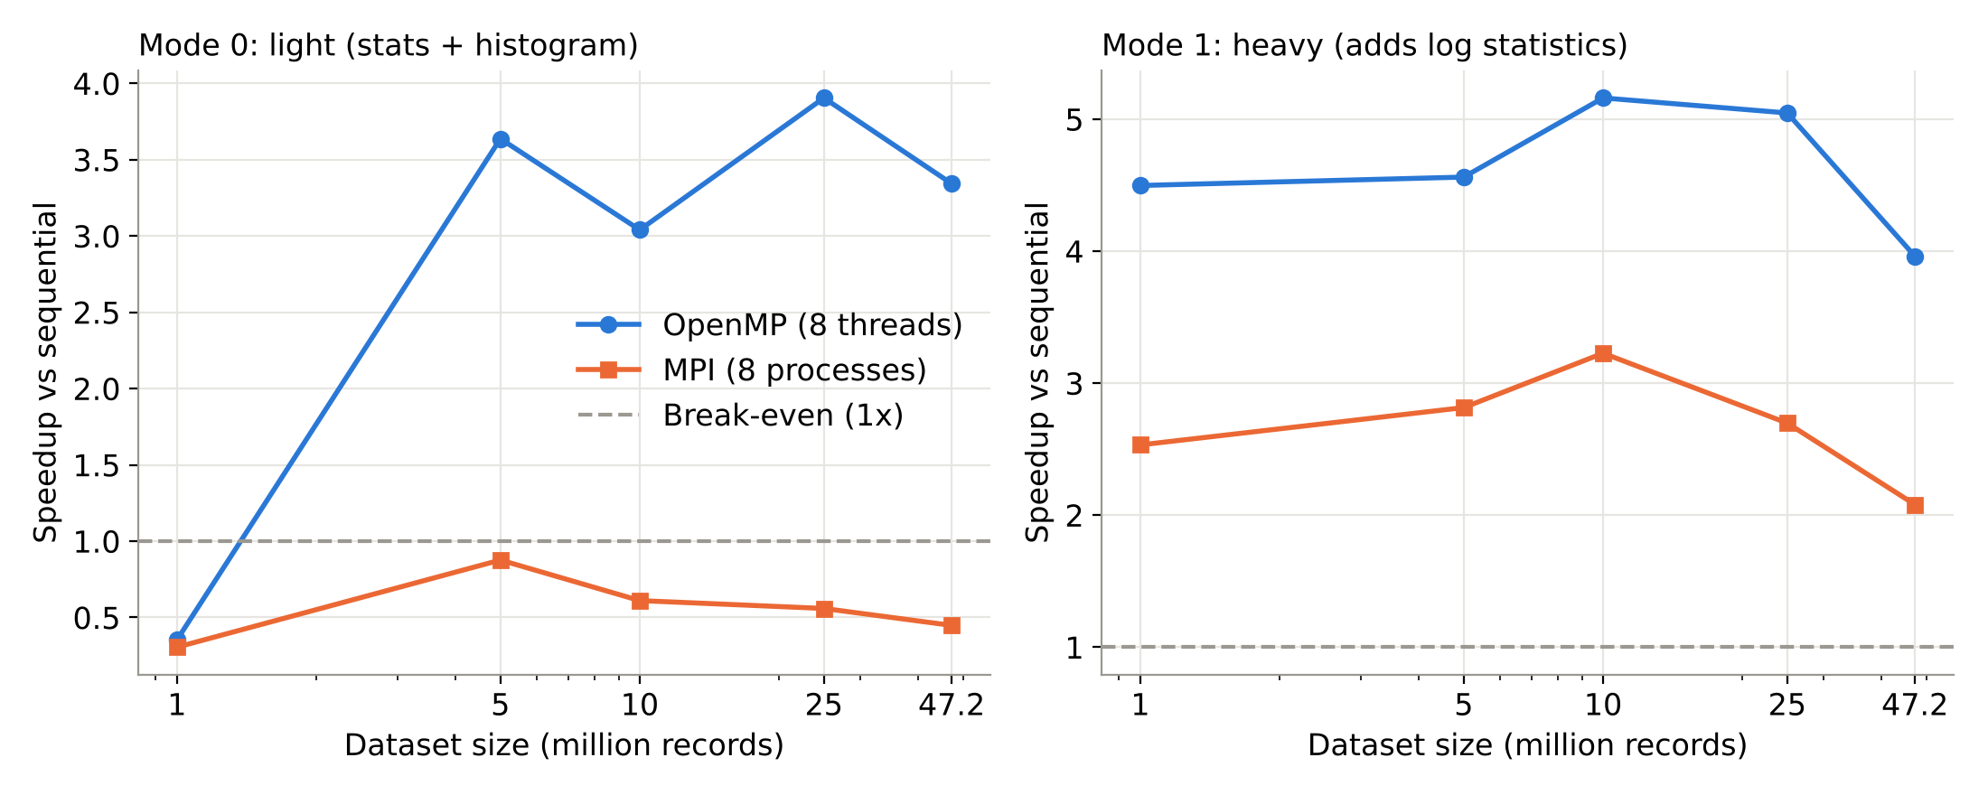
Effect of data size (8 workers)
Heavy: OpenMP 4.0x to 5.2x, MPI 2.1x to 3.2x for every size of 1 M or more
Light: OpenMP needs 5 M or more records to pay off (0.35x at 1 M); MPI never exceeds 0.88x
Notes:
Small data: thread start-up and messaging overhead dominate. Larger data: compute grows with N, but MPI scatter cost grows with N too.

Slide 8
Conclusions
OpenMP wins on one machine
MPI pays for communication
Compute per byte decides
Up to 3.96x with no data movement. Threads share memory.
Scatter of 378 MB is serial: 47% to 90% of its time at 8 processes.
Heavy work scales in both models. Light work only pays in OpenMP.
Limits
These MPI runs share memory inside one machine, so real network cost is not yet included.
Notes:
Main conclusion: parallelism pays off only when computation per byte moved is large enough. Cluster run to be added.

