Slide 1
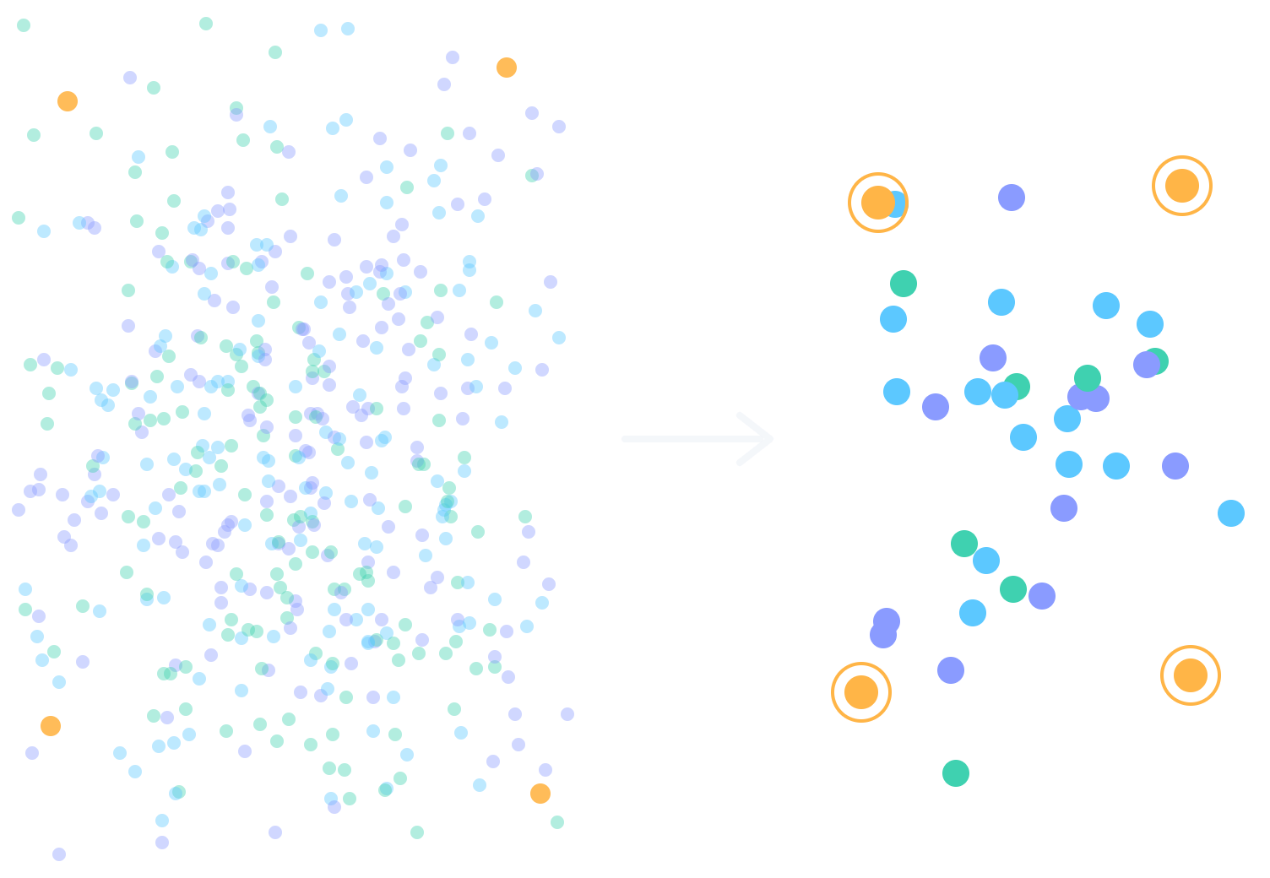
SMART SAMPLING
Millions of rows.
A few thousand.
Nothing lost.
Karthik S · Technology Conference
Notes:
[0:00–0:15] Walk out, pause, let the slide sit for a beat. "Good morning. I've got five minutes, so I'm going to ask you to imagine something with me. Hold on to this line on the screen — millions of rows, a few thousand, nothing lost. We'll come back to it."

Slide 2
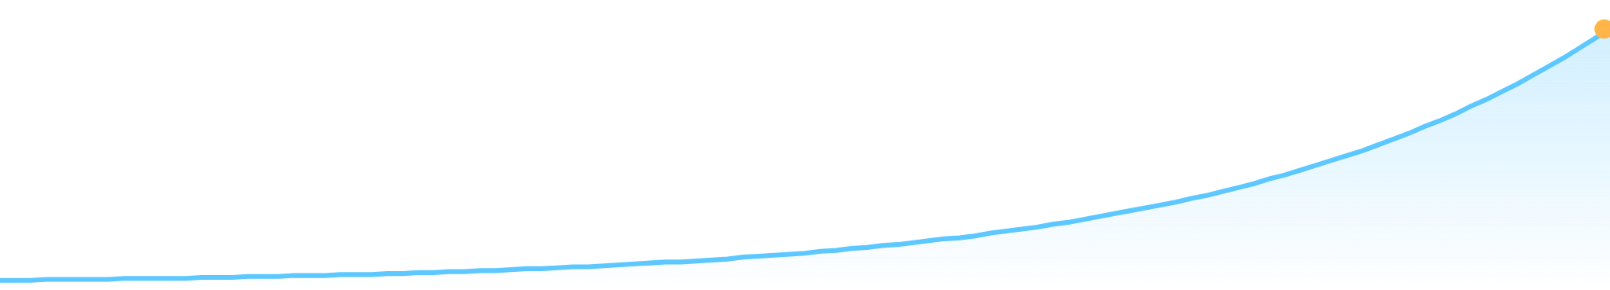
WHERE WE ARE
Our data keeps growing.
Our time to look at it doesn't.
Every day, our systems create more records than we can ever test, train on, or check — and the line only goes up.
Notes:
[0:15–0:45] "Think about how much data our systems create every single day — every application, every transaction, every log. [Optional: drop in one real number from our own estate here, e.g. how many records a key platform writes per day.] That pile keeps getting bigger. But our time, our test cycles, our compute — those don't grow at the same speed. We simply can't look at all of it. So what do we do?"

Slide 3
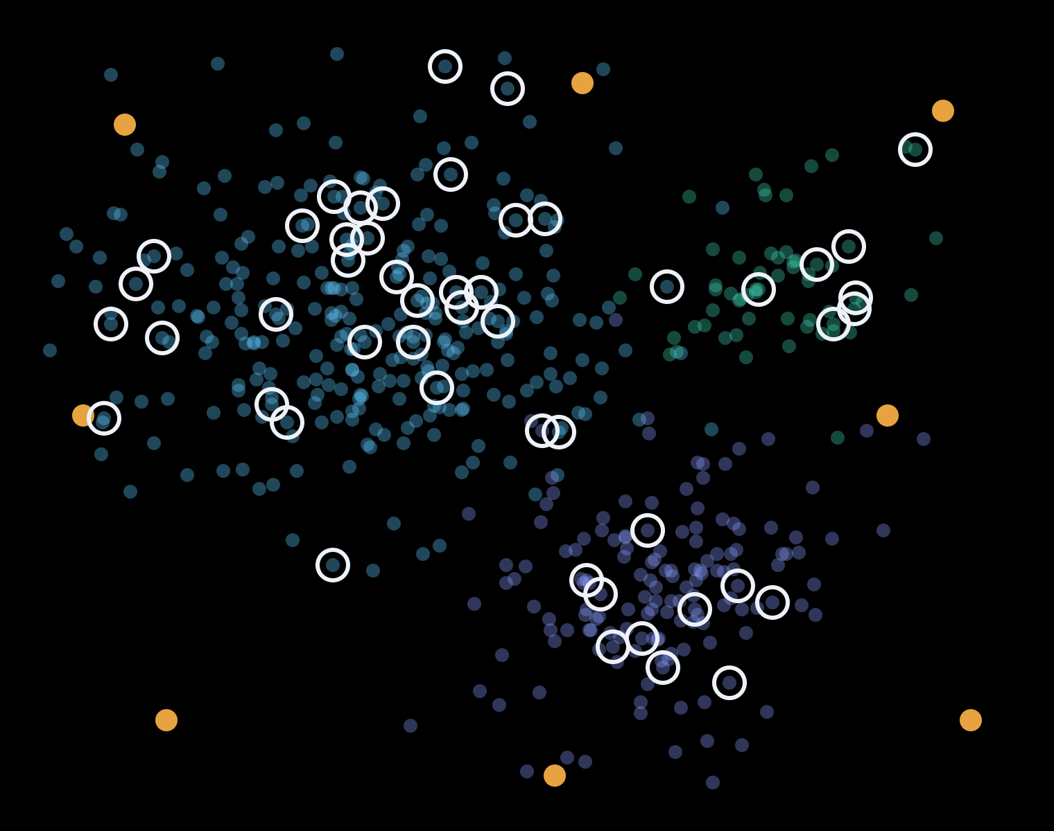
THE SHORTCUT
So we sample.
Randomly.
And hope.
A random 10% looks representative. But the rare records — the ones that matter most — usually don't make the cut.
The records we throw away are the ones that break us.
○ picked at random
● rare cases — left behind
Notes:
[0:45–1:25] "We take a sample. Ten percent, at random, and we hope it's representative. Look at the picture — the white rings are what random sampling picked. Plenty from the big, common groups. But see the orange dots? The rare ones. The outliers. Random sampling walked right past them." Point at the amber line. "And the records we throw away are the ones that break us. The edge case we didn't test is the Friday-night incident. The rare pattern the model never saw is the fraud it doesn't catch. The outlier that got averaged away is the migration that looked green and wasn't."

Slide 4
IMAGINE
What if a million rows could be represented by a thousand —
…and still carry every pattern?
Notes:
[1:25–1:40] Slow down here. Pause before reading it. "So let me ask you — what if a million rows could be represented by a thousand... and still carry every single pattern in the data?" Let it land. Look at the room.

Slide 5
IMAGINE
What if a million rows could be represented by a thousand —
…and still carry every pattern?
…plus every edge case and every outlier?
Notes:
[1:40–1:55] Click, let the amber line rise. "And what if it didn't stop there — what if those thousand rows also kept every edge case, and every outlier? The exact records random sampling throws away." Pause. "Some of you are already picturing that tool."

Slide 6
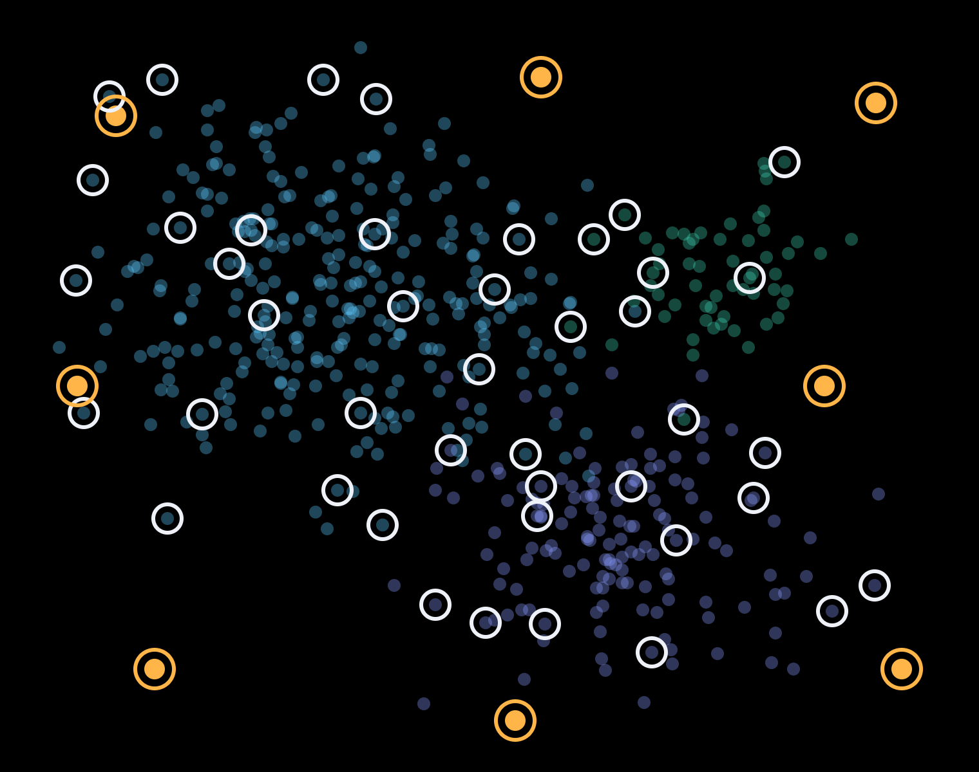
If you're already picturing it —
we built it.
Smart Sampling · working prototype
Every ring is chosen with purpose: a few from every segment, and every outlier kept.
Notes:
[1:55–2:15] "If you're picturing it — good news. We built it. It's called Smart Sampling, and the prototype is working today. Same data as the earlier picture — but look where the rings are now. A few from every group, the small ones too, and every orange outlier is kept. Nothing important left behind."

Slide 7

HOW IT WORKS · AN ML-POWERED PIPELINE
Four stages. Each one makes the data
smaller — and smarter.
01
02
03
04
Profile
Understand
Protect
Select
Check the data is healthy and ready to use.
Find the features that really shape behavior.
Lock in every edge case, then cover every segment.
Cluster, then keep the few that speak for the many.
Automated feature ranking
Statistical profiling
ML anomaly detection
ML clustering
Machine learning does the heavy lifting — no model to train or maintain. Same input, same output, every time.
Notes:
[2:15–3:00] Keep it light — name the ML, skip the maths. "How does it work? It's a machine-learning pipeline, four stages. One: profile — is the data healthy? Two: understand — it ranks which features actually drive behavior, automatically. Three: protect — machine-learning anomaly detection finds every edge case and locks it in, then every segment gets covered. Four: select — machine-learning clustering groups what's left and keeps the few rows that speak for the many. And there's no model to train or babysit — the ML runs inside the pipeline. Same input, same result, every time, so it's auditable. If you want the algorithms, find me after — I'll happily geek out."

Slide 8
PROOF, NOT A PROMISE
What the prototype delivered
60%
100%
100%
97%
smaller dataset — with nothing important lost
of behavioral signatures still covered
of edge cases and outliers found and kept
data quality score before sampling begins
Prototype run. The pipeline processes data in chunks, so it is built to scale with volume.
Notes:
[3:00–3:30] "This isn't a slide-ware idea. On our prototype run the dataset got 60% smaller — and we still covered 100% of the behavioral signatures. Every edge case and every outlier it found — 100% — made it into the final sample. The ones random sampling would likely have dropped. The next step is to prove it at production scale — which is where you come in."

Slide 9





WHERE IT HELPS
One tool. Five places it pays off.
Regression testing
ML training
Migration checks
Production monitoring
Synthetic data
Training sets that keep the rare cases models usually miss.
Test on a small slice with full coverage. Faster runs, same confidence.
Compare source and target statistically before go-live.
Consistent samples over time to spot drift early.
Each segment becomes a template for realistic test data.
Notes:
[3:30–4:00] "Where does this help? Think about your own team. QA — run regression on a small slice instead of production-sized data. Data science — training sets that include the rare cases. Migrations — compare source and target properly before go-live. Monitoring — consistent samples to catch drift. And synthetic data. If you touch data, one of these is probably yours."

Slide 10

WHERE IT IS GOING
From a tool you use
to an agent that tunes itself.
TODAY
NEXT
FUTURE
Interactive tool
Service & API
AI agent
Explore, configure and see results live.
Plugs into CI/CD and batch pipelines.
Watches its own scores, adjusts, re-runs until it is right.
Home-grown. No licences, just compute — tuned to each dataset, and every run proves itself.
Notes:
[4:00–4:35] "Where's it going? Today it's an interactive tool. Next, it becomes a service — an API your pipelines call in CI/CD. And the future: an AI agent that watches its own quality scores, adjusts its settings, and re-runs until it gets it right. And the best part — it's ours. Home-grown. No licence fees, just compute. Tuned to your data, and every run comes with its own quality score."

Slide 11
LET US TALK
Bring me your biggest,
messiest dataset.
Let's see how few rows it takes to tell the whole story.
Karthik S · [email or Teams channel]
Smart Sampling — millions of rows, a few thousand, nothing lost.
Notes:
[4:35–5:00] "So here's my ask. Bring me your biggest, messiest dataset. Let's see how few rows it takes to tell the whole story. Millions of rows. A few thousand. Nothing lost. Thank you." Stop. Smile. Don't add anything after 'thank you'.

