Slide 1
AgriViz: Analyzing Farmer Queries with Data
Big Data Visual Analytics (Semester II, 2024–2025)

Slide 2
Introduction and Key Features
Kisan Call Centers (KCCs): Government sponsored call centres to resolve farmer queries
Project goal: Aims to extract insights from KCC queries; and crop price data to answer queries efficiently. Understand regional issues, seasonal patterns, and price volatility
Project description: Interactive dashboard for geospatial, temporal, and semantic exploration for KCC data; geospatial, temporal and variational analysis for Crop Price data
Target Audience: KCC support staff, policymakers, agribusinesses, farmer advocacy groups, researchers, entrepreneurs.
How will it help: Reveals region-specific and seasonal farming issues for timely intervention. Gives insights about crop price trends for answering queries.

Slide 3
Data and Scraping
KCC Data:
Data: Contains 4M+ farmer queries from 2006 - present.
Fields: StateName, DistrictName, Season, Sector, Category, Crop, QueryType, QueryText, CreatedOn
Source: Indian Government; Publicly available at data.gov.in
Crop Price Data:
Data: Covers 10M+ records from 2015 -present.
Fields: District, Market, Commodity, Variety, Standard, MinPrice, MaxPrice, ModalPrice, PriceDate
Source: Indian Government; Publicly available at agmarknet.gov.in
Other API Data:
OpenWeatherMap for getting GeoCodes of Districts in Price Map.
Precomputed Geojson for States and Districts
Scraping:
Scraped page-wise
Parsed and filtered using BeautifulSoup.

Slide 4
Preprocessing and Parallelization
Data cleaning: Removed irrelevant columns and inconsistent entries such as mismatched state and district names to improve accuracy.
Storage optimization: Reduced the original dataset size from ~16 + 1 GB to ~5 GB (RAM Footprint), enabling smoother data access and storage efficiency.
Preprocessing efficiency: Cleaned and compressed data (e.g., using category) to ensure compatibility with real-time visualization tools.
Parallel graph rendering: Implemented multi-threaded data loading and rendering, achieving up to a 5x speed boost compared to serial processing.
Improved responsiveness: Enabled fast and smooth dashboard interactions, even when exploring large datasets interactively.

Slide 5

Plots Used – Choropleth
State-level visualization: Shows geographic distribution of farmer queries using color intensity to represent query volume.
Drill-down to districts: Enables detailed insights by zooming into specific districts within states for localized analysis.
Pattern detection: Highlights regions with high agricultural concerns, guiding where intervention might be needed most.
Interactive interface: Allows users to navigate and compare spatial data dynamically without needing to reload or filter manually.
Starting point for exploration: Serves as the visual entry point into the dashboard, helping users choose areas of interest for deeper analysis.

Slide 6
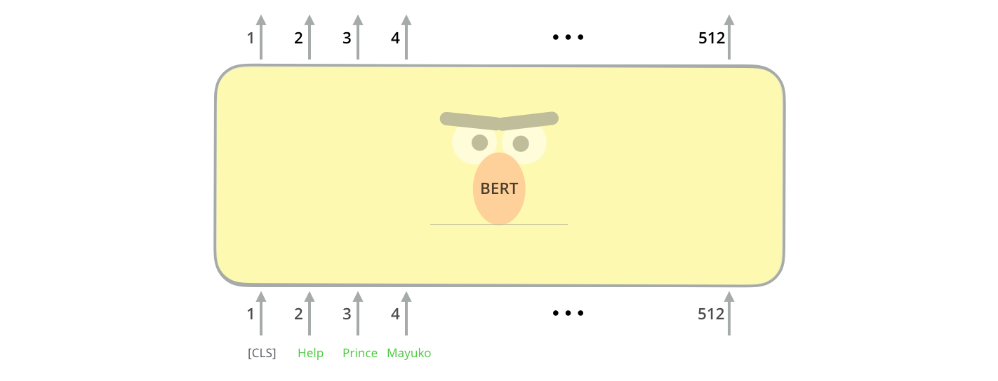
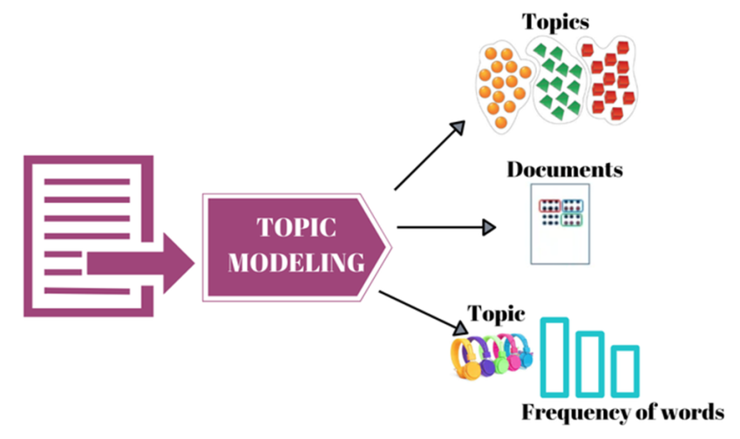
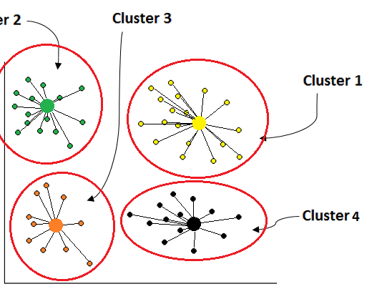
Clustering Query Types
Clustering technique: Used BERT embeddings + agglomerative clustering to group similar queries.
Labeling clusters: Applied TF-IDF to extract keywords that summarize each query cluster.

Slide 7
Plots Used – Time Series/Stream Graph
Time series analysis: Displays daily query volumes to reveal seasonal or event-driven spikes.
Stream graph visualization: Shows how different query types evolved over time using cluster-based streams.
User interactivity: Allows zooming into specific periods or clusters to observe changing concerns.

Slide 8
Plots Used – Node Graph (Crop and Query)
Query relationship graph: Each node represents a cluster of semantically similar queries, with edges indicating temporal correlations between them.
Co-occurring issues: Helps identify query types that often spike together—such as pest and weather concerns during monsoon.
Crop interdependence: A similar node graph was created for crops to show relationships in their query trends across time.
Agricultural insights: Reveals crops that share seasons, pests, or market patterns—useful for planning and crop rotation.
Interactive layout: Users can explore connections between crops and concerns to understand regional agricultural dynamics.

Slide 9
Seasonality Analysis
Monthly trends by sector: Multi-line plots display how query volumes vary across months for different sectors like pests, weather, and fertilizers.
Sowing season spikes: A clear increase in agricultural queries is observed during June–July, corresponding to monsoon and sowing.
Sectoral comparison: Highlights which sectors dominate in which months—e.g., pest concerns peaking during monsoon.
Time-sensitive planning: Helps government and NGOs allocate resources based on seasonal concern patterns.
Annual overview: Provides a calendar-like summary of query activity, aiding in anticipation of recurring issues.

Slide 10
Word Cloud
State-wise visualization: Word clouds for each state show the most frequent keywords in farmer queries.
Regional specialization: Certain crops or issues appear prominently in specific states—e.g., coconut in Kerala, wheat in Haryana.
Semantic cues: Offers a quick view into the nature of farmer concerns without needing to read individual queries.
Language patterns: Captures local terminologies used by farmers, helpful for designing region-specific advisories.
Cross-state comparison: Enables analysts to compare agricultural priorities across different parts of India.

Slide 11
Interconnection Between Two Datasets
Dual-pane dashboard: Combines insights from farmer queries and crop price data for a comprehensive view.
Cross-analysis potential: Detects whether certain query patterns align with price fluctuations or market shocks.
Policy synergy: Enables data-driven intervention by linking crop prices with the nature and timing of farmer concerns.
Unified interface: Users can explore both datasets simultaneously, enhancing context and decision-making.
Improved efficiency: Supports faster and more informed responses to queries related to market dynamics and crop planning.

Slide 12
Mean and Variance Across Districts
Geospatial price map: Shows average crop prices across districts using color-coded scatter points on an interactive map.
Variance toggle: Users can switch to view price variance, helping identify areas with unstable or volatile pricing.
Price disparity insight: Highlights significant differences in pricing, such as wheat ranging from ₹1903 in Agra to ₹3794 in Kollam.
Economic signal: Districts with high variance may indicate supply-chain issues or poor market access.
Policy focus tool: Supports targeting price stabilization measures or market reforms in vulnerable regions.

Slide 13
Time Series of Price and Prediction
Temporal price analysis: Displays average crop price trends over time across all districts.
Seasonal patterns: Identifies regular trends such as price hikes during off-season periods or dips during harvest.
Forecast modeling: SARIMA model is used to generate 1-year forward predictions based on past price behavior.
Planning benefit: Farmers and traders can anticipate price trends and optimize storage, selling, or procurement decisions.
Trend interpretation: The decomposition into trend and seasonality provides a clearer understanding of price dynamics.

Slide 14
SARIMA – Components
Model decomposition: SARIMA splits time series into trend, seasonal, and residual components.
Residual noise: Residual analysis helps identify unusual fluctuations not explained by season or trend.
Price prediction: Understanding components improves confidence in future price forecasts.
Use case: Helps users differentiate between regular seasonal cycles and broader economic trends; also helps answering price queries.
Crop-specific behavior: Some crops like apples show high seasonal variation, while others like wheat are stable year-round.

Slide 15
Variety-wise Distribution of Prices
Price histogram: Shows average prices of the top 10 varieties for the selected crop.
Varietal comparison: Reveals price gaps across varieties (e.g., American apple > Red Gold), informing farmer choices.
Market insight: Higher prices often reflect better demand, quality, or shelf life—important for variety selection.
Region-agnostic view: Averages are calculated across all districts and time, giving a general market perspective.
Decision-making aid: Helps farmers and buyers choose varieties that maximize profitability or fit market needs.

Slide 16

DEMO

Slide 17
Results
Geographic patterns: Spatial maps revealed high-query and high-volatility districts, useful for targeted interventions.
Semantic themes: Word clouds and node graphs exposed dominant issues and co-occurring agricultural concerns.
Temporal insights: Stream graphs and monthly breakdowns illustrated seasonal patterns in farmer queries.
Market dynamics: Time series analysis uncovered pricing trends, volatility, and seasonal price swings.
Forecasting and planning: SARIMAX predictions and varietal analysis supported forward-looking agricultural decisions.

Slide 18
Thank You
Team Members:
Siddharth Kalra, Chitwan Goel, Geetika, Vikas Yadav,
Divyansh, Shrey Bansal, Aniket Suhas Borkar, Kartik Anant Kulkarni

