Slide 1
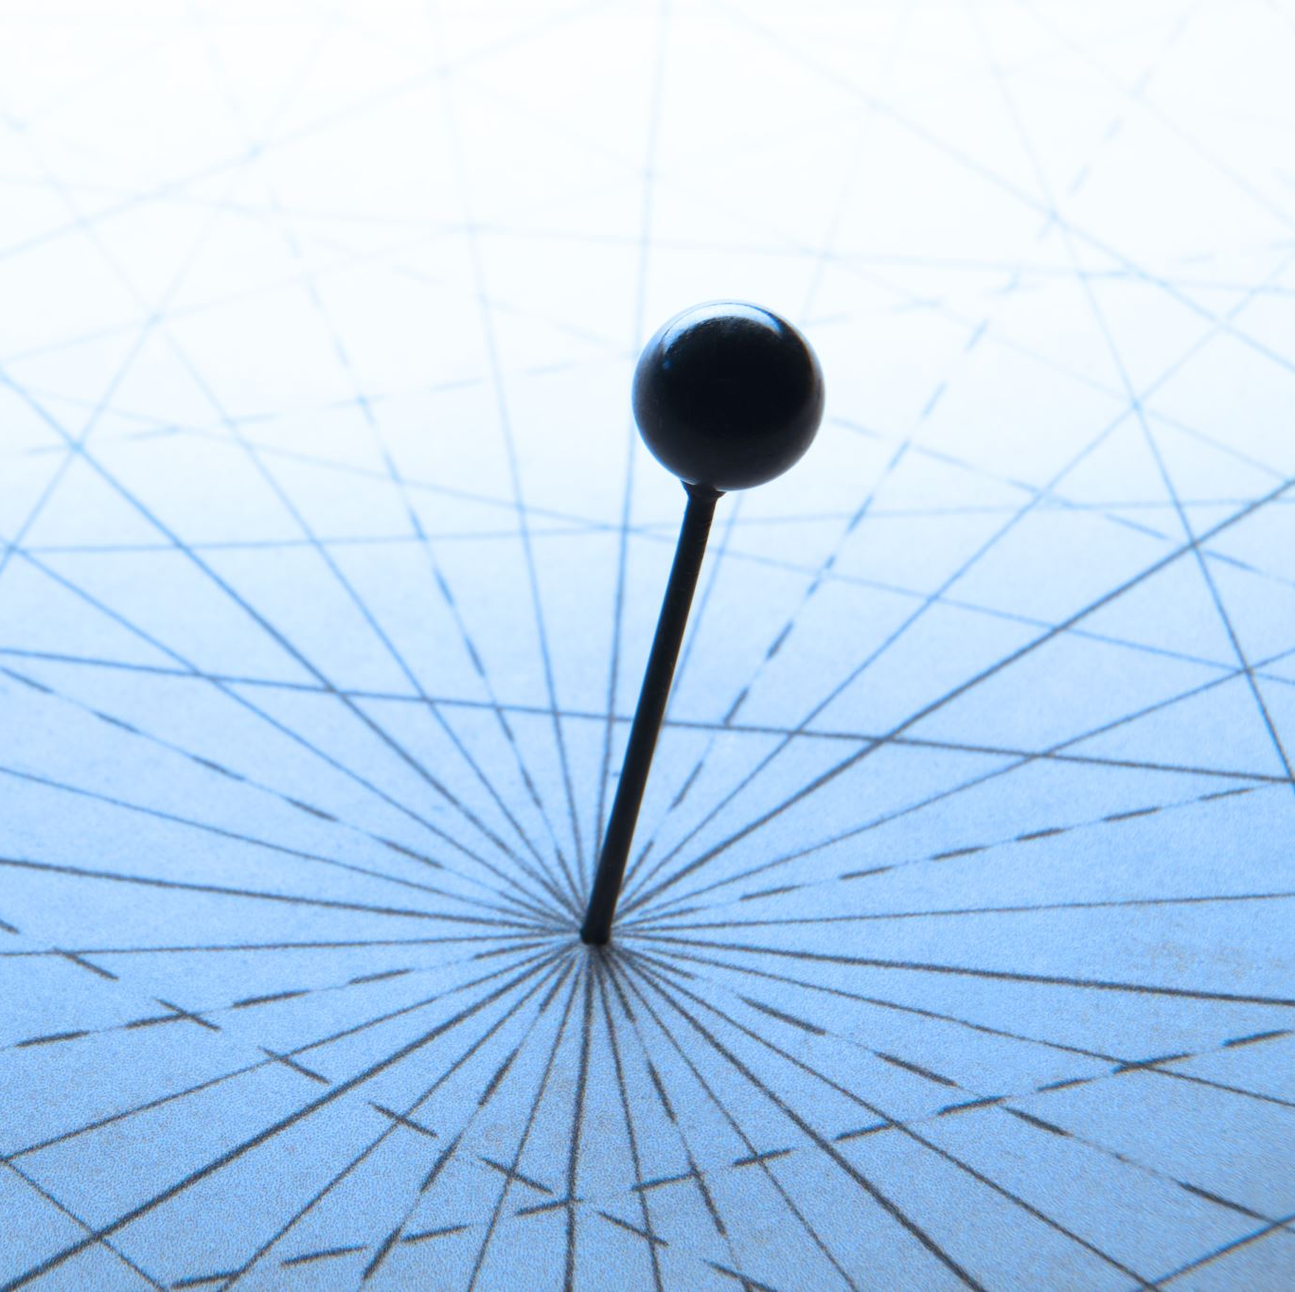
Approximate Distance Oracle
Kartik Anant Kulkarni (210493)
Siddharth Garg (211031)
Goural Dureja (210393)

Slide 2
Acknowledgement
We are extremely grateful to our professor, Prof. Surender Baswana, for his unwavering support,
expert guidance, and invaluable suggestions throughout the project. His insights played a key
role in refining our approach and in the development of our algorithms. In particular, the hints
provided during discussions about 3-approximate distance oracles and advice on extending these
ideas to a 5-approximate variant were crucial in enabling us to generalize the method to a (2k−1)-
approximate oracle. We would also like to emphasize that, aside from some initial background
reading on implementation techniques, no external assistance was used in the development of this
project. Overall, this experience has been highly educational, offering us a practical insight into
the challenges and problem-solving required in algorithm design and evaluation—mirroring the
real-world complexities faced by researchers in the field.

Slide 3

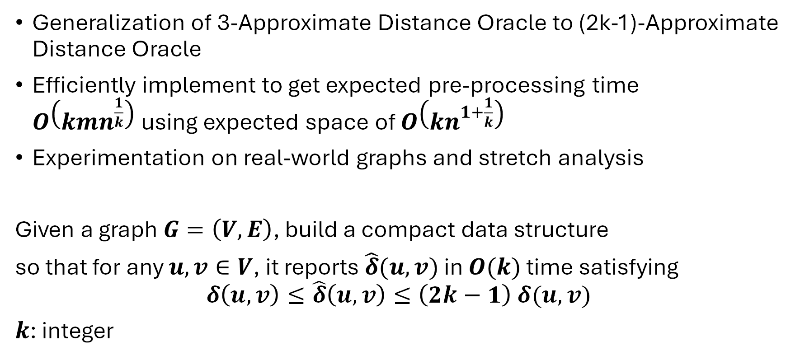
PROBLEM INTRODUCTION
Generalization of 3-Approximate Distance Oracle to (2k-1)-Approximate Distance Oracle
Efficiently implement to get expected pre-processing time $O\left(kmn^{\frac{1}{k}}\right)$using expected space of $O\left(kn^{1+\frac{1}{k}}\right)$
Experimentation on real-world graphs and stretch analysis
Given a graph $G=\left(V,E\right)$, build a compact data structure
so that for any $u,v∈V$, it reports $\hat{δ}(u,v)$ in $O(k)$ time satisfying
$$δ\left(u,v\right)≤\hat{δ}\left(u,v\right)≤\left(2k−1\right) δ(u,v)$$
$k$: integer

Slide 4
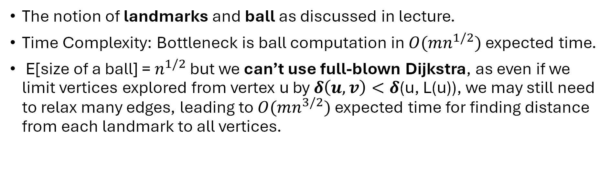
3-Approximate Distance Oracle
The notion of landmarks and ball as discussed in lecture.
Time Complexity: Bottleneck is ball computation in $O(mn^{1/2})$ expected time.
E[size of a ball] = $n^{1/2}$ but we can’t use full-blown Dijkstra, as even if we limit vertices explored from vertex u by $δ\left(u, v\right)<δ$(u, L(u)), we may still need to relax many edges, leading to $O(mn^{3/2})$ expected time for finding distance from each landmark to all vertices.
Edges to other vertices relaxed

Slide 5

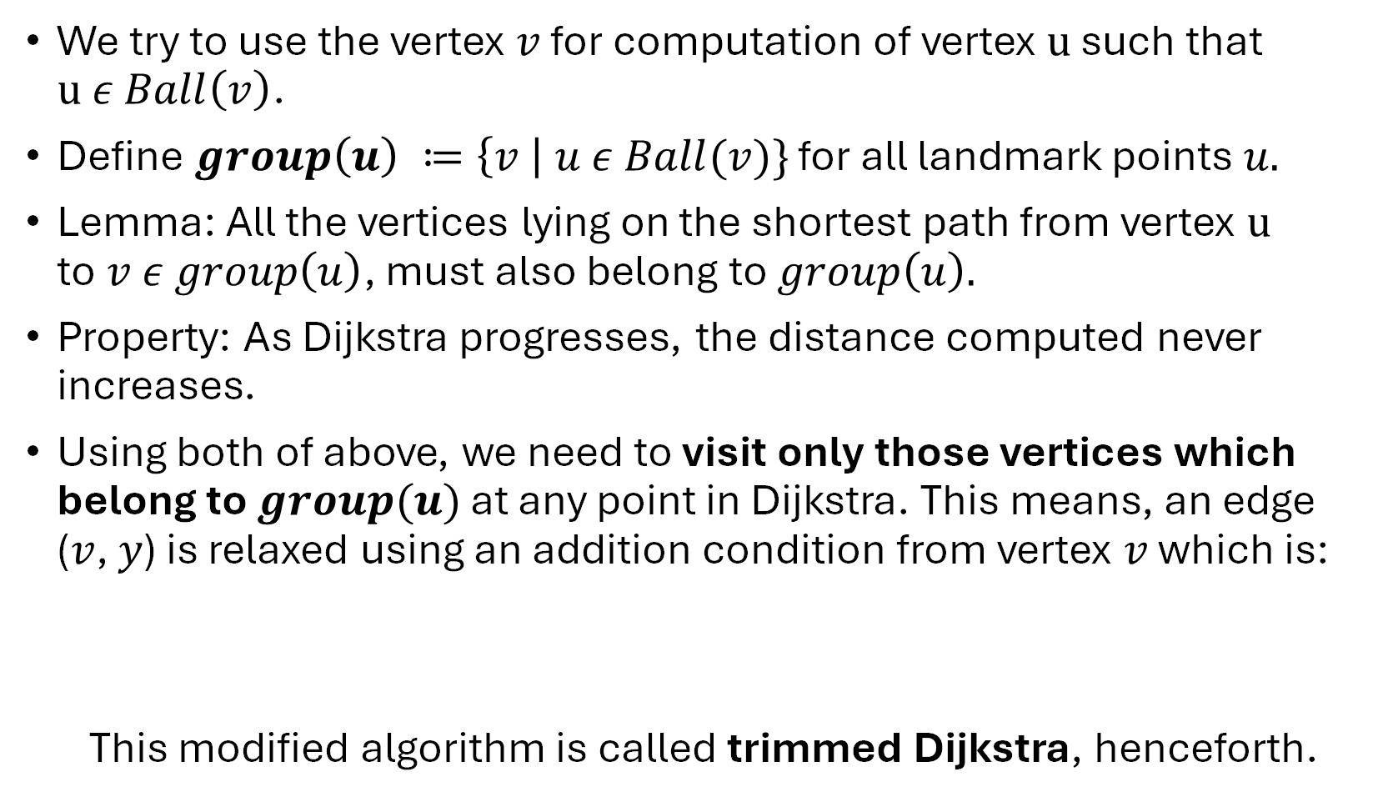
We try to use the vertex $v$ for computation of vertex $u$ such that $u ε Ball\left(v\right)$.
Define $group\left(u\right) ≔\left\{v \right| u ε Ball(v)\}$ for all landmark points $u.$
Lemma: All the vertices lying on the shortest path from vertex $u$ to$v ε group\left(u\right)$, must also belong to $group\left(u\right).$
Property: As Dijkstra progresses, the distance computed never increases.
Using both of above, we need to visit only those vertices which belong to $group(u)$ at any point in Dijkstra. This means, an edge ($v$, $y$) is relaxed using an addition condition from vertex $v$ which is:
This modified algorithm is called trimmed Dijkstra, henceforth.
$\left(d(u, v\right)+weight\left(v, y\right)< δ(y, L(y))$)

Slide 6
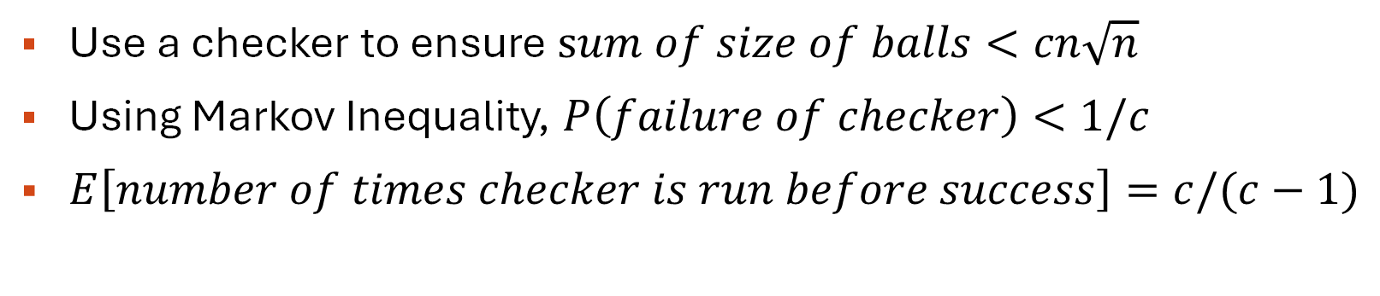

Bound on space utilized
Space utilization is bounded even if some balls are quite large and other balls are still small. So, we should be more concerned about total size of balls instead of individual ball sizes.
$$E\left[sum of sizes of ball\right]=n\sqrt{n}$$
Use a checker to ensure $sum of size of balls<cn\sqrt{n}$
Using Markov Inequality, $P\left(failure of checker\right)<1/c$
$E\left[number of times checker is run before success\right]=c/(c−1)$

Slide 7
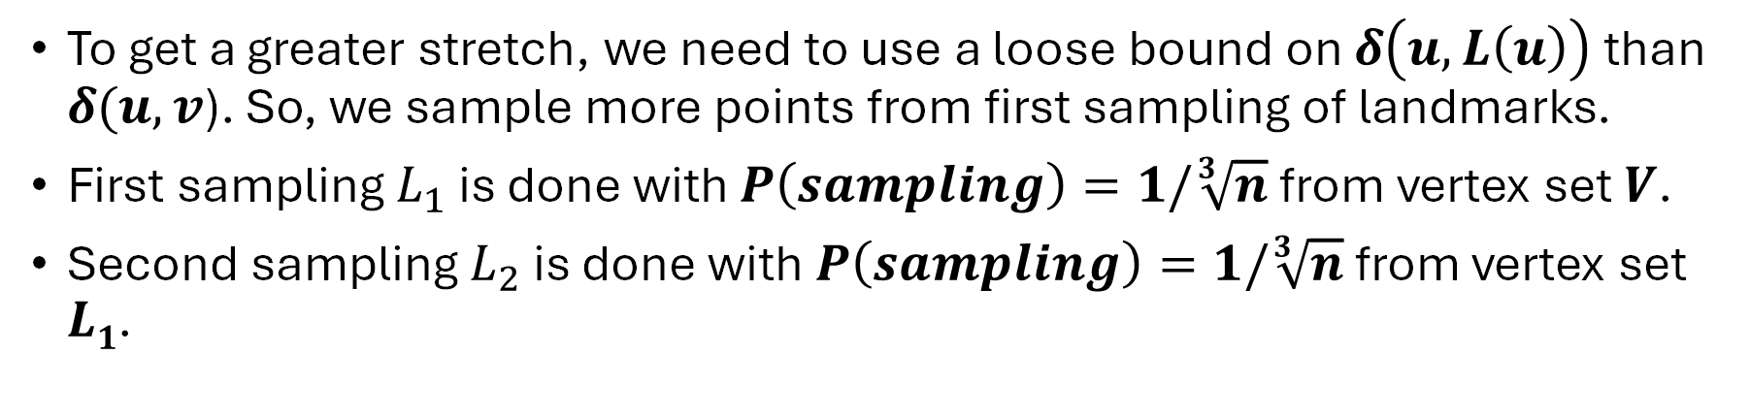
Generalization of k = 2 to k = 3
To get a greater stretch, we need to use a loose bound on $δ\left(u, L\left(u\right)\right)$ than $δ(u, v$). So, we sample more points from first sampling of landmarks.
First sampling $L_{1}$ is done with $P\left(sampling\right)=1/\sqrt[3]{n}$ from vertex set $V$.
Second sampling $L_{2}$ is done with $P\left(sampling\right)=1/\sqrt[3]{n}$ from vertex set $L1$.
…........
Second level of landmarks L₂
…......
First level of landmarks L₁
…...

Slide 8
Justification of stretch 5
We get a stretch of 7 if we use an intermediate landmark point for query processing.
$δ\left(u, L1\left(u\right)\right)+δ\left(L1\left(u\right), L2\left(u\right)\right)$ + $δ\left(u, L2\left(u\right)\right)$ $≤7δ\left(u, v\right)$
So, we must use vertex $L2\left(u\right) and u$ for query processing.
$δ\left(u, L2\left(u\right)\right)+δ\left(L2\left(u\right), u\right)$ $≤5δ\left(u, v\right)$

Slide 9
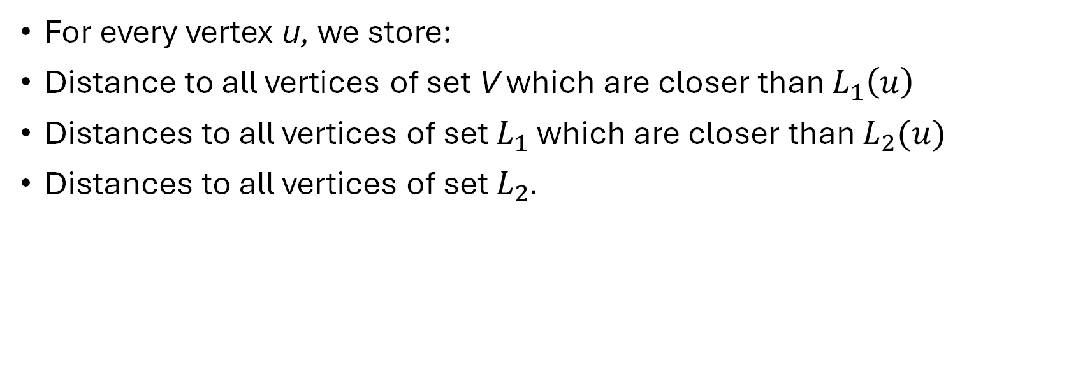
Distance Information stored
For every vertex u, we store:
Distance to all vertices of set V which are closer than $L_{1}\left(u\right)$
Distances to all vertices of set $L_{1}$ which are closer than $L_{2}(u)$
Distances to all vertices of set $L_{2}.$

Slide 10
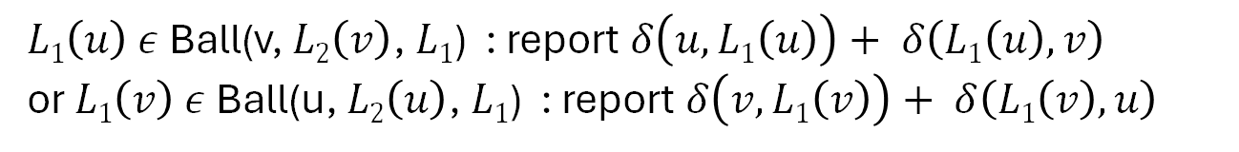
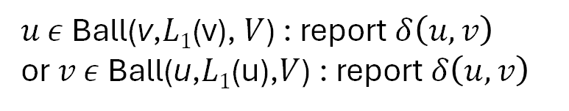
Query Processing
Assume a given vertex u from which we need to find approximate distance to vertex v.
$u$ $ε$ Ball(v,$L1$(v), $V$) : report $δ\left(u, v\right)$
or $v$ $ε$ Ball(u,$L1$(u),$V$) : report $δ\left(u, v\right)$
$L1\left(u\right)$ $ε$ Ball(v, $L2\left(v\right)$, $L1$) : report $δ\left(u, L1\left(u\right)\right)+ δ\left(L1\left(u\right), v\right)$
or $L1\left(v\right)$ $ε$ Ball(u, $L2\left(u\right)$, $L1$) : report$δ\left(v,L1\left(v\right)\right)+ δ\left(L1\left(v\right), u\right)$
else: report $δ\left(u, L2\left(u\right)\right)+ δ\left(L2\left(u\right), v\right)$

Slide 11
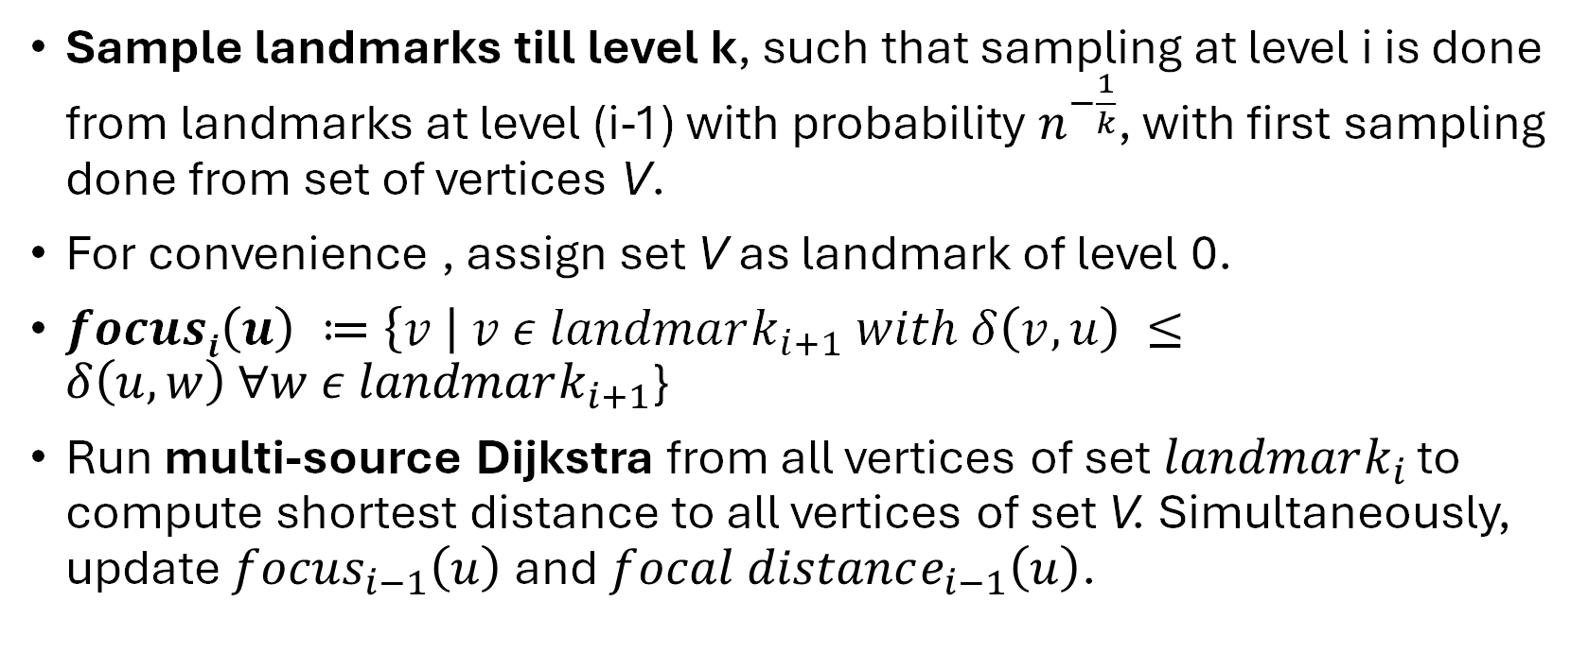
Generalization to (2k-1)-Approximate Distance Oracle
Sample landmarks till level k, such that sampling at level i is done from landmarks at level (i-1) with probability $n^{−\frac{1}{k}}$, with first sampling done from set of vertices V.
For convenience , assign set V as landmark of level 0.
$focusi\left(u\right) ≔\left\{v \right| v ε landmark_{i+1} with δ\left(v, u\right) ≤δ\left(u, w\right) ∀w ε landmark_{i+1}$}
Run multi-source Dijkstra from all vertices of set $landmark_{i }$to compute shortest distance to all vertices of set V. Simultaneously, update $focus_{i−1}\left(u\right)$and $focal distance_{i−1}\left(u\right)$.

Slide 12
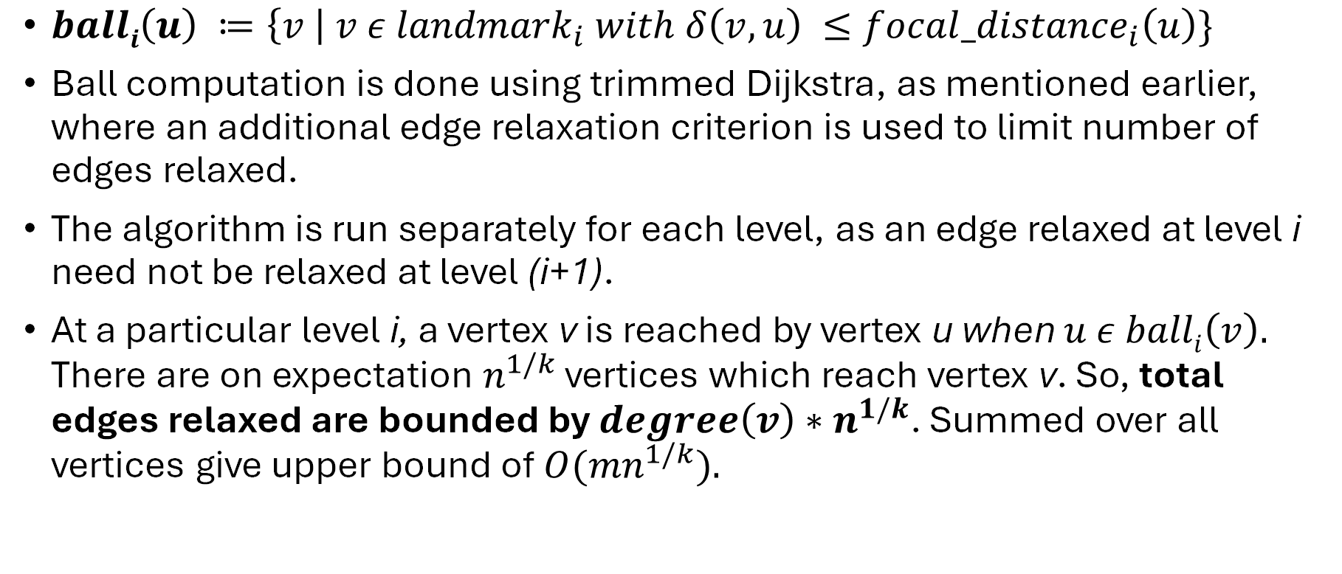
Efficient Ball Computation
$balli\left(u\right) ≔\left\{v \right| v ε {landmark}_{i} with δ\left(v, u\right) ≤{focal_distance}_{i}\left(u\right)\}$
Ball computation is done using trimmed Dijkstra, as mentioned earlier, where an additional edge relaxation criterion is used to limit number of edges relaxed.
The algorithm is run separately for each level, as an edge relaxed at level i need not be relaxed at level (i+1).
At a particular level i, a vertex v is reached by vertex u when $u ε balli\left(v\right).$ There are on expectation $n^{1/k}$ vertices which reach vertex v. So, total edges relaxed are bounded by $degree\left(v\right)∗n^{1/k}$. Summed over all vertices give upper bound of ${O(mn}^{1/k}).$

Slide 13
The balls need to be stored in a hash table for efficient querying.
For query processing, there is no need to retrieve the level of any vertex in the ball (as we use successive foci). Hence, we can reduce redundancy by hashing the entire ball together.
We achieve the same practically using FPH which is a C++ implemented perfect dynamic hashing. This library handles false positives allowing O(1) worst case query time and accurate absence of a particular point in ball.

Slide 14

Distance Information Stored
For every vertex u, we store:
Distances to all vertices of set $L_{i}$ which are closer than$focus_{i}\left(u\right)$for all i $ε$ [1, k-1]
Distances to all vertices of set $L_{k}$by defining $focus_{k}\left(u\right)$ at infinity.

Slide 15
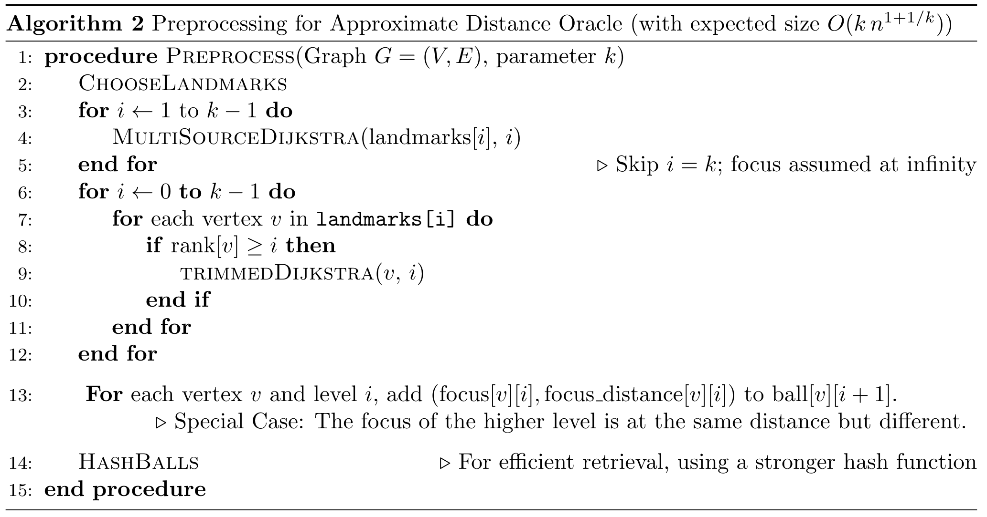
Pre-ProcessinG

Slide 16
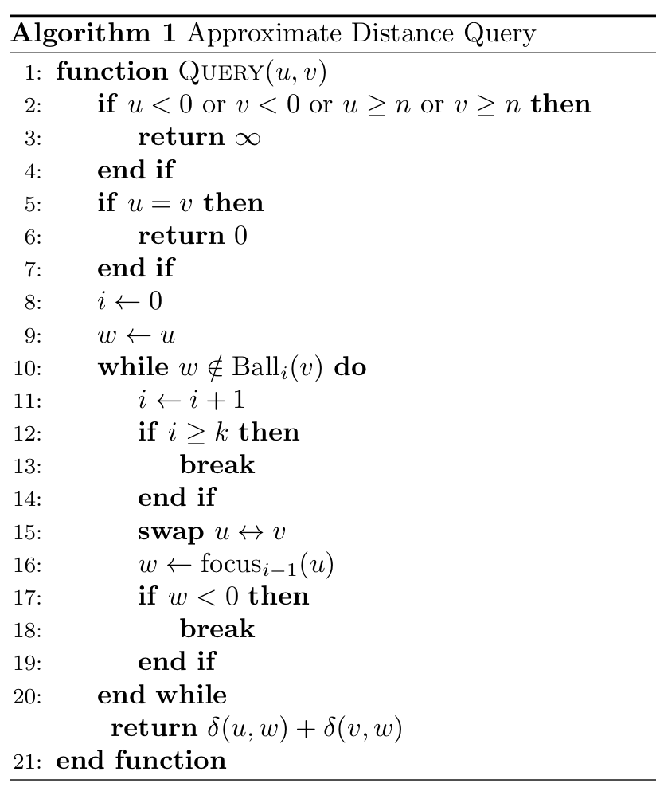
Query Processing

Slide 17
Justification of stretch
Induction: Addition of level i of landmarks to level (i-1) increases the stretch from (2i-1) to (2i+1).
Adding level of landmark add 2 to the stretch.
Base Case: Extension of 3-Approximate Distance Oracle to 5-Approximate Distance Oracle.

Slide 18
VISUALISATION

Slide 19
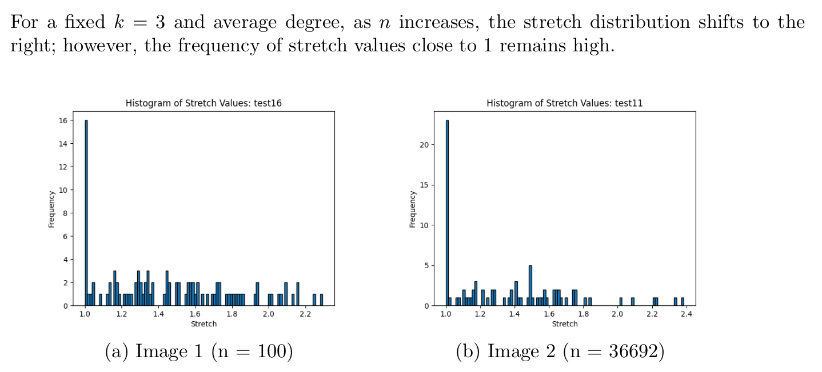
Graphs

Slide 20
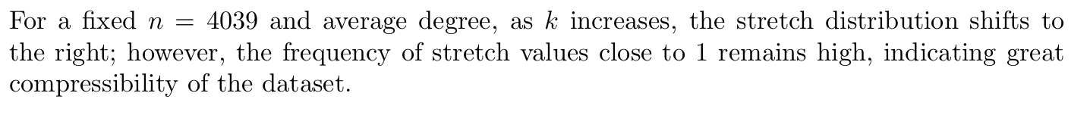
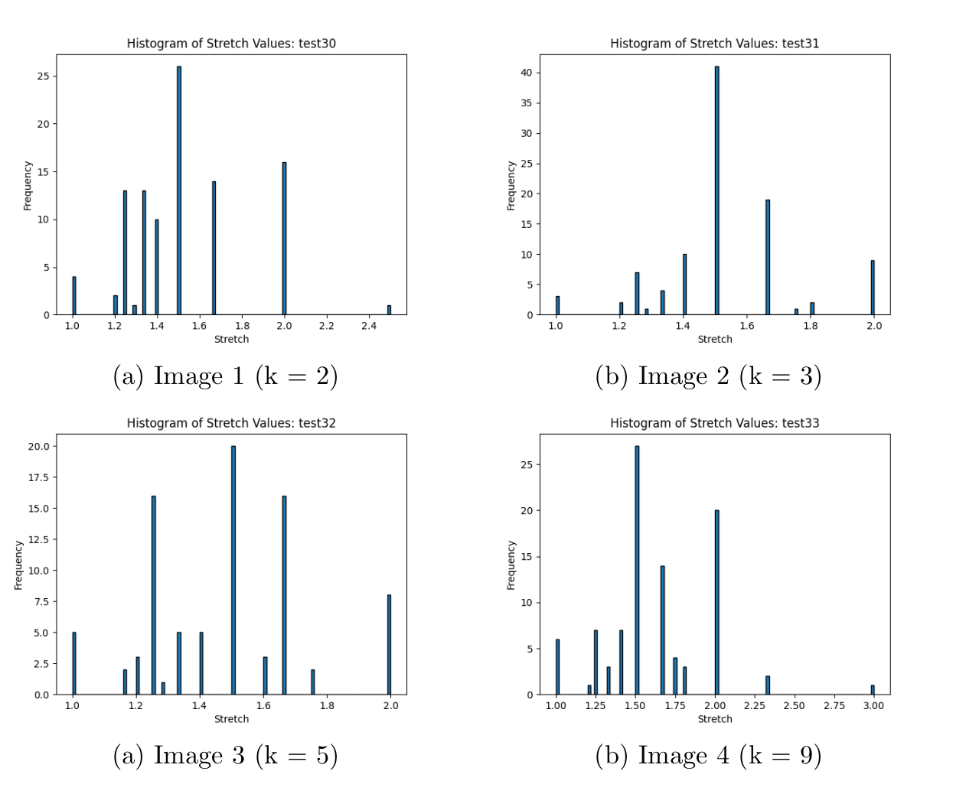
GRAPHS

Slide 21
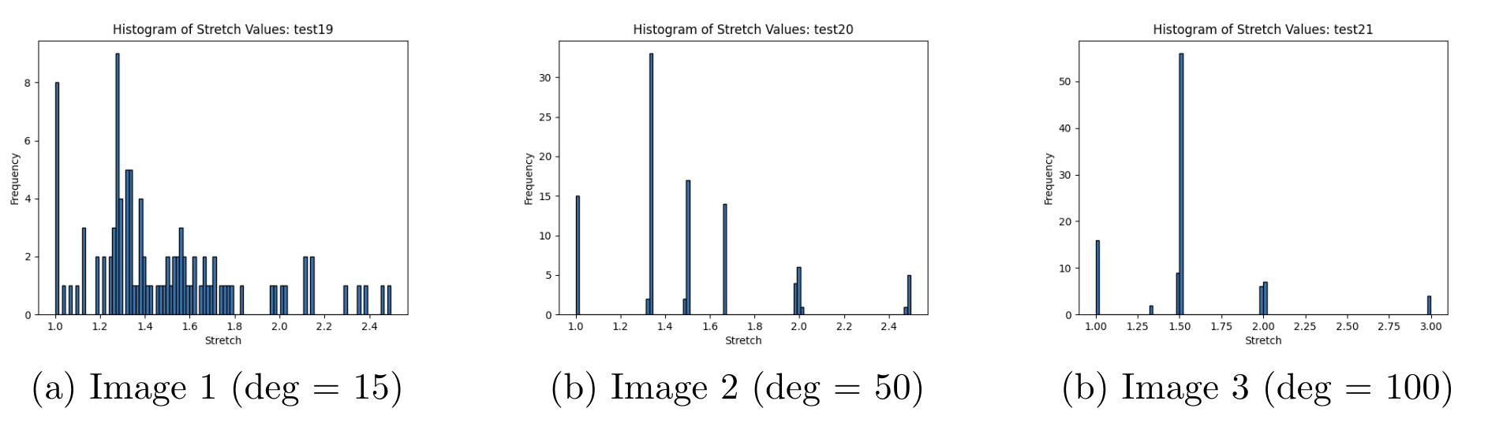
Graphs

Slide 22
CONCLUSION

Slide 23
Future Improvements
Parallelization for Fast Pre-Processing: One promising direction is to parallelize the preprocessing phase. Since computing local distance information and forming the clusters or ball sets for each vertex can be done independently, distributing this work across multiple processors or cores can significantly reduce the overall runtime.
Dynamic Updates: Enhancing the data structure to support dynamic updates—such as insertions, deletions, or weight modifications—without requiring a full re-preprocessing of the graph would make the oracle more practical for real-time or evolving networks.

