Slide 1
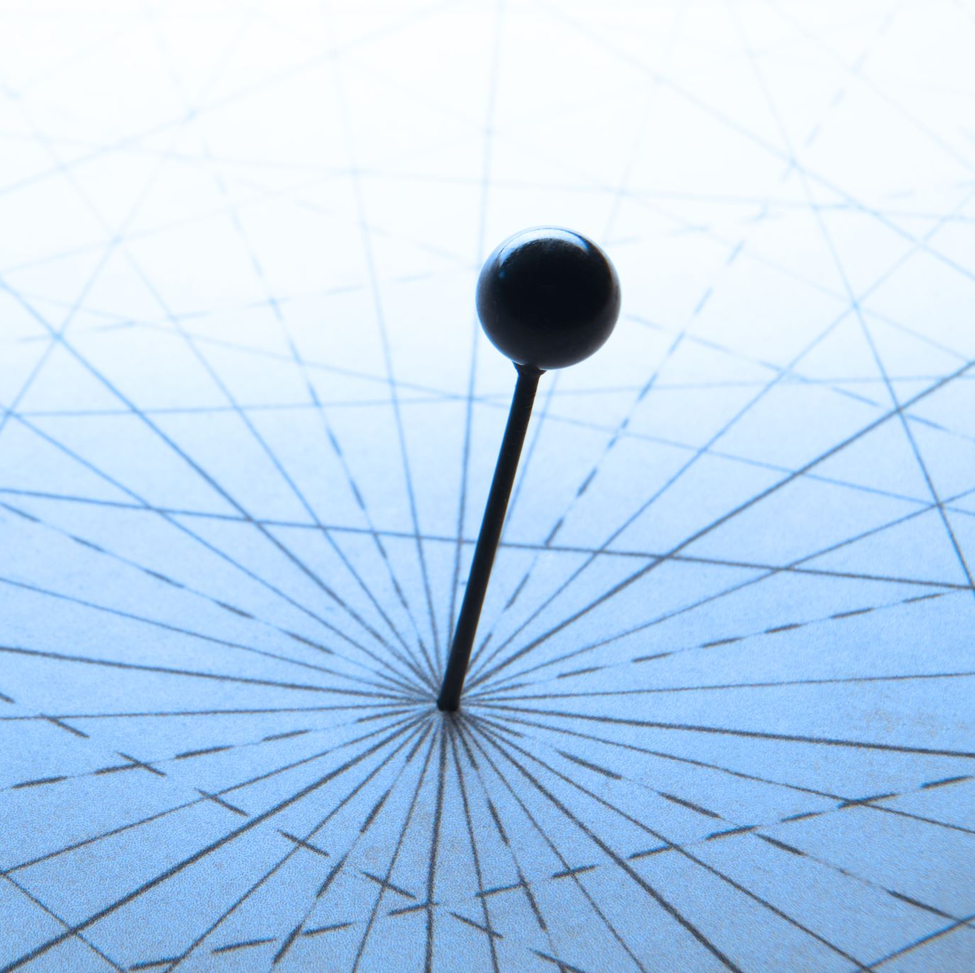
Approximate Distance Oracle
Kartik Anant Kulkarni
Siddharth Garg
Goural Dureja

Slide 2
Acknowledgement
We are extremely grateful to our professor, Prof. Surender Baswana, for his unwavering support,
expert guidance, and invaluable suggestions throughout the project. His insights played a key
role in refining our approach and in the development of our algorithms. In particular, the hints
provided during discussions about 3-approximate distance oracles and advice on extending these
ideas to a 5-approximate variant were crucial in enabling us to generalize the method to a (2k−1)-
approximate oracle. We would also like to emphasize that, aside from some initial background
reading on implementation techniques, no external assistance was used in the development of this
project. Overall, this experience has been highly educational, offering us a practical insight into
the challenges and problem-solving required in algorithm design and evaluation—mirroring the
real-world complexities faced by researchers in the field.

Slide 3

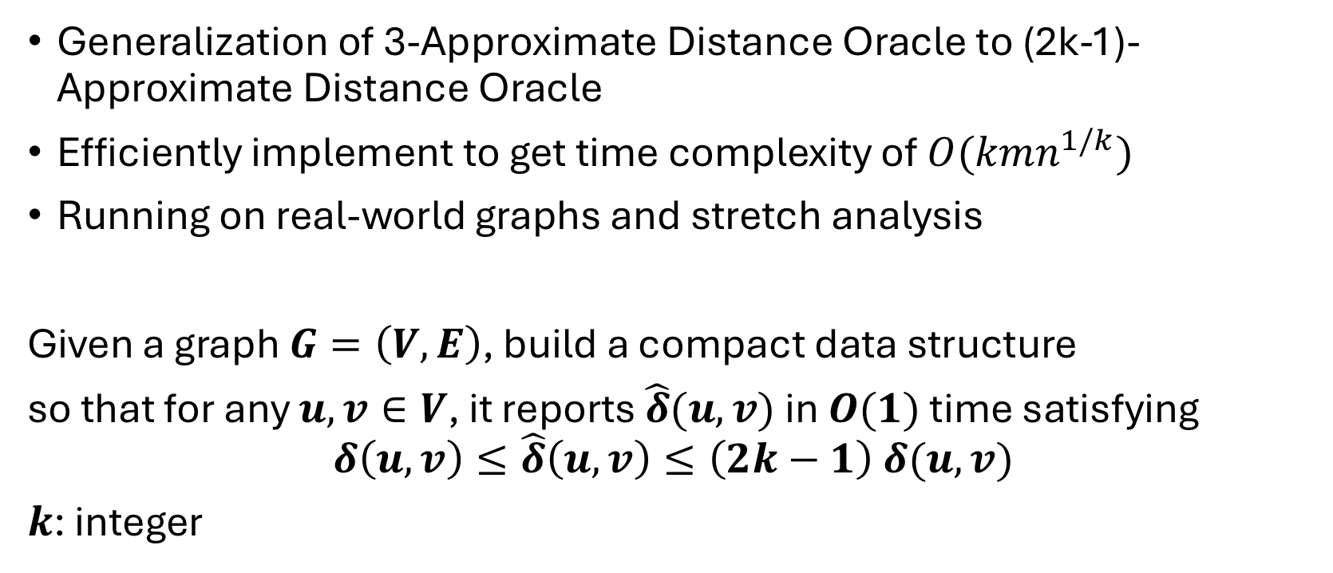
PROBLEM INTRODUCTION
Generalization of 3-Approximate Distance Oracle to (2k-1)-Approximate Distance Oracle
Efficiently implement to get time complexity of $O(kmn^{1/k})$
Running on real-world graphs and stretch analysis
Given a graph $G=\left(V,E\right)$, build a compact data structure
so that for any $u,v∈V$, it reports $\hat{δ}(u,v)$ in $O(1)$ time satisfying
$$δ\left(u,v\right)≤\hat{δ}\left(u,v\right)≤\left(2k−1\right) δ(u,v)$$
$k$: integer

Slide 4
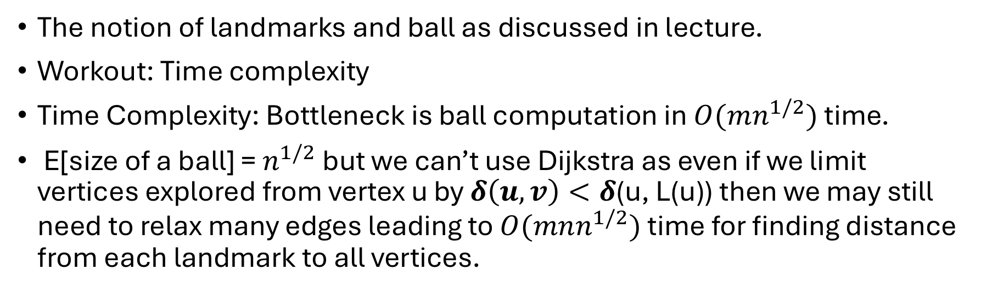
3-Approximate Distance Oracle
The notion of landmarks and ball as discussed in lecture.
Workout: Time complexity
Time Complexity: Bottleneck is ball computation in $O(mn^{1/2})$ time.
E[size of a ball] = $n^{1/2}$ but we can’t use Dijkstra as even if we limit vertices explored from vertex u by $δ\left(u, v\right)<δ$(u, L(u)) then we may still need to relax many edges leading to $O(mnn^{1/2})$ time for finding distance from each landmark to all vertices.
Edges to other vertices relaxed

Slide 5

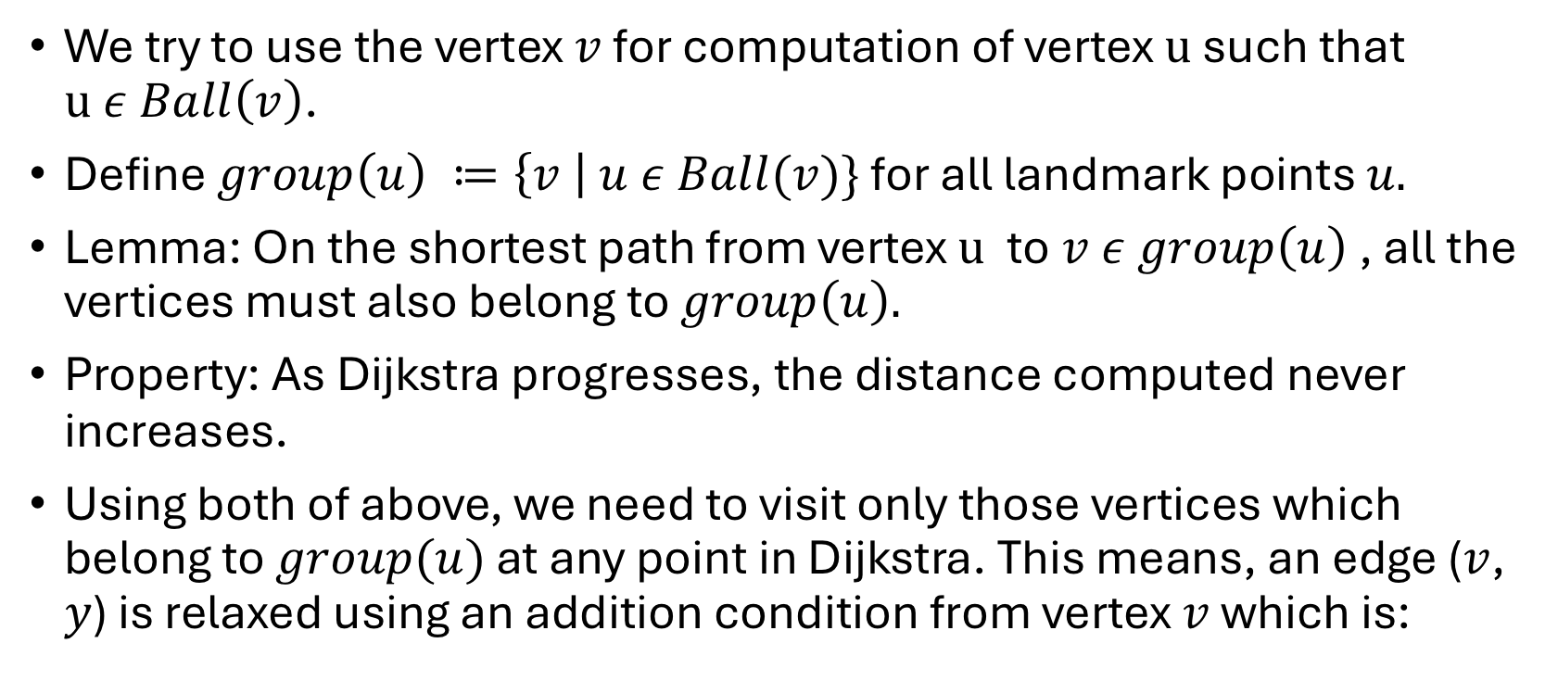
We try to use the vertex $v$ for computation of vertex $u$ such that $u ε Ball\left(v\right)$.
Define $group\left(u\right) ≔\left\{v \right| u ε Ball(v)\}$ for all landmark points $u.$
Lemma: On the shortest path from vertex $u$ to$v ε group\left(u\right)$, all the vertices must also belong to $group\left(u\right).$
Property: As Dijkstra progresses, the distance computed never increases.
Using both of above, we need to visit only those vertices which belong to $group(u)$ at any point in Dijkstra. This means, an edge ($v$, $y$) is relaxed using an addition condition from vertex $v$ which is:
$\left(d(u, v\right)+weight\left(v, y\right)< δ(y, L(y))$)

Slide 6
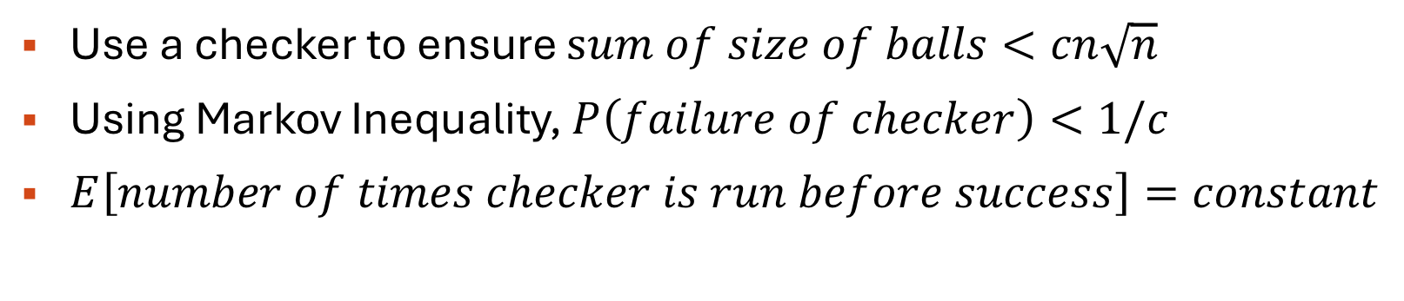

Bound on space utilized
Since, the space utilized may blowup even if some balls are quite large and some balls are still small. So, we use sum of sizes of balls as an indicator of space utilized instead of individual ball size.
$$E\left[sum of sizes of ball\right]=n√n$$
Use a checker to ensure $sum of size of balls<cn\sqrt{n}$
Using Markov Inequality, $P\left(failure of checker\right)<1/c$
$E\left[number of times checker is run before success\right]=constant$

Slide 7
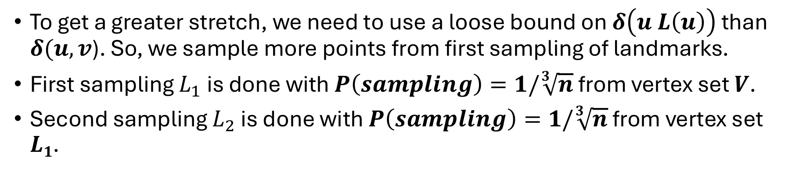
Generalization of k = 2 to k = 3
To get a greater stretch, we need to use a loose bound on $δ\left(u L\left(u\right)\right)$ than $δ(u, v$). So, we sample more points from first sampling of landmarks.
First sampling $L_{1}$ is done with $P\left(sampling\right)=1/\sqrt[3]{n}$ from vertex set $V$.
Second sampling $L_{2}$ is done with $P\left(sampling\right)=1/\sqrt[3]{n}$ from vertex set $L1$.
…........
Second level of landmarks L₂
…......
First level of landmarks L₁
…...

Slide 8
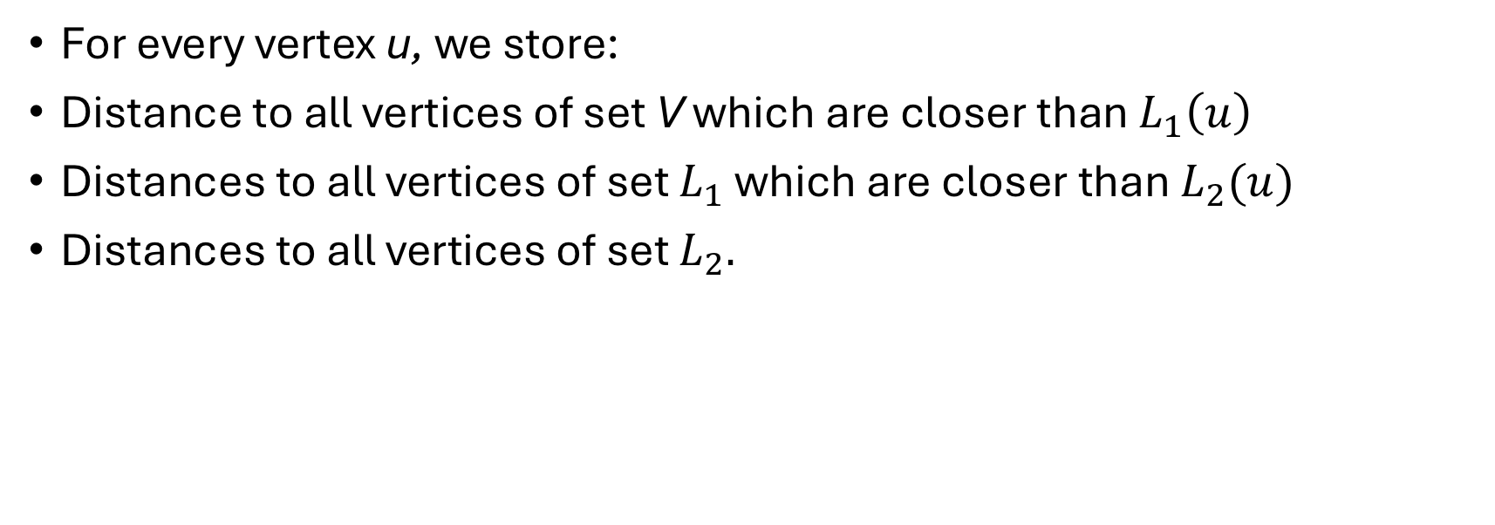
Distance Information stored
For every vertex u, we store:
Distance to all vertices of set V which are closer than $L_{1}\left(u\right)$
Distances to all vertices of set $L_{1}$ which are closer than $L_{2}(u)$
Distances to all vertices of set $L_{2}.$

Slide 9
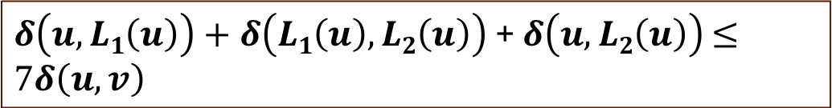
Justification of stretch 5
We get a stretch of 7 if we use an intermediate landmark point for query processing.
$δ\left(u, L1\left(u\right)\right)+δ\left(L1\left(u\right), L2\left(u\right)\right)$ + $δ\left(u, L2\left(u\right)\right)$ $≤7δ\left(u, v\right)$
So, we must use vertex $L2\left(u\right) and u$ for query processing.
$δ\left(u, L2\left(u\right)\right)+δ\left(L2\left(u\right), u\right)$ $≤5δ\left(u, v\right)$

Slide 10
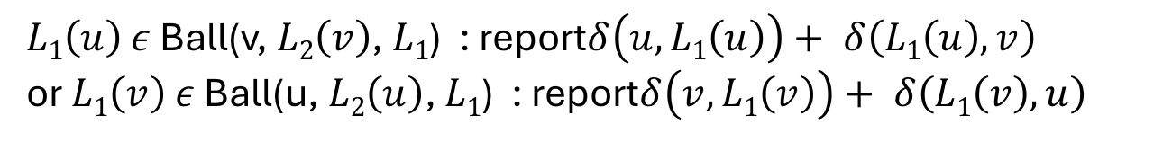
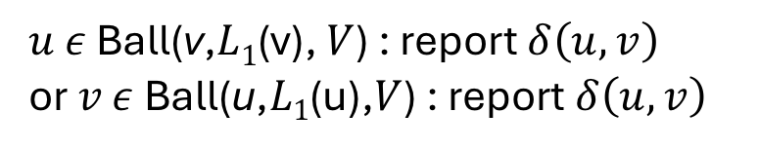
Query Processing
Assume a given vertex u from which we need to find approximate distance to vertex v.
$u$ $ε$ Ball(v,$L1$(v), $V$) : report $δ\left(u, v\right)$
or $v$ $ε$ Ball(u,$L1$(u),$V$) : report $δ\left(u, v\right)$
$L1\left(u\right)$ $ε$ Ball(v, $L2\left(v\right)$, $L1$) : report$δ\left(u, L1\left(u\right)\right)+ δ\left(L1\left(u\right), v\right)$
or $L1\left(v\right)$ $ε$ Ball(u, $L2\left(u\right)$, $L1$) : report$δ\left(v,L1\left(v\right)\right)+ δ\left(L1\left(v\right), u\right)$
else: report $δ\left(u, L2\left(u\right)\right)+ δ\left(L2\left(u\right), v\right)$

Slide 11
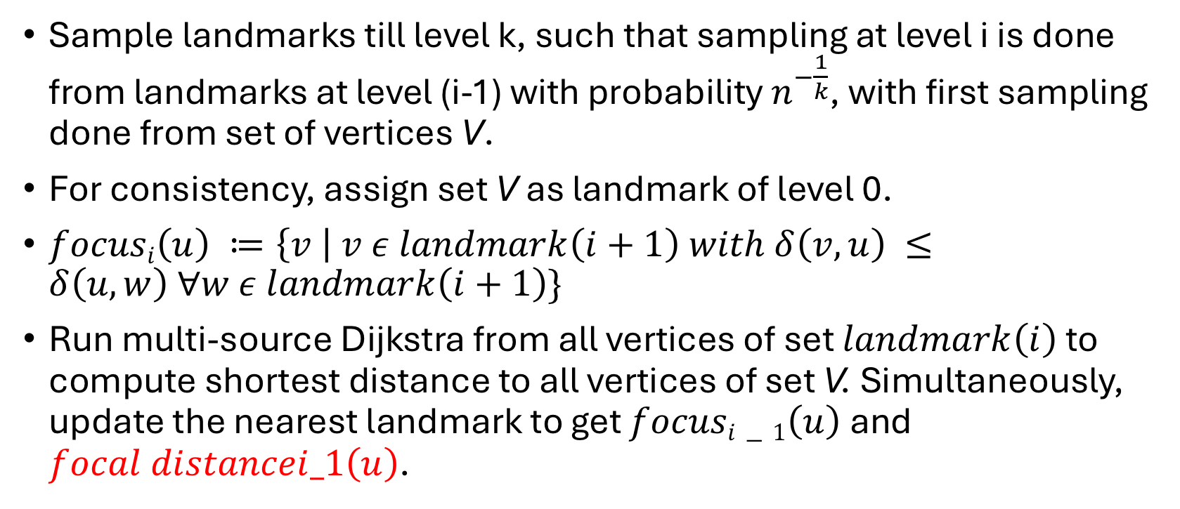
Generalization to (2k-1)-Approximate Distance Oracle
Sample landmarks till level k, such that sampling at level i is done from landmarks at level (i-1) with probability $n^{−\frac{1}{k}}$, with first sampling done from set of vertices V.
For consistency, assign set V as landmark of level 0.
$focusi\left(u\right) ≔\left\{v \right| v ε landmark\left(i+1\right) with δ\left(v, u\right) ≤δ\left(u, w\right) ∀w ε landmark\left(i+1\right)\}$
Run multi-source Dijkstra from all vertices of set $landmark\left(i\right)$ to compute shortest distance to all vertices of set V. Simultaneously, update the nearest landmark to get $focusi−1\left(u\right)$and $focal distancei_1\left(u\right)$.

Slide 12
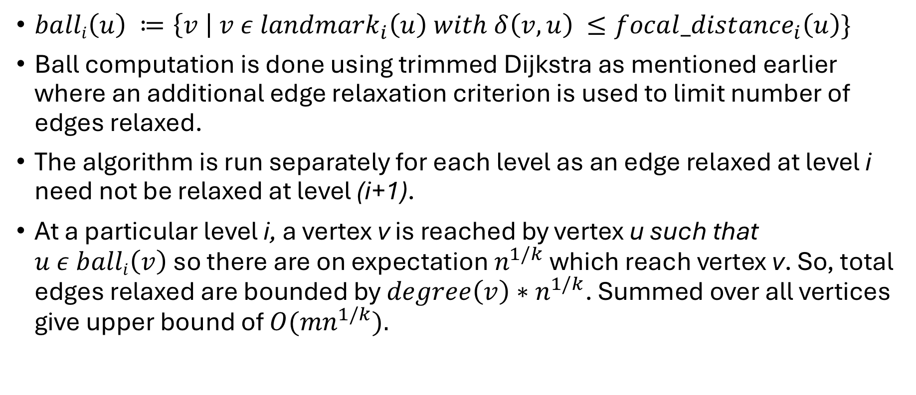
Efficient Ball Computation
$balli\left(u\right) ≔\left\{v \right| v ε {landmark}_{i}\left(u\right) with δ\left(v, u\right) ≤{focal_distance}_{i}\left(u\right)\}$
Ball computation is done using trimmed Dijkstra as mentioned earlier where an additional edge relaxation criterion is used to limit number of edges relaxed.
The algorithm is run separately for each level as an edge relaxed at level i need not be relaxed at level (i+1).
At a particular level i, a vertex v is reached by vertex u such that $u ε balli\left(v\right)$so there are on expectation $n^{1/k}$ which reach vertex v. So, total edges relaxed are bounded by $degree\left(v\right)∗n^{1/k}$. Summed over all vertices give upper bound of ${O(mn}^{1/k}).$

Slide 13
The level-wise ball stored needs to be stored in a hash table and there is no need to store level-wise ball as information of presence of level i pivot of u is present in ball of v.
We achieve the same using FPH which is a C++ implemented perfect dynamic hashing. This library handles false positives allowing O(1) worst case query time and accurate absence of a particular point in ball.

Slide 14
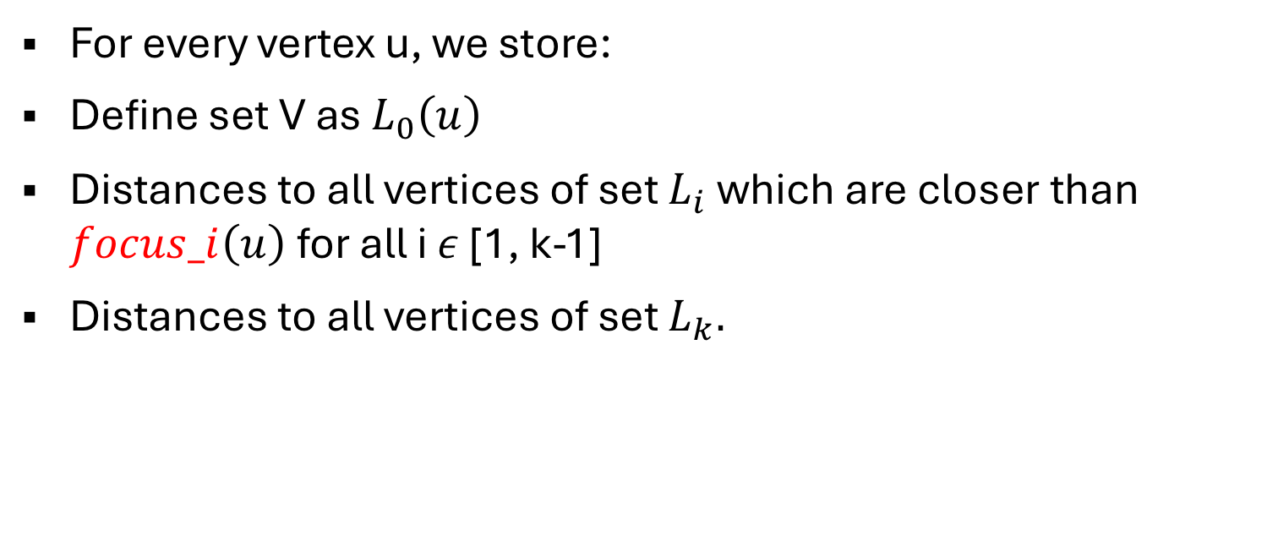
Distance Information Stored
For every vertex u, we store:
Define set V as $L_{0}\left(u\right)$
Distances to all vertices of set $L_{i}$ which are closer than $focus_i\left(u\right)$for all i $ε$ [1, k-1]
Distances to all vertices of set $L_{k}.$

Slide 15
Justification of stretch
Induction: Addition of level i of landmarks to level (i-1) increases the stretch from (2i-1) to (2i+1).
Adding level of landmark add 2 to the stretch.
Base Case: Extension of 3-Approximate Distance Oracle to 5-Approximate Distance Oracle.

Slide 16
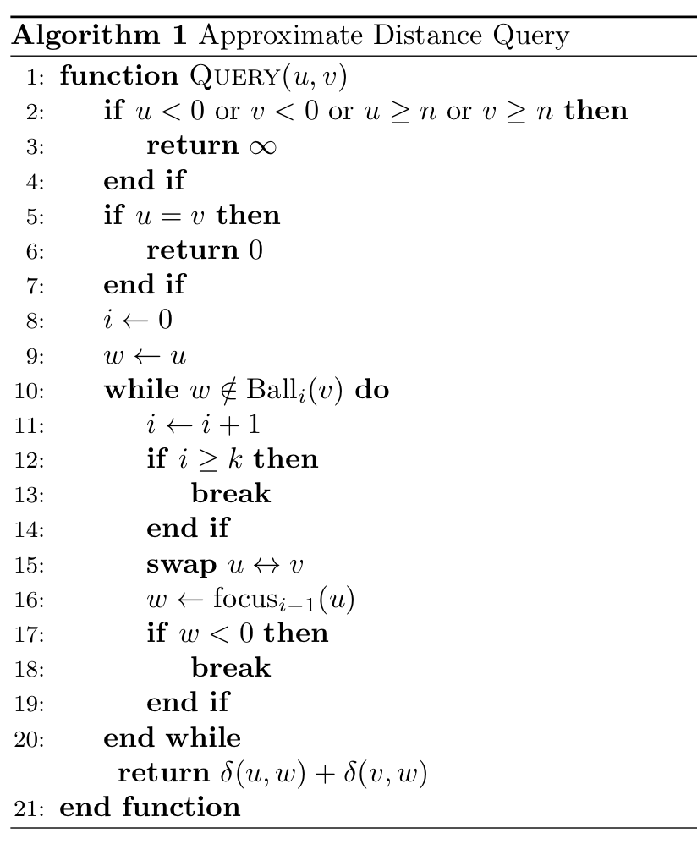
Query Processing

Slide 17
VISUALISATION

Slide 18
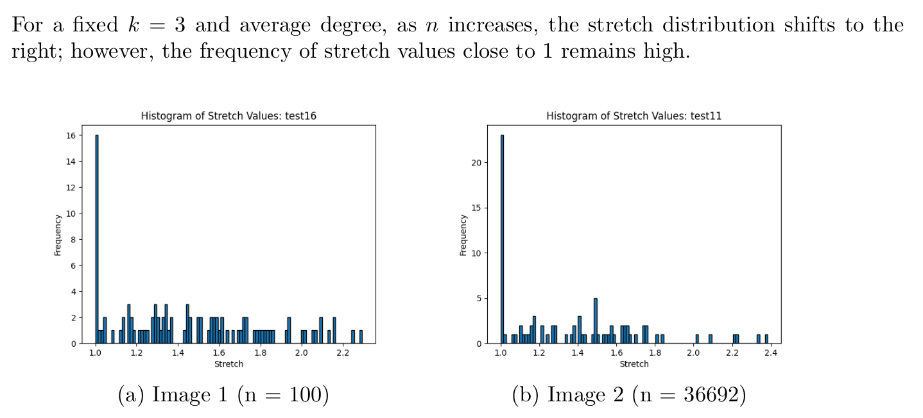
Graphs

Slide 19
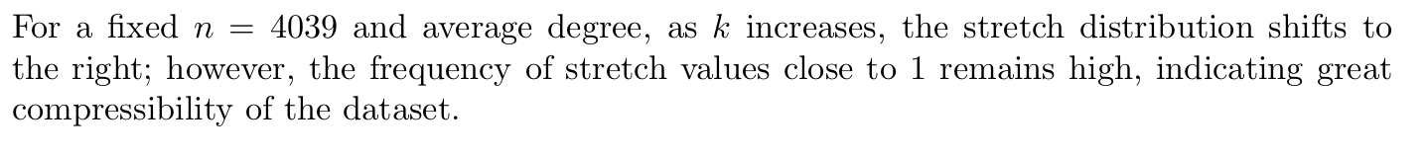
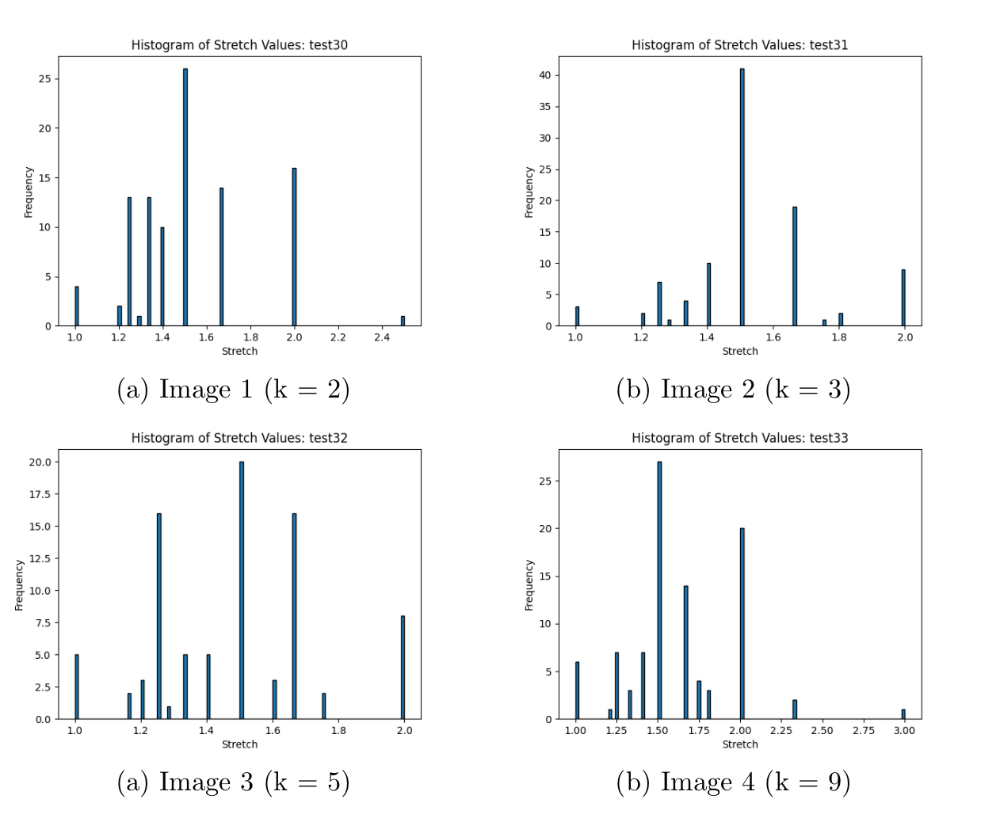
GRAPHS

Slide 20
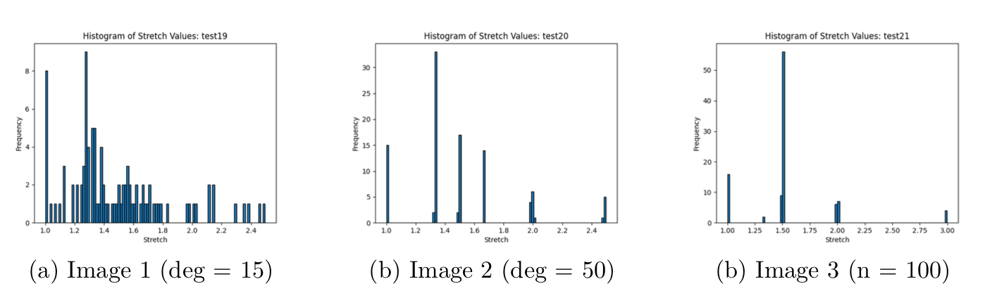
Graphs

Slide 21
Future Improvements
Parallelization for Fast Pre-Processing: One promising direction is to parallelize the preprocessing phase. Since computing local distance information and forming the clusters or ball sets for each vertex can be done independently, distributing this work across multiple processors or cores can significantly reduce the overall runtime.
Dynamic Updates: Enhancing the data structure to support dynamic updates—such as insertions, deletions, or weight modifications—without requiring a full re-preprocessing of the graph would make the oracle more practical for real-time or evolving networks.

