Slide 1
IMAGE-CAPTION BOT
PRESENTED BY:
KARTIK (18103051)

Slide 2
OVERVIEW
IMAGE CAPTIONING IS THE PROCESS OF GENERATING TEXTUAL DESCRIPTION OF AN IMAGE.
IT USES BOTH NATURAL-LANGUAGE-PROCESSING AND COMPUTER-VISION TO GENERATE THE CAPTIONS.

Slide 3
DEEP LEARNING
DEEP LEARNING IS A SUBFIELD OF MACHINE LEARNING CONCERNED WITH ALGORITHMS INSPIRED BY THE STRUCTURE AND FUNCTION OF THE BRAIN CALLED ARTIFICIAL NEURAL NETWORKS.
IN-SHORT, IT IS NEURAL NETWORKS WITH MULTIPLE LAYERS.
DEEP LEARNING TACKLES THE PROBLEM OF IMAGE CAPTIONING QUITE WELL THAN ANY OTHER PARADIGMS OF PROGRAMMING.

Slide 4
PLATFORMS & TOOLS
KAGGLE PLATFORM
GOOGLE CLOUD CONSOLE PLATFORM
KERAS WITH TENSORFLOW AS BACKEND
PRE-TRAINED VGG MODEL BY OXFORD
VIM TEXT-EDITOR

Slide 5
DATASET DESCRIPTION
A GOOD DATASET TO USE WHEN GETTING STARTED WITH IMAGE CAPTIONING IS THE FLICKR8K DATASET.
FLICKR8K_DATASET.ZIP (1 GIGABYTE) AN ARCHIVE OF ALL PHOTOGRAPHS (6000+2000).
FLICKR8K_TEXT.ZIP (2.2 MEGABYTES) AN ARCHIVE OF ALL TEXT DESCRIPTIONS FOR PHOTOGRAPHS(5 CAPTIONS PER IMAGE).
THE REASON OF USING FLICKR8K DATASET IS BECAUSE IT IS REALISTIC AND RELATIVELY SMALL TO BUILD MODELS ON YOUR WORKSTATION USING A CPU.

Slide 6
CONCEPTS
CNN ( CONVOLUTION NEURAL NETWORK ) USED IN VGG.
LONG SHORT-TERM MEMORY (LSTM) RECURRENT NEURAL NETWORK.
TEXT-PROCESSING.
BLEU SCORE FOR TEXTUAL EVALUATION.
LINUX AND COMMAND LINE
GOOGLE CLOUD CONSOLE USAGE

Slide 7
BRIEF APPROACH
Words
(pre-processed)
RNN
(LSTM)
Merger Layer
Image features
(Pre-processed)

Slide 8
VGG (VISUAL GEOMETRY GROUP)
VERY DEEP CONVOLUTIONAL NETWORKS FOR LARGE-SCALE VISUAL RECOGNITION.
CONVOLUTIONAL NETWORKS (CONVNETS) CURRENTLY SET THE STATE OF THE ART IN VISUAL RECOGNITION.
THEY CREATED 16 AND 19 LAYERED MODELS TO WIN THE IMAGENET COMPETITION IN 2014.
WE HAVE USED THE 16 LAYERED VGG MODEL IN OUR PROJECT TO EXTRACT THE FEATURES OF IMAGES.

Slide 9
CONVOLUTIONAL NEURAL NETWORK (CNN)
CNN ARE VERY SIMILAR TO ORDINARY NEURAL NETWORKS.
CONVNET ARCHITECTURES MAKE THE EXPLICIT ASSUMPTION THAT THE INPUTS ARE IMAGES, WHICH ALLOWS US TO ENCODE CERTAIN PROPERTIES INTO THE ARCHITECTURE.
CNNS OPERATE OVER VOLUMES.
IT HAS FILTERS, POOLING LAYERS BECAUSE OF THE ASSUMPTION THAT INPUT IS ALWAYS AN IMAGE.

Slide 10
RNN AND LSTM
RECURRENT NEURAL NETWORKS ARE THE STATE OF THE ART ALGORITHM FOR SEQUENTIAL DATA AND AMONG OTHERS USED BY APPLES SIRI AND GOOGLES VOICE SEARCH.
IT HAS AN INTERNAL MEMORY WHICH MAKES IT PERFECTLY SUITED FOR MACHINE LEARNING PROBLEMS THAT INVOLVE SEQUENTIAL DATA BECAUSE IT CAN REMEMBERS IT’S INPUT.
IN OUR MODEL, TEXT INPUT SEQUENCES WITH A PRE-DEFINED LENGTH (34 WORDS) WHICH ARE FED INTO AN EMBEDDING LAYER THAT USES A MASK TO IGNORE PADDED VALUES. THIS IS FOLLOWED BY AN LSTM LAYER WITH 256 MEMORY UNITS.

Slide 11
BLEU SCORE
BLEU, OR THE BILINGUAL EVALUATION UNDERSTUDY, IS A SCORE FOR COMPARING TRANSLATION OF TEXT TO ONE OR MORE REFERENCE TRANSLATIONS.
IN OUR MODEL THERE WERE MORE THAN ONE POSSIBLE CAPTIONS FOR AN IMAGE, SO, WE EVALUATE OUR MODEL USING BLEU SCORE.
A PERFECT MATCH RESULTS IN A SCORE OF 1.0, WHEREAS A PERFECT MISMATCH RESULTS IN A SCORE OF 0.0.
NLTK, PROVIDES AN IMPLEMENTATION OF THE BLEU SCORE.
WE HAVE USED CORPUS_BLUE FOR CALCULATING THE BLEU SCORE FOR MULTIPLE SENTENCES SUCH AS A PARAGRAPH OR A DOCUMENT.

Slide 12
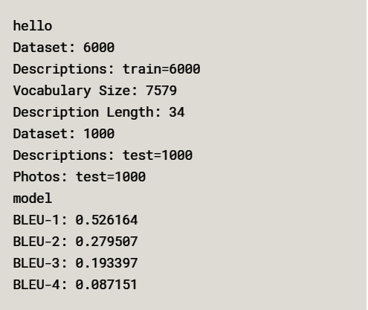
OUR EVALUATION

Slide 13
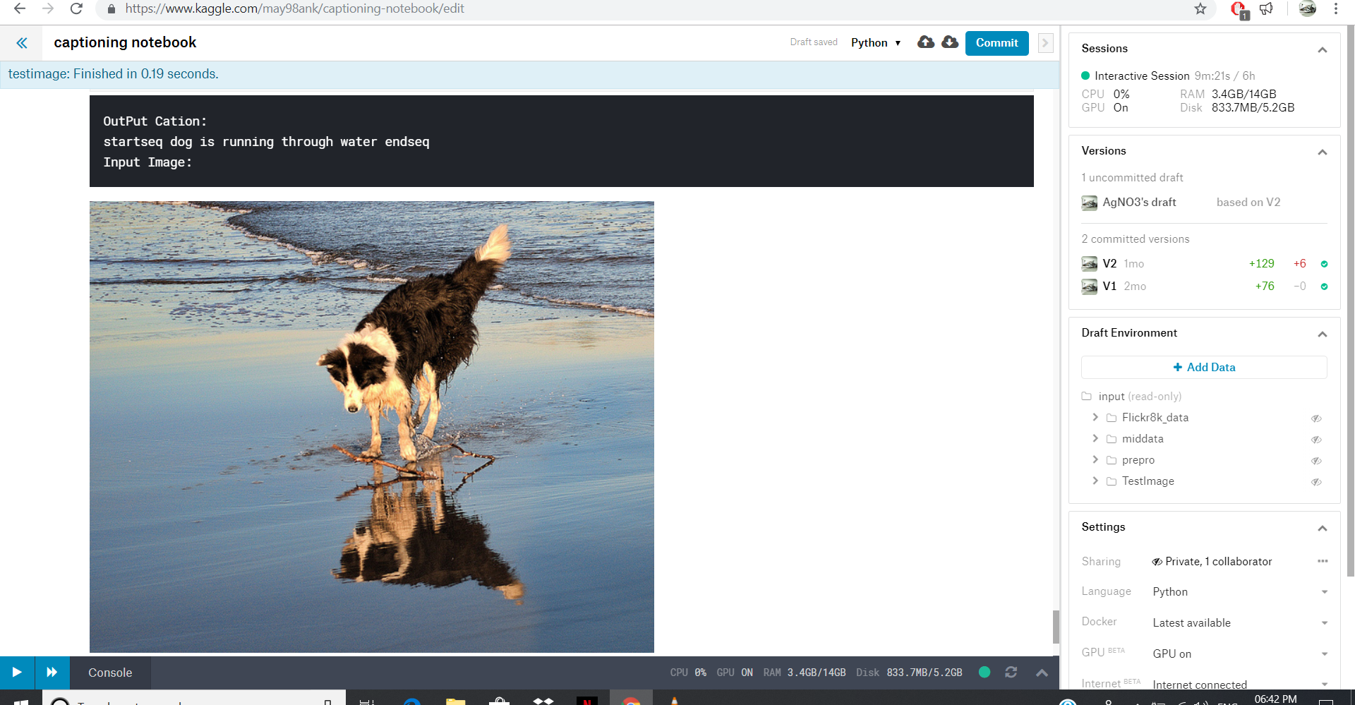
OUTPUT-1

Slide 14
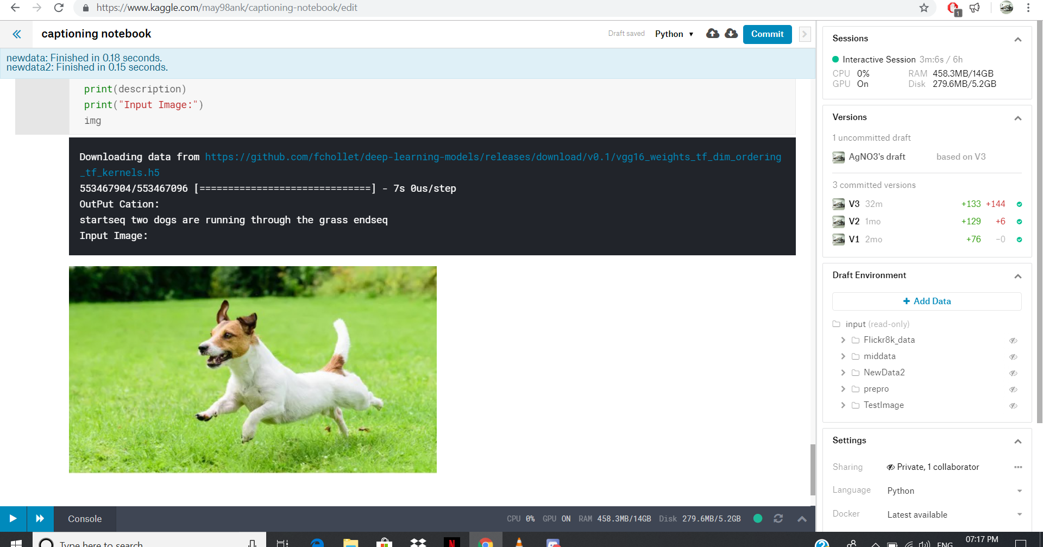
OUTPUT-2

Slide 15
CONCLUSION
HERE WE CAN CONCLUDE THAT (RNN + VGG) CAN GIVE GOOD RESULTS FOR IMAGE CAPTIONING EVEN AFTER TRAINING ON SMALL DATASETS LIKE FLICKR_8K.

Slide 16
Thank You
EveryOne

