Slide 1
CSE 3002- programming in java unit v Concurrency
Dr. R. Manikandan
Assistant professor (senior grade)
Vit bhopal university

Slide 2
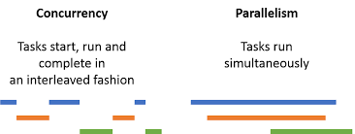
Concurrency : Introduction
Concurrency means multiple computations are happening at the same time. In other words, concurrency is the ability to run several programs or several parts of a program simultaneously.
Concurrency is everywhere in modern programming, whether we like it or not: Multiple computers in a network. Multiple applications running on one computer. Multiple processors in a computer (today, often multiple processor cores on a single chip).

Slide 3
Multitasking: Introduction
Process : In computing, a process is the instance of a computer program that is being executed.
Thread: A thread is a path of execution within a process (OR) A thread is a single sequence stream within in a process
A process can contain multiple threads. The primary difference is that threads within the same process run in a shared memory space, while processes run in separate memory spaces.
Multitasking is when one person handles more than one task at the same time.
Modern operating systems use preemptive multitasking to allocate CPU time to applications. There are two types of tasks (Process and Thread) that can be scheduled for execution.

Slide 4
Multithreading: Introduction
Multithreading is a Java feature that allows concurrent execution of two or more parts of a program for maximum utilization of CPU.
Each part of such program is called a thread. So, threads are light-weight processes within a process.
A thread is a lightweight sub-process, the smallest unit of processing.
Multiprocessing and Multithreading, both are used to achieve Multitasking.

Slide 5
Multithreading: Introduction
Multitasking is a process of executing multiple tasks simultaneously. We use multitasking to utilize the CPU. Multitasking can be achieved in two ways:
Process-based Multitasking (Multiprocessing)
Thread-based Multitasking (Multithreading)
1) Process-based Multitasking (Multiprocessing)
Each process has an address in memory. In other words, each process allocates a separate memory area.
A process is heavyweight.
Cost of communication between the process is high.
Switching from one process to another requires some time for saving and loading registers, memory maps, updating lists, etc.
2) Thread-based Multitasking (Multithreading)
Threads share the same address space.
A thread is lightweight.
Cost of communication between the thread is low.

Slide 6
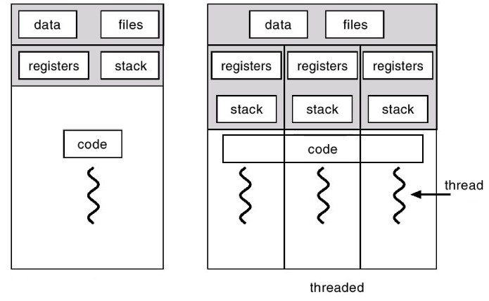
Process Vs. Thread

Slide 7
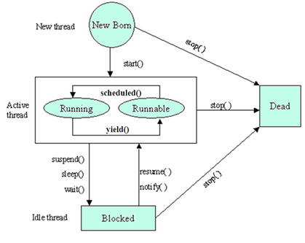
Life Cycle of a Thread
A thread goes through various stages in its life cycle.
For example, a thread is born, started, runs, and then dies. The following diagram shows the complete life cycle of a thread.

Slide 8
Life Cycle of a Thread
New − A new thread begins its life cycle in the new state. It remains in this state until the program starts the thread. It is also referred to as a born thread.
Runnable − After a newly born thread is started, the thread becomes runnable. The runnable means that the thread is ready for execution and is waiting for the availability of the processor.
Running – It means that the processor has given its time to the thread for its execution. The thread runs until it relinquishes control on its own or it is preempted by a higher priority thread.
Waiting − Sometimes, a thread transitions to the waiting state while the thread waits for another thread to perform a task. A thread transitions back to the runnable state only when another thread signals the waiting thread to continue executing.
Terminated (Dead) − A runnable thread enters the terminated state when it completes its task or otherwise terminates.

Slide 9
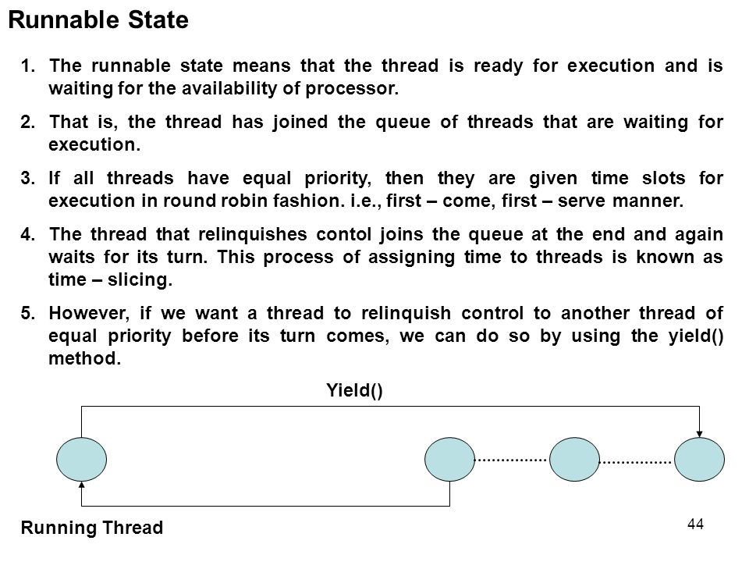
Life Cycle of a Thread

Slide 10
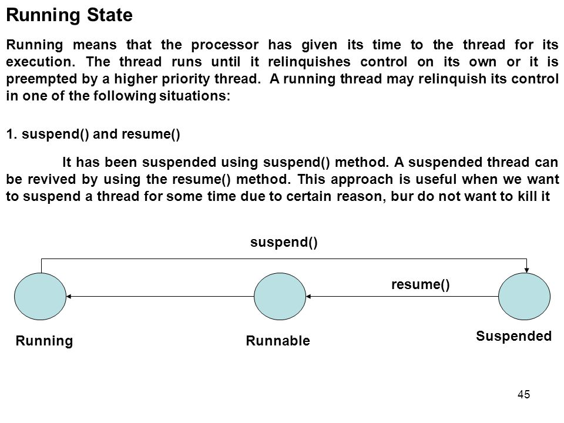
Life Cycle of a Thread

Slide 11
Creating a Threads in Java
Threads can be created by using two mechanisms : 1.Extending the Thread class 2. Implementing the Runnable Interface
Thread creation by extending the Thread class
We create a class that extends the java.lang.Thread class. This class overrides the run() method available in the Thread class.
A thread begins its life inside run() method. We create an object of our new class and call start() method to start the execution of a thread. Start() invokes the run() method on the Thread object.
Example: Multithread1.java
Thread creation by implementing the Runnable Interface
We create a new class which implements java.lang.Runnable interface and override run() method. Then we instantiate a Thread object and call start() method on this object.
Example: Multithread2.java

Slide 12
Creating a Threads in Java
Thread Class vs. Runnable Interface
If we extend the Thread class, our class cannot extend any other class because Java doesn’t support multiple inheritance. But, if we implement the Runnable interface, our class can still extend other base classes.
We can achieve basic functionality of a thread by extending Thread class because it provides some inbuilt methods like yield(), interrupt() etc. that are not available in Runnable interface.
Example: ThreadTest.java, TestSleepMethod1.java, ThreadMethods.java

Slide 13
Executor Service
To create threads in Java by extending the Thread class or implementing the Runnable interface.
While it is easy to create one or two threads and run them
It becomes a problem when your application requires creating 20 or 30 threads for running tasks concurrently.
java.util.concurrent.ExecutorService
The Behavior of an ExecutorService
A cached thread pool ExecutorService:
Creates new threads as needed
Reuses its threads (Its threads do not die after finishing their task.)
Terminates threads that have been idle for 60 seconds

Slide 14
Executor Service: Creating and managing threads
Thread Creation: It provides various methods for creating threads, more specifically a pool of threads, that your application can use to run tasks concurrently.
Thread Management: It manages the life cycle of the threads in the thread pool. You don’t need to worry about whether the threads in the thread pool are active or busy or dead before submitting a task for execution.
Task submission and execution: Executors framework provides methods for submitting tasks for execution in the thread pool, and also gives you the power to decide when the tasks will be executed.
For example, You can submit a task to be executed now or schedule them to be executed later or make them execute periodically.

Slide 15
Executor Service
Java Concurrency API defines the following three executor interfaces:
Executor - A simple interface that contains a method called execute() to launch a task specified by a Runnable object.
ExecutorService - A sub-interface of Executor that adds functionality to manage the lifecycle of the tasks.
It also provides a submit() method whose overloaded versions can accept a Runnable as well as a Callable object.
Callable objects are similar to Runnable except that the task specified by a Callable object can also return a value.
ScheduledExecutorService - A sub-interface of ExecutorService. It adds functionality to schedule the execution of the tasks.
Example: ExecutorsExample.java

Slide 16
Executor Service
Other types of ExecutorService implementations are available:
int cpuCount = Runtime.getRuntime().availableProcessors();
ExecutorService es = Executors.newFixedThreadPool(cpuCout);
A fixed thread pool ExecutorService:
Contains a fixed number of threads
Reuses its threads (Its threads do not die after finishing their task.)
Queues up work until a thread is available
Could be used to avoid over working a system with CPU-intensive tasks

Slide 17
Executor Service: Shutting down
Shutting down an ExecutorService is important because its threads are nondaemon threads and will keep your JVM from shutting down.
shutdown() - when shutdown() method is called on an executor service, it stops accepting new tasks, waits for previously submitted tasks to execute, and then terminates the executor.
shutdownNow() - this method interrupts the running task and shuts down the executor immediately.
System.out.println("Shutting down the executor"); executorService.shutdown();

Slide 18
Executor Service: Multiple Thread
Note:
In a fixed thread-pool, the executor service makes sure that the pool always has the specified number of threads running.
If any thread dies due to some reason, it is replaced by a new thread immediately.
When a new task is submitted, the executor service picks one of the available threads from the pool and executes the task on that thread.
If we submit more tasks than the available number of threads and all the threads are currently busy executing the existing tasks, then the new tasks will wait for their turn in a queue.
Example: ExecutorsExample1.java

Slide 19
java.util.concurrent.Callable
A Callable is similar to Runnable except that it can return a result using generics and throw a checked exception.
Callable interface has a single method call() which is meant to contain the code that is executed by a thread.
Example:
Callable<String> callable = new Callable<String>() {
public String call() throws Exception{
// Perform some computation
Thread.sleep(2000);
return "Return some result";
} };
Note that with Callable, you don’t need to surround Thread.sleep() by a try/catch block, because unlike Runnable, a Callable can throw a checked exception.

Slide 20
Example Callable Task
public class ExampleCallable implements Callable {
private final String name;
private final int len;
private int sum = 0;
public ExampleCallable(String name, int len) {
this.name = name;
this.len = len;
}
@Override
public String call() throws Exception {
for (int i = 0; i < len; i++) {
System.out.println(name + ":" + i);
sum += i;
}
return "sum: " + sum;
}
}
Return a String from this task: the sum of the series

Slide 21
java.util.concurrent.Future
The Future interface is used to obtain the results from a Callable’s call() method.
Use future.get() method to retrieve the result of the future.
Future<V> future = es.submit(callable);
//submit many callables
try {
V result = future.get();
} catch (ExecutionException|InterruptedException ex) {
}
ExecutorService controls when the work is done.
Gets the result of the Callable’s call method (blocks if needed).
If the Callable threw an Exception
Notes:
Waiting on a Future
Because the call to Future.get() will block, you must do one of the following:
Submit all your work to the ExecutorService before calling any Future.get() methods.
Be prepared to wait for that Future to obtain the result.
Use a non-blocking method such as Future.isDone() before calling Future.get() or use Future.get(long timeout, TimeUnit unit), which will throw a TimeoutException if the result is not available within a given duration.

Slide 22
Example
public static void main(String[] args) {
ExecutorService es = Executors.newFixedThreadPool(4);
Future<String> f1 = es.submit(new ExampleCallable("one",10));
Future<String> f2 = es.submit(new ExampleCallable("two",20));
try {
es.shutdown();
es.awaitTermination(5, TimeUnit.SECONDS);
String result1 = f1.get();
System.out.println("Result of one: " + result1);
String result2 = f2.get();
System.out.println("Result of two: " + result2);
} catch (ExecutionException | InterruptedException ex) {
System.out.println("Exception: " + ex);
}
}
Wait 5 seconds for the tasks to complete
Get the results of tasks f1 and f2
Example: CallableExample.java

Slide 23
Threading Concerns
Thread Safety
Classes should continue to behave correctly when accessed from multiple threads.
Thread safety is really about the ability of a class to perform the same way when it is accessed by one thread, or multiple threads.
Fundamentally, a class performs actions and holds data. A class is thread safe if the actions the class performs and the data stored are consistent when used accessed by multiple threads.
Notes:
Thread safety is really about the ability of a class to perform the same way when it is accessed by one thread, or multiple threads. Fundamentally, a class performs actions and holds data. Using this definition of thread safety – a class is thread safe if the actions the class performs and the data stored are consistent when used accessed by multiple threads.
Deadlock is a situation where thread A is blocked waiting for a condition set by thread B, but thread B is also blocked waiting for a condition set by thread A.
Livelock is a condition where a thread is not blocked, but cannot move forward because an operation it continually retries fails. Livelock is related to another condition, starvation, where a thread attempts to access a resource that it can never access – likely because other higher priority threads are continually accessing the resource.

Slide 24
Threading Concerns
Performance: Deadlock and livelock
Threads typically interact with other threads. As more threads are introduced into an application, the possibility exists that threads will reach a point where they cannot continue.
Deadlock is a situation where thread A is blocked waiting for a condition set by thread B, but thread B is also blocked waiting for a condition set by thread A.
Livelock is a condition where a thread is not blocked, but cannot move forward because an operation it continually retries fails.
Livelock is related to another condition, starvation, where a thread attempts to access a resource that it can never access – likely because other higher priority threads are continually accessing the resource.
Notes:
Thread safety is really about the ability of a class to perform the same way when it is accessed by one thread, or multiple threads. Fundamentally, a class performs actions and holds data. Using this definition of thread safety – a class is thread safe if the actions the class performs and the data stored are consistent when used accessed by multiple threads.
Deadlock is a situation where thread A is blocked waiting for a condition set by thread B, but thread B is also blocked waiting for a condition set by thread A.
Livelock is a condition where a thread is not blocked, but cannot move forward because an operation it continually retries fails. Livelock is related to another condition, starvation, where a thread attempts to access a resource that it can never access – likely because other higher priority threads are continually accessing the resource.

Slide 25
Problems with Shared Data
Static and instance fields are potentially shared by threads.
Some variable types are never shared. The following types are always thread-safe:
Local variables
Method parameters
Exception handler parameters
Immutable data
Any shared data that is immutable, such as String objects or final fields, are thread-safe because they can only be read and not written.
Notes:
Thread safety is really about the ability of a class to perform the same way when it is accessed by one thread, or multiple threads. Fundamentally, a class performs actions and holds data. Using this definition of thread safety – a class is thread safe if the actions the class performs and the data stored are consistent when used accessed by multiple threads.
Deadlock is a situation where thread A is blocked waiting for a condition set by thread B, but thread B is also blocked waiting for a condition set by thread A.
Livelock is a condition where a thread is not blocked, but cannot move forward because an operation it continually retries fails. Livelock is related to another condition, starvation, where a thread attempts to access a resource that it can never access – likely because other higher priority threads are continually accessing the resource.

Slide 26
Problems with Shared Data
Multithreading is a very powerful tool which enables us to better utilize the system’s resources, but we need to take special care while reading and writing data shared by multiple threads.
Two types of problems arise when multiple threads try to read and write shared data concurrently -
Thread interference errors
When multiple threads try to read and write a shared variable concurrently, and these read and write operations overlap in execution, then the final outcome depends on the order in which the reads and writes take place, which is unpredictable. This phenomenon is called Race condition.
Thread interference errors can be avoided by synchronizing access to shared variables.
Synchronized code blocks are used to ensure that data that is not thread-safe will not be accessed concurrently by multiple threads.
Notes:
Thread safety is really about the ability of a class to perform the same way when it is accessed by one thread, or multiple threads. Fundamentally, a class performs actions and holds data. Using this definition of thread safety – a class is thread safe if the actions the class performs and the data stored are consistent when used accessed by multiple threads.
Deadlock is a situation where thread A is blocked waiting for a condition set by thread B, but thread B is also blocked waiting for a condition set by thread A.
Livelock is a condition where a thread is not blocked, but cannot move forward because an operation it continually retries fails. Livelock is related to another condition, starvation, where a thread attempts to access a resource that it can never access – likely because other higher priority threads are continually accessing the resource.

Slide 27
synchronized Methods
public class SynchronizedCounter {
private static int i = 0;
public synchronized void increment(){
i++;
}
public synchronized void decrement(){
i--;
}
public synchronized int getValue(){
return i;
}
}
Notes:
Synchronized Method Behavior
In the example in the slide, you can call only one method at a time in a SynchronizedCounter object because all its methods are synchronized. In this example, the synchronization is per SynchronizedCounter. Two SynchronizedCounter instances could be used concurrently.
If the methods were not synchronized, calling decrement while getValue is accessed might result in unpredictable behavior.

Slide 28
synchronized Blocks
public void run(){
for (int i = 0; i < countSize; i++){
synchronized(this){
count.increment();
System.out.println(threadName
+ " Current Count: " + count.getValue());
}
} }
Synchronization in multithreaded applications ensures reliable behavior. Because synchronized blocks and methods are used to restrict a section of code to a single thread, you are potentially creating performance bottlenecks. synchronized blocks can be used in place of synchronized methods to reduce the number of lines that are exclusive to a single thread.
Notes:
Synchronization Bottlenecks
Synchronization in multithreaded applications ensures reliable behavior. Because synchronized blocks and methods are used to restrict a section of code to a single thread, you are potentially creating performance bottlenecks. synchronized blocks can be used in place of synchronized methods to reduce the number of lines that are exclusive to a single thread.
Use synchronization as little as possible for performance, but as much as needed to guarantee reliability.

Slide 29
Problems with Shared Data
Memory Consistency Errors
Memory inconsistency errors occur when different threads have inconsistent views of the same data. This happens when one thread updates some shared data, but this update is not propagated to other threads, and they end up using the old data.
Volatile keyword is used to avoid memory consistency errors in multithreaded programs.
It tells the compiler to avoid doing any optimizations to the variable. If you mark a variable as volatile, the compiler won’t optimize or reorder instructions around that variable.
Notes:
Thread safety is really about the ability of a class to perform the same way when it is accessed by one thread, or multiple threads. Fundamentally, a class performs actions and holds data. Using this definition of thread safety – a class is thread safe if the actions the class performs and the data stored are consistent when used accessed by multiple threads.
Deadlock is a situation where thread A is blocked waiting for a condition set by thread B, but thread B is also blocked waiting for a condition set by thread A.
Livelock is a condition where a thread is not blocked, but cannot move forward because an operation it continually retries fails. Livelock is related to another condition, starvation, where a thread attempts to access a resource that it can never access – likely because other higher priority threads are continually accessing the resource.

Slide 30
java.util.concurrent Classes and Packages
The java.util.concurrent package contains a number of classes that help with your concurrent applications. Here are just a few examples.
java.util.concurrent.atomic package
Lock free thread-safe variables
CyclicBarrier
A class that blocks until a specified number of threads are waiting for the thread to complete.
Concurrency collections
Notes:
The use of synchronized code blocks can result in performance bottlenecks. Several components of the java.util.concurrent package provide alternatives to using synchronized code blocks.

