Slide 1
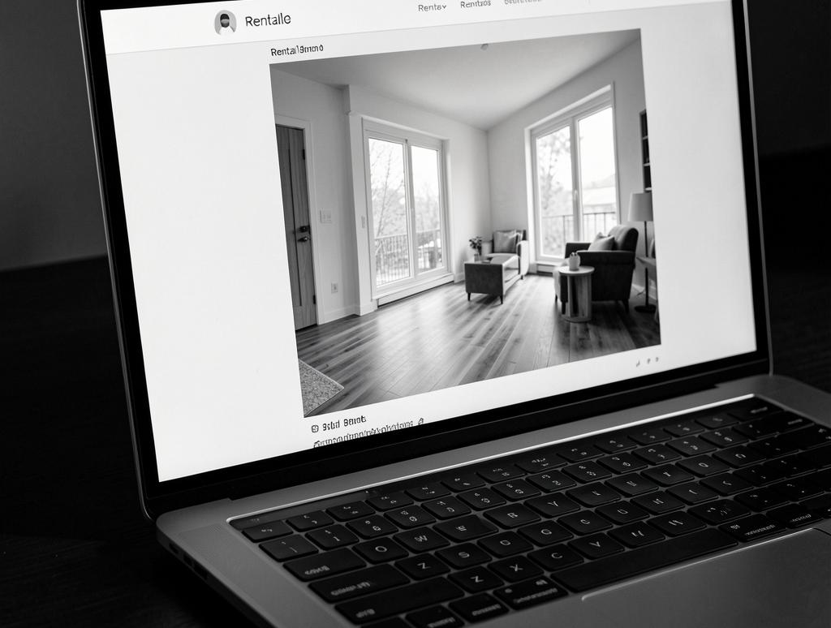
StayVynix

Slide 2

Introduction
StayVynix is a scalable short-term rental marketplace built with the MERN stack, designed to connect hosts and guests through a secure, intuitive web app.
Goal: Validate product-market fit and deliver a production-ready MVP within 3 months.

Slide 3

01
Project Overview

Slide 4
Concept & Vision
StayVynix combines listing management, booking, and payments into one platform.
Focus on user experience, host tools, and operational efficiency to differentiate from competitors.
Vision: Become the trusted local-first alternative for travelers and hosts.

Slide 5
Target Users
Primary: independent hosts and leisure travelers seeking flexible stays.
Secondary: property managers and business travelers requiring reliable listings.
Emphasis on trust, ease of use, and competitive fees to drive adoption.

Slide 6

Business Model
StayVynix monetizes via a commission on bookings and optional host subscription plans for premium tools.
Focus on scalable revenue streams: service fees, featured listings, and partnerships.
Drive profitability through user retention, optimized host economics, and targeted marketing.

Slide 7

01
Technical Architecture

Slide 8
MERN Stack
Frontend: React with component-driven design and client-side routing.
Backend: Node.js + Express providing RESTful APIs.
Database: MongoDB for flexible listing schemas and fast queries.

Slide 9
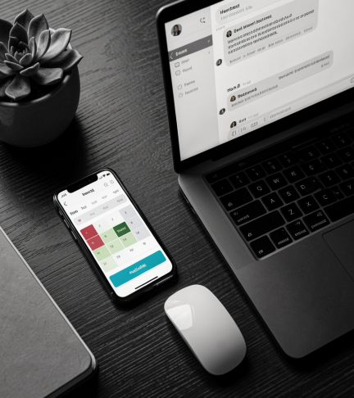
Key Features
Listing creation and management with calendar syncing and dynamic pricing.
Booking flow with availability checks, secure payments, and messaging between host/guest.
Admin dashboard, analytics, and review system to build trust.

Slide 10
Deployment & Security
Containerized deployment using Docker and CI/CD pipelines for rapid releases.
Use HTTPS, JWT-based auth, input validation, and role-based access control to protect data.
Monitor performance and incidents with logging and automated alerts.

Slide 11
Conclusions
StayVynix combines a proven MERN architecture with product features tailored to hosts and guests, enabling rapid MVP delivery.
Next steps: finalize MVP scope, implement core bookings/payments, and deploy a pilot to validate assumptions.

Slide 12
THANKS!
DOES ANYONE HAVE ANY QUESTIONS?
addyouremail@freepik.com
+91 620 421 838
yourcompany.com
Please keep this slide for attribution.

