Slide 1
Software Engineering – ESC501
- Prof. Poulami Dutta

Slide 2
Course Outcomes
ESC-501.1 | Identify a suitable life cycle model that meets specification, performance, maintenance and quality requirements for a given software development problem.
ESC-501.2 | Construct a design model using appropriate software engineering methodologies from the given specifications.
ESC-501.3 | Analyze software requirements through a productive working relationship with various stakeholders of the project to come up with a viable project plan to deliver the software product with optimized size, effort, time and cost using suitable estimation methods.
ESC-501.4 | Develop a working model to monitor the progress of the project and ensure that it provides quality assurance in the short and long run by utilizing relevant standards and suitable testing practices.
ESC-501.5 | Design software products/prototypes related to various real life/IT problems by relating the software architectural styles.

Slide 3
ILOs (Intended Learning Outcomes)
Identify the scope and necessity of software engineering.
Identify the causes of and solutions for software crisis.
Differentiate a piece of program from a software product.

Slide 4
What is software engineering?
Software engineering is composed of two words, software and engineering.
Software is defined as a collection of programs, procedures, rules, data and associated documentation. The s/w is developed keeping in mind certain h/w and operating system consideration commonly known as platform.
Engineering means systematic procedure to develop software.
Software engineering as an engineering branch is associated with the development of software product using well-defined scientific principles, methods and procedures. The outcome of software engineering is an efficient and reliable software product.
IEEE Definition: The application of a systematic, disciplined, quantifiable approach to the development, operation and maintenance of software.

Slide 5
Growth of Software
Technology Development Pattern
Engineering
Technology
Craft
Esoteric Past
Experience
Systematic Use of Past
Experience and Scientific Basis
Unorganized Use of
Past Experience
Art
Time

Slide 6
Why Study Software Engineering?
To acquire skills to develop large programs:
Exponential growth in complexity and difficulty level with size.
The ad hoc approach breaks down when size of software increases.
Ability to solve complex programming problems:
How to break large projects into smaller and manageable parts?
Learn techniques of:
specification, design, interface development, testing, project management, etc.
To acquire skills to be a better programmer:
Higher Productivity
Better Quality Programs

Slide 7
Software Quality
Portability: to be able to work in different operating system environments, in different machines, with other software products.
Usability: if different categories of users (i.e. both expert and novice users) can easily invoke the functions of the product, the software is said to be usable.
Reusability: if different modules of the product can easily be reused to develop new products, the software is said to be reusable.
Correctness: if different requirements as specified in the SRS document have been correctly implemented, the software is said to be correct.
Maintainability: if errors can be easily corrected, new functions can be easily added to the product, and the functionalities of the product can be easily modified, etc. the software is said to be maintainable.

Slide 8
Types of Software
System Software: It includes the operating system & all the utilities to enable the computer to run. Ex-OS.
Application Software: It consists of programs to perform user oriented tasks. Ex-word processor, database management.

Slide 9
Software Crisis
Software products:
fail to meet user requirements.
frequently crash.
expensive.
difficult to alter, debug, and enhance.
often delivered late.
use resources non-optimally.

Slide 10
Software Crisis (cont.)
H/w cost
S/w cost
1960
Year
1999
Relative Cost of Hardware and Software

Slide 11
Factors contributing to the software crisis
Larger problems,
Lack of adequate training in software engineering,
Increasing skill shortage,
Low productivity improvements.

Slide 12
Need for Software Engineering
Large Software – It is easier to build a wall than a house or a building.
Scalability – Program with 100 LOC and 10000 LOC.
Cost – Hardware cost has come down but software cost continues to be on the rise.
Dynamic Nature – New enhancements being done to an already existing software.
Quality Management - Better process of software development provides better and quality software product.

Slide 13
Programs versus Software Products
Set of instructions related to each other
Usually small in size
Author himself is sole user
Single developer
Programs are defined by individuals for their personal use
Lacks proper user interface
Lacks proper documentation
Ad hoc development
Limited functionality
Collection of programs designed for specific task
Large in size
Large number of users
Team of developers
A software product is usually developed by a group of engineers working as a team
Well-designed interface
Well documented & user-manual prepared
Systematic development using principles of SE
Exhibits more functionality

Slide 14
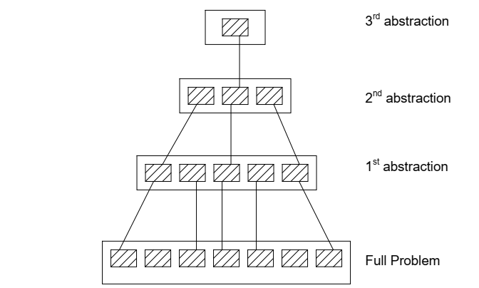
Software Engineering Principles
Abstraction – Omits irrelevant details and consider aspects that are relevant.

Slide 15
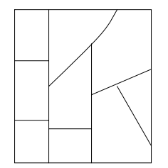
Software Engineering Principles (cont.)
Decomposition – A complex problem is divided into several smaller problems and then the smaller problems are solved one by one.
Each component is solved independently.

Slide 16
Emergence of Software Engineering
Assembly Language
High-Level Language
Control Flow-based Design
Data-Structure Oriented Design
Data-Flow Oriented Design
Object-Oriented-based Design
Structured vs. Unstructured Programming

Slide 17


