Slide 1
Software Engineering (ESC501)
- Prof. Poulami Dutta

Slide 2
Intended Learning Outcomes (ILOs)
Explain what a prototype is.
Explain why and when a prototype needs to be developed during software development.
Identify the situations in which one would prefer to build a prototype.
State the activities carried out during each phase of a spiral model.
Identify circumstances under which spiral model should be used for software development.
Tailor a development process to a specific project.
Explain the advantages and disadvantages of the V-model.
Understand the goals and objectives of the RAD model.
Comparative study of the models.

Slide 3
Prototyping Model
Before starting actual development,
a working prototype of the system should first be built.
A prototype is a toy implementation of a system:
limited functional capabilities,
low reliability,
inefficient performance.

Slide 4
Reasons for developing a prototype
Illustrate to the customer:
input data formats, messages, reports, or interactive dialogs.
Examine technical issues associated with product development:
Often major design decisions depend on issues like:
response time of a hardware controller,
efficiency of a sorting algorithm, etc.

Slide 5
Prototyping Model (contd.)
The third reason for developing a prototype is:
it is impossible to ``get it right'' the first time,
we must plan to throw away the first product
if we want to develop a good product.

Slide 6
Prototyping Model (contd.)
Start with approximate requirements.
Carry out a quick design.
Prototype model is built using several short-cuts:
Short-cuts might involve using inefficient, inaccurate, or dummy functions.
A function may use a table look-up rather than performing the actual computations.

Slide 7
Prototyping Model (contd.)
The developed prototype is submitted to the customer for his evaluation:
Based on the user feedback, requirements are refined.
This cycle continues until the user approves the prototype.
The actual system is developed using the classical waterfall approach.

Slide 8
Prototyping Model (contd.)
Build Prototype
Customer satisfied
Requirements
Gathering
Customer Evaluation of Prototype
Quick Design
Design
Refine Requirements
Implement
Test
Maintain

Slide 9
Prototyping Model (contd.)
Requirements analysis and specification phase becomes redundant:
final working prototype (with all user feedbacks incorporated) serves as an animated requirements specification.
Design and code for the prototype is usually thrown away:
However, the experience gathered from developing the prototype helps a great deal while developing the actual product.

Slide 10
Prototyping Model (contd.)
Even though construction of a working prototype model involves additional cost --- overall development cost might be lower for:
systems with unclear user requirements,
systems with unresolved technical issues.
Many user requirements get properly defined and technical issues get resolved:
these would have appeared later as change requests and resulted in incurring massive redesign costs.

Slide 11
Evolutionary Model
Evolutionary model (aka successive versions or incremental model):
The system is broken down into several modules which can be incrementally implemented and delivered.
First develop the core modules of the system.
The initial product skeleton is refined into increasing levels of capability:
by adding new functionalities in successive versions.

Slide 12
Evolutionary Model (CONT.)
Successive version of the product:
functioning systems capable of performing some useful work.
A new release may include new functionality:
also existing functionality in the current release might have been enhanced.

Slide 13
Evolutionary Model (CONT.)
C
C
A
A
A
B
B

Slide 14
Advantages of Evolutionary Model
Users get a chance to experiment with a partially developed system:
much before the full working version is released.
Helps finding exact user requirements:
much before fully working system is developed.
Core modules get tested thoroughly:
reduces chances of errors in final product.

Slide 15
Disadvantages of Evolutionary Model
Often, difficult to subdivide problems into functional units:
which can be incrementally implemented and delivered.
evolutionary model is useful for very large problems,
where it is easier to find modules for incremental implementation.

Slide 16
Evolutionary Model with Iteration
Many organizations use a combination of iterative and incremental development:
a new release may include new functionality.
existing functionality from the current release may also have been modified.

Slide 17
Evolutionary Model with iteration
Several advantages:
Training can start on an earlier release.
customer feedback taken into account.
Markets can be created:
for functionality that has never been offered.
Frequent releases allow developers to fix unanticipated problems quickly.

Slide 18
Spiral Model
Proposed by Boehm in 1988.
Each loop of the spiral represents a phase of the software process:
the innermost loop might be concerned with system feasibility,
the next loop with system requirements definition,
the next one with system design, and so on.
There are no fixed phases in this model, the phases shown in the figure are just examples.
Each phase in this model is split into four sectors (or quadrants)

Slide 19
Spiral Model (CONT.)
The team must decide:
how to structure the project into phases.
Start work using some generic model:
add extra phases,
for specific projects or when problems are identified during a project.

Slide 20
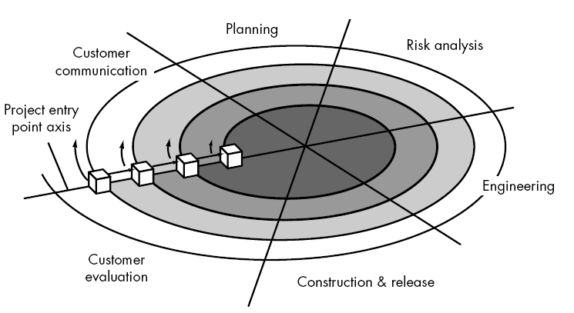
Spiral Model

Slide 21
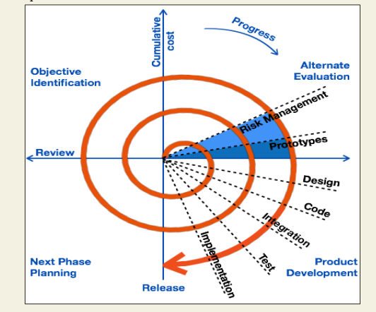
Spiral Model

Slide 22
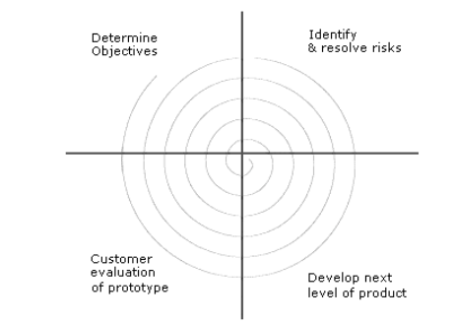
Spiral Model

Slide 23
Spiral Model (CONT.)
First quadrant (Objective Setting) • During the first quadrant, it is needed to identify the objectives of the phase. • Examine the risks associated with these objectives.
Second Quadrant (Risk Assessment and Reduction) • A detailed analysis is carried out for each identified project risk. • Steps are taken to reduce the risks. For example, if there is a risk that the requirements are inappropriate, a prototype system may be developed.

Slide 24
Spiral Model (CONT.)
Third Quadrant (Development and Validation) • Develop and validate the next level of the product after resolving the identified risks.
Fourth Quadrant (Review and Planning) • Review the results achieved so far with the customer and plan the next iteration around the spiral. • Progressively more complete version of the software gets built with each iteration around the spiral.

Slide 25
Spiral Model (CONT.)
It works on:
Concept development projects.
New product development projects.
Product enhancement projects.
Product maintenance projects.

Slide 26
Objective Setting
Identify objectives of the phase,
Examine the risks associated with these objectives.
Risk:
any adverse circumstance that might hamper successful completion of a software project.
Find alternate solutions possible.

Slide 27
Risk Assessment and Reduction
For each identified project risk,
a detailed analysis is carried out.
Steps are taken to reduce the risk.
For example, if there is a risk that the requirements are inappropriate:
a prototype system may be developed.

Slide 28
Spiral Model (CONT.)
Development and Validation:
develop and validate the next level of the product.
Review and Planning:
Review the results achieved so far with the customer and plan the next iteration around the spiral.
With each iteration around the spiral:
progressively more complete version of the software gets built.

Slide 29
Spiral Model as a meta model
Subsumes all discussed models:
a single loop spiral represents waterfall model.
uses an evolutionary approach --
iterations through the spiral are evolutionary levels.
enables understanding and reacting to risks during each iteration along the spiral.
uses:
prototyping as a risk reduction mechanism,
retains the step-wise approach of the waterfall model.

Slide 30
Comparison of Different Life Cycle Models
Iterative waterfall model
most widely used model.
But, suitable only for well-understood problems.
Prototype model is suitable for projects not well understood:
user requirements.
technical aspects.

Slide 31
Comparison of Different Life Cycle Models (CONT.)
Evolutionary model is suitable for large problems:
can be decomposed into a set of modules that can be incrementally implemented,
incremental delivery of the system is acceptable to the customer.
The spiral model:
suitable for development of technically challenging software products that are subject to several kinds of risks.

Slide 32
V-Model
A variant of the waterfall model.
It gets its name from the visual appearance.
Here, verification and validation activities are carried out throughout the development life cycle thereby reducing the chances of bugs in the product.
Suitable for use in projects concerned with development of safety-critical software.

Slide 33
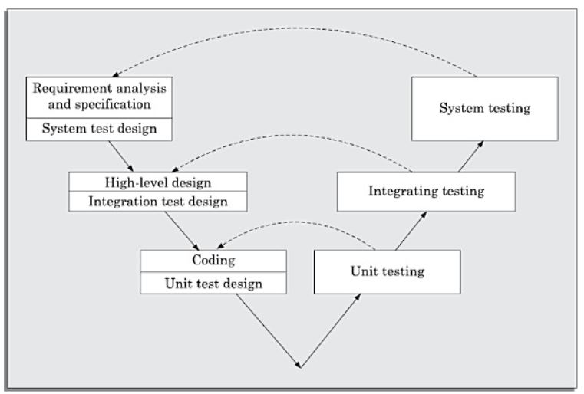
V-Model (contd….)

Slide 34
V-Model (contd….)
2 main phases:
Development – left half of the model.
Validation – right half of the model.
In the development phase, along with the development of a work product, test case design and plan for testing of the work product is also carried out.
Actual testing is done in the validation phase.
In the validation phase, testing is carried out in three steps. The purpose is:
To detect defects in the corresponding phases of software development,
Requirements Analysis and Specification,
Design and coding.

Slide 35
Advantages and Disadvantages of V-Model
Much of the testing activities (test case design, test planning etc.) are carried out in parallel with development activities.
Thus, significant part of the testing activities is already complete before testing phase starts.
This model leads to a shorter testing phase and an overall faster product development.
Test cases are designed when schedule pressure has not yet built up, thereby ensuring better quality.
Testing team is reasonably occupied throughout the development cycle leading to efficient manpower utilization.
Testing team is associated with the project since its inception thereby having a sound knowledge and understanding of the development artifacts.
Being a derivative of the classical waterfall model, it inherits most of the weaknesses of the waterfall model.

Slide 36
RAD (Rapid Application Development)-Model
It was proposed to overcome the rigidities of the waterfall model and its derivatives that make it difficult to accommodate change requests from the customer.
It has features of both the prototyping and evolutionary models.
It deploys the evolutionary model to obtain and incorporate customer feedbacks.
Here, prototypes are constructed and delivered to the customer.
Unlike prototyping model, prototypes are not thrown away but are enhanced and used in S/W construction.

Slide 37
Goals of RAD Model
To decrease the time taken and cost incurred to develop S/W systems.
Minimal use of planning,
Heavy reuse of any existing code through rapid prototyping.
To limit costs of accommodating change requests.
Customers give change requests pertaining to an already developed feature.
Incorporation of such change requests right after the delivery of an incremental feature saves cost since it is carried out prior to large investments made in development and testing.
To reduce communication gaps between the customer and the developer.
The lack of long-term and detailed planning gives the flexibility to accommodate requirement changes that may be required later.
The RAD model tries to overcome the problem inherent in iterative waterfall model by inviting and incorporating customer feedbacks on successively developed and refined prototypes.

Slide 38
Working of RAD Model
Development takes place in a series of short cycles or iterations.
Development team focuses on the present iteration and plans are made for one increment at a time.
The time planned for each iteration is called a time-box.
Each iteration enhances the functionality of the application by only a small amount.
During each iteration a quick-and-dirty prototype style software is developed.
The customer evaluates the prototype and provides feedback on specific improvements and based on this the prototype is refined.
Prototype is not released to the customer.

Slide 39
Applications of RAD Model
Customized Software.
Non-critical Software.
Highly constrained project schedules.
Large Software.

Slide 40
Exceptions
Generic Products.
Requirement of optimal performance and reliability.
Lack of similar products.
Monolithic Entity.

Slide 41


