Slide 1

Prediction on customers’ subscription for bank term deposit
Submitted by: Group 2

Slide 2

Introduction
Term deposits are a bank's primary source of revenue. A term deposit is a short-term monetary investment held with a bank. Your money is invested for a set period of time, or term, at a set rate of interest.
One of the most successful ways to reach out to individuals is through telemarketing campaigns. They do, however, need a significant expenditure because enormous call centers are employed to carry out these programs. As a result, it's critical to identify the clients who are most likely to convert before making a call to them.
More than one contact with the same consumer was frequently necessary in order to determine if the product (bank term deposit) would be subscribed to ('yes') or not ('no') by the customer.

Slide 3
Dataset Description
Total of 4521 instances with 17 attributes
Age – age of the person
Job – the type of job
Marital - marital status
Education – education level
Default – whether the person has credit in default
Balance – Account Balance
Housing - whether the person has a housing loan
Loan- whether the person has a personal loan
Contact - contact communication type
Day - last contact day of the month
Month - last contact month of the year
Duration - last contact duration, in seconds
Campaign - the total number of contacts made throughout this campaign
Pdays- the number of days since the client was last contacted as part of a prior campaign
Previous- the number of connections made for this customer and before this campaign
Poutcome - the result of a prior marketing effort

Slide 4
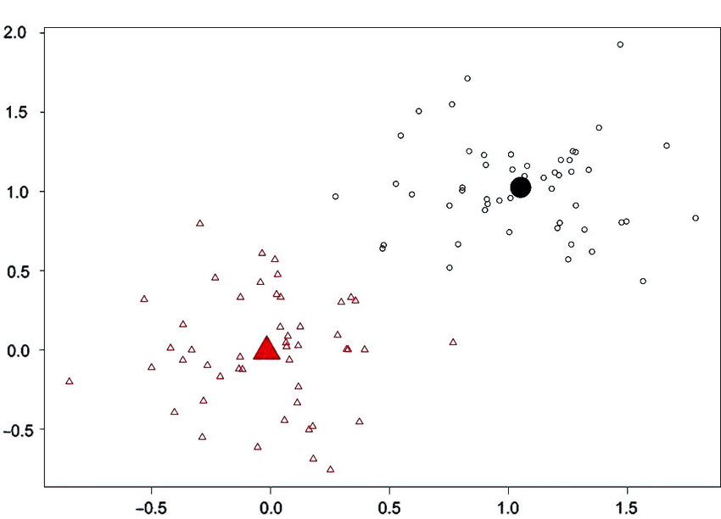
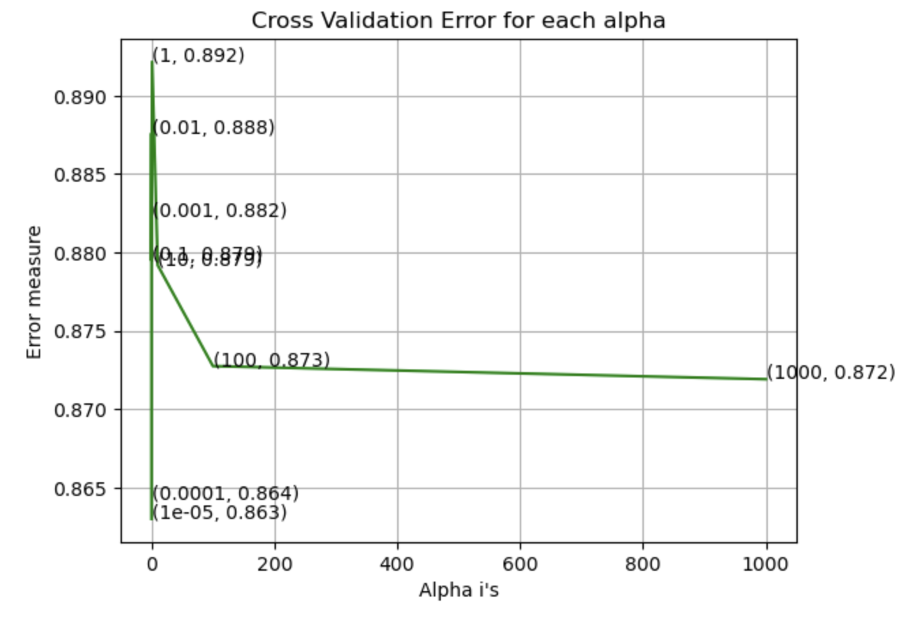
Models Used
Logistic Regression
K-Means

Slide 5
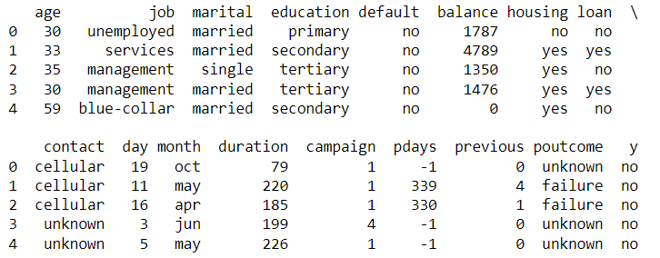
Dataset

Slide 6
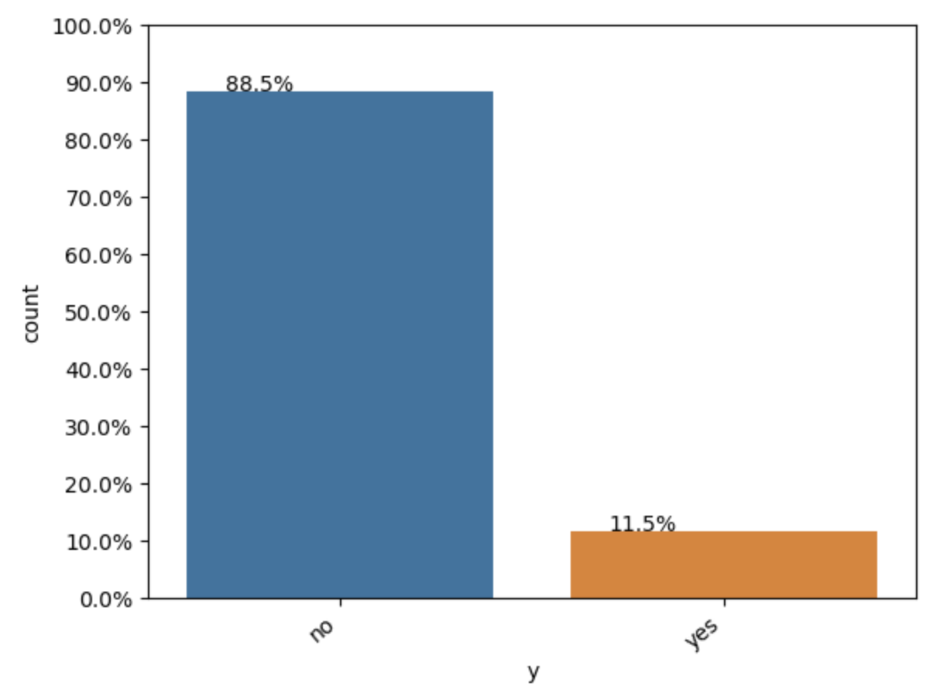
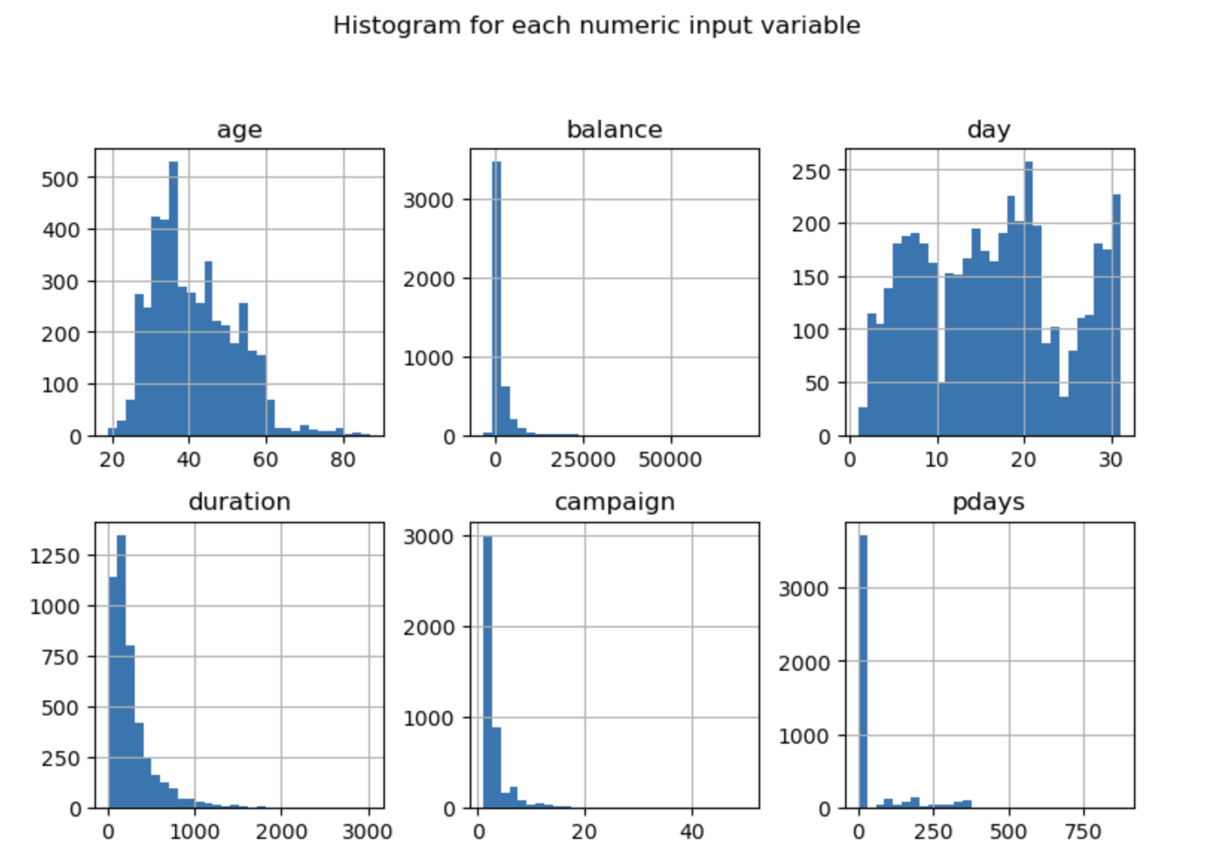
Data Visualization

Slide 7
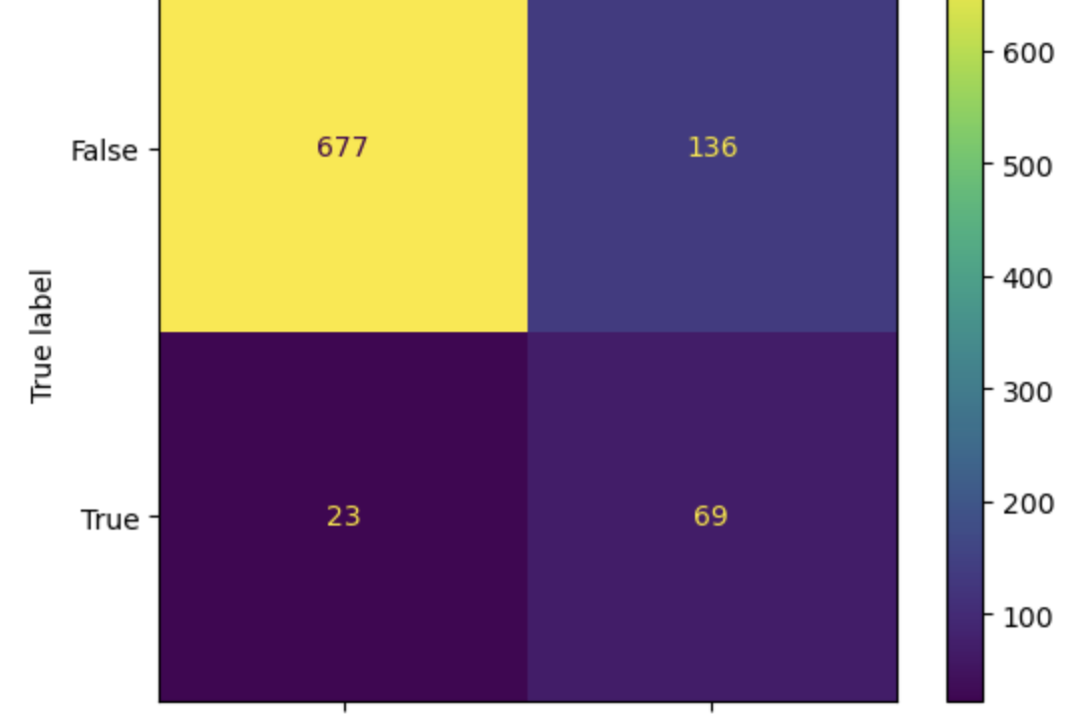
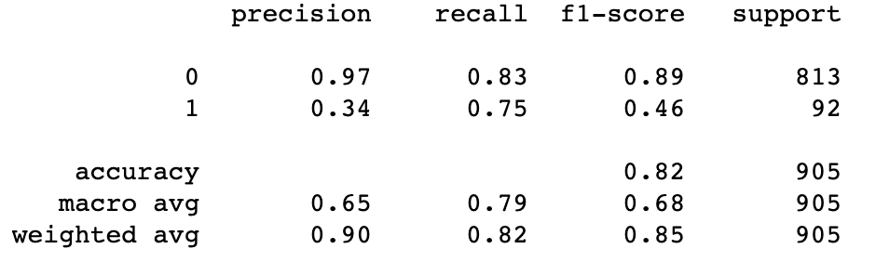
Logistic Regression Results
The accuracy of the model to predict whether the customer will subscribe for bank term deposit based upon the features selected comes out to be 82%

Slide 8
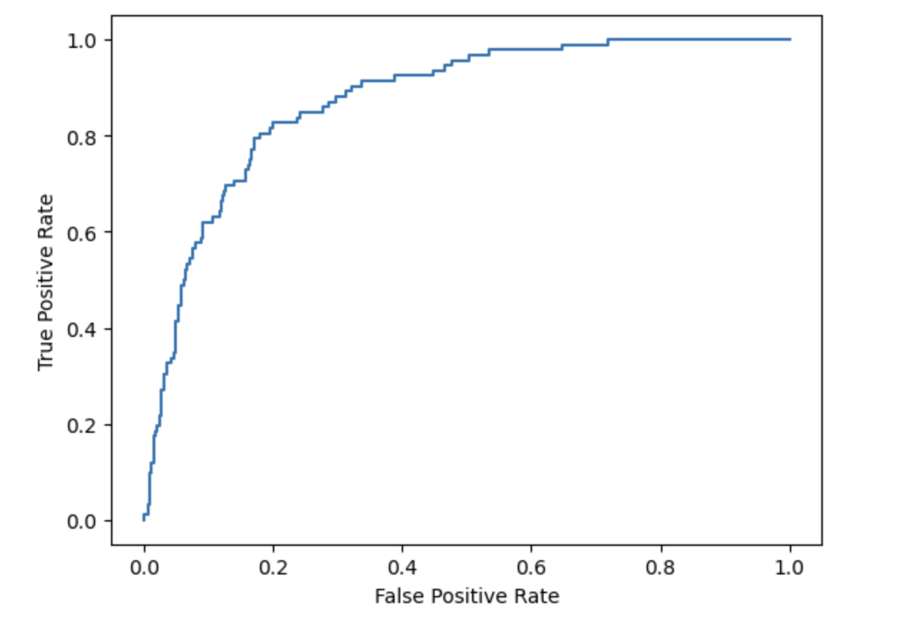
ROC Curve

Slide 9
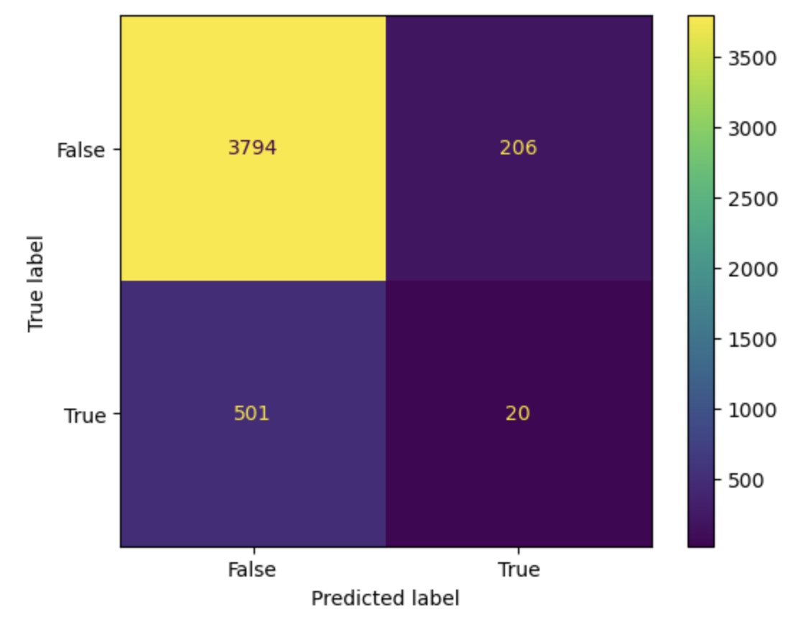
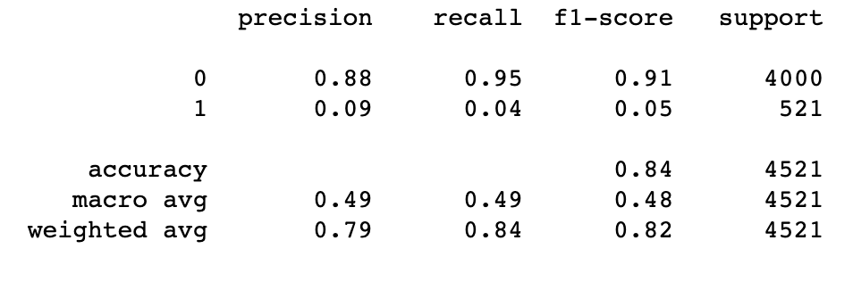
KMeans Model Results
The accuracy of the model to predict whether the customer will subscribe for bank term deposit based upon the features selected comes out to be 84%

Slide 10
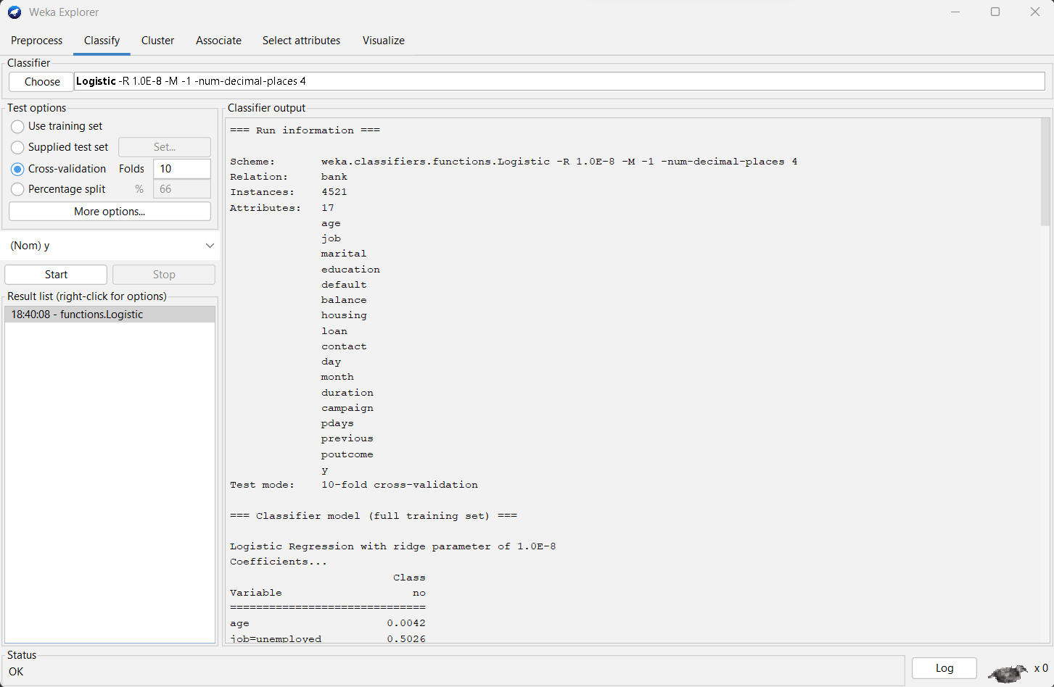
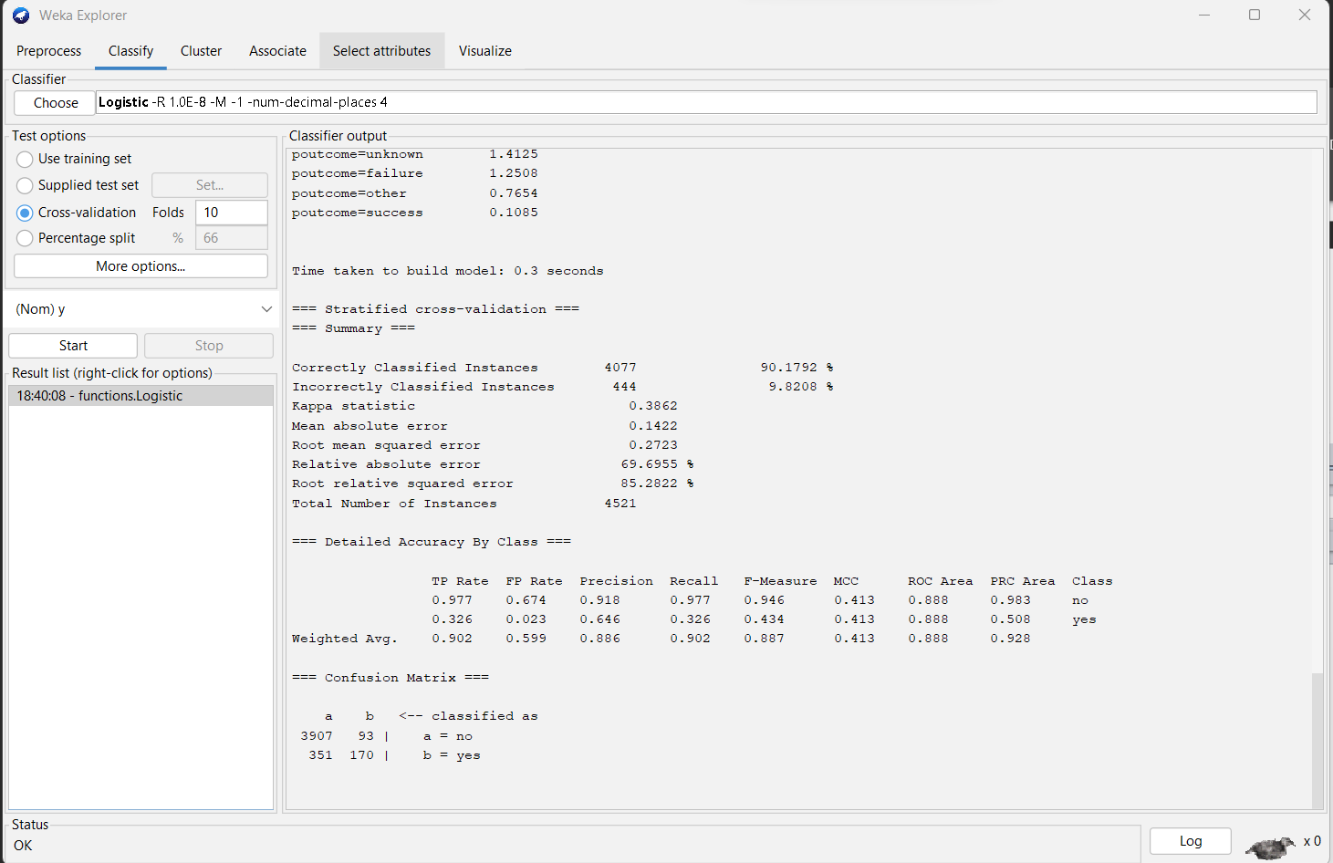
Logistic Regression Results using Weka
Accuracy is 88.7%

Slide 11
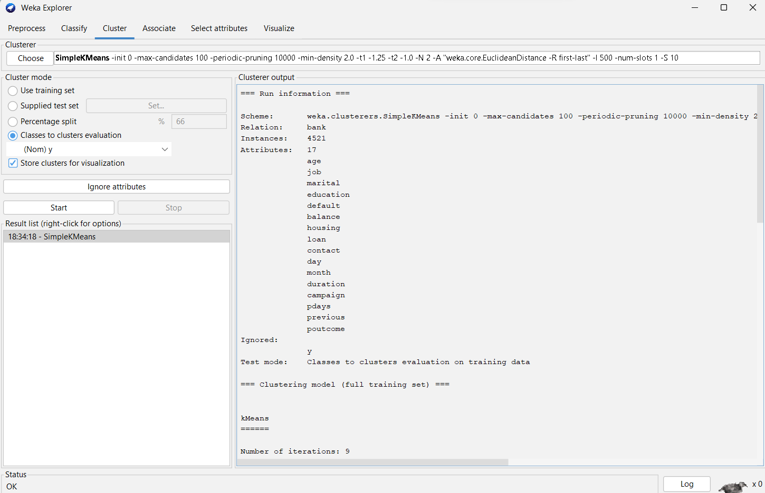
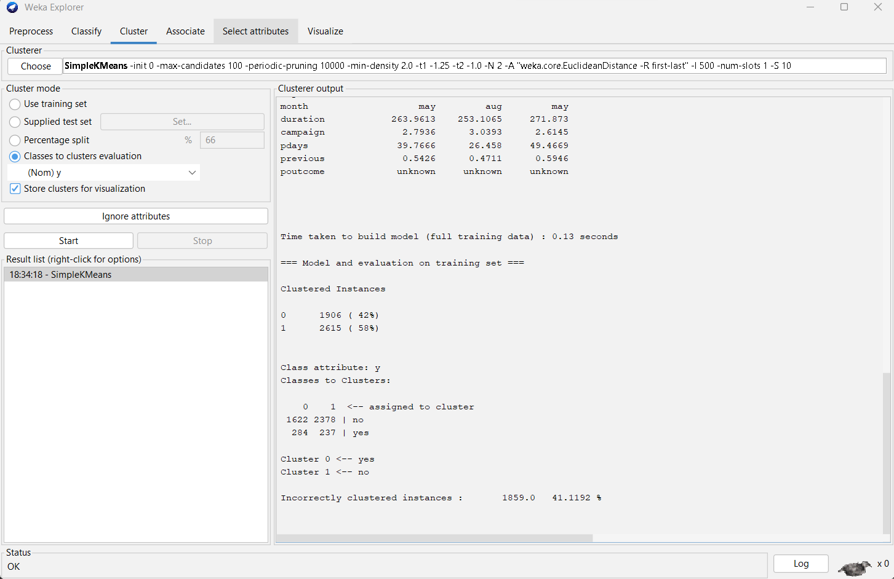
K-Means Algorithm Results using Weka

Slide 12
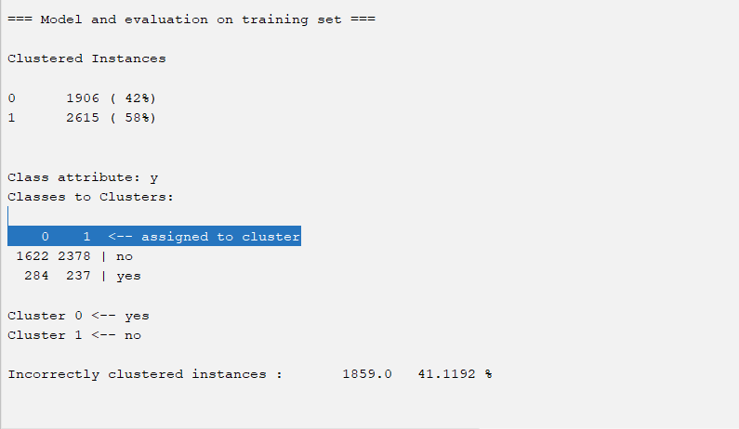

Slide 13
Conclusion:
To conclude, after performing all the algorithms we can determine on what basis the customer subscribes to the term deposit.
According to the results of logistic regression, approx. 90% of the instances were correctly classified and only around 9% of the instances were classified incorrectly.
Poutcome affects more in determining whether the customer subscribes or not and age affects the least.

