Slide 1
Heart Attack Prediction
Kartik Nain
ITE 5201 Humber College

Slide 2
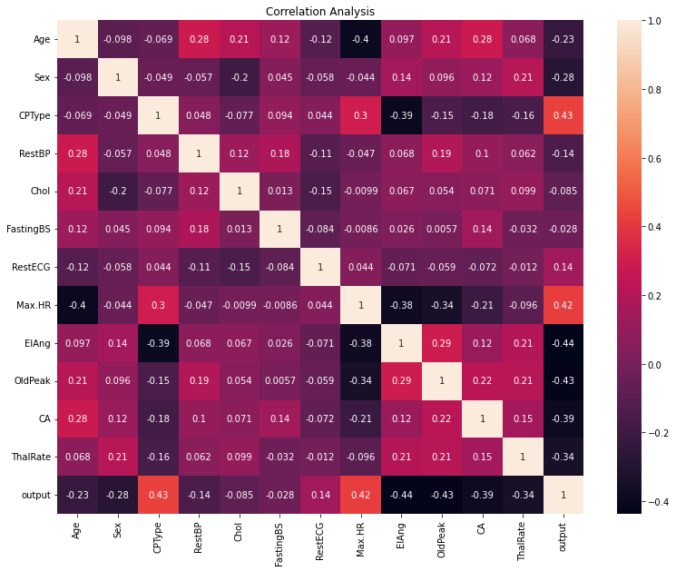
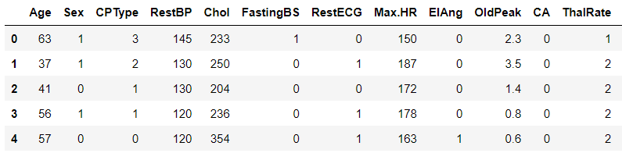
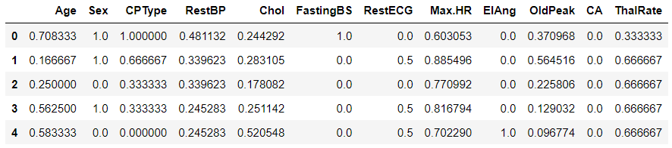
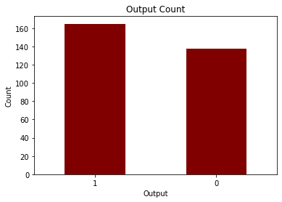
Problem Statement and Dataset Discussion
Prediction of Heart Attack Occurrence among people of different ages

Slide 3
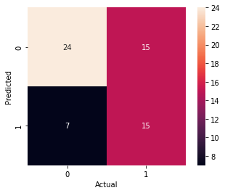
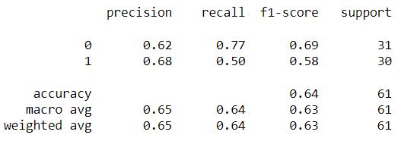
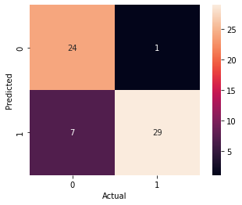
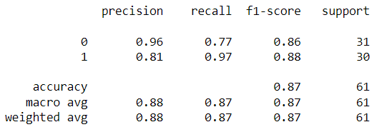
Predictive Models
Perceptron Model
Logistic Regression Model

Slide 4
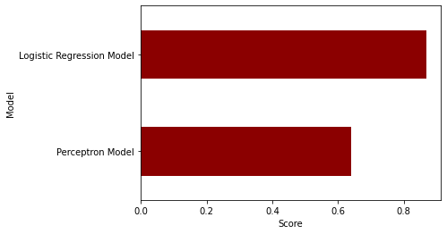
Results and Discussion
Comparison of Prediction Models: An accuracy jump to 87% is observed when implementing Logistic Regression Model in place of Perceptron Model which has 64% accuracy.
Result: With the help of the LR Model, we can predict the occurrence of heart attack among people using certain features with an accuracy of 87%

