Slide 1

SISTRaahi
Major Project - II
CS - 805
Problem Statement: SISTraahi automates bus scheduling, optimizes routes, and enables real-time tracking using GPS and data analytics. It enhances efficiency, improves resource utilization, and ensures passenger safety with emergency assistance, providing a seamless and reliable public transportation experience.
Project Group Number: 18
Group Member Details:
Kartik Jaiswal 0187CS211083
Kartik Sahu 0187CS211085
Jatin Sahu 0187CS211078
Praveen Pandey 0187CS211124
Guide Details: Prof. Jai Mungi

Slide 2
Idea/Approach Details
Live Bus Tracking Web Application: A user-friendly web app for real-time bus tracking and comprehensive bus information.
Dynamic Data Retrieval: Users enter the bus number to retrieve details using a "SERVLET API" from our database.
Effortless Route Search: A search feature helps users find buses by route or stop name.
Live GPS Tracking: Users track buses in real-time using "GPS DEVICE" and "MAPS JAVASCRIPT API."
Estimated Arrival Time: Inputting bus number and destination stop provides estimated arrival times based on bus location and speed.
Admin Control: Admins can manage bus data, adding or removing buses as needed.
User Feedback: Passengers can provide feedback and file complaints to enhance services.
Emergency Assistance: Contact departments in emergencies with live bus location sharing.
Emission Compliance: Refers to displaying whether a bus meets its specific environmental standards (e.g. '"Bharat stage IV") regarding the amount of pollutants it emits and clean fuel usage.
Emergency Helpline and Complaint Bot: We provide an emergency helpline number and complaint bot, empowering passengers, especially women, to report harassment incidents directly from the bus. Prioritizing safety, we offer immediate support and assistance when needed.

Slide 3
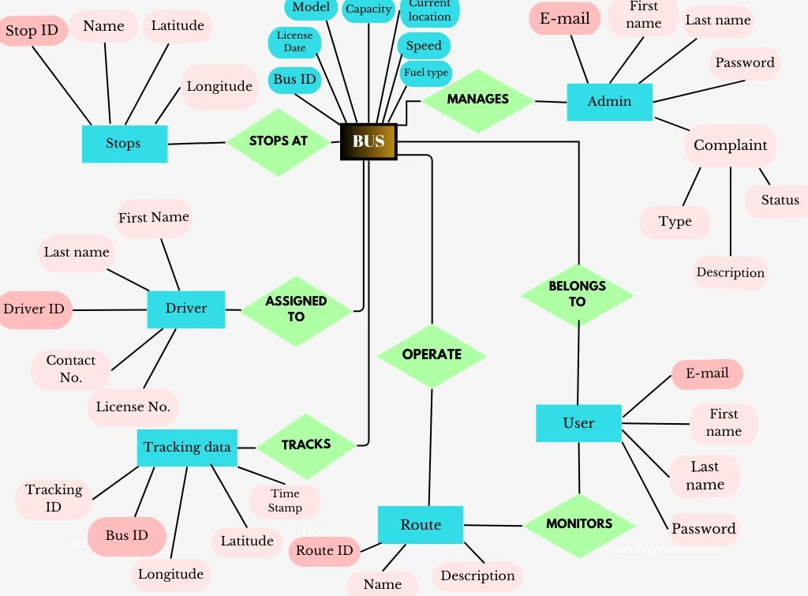
ER DIAGRAM

Slide 4







TECHNOLOGY STACK:
DATABASE :
MYSQL
FRONTEND:
HTML, CSS, JavaScript, and Bootstrap will compose the frontend.
BACKEND:
Java Servlets and JSP will manage request and response.
JDBC will facilitate the connection between Servlets/JSP and the database.
MySQL will serve as the database.
Google Maps API services will be employed for tracking.

Slide 5
Idea/Approach Details
1.
Cost of Google API Services:
Dependency: Our project relies on Google API services for
mapping and location-related functionalities. Since these services
are paid, the availability of funds or budget allocation is a
dependency.
2. Immediate Assistance for Complaints:
Dependency: Our project aims to provide immediate assistance for
complaints, especially in emergency situations and women's
harassment cases. The ability to provide such aid depends on the
availability of the relevant departments or services to respond
promptly.
3. Hardware for GPS Tracking:
Dependency: Hardware such as GPS devices is required to
implement GPS tracking. The availability and procurement of this
hardware is a critical dependency for the project.

Slide 6
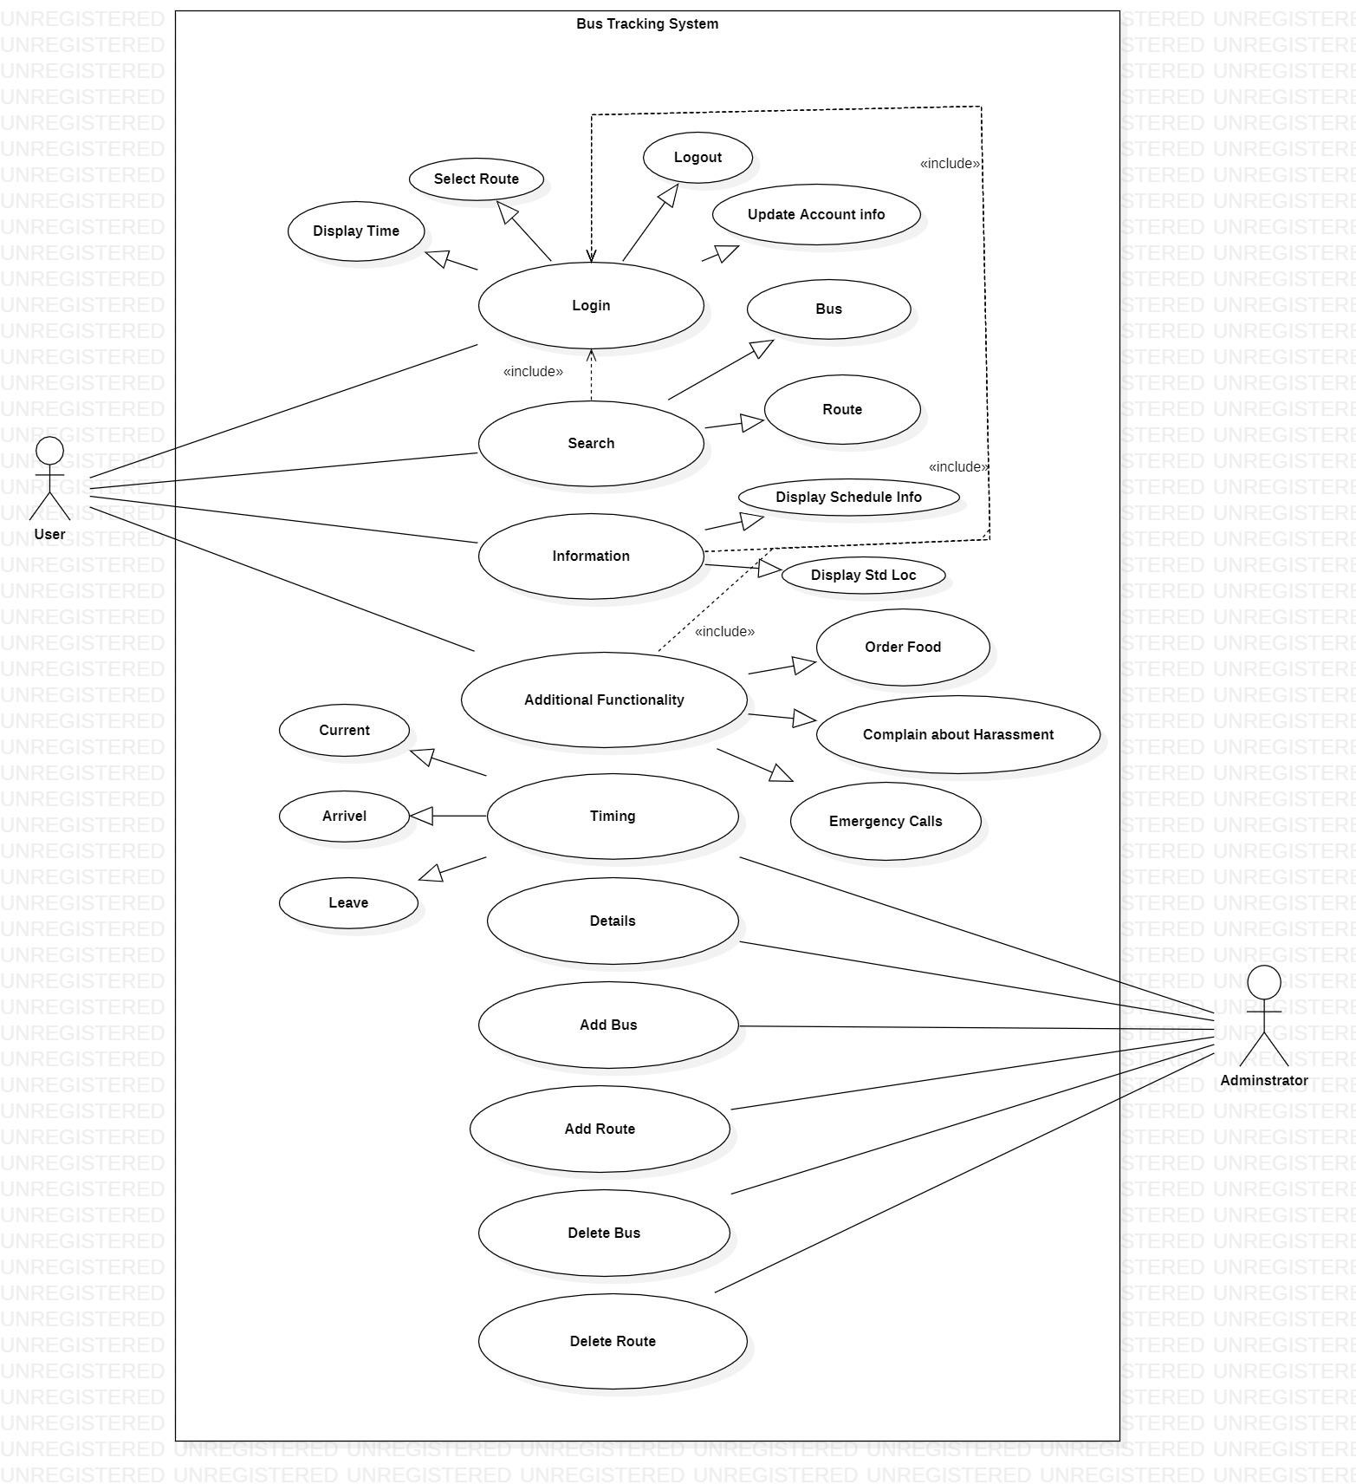
Use Case

Slide 7
Team Member Details
Team Leader Name: Kartik Jaiswal
Branch : B.tech Stream : CSE Team Member 1 Name: Kartik Sahu Branch : B.tech Stream :CSE Team Member 2 Name: Jatin Sahu Branch : B.tech Stream :CSE Team Member 3 Name: Praveen Pandey Branch : B.tech Stream : CSE
0187CS211083
0187CS211085
0187CS211078
0187CS211124
Team Guide
Prof. Jai Mungi

