Slide 1


Activity Tracking with Machine Learning
Under The Guidance
-----------------------------
Prepared By -
Kartik Sajwan(170101041)
Nishika Rana(170101055)
Prashant Bhandari(170101061)
Department Of Computer Science &Engineering
Uttaranchal Institute Of Technology

Slide 2
OUTLINE
INTRODUCTION
LITERATURE REVIEW
OBJECTIVES
METHODOLOGY
CONCLUSION
REFRENCES

Slide 3
Introduction
Posture is important
Incorrect form puts strain on body
Help people correct their form while performing various tasks
Record activity data for further processing
Send relevant data to the user for later later review

Slide 4
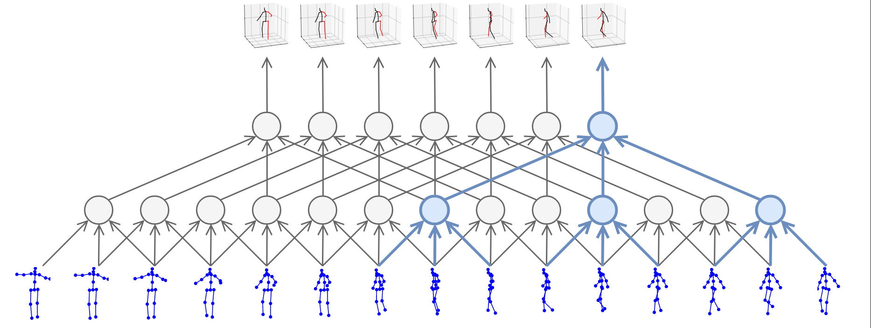
Literature Review (from where you get the idea)
1. Exercise done improperly is A LOT OF STRESS on the body - to improve form during exercising we came up with the idea of human activity tracking.
2. Videopose3d for keypoint detection developed by FacebookResearch team
3. Datasets used for training the ML models- Human3.6, HumanEva and COCO dataset
4. CNN

Slide 5
Objectives
The model developed under this project would be able to track human activity based on their keypoints in real time.
Record the tracking data for further classification and processing.

Slide 6
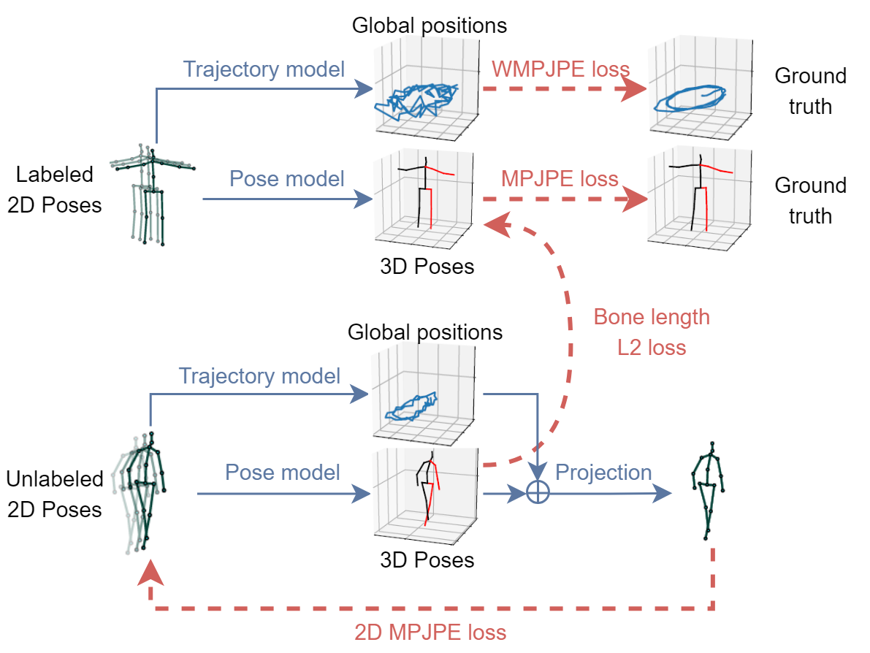
Methodology/Proposed work
VideoPose3D by FacebookResearch
Hardware to train models on - Ryzen 5, RTX 2060 based system

Slide 7
Conclusion
VideoPose3d is only pose detection.
Further it by activity tracking.
Eg. Record gym exercise data, correct posture, physiotherapy instructor.

Slide 8
References
https://arxiv.org/abs/1811.117422
https://github.com/facebookresearch/VideoPose3D
COCO Dataset https://cocodataset.org/
Catalin Ionescu, Dragos Papava, Vlad Olaru and Cristian Sminchisescu, Human3.6M: Large Scale Datasets and Predictive Methods for 3D Human Sensing in Natural Environments, IEEE Transactions on Pattern Analysis and Machine Intelligence, vol. 36, No. 7, July 2014 [pdf][bibtex]
Catalin Ionescu, Fuxin Li and Cristian Sminchisescu, Latent Structured Models for Human Pose Estimation, International Conference on Computer Vision, 2011 [pdf][bibtex]

Slide 9
Thank You

