Slide 1
POWERTURN
SUYASH KARN|KARTIK THAKKER|AMAN RAJ
TM190E37
Notes:
Good morning respected Judges I am suyash , aman ,kartik we are from department of industrial and system engennering

Slide 2
INDEX
Understanding the problem statement
When do we switch from AC to HVDC.
Identifying the locations for HVDC converters.
Economic assessment.

Slide 3
Understanding the problem statement
The primary goal of the P.S. is to optimize the following -
HVDC converter station capacity.
Distribution and network of transmission lines.
Solar Generation.
Individual level
Large scale
Battery Storage Capacity
Notes:
Our primary goal was to …………………………………………….for that we had made a permanent plan solution

Slide 4
When do we switch from AC to HVDC ?

Slide 5
Why HVDC?
Attenuation - AC current gets attenuated to a greater extent when transmitting over greater distance.
Utilization of conductor material - AC current gets accumulated towards the boundary of the conductor
Broader land strip requirement - AC transfer requires 3 channels, DC requires 1.
Smaller footprint - Better for the environment

Slide 6
HVDC and Transmission lines --
We need to identify the optimal capacities and locations for setting up HVDC converter stations, so as to minimize the costs and power losses, and to provide electricity to maximum regions and make it profitable for private landowners to set up solar plants.

Slide 7
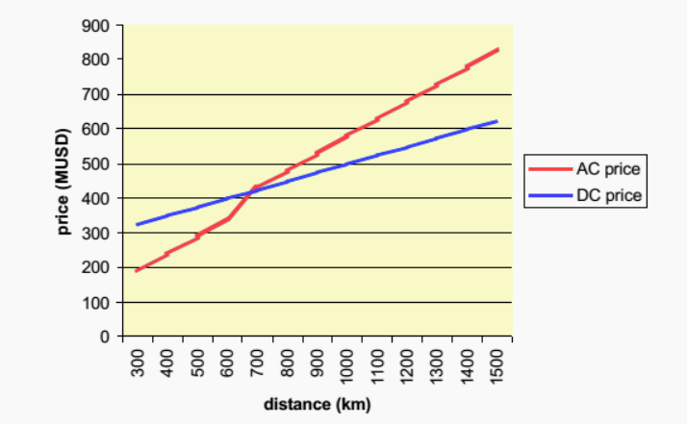
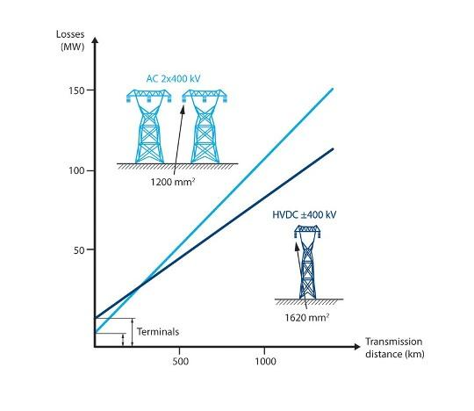

Slide 8
Identifying locations for HVDC converters
Notes:
For identifying the potential location model for HVDC we have considered and refered to a couple of maps of electricity suppliance in india

Slide 9
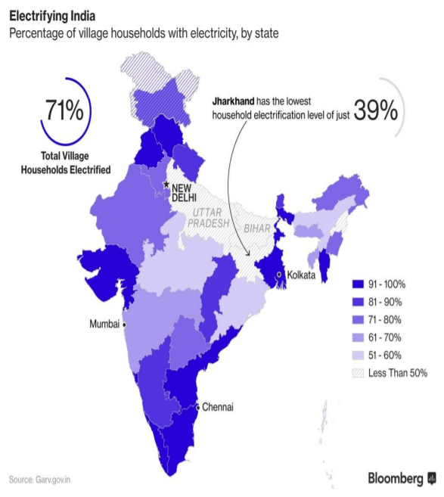
We infere the regions where there is a deficit of electricity supply.
Notes:
Electricity supply

Slide 10
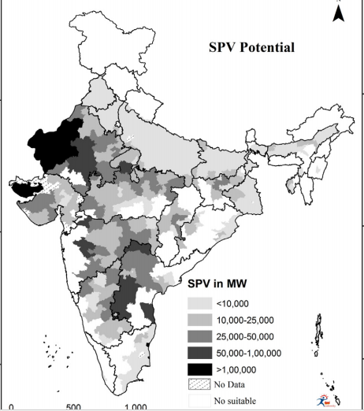
We can identify from this graph the potential regions to set up power plants
Notes:
Solar photo voltaic pottential

Slide 11
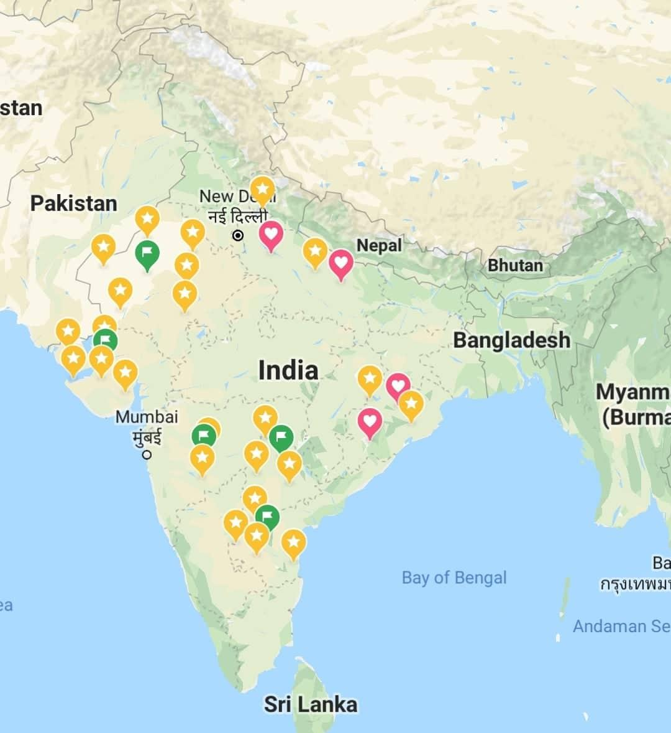
The green ticks are HVDC converters in the regions of healthy electricty production.
The red ticks are HVDC converters in locations with electricity deficit.
Notes:
On the above study we marked potential sites of india considering the potential sites.

Slide 12
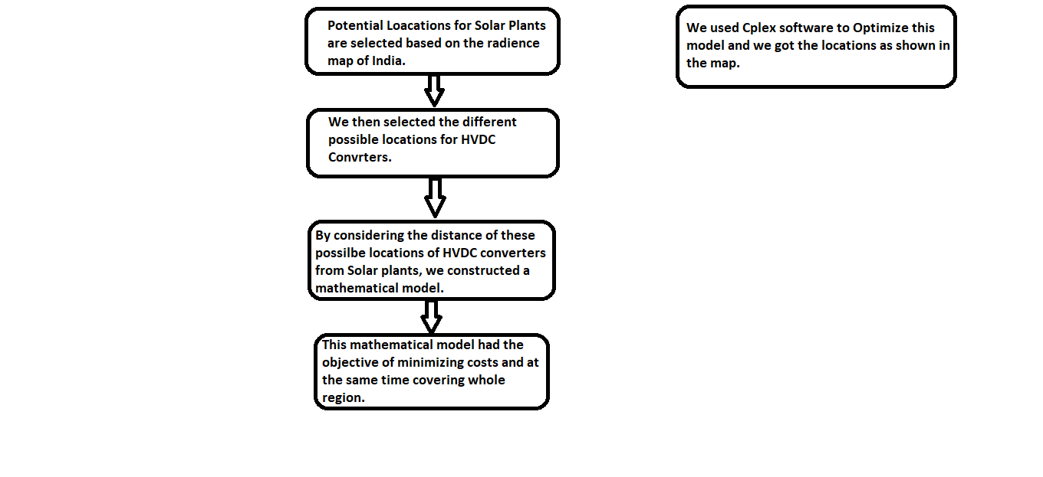
Notes:
Lets summerise
We constructed a mathematical model for optimizing the economic and technical aspect of required construction at the same time covering whole region

Slide 13
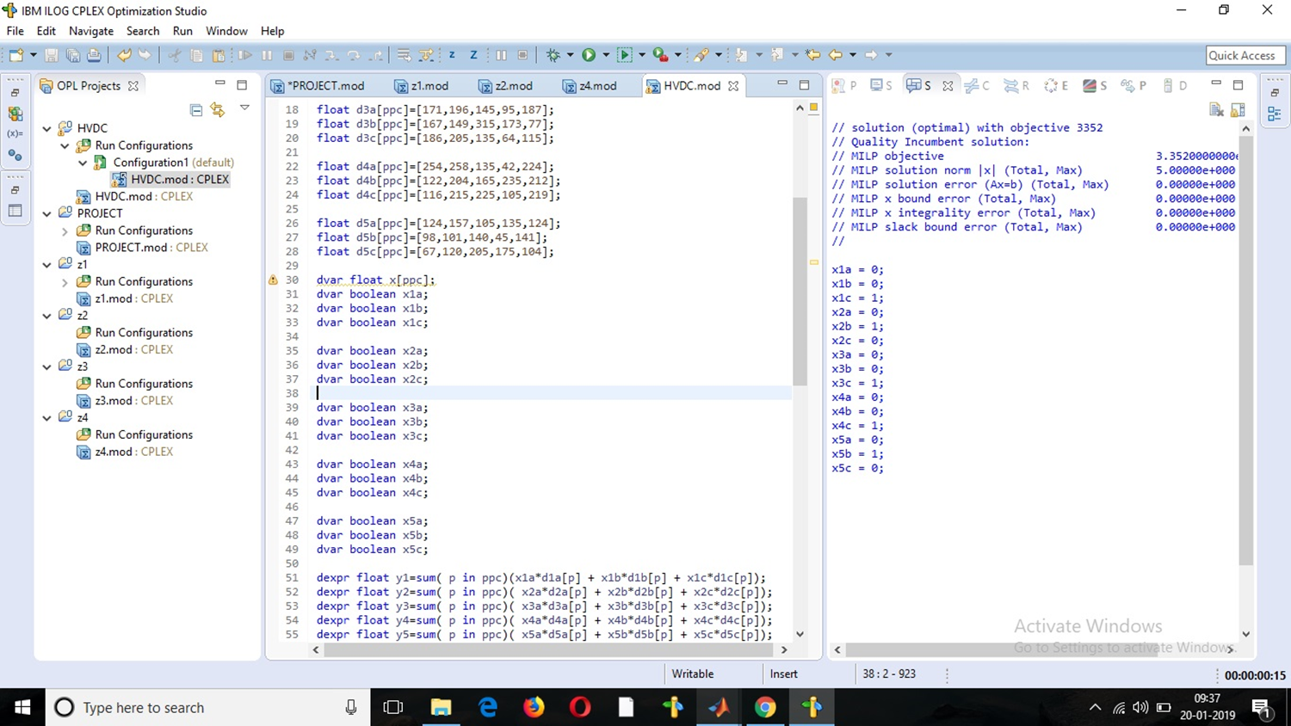

Slide 14
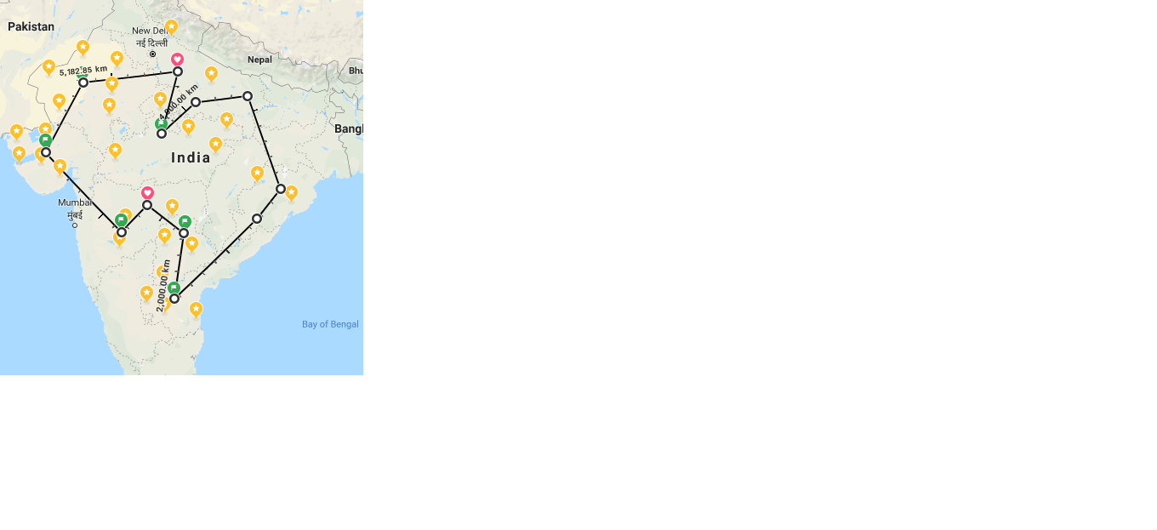
We have located the HVDC converters such that it optimizes the coverage at the minimum cost.
Notes:
These were the optimized location of all the proposed hdvc convertor the reason why we tried to cover maximum region is because our plan is to lay down a network of HDVC transmission so that we could connect all renewable source of energy across india through online transmission and to make private land owners feasible to earn profit from settuping up the plant at their private land.

Slide 15
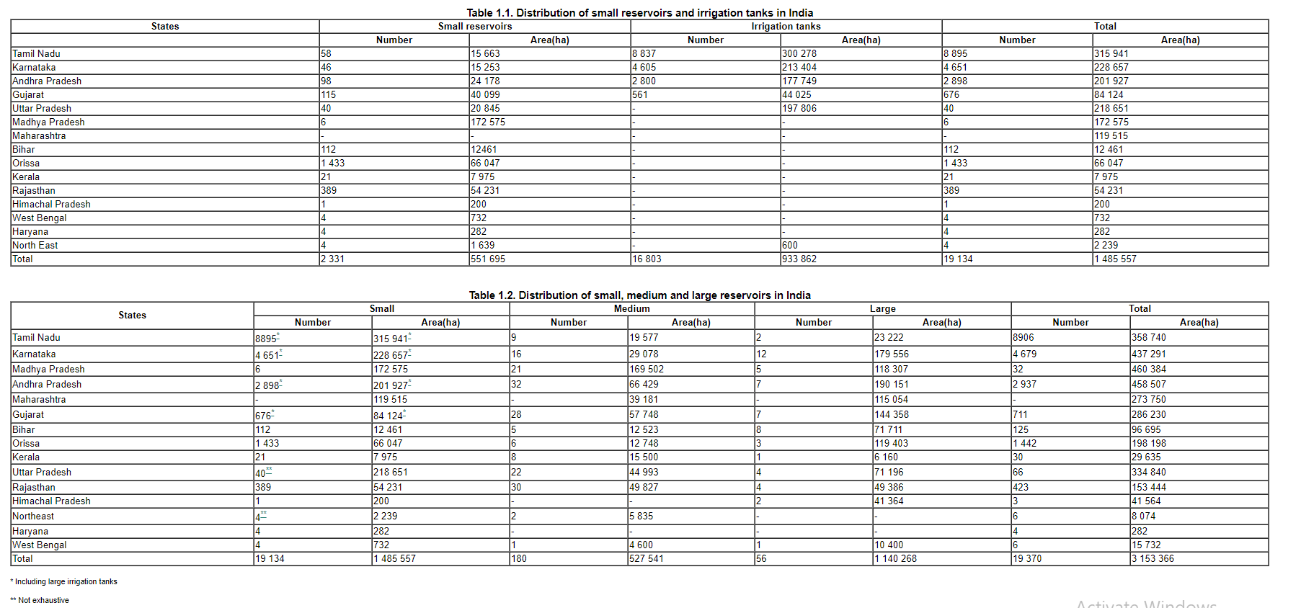
POTENTIAL PLACES FOR ON GRID INSTALLATION --
Solar panels can be installed over dam reservoirs. This was not possible earlier due to large attenuation when AC transmission was being used.
In India we have 4638k hectares of surface area available just from stationary water reservoirs.
1.6 percent is what we . require
Notes:
Our plan was to get 70GW from the solar power plant for that we neeed approximately land around 60k-70k hectare and just to give you an idea of available land is in india we have a unused land of 4638k hectares over small water resources ,irrigation tank ,Dams,cannals and etc and we just need 1.6 percent of total to produce 70GW

Slide 16
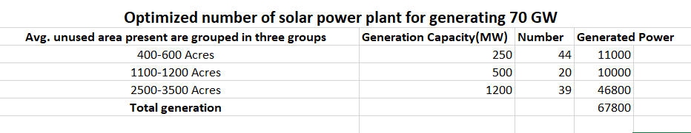

Slide 17
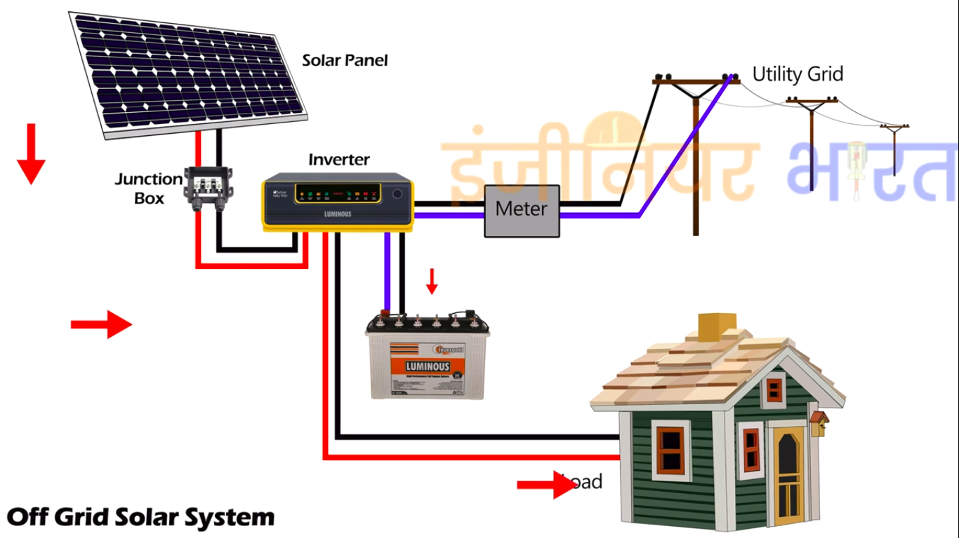
Solar generation - Individual level - Off grid
These methods are applied in regions where electricity supply is scarce.

Slide 18
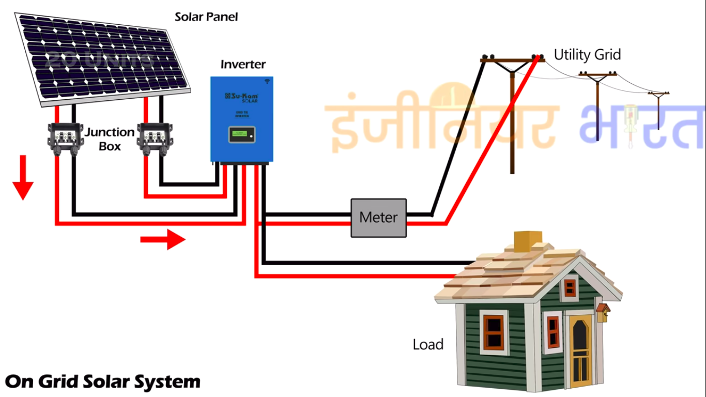
Solar generation - large scale - grid connected
These methods are applied in regions where electricity supply is irregular.

Slide 19
Battery storage capacity
Average battery life is around 15 years, so we need at least one replacement in the given 30 years project.
The average power consumption of a household in 90kWh/day and the approximate cost for batteries is $400/kWh, considering these numbers we get –
30*365*90 = 985500 – CONSUMPTION
Average cost of installation is $1500/kW*90 = $135,000
$135000 + $8000 = $143000
Cost/kW = $143000/985500 = $0.14/kW

Slide 20
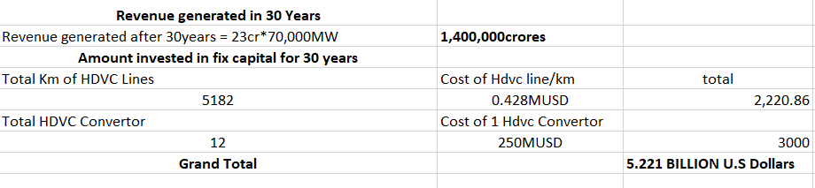

Slide 21
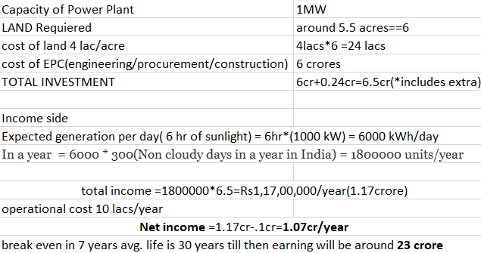
Economic assessment

