Slide 1
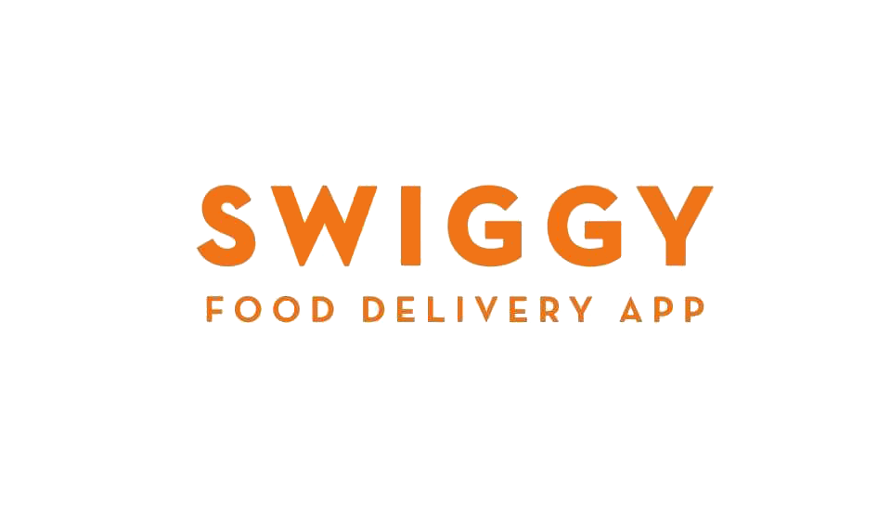

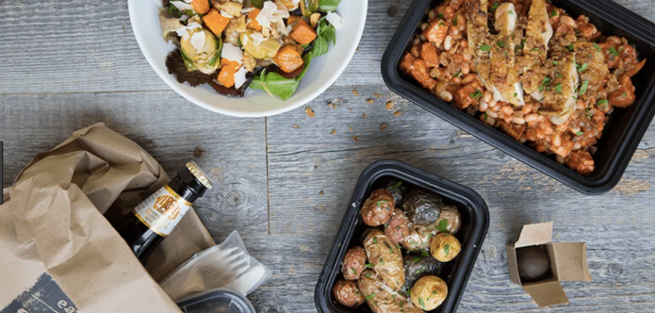
Design-a-Thon

Slide 2
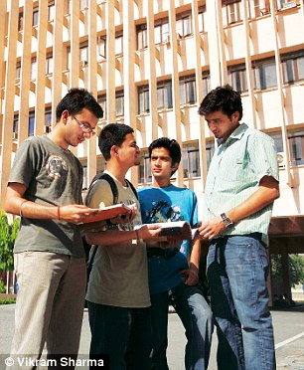
The Demographic / Target Audience
The Main target audience identified by us for this product are the students of IIT Kharagpur.
These students lie mostly between the age of 18 to 25 and can safely be considered to be millennials who have a creative mind-set and enjoy a fast and on the go flexible lifestyle.
They have very small attention spans and particularly hate unintereactive and long procedures.
Living amongst the digital world from birth, they have encountered several hundred apps and have an excellent knowledge of the technology.
As millennials, they like to know that what they are doing is important and will lead to development.

Slide 3
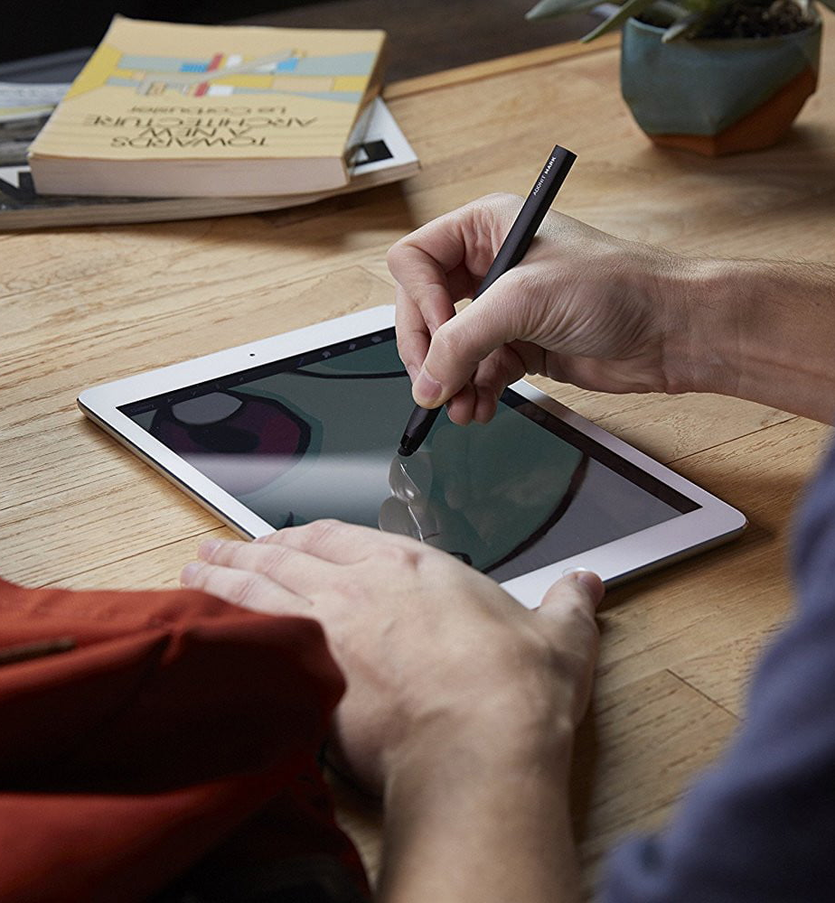
The Process
Keeping in mind the characteristics of the target audience, we designed the features of the on boarding process accordingly.
The app needs to be user friendly. Thus, we tried to make the app creative and interactive in how it accepts data and presents itself. Also, since the target is to stand out and be unique.
The process needs to incorporate the flexibility of lifestyle of the students as well as teach them the delivery process in a way that was easy to remember.
Finally, the on boarding process needs to give the audience a sense of achievement and importance to ensure their further participation.

Slide 4
The Solution
The sign up page describes the role of the delivery executive to be that of ‘hunger saviour’, thus glorifying the job to an extent as well as giving the job a purpose with which the target audience will be able to connect immediately, as well as give them a sense of growth connected to the job.
Since the students do not enjoy filling up long forms, we created the availability page in the form of a grid.
In it the user can choose his/her time slots with just a tap on the screen.
The user has to input his/her department, course and year of study. It will then use this data to access the inbuilt the timetables in the app and cross out the class hours on its own, thus reducing the input required from the user even more and making the process faster.
The user has the permission to edit this availability grid in the long run too.

Slide 5
The tutorial designed to help the user understand the process has been made as interactive and hands on as possible.
The tutorial gives them the understanding of the interface and the layout of various screens of importance during the delivery process e.g. how to go to the earnings tab, how to check their delivery histories etc.
The tutorial also has a mock delivery process in which the user will get a mock delivery request, mock delivery locations and complete overview of the delivery process (he does not have to go to the actual locations).
During this mock run, the tutorial will guide the user at each stage teaching him/her how to accept requests, how to navigate and read the routes on the map, the estimated times of pickup and delivery, communication with the restaurants and the rating system among other things, everything in real time i.e. the user has to click on the accept button, navigate the screens etc.
Lastly, the tutorial will also guide the user to the ‘Help’ button on the screen which allows the user to either jump back to the tutorials or contact the support team if he/she gets stuck during an actual delivery process.

Slide 6

Thank you!
Saumitra Joshi (17ME10057) Kartik Thakker (17IM10035)
Raj Gupta (17MF3IM16) Rachana Verma (17AR10029)

