Slide 1
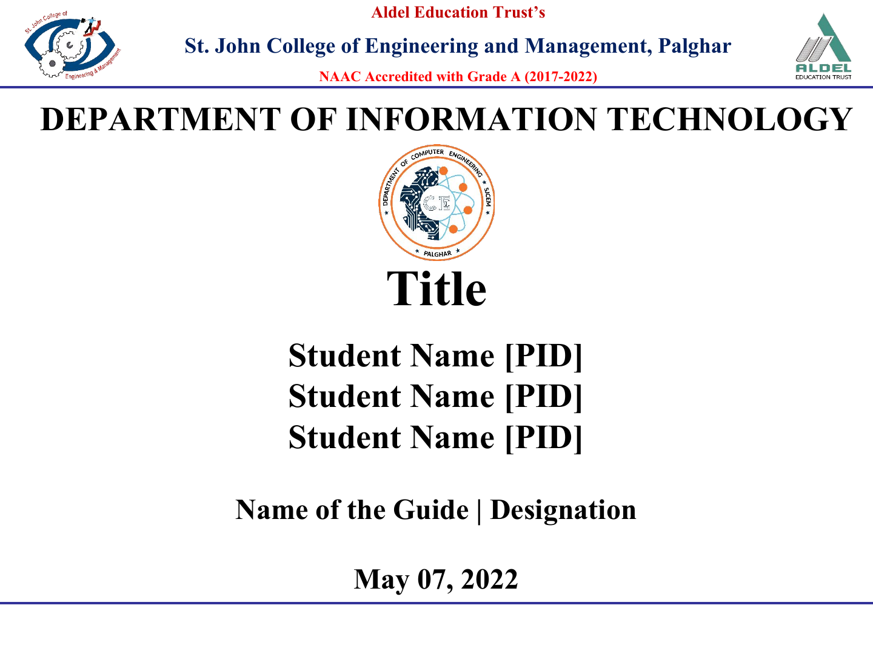
SMART PERSONAL FINANCE
& BUDGET MANAGEMENT SYSTEM
Student Name [PID]
Student Name [PID]
Student Name [PID]
Name of the Guide | Designation
September 23, 2026
Notes:
Project title and structure drawn from the local project README.md. Student names, PIDs, and guide details were not supplied and remain editable.

Slide 2
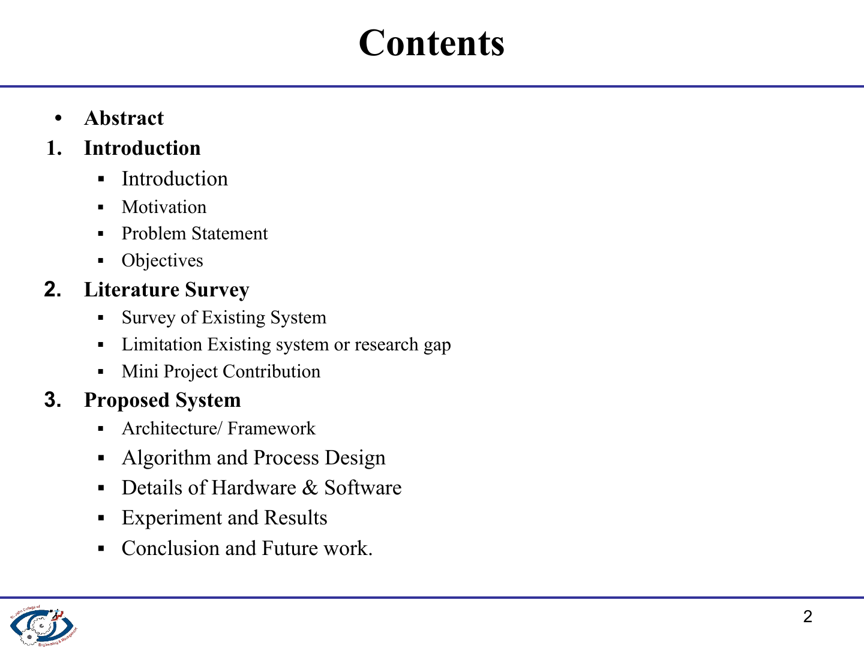
Notes:
Template structure preserved. Objectives appear with the introduction on slide 4.

Slide 3
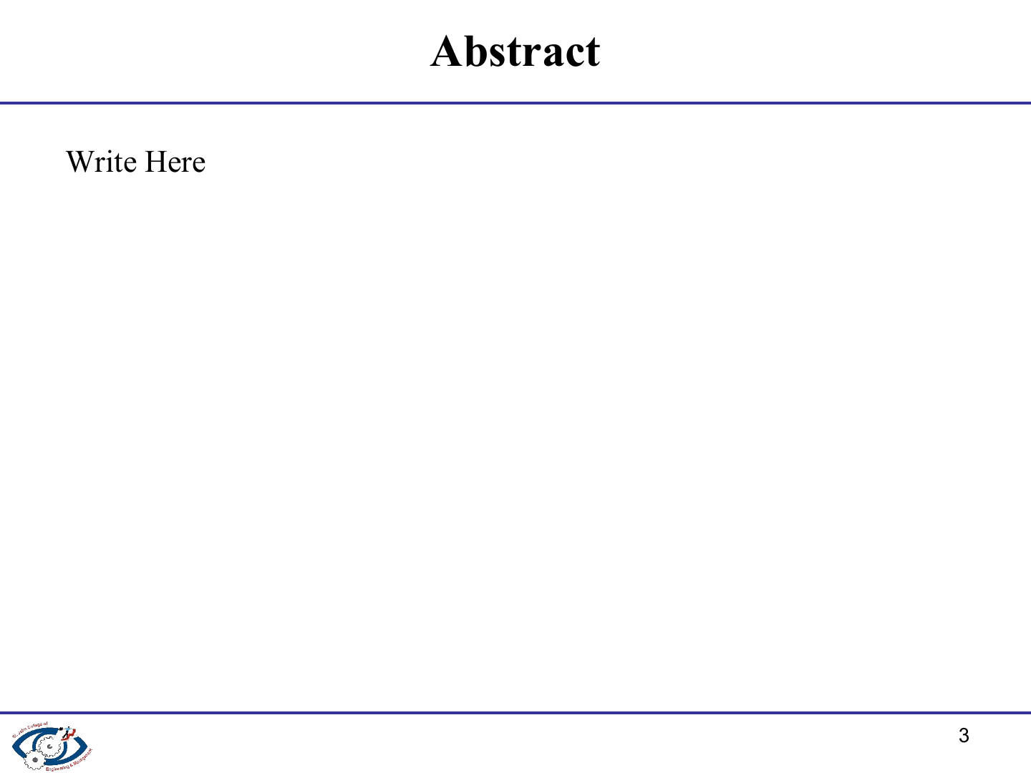
The Smart Personal Finance & Budget Management System is a Flask and SQLite web application for recording income, expenses, budgets, and financial goals. It calculates a user's monthly surplus and safe investment capacity after allowing for an emergency reserve and active goal commitments. The system also presents stocks, gold rates, mutual fund information, and financial news through external APIs with SQLite cache fallbacks. A DSA-based recommendation engine filters, scores, and ranks investment options against the user's risk tolerance, time horizon, goal, liquidity needs, and available capacity. The result is an explainable academic prototype for practical personal-finance planning.
Notes:
Source: README.md, Project Overview, Key Features, and Recommendation Engine sections.

Slide 4
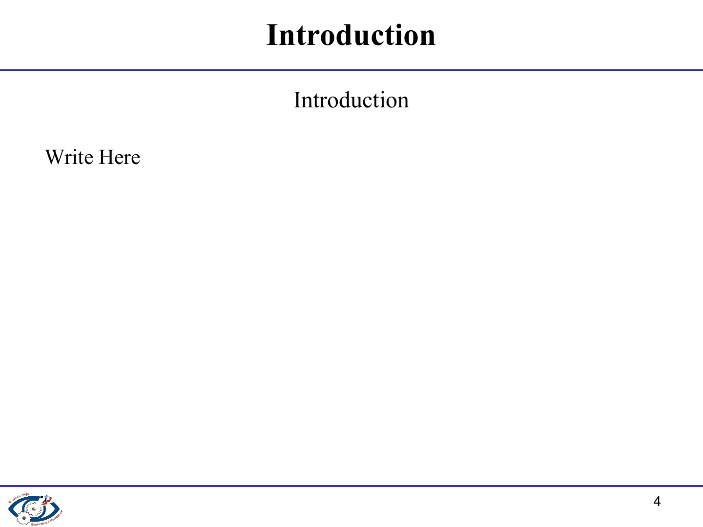
A full-stack web application for personal cash-flow tracking, budget planning, financial goals, and investment discovery.
Objectives
Record and review income, expenses, budgets, and financial goals in one portal.
Calculate monthly surplus and a disciplined investment capacity.
Match investment options to entered risk tolerance, horizon, goals, and capacity.
Show financial market data with local cached fallbacks when an API is unavailable.
Notes:
Source: README.md, Project Overview and Project Objectives.

Slide 5

Personal financial information is often spread across notebooks, banking apps, and separate market portals.
Users need early warnings when category spending approaches a budget limit.
A savings figure alone does not show how much money can be invested safely.
Investment options need clear, criteria-based matching instead of generic suggestions.
The problem provides a practical use case for data structures and algorithms in a web system.
Notes:
Source: README.md, Problem Statement and DSA Implementation sections.

Slide 6
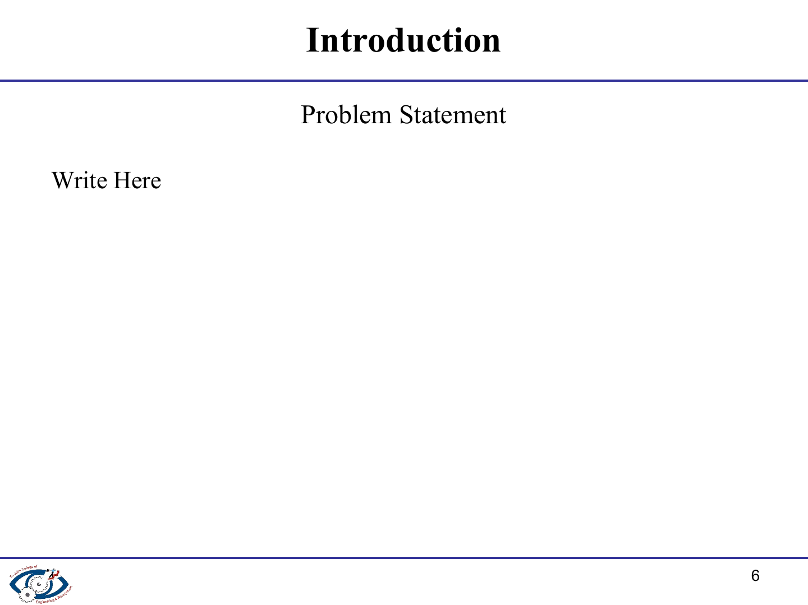
Many users cannot clearly compare monthly income with categorized spending and active budget limits.
Expense trackers rarely deduct emergency reserves and goal obligations before presenting investment options.
Market prices, gold rates, mutual fund data, and financial news require users to visit disconnected sources.
Generic investment suggestions may ignore the user's risk tolerance, horizon, affordability, and liquidity needs.
Notes:
Source: README.md, Problem Statement.

Slide 7
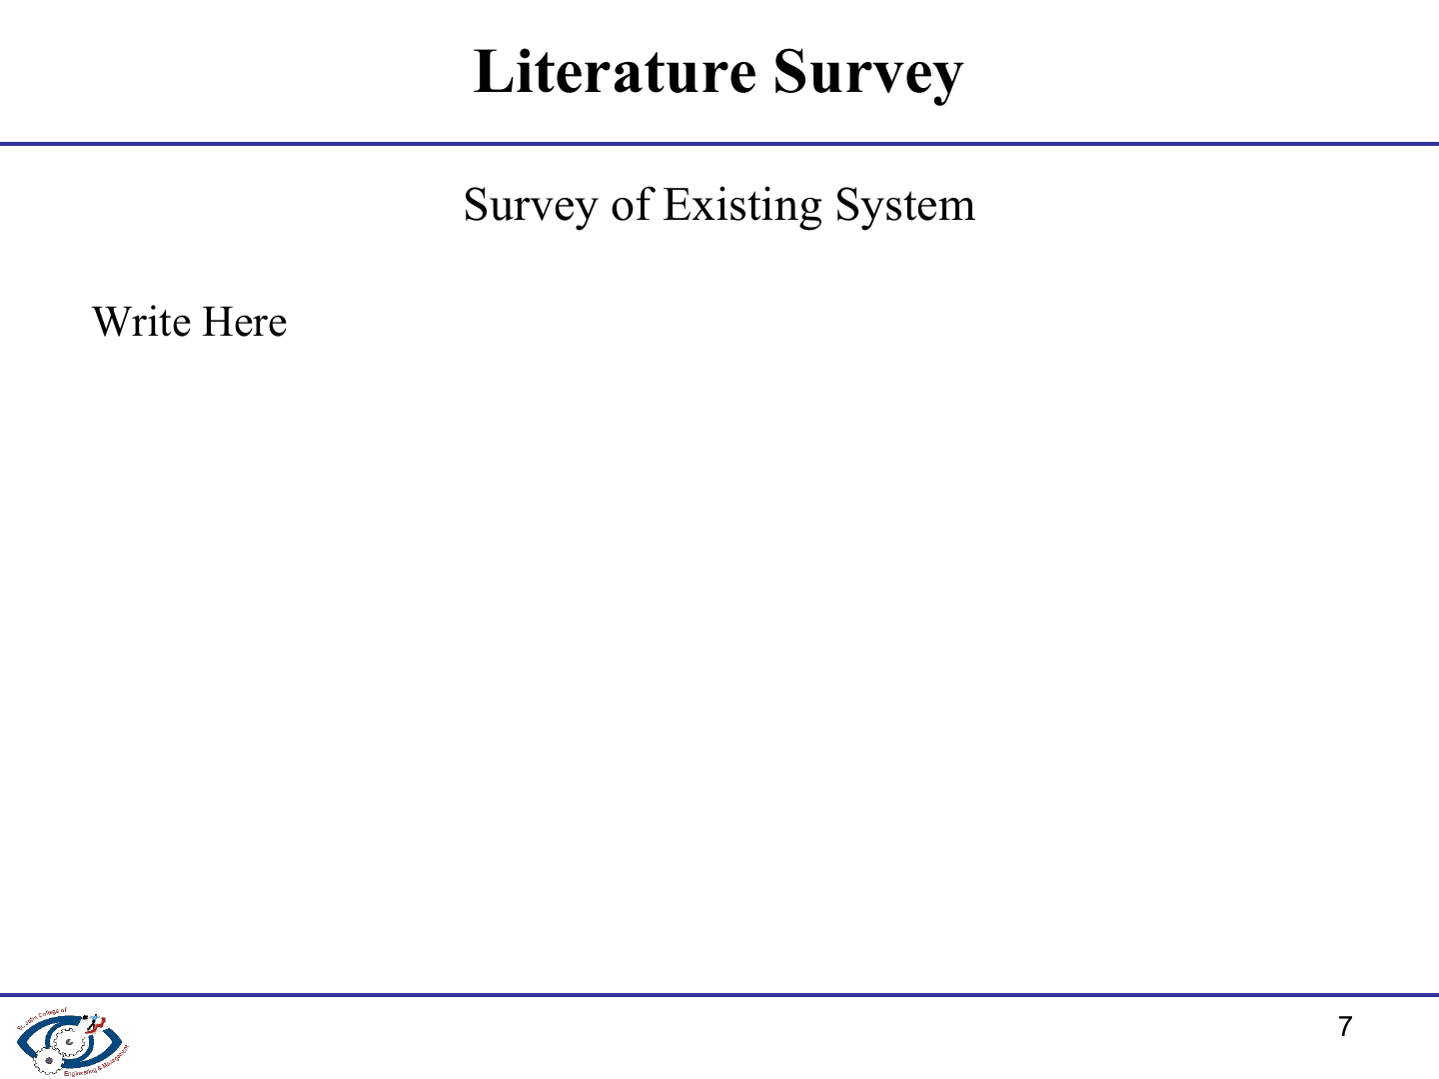
Existing approach | What it provides | Gap addressed by this project
Expense tracker | Income and expense entry | No goal-adjusted investment capacity or ranking
Market portal | Quotes for one asset class | No connection to personal cash flow or budgets
Generic investment widget | Basic category suggestions | Limited explanation of risk, affordability, and horizon fit
Proposed system | Finance records, data feeds, and matching | Integrates planning and explainable DSA ranking
Notes:
Comparison synthesized from the project problem statement and feature set in README.md. It describes system categories rather than a benchmark of named products.

Slide 8
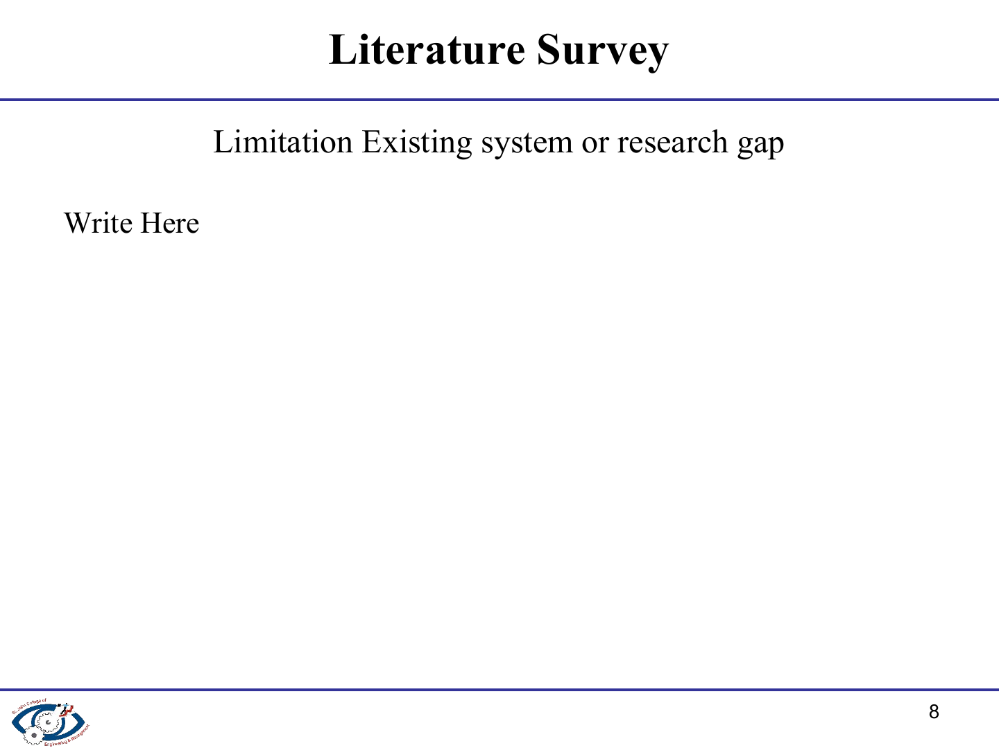
Research gap addressed by the proposed system
A single workflow is needed from financial recording to investment-option matching.
Investment capacity should account for emergency reserve allocation and goal commitments.
Recommendations should explain the score instead of hiding the matching logic.
Live financial data should remain usable when network access or API quotas fail.
Academic DSA implementations should operate on meaningful system data rather than isolated examples.
Notes:
Source: README.md, Problem Statement, Recommendation Engine, and API fallback descriptions.

Slide 9
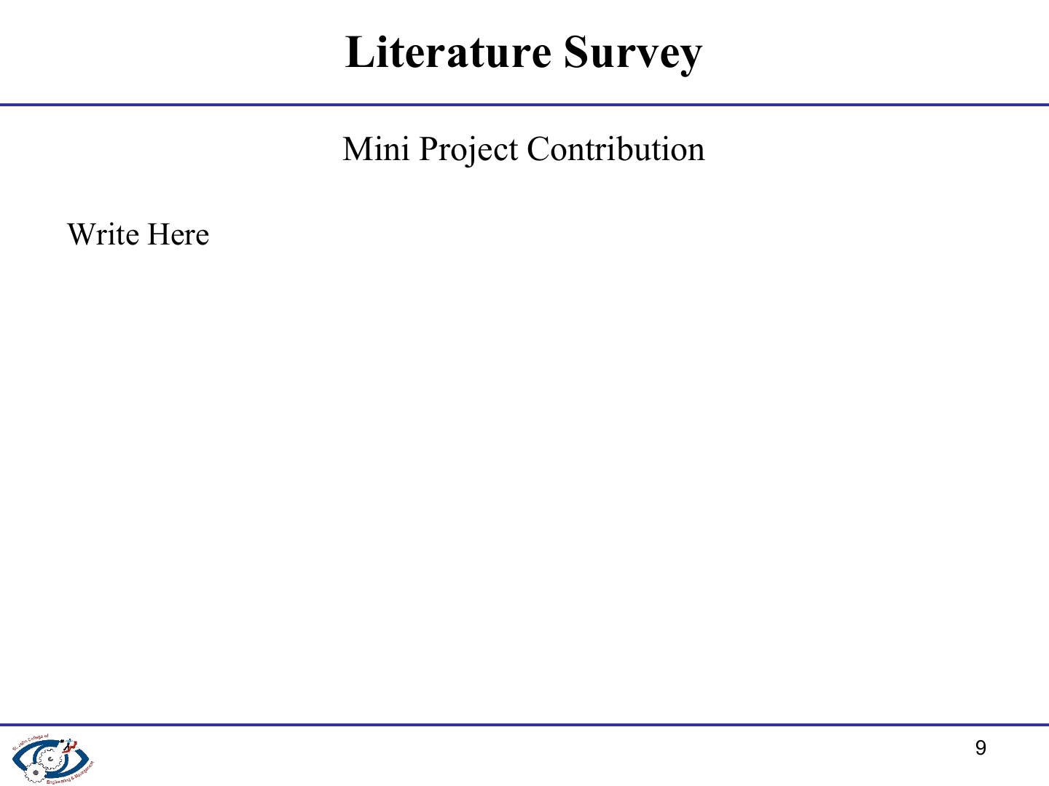
A secure Flask portal with registration, session control, and hashed passwords.
SQLite schema with foreign keys, validation constraints, audit records, and automatic first-run setup.
Budget status indicators and goal progress calculations for daily financial planning.
Searching, sorting, filtering, hash indexing, and max-heap ranking modules for investment matching.
External financial data clients with cached fallback records for reliable demonstrations.
Notes:
Source: README.md, Key Features, Database Architecture, and DSA Implementation.

Slide 10
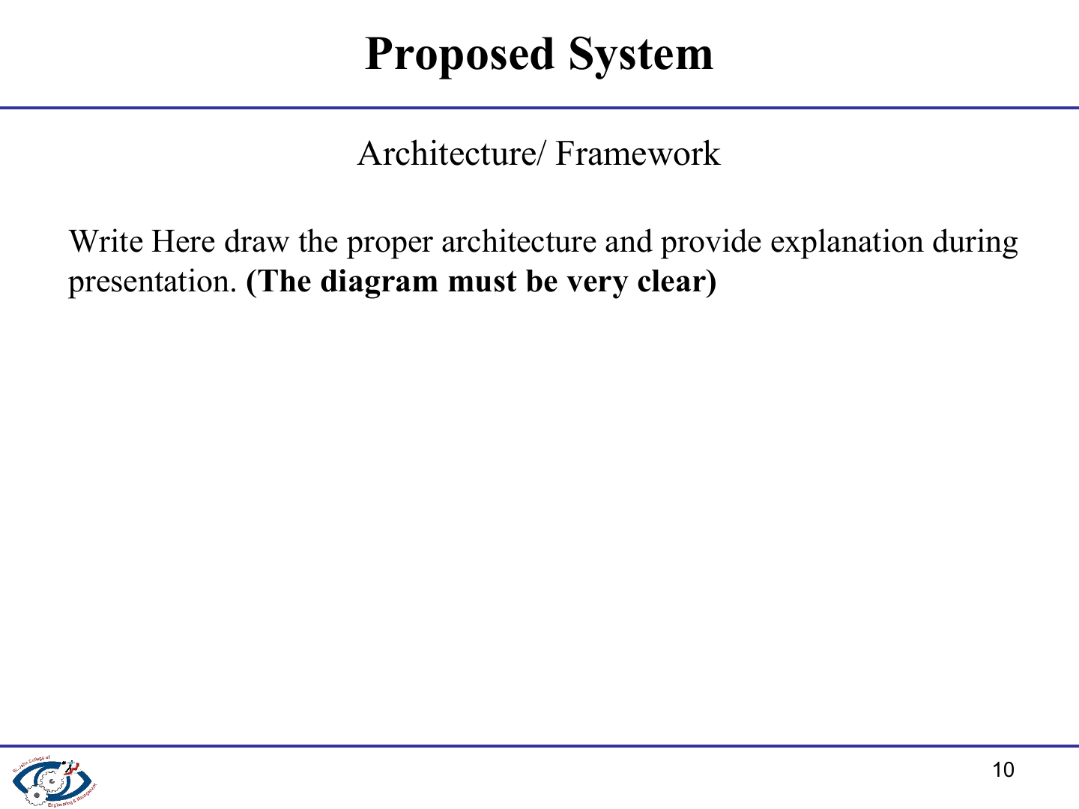
User Browser
HTML5, CSS3, JavaScript
Flask Application Layer
Routes and session guard
SQLite Database
Records, cache, audit logs
Services
Auth, finance, dashboard, investment
DSA Layer
Search, sort, filter, hash index, max-heap
External API Clients
Stocks, gold, news, mutual funds
The application combines user records, DSA modules, and market-data clients through a Flask service layer.
Notes:
Source: README.md, System Architecture. Diagram is editable in the PowerPoint file.

Slide 11
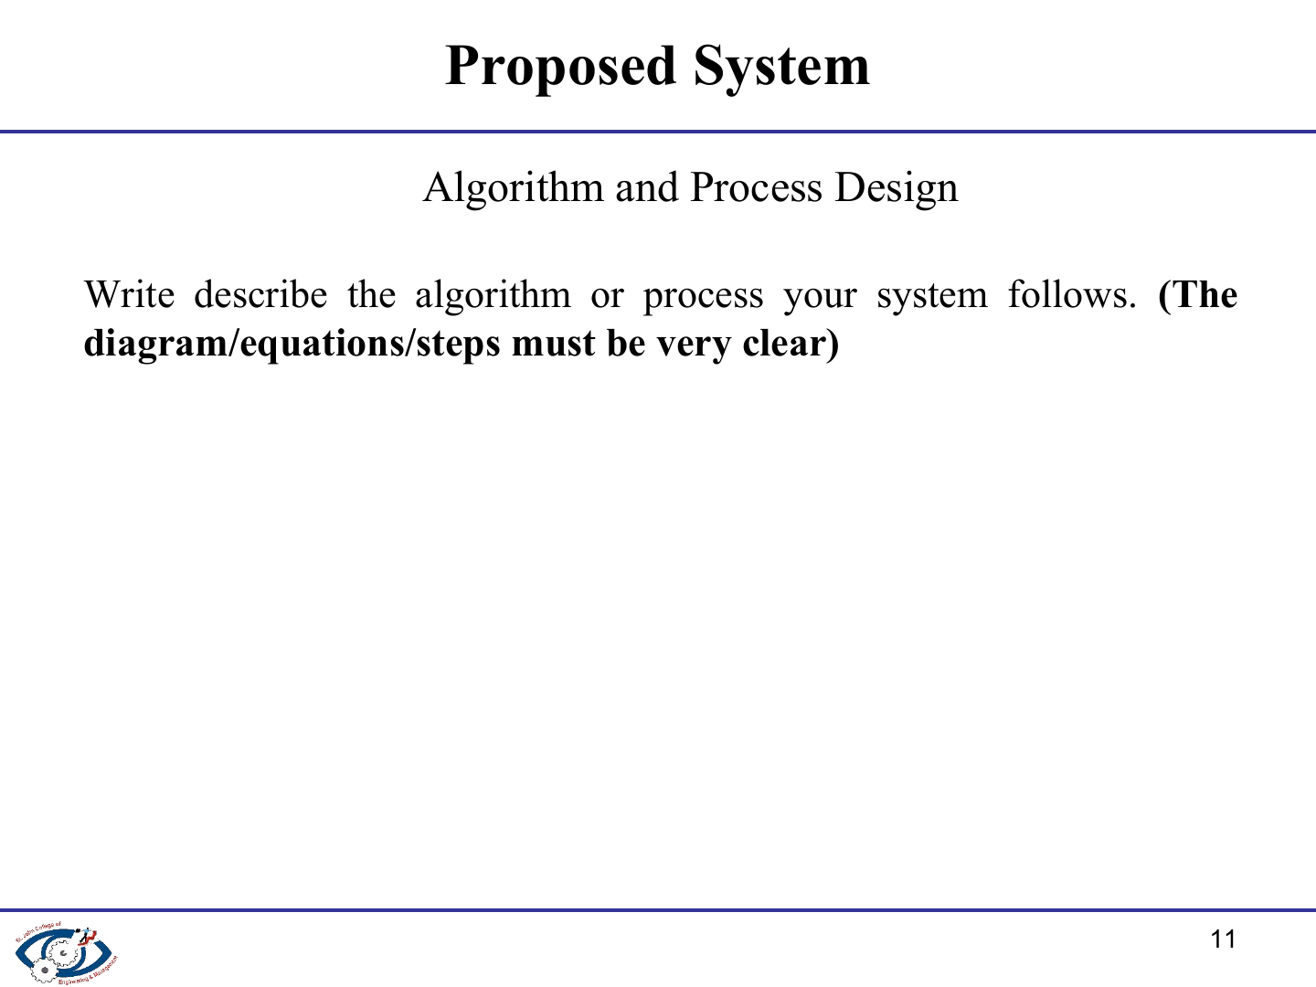
1. User input
Income, expense, goal, profile
2. Cash-flow calculation
Surplus = income - expenses
3. Safe capacity
Subtract reserve and goal amount
4. Filter candidates
Risk, amount, horizon, category
5. Score matches
Risk 30, amount 25, horizon 20, goal 15, liquidity 10
6. Rank output
Max-heap returns top options with reasons
Available Capacity = max(0, Surplus - Emergency Reserve - Monthly Goal Commitments)
Notes:
Source: services/recommendation_service.py and algorithms/recommendation.py. Diagram and formula are editable in the PowerPoint file.

Slide 12
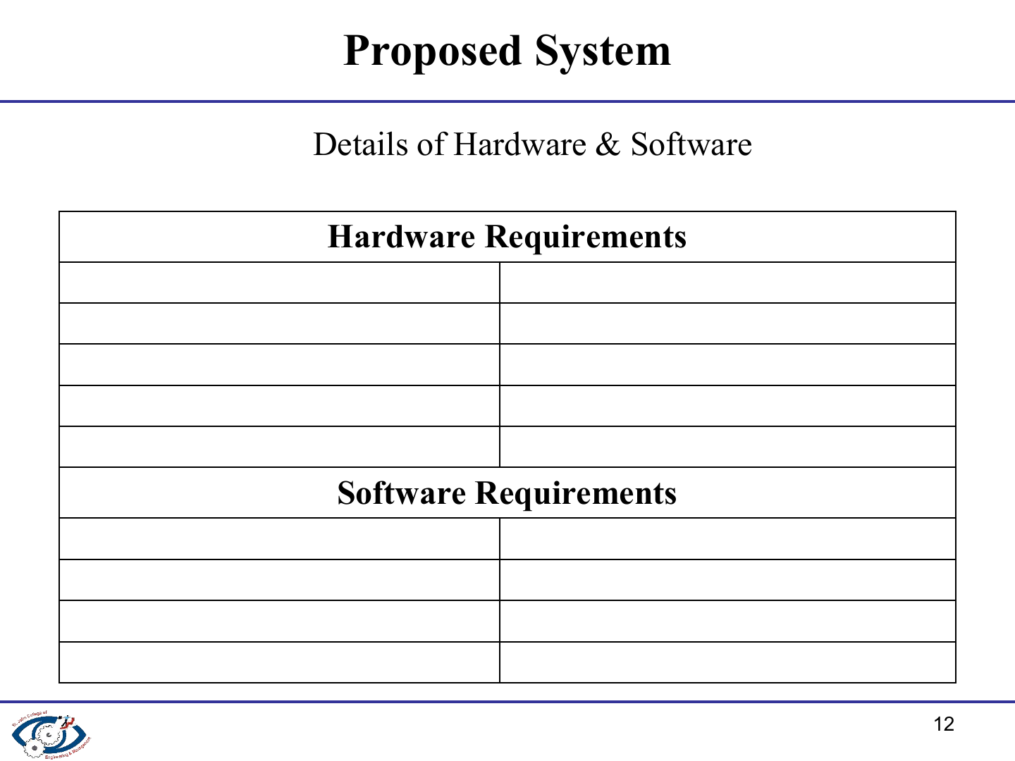
Hardware Requirements
Component | Minimum requirement
Processor | Dual-core 2 GHz or higher
RAM | 4 GB
Storage | 500 MB free disk space
Network | Internet for live APIs; local cache supports an offline demo
Software Requirements
Component | Requirement
Operating system | Windows, Linux, or macOS
Runtime | Python 3.10 or higher
Application stack | Flask 3.x, SQLite 3, HTML5, CSS3, JavaScript
Libraries | requests, python-dotenv, Chart.js via CDN
Notes:
Source: README.md, Technology Stack and Installation & Setup. Requirements are stated as practical minimums for the supplied application.

Slide 13
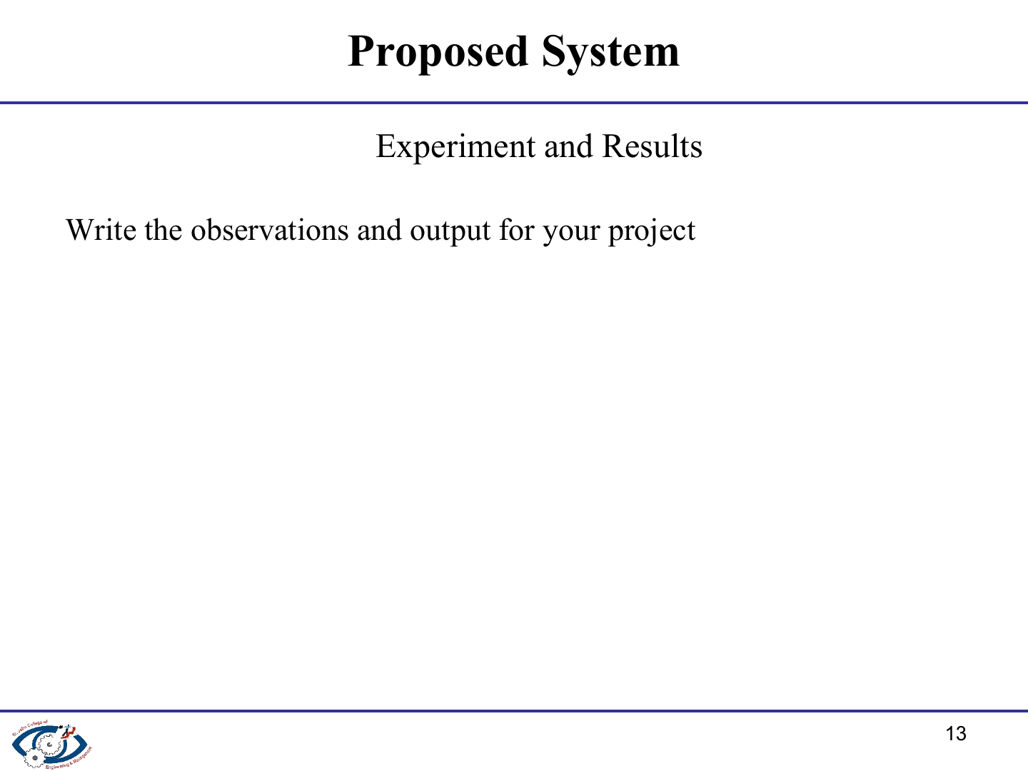
Automated acceptance test scenario
Test condition | Assertion in the project test suite
Income ₹50,000; expenses ₹30,000 | ₹20,000 surplus and a 40% savings rate
Goal ₹5,00,000; current amount ₹50,000 | ₹4,50,000 remaining amount and a monthly contribution calculation
MEDIUM risk; LONG horizon | At least three recommendations ranked in descending score order
API missing, unavailable, or rate-limited | Cached SQLite data remains available without an application crash
The test suite also verifies SQLite persistence, route rendering, algorithm routines, and recommendation explainability.
Notes:
Source: test_system.py, especially test_05_final_acceptance_test_requirement_37. The slide reports assertions specified in the local automated test suite.

Slide 14
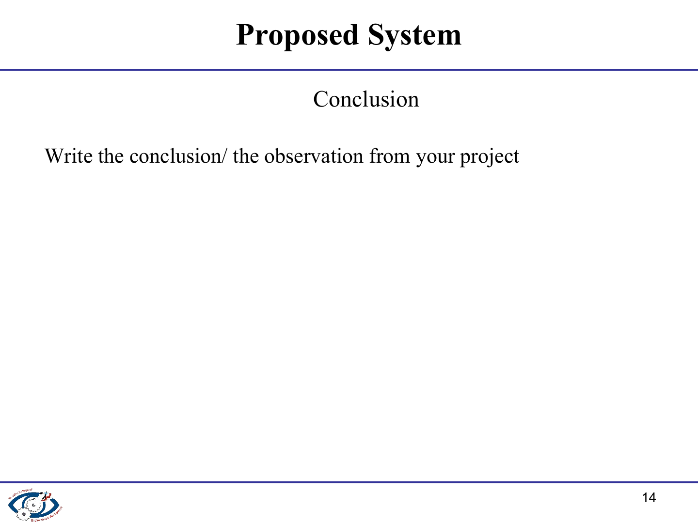
The system turns income, expenses, budgets, and goals into a clear monthly financial picture.
Investment capacity protects an emergency reserve and required goal contributions before matching options.
DSA modules provide transparent searching, filtering, scoring, and priority-based ranking.
Flask, SQLite, and cached API fallbacks create a portable and reliable academic prototype.
Recommendations show criteria-based options and do not claim guaranteed returns or financial advice.
Notes:
Source: README.md, Project Overview, Recommendation Engine, and Limitations & Future Scope.

Slide 15
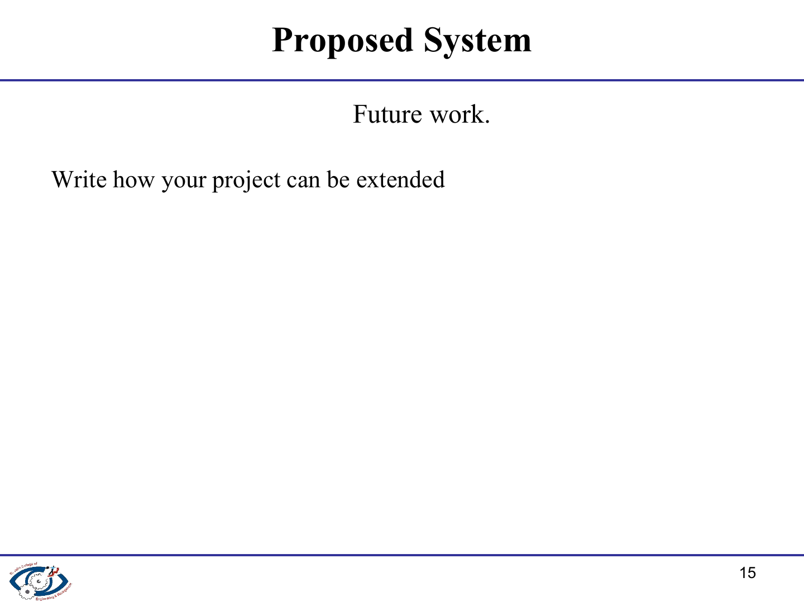
Import bank statements from PDF or CSV files to reduce manual data entry.
Add Monte Carlo simulations for long-term goal and retirement forecasting.
Introduce two-factor authentication through an email one-time password.
Create tax summaries and annual capital-gains reports for export.
Extend the system with multi-currency support and cloud deployment.
Notes:
Source: README.md, Limitations & Future Scope. Multi-currency support and cloud deployment are proposed extensions consistent with the documented INR-only current implementation.

Slide 16
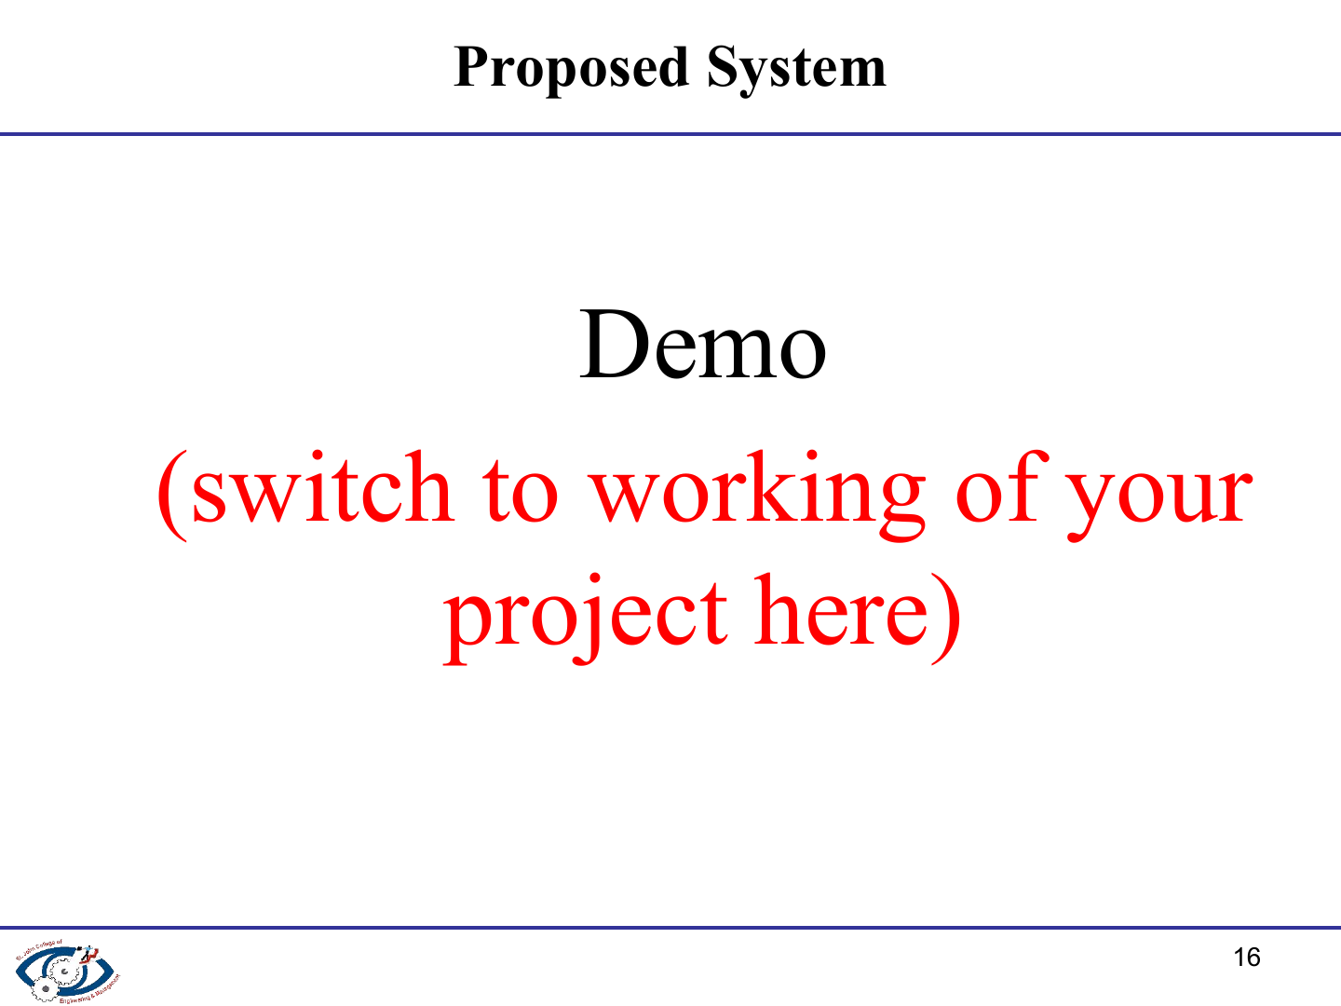
Live demonstration flow
Register or log in to open the personal dashboard.
Record ₹50,000 income and ₹30,000 categorized expenses.
Set category budgets and create a financial goal.
Choose a MEDIUM risk profile and a LONG investment horizon.
Open the recommendation page to show capacity, ranked options, and reasons.
Show stock, gold, mutual fund, news, and backend status pages.
Notes:
Demo sequence based on the application routes in app.py and the acceptance scenario in test_system.py.

Slide 17
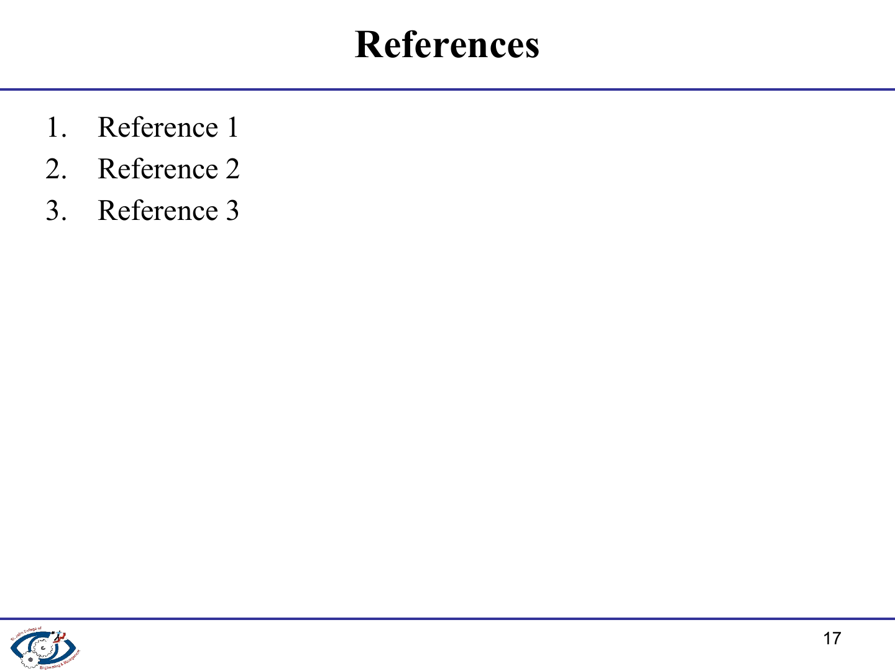
1. Smart Personal Finance & Budget Management System, local README and source code.
2. Flask Documentation. https://flask.palletsprojects.com/
3. SQLite Documentation. https://www.sqlite.org/docs.html
4. Alpha Vantage, GoldAPI, NewsAPI, and MFAPI.in documentation.
Notes:
References listed for presentation use. The project functionality is documented locally in README.md and the corresponding Python modules.

Slide 18
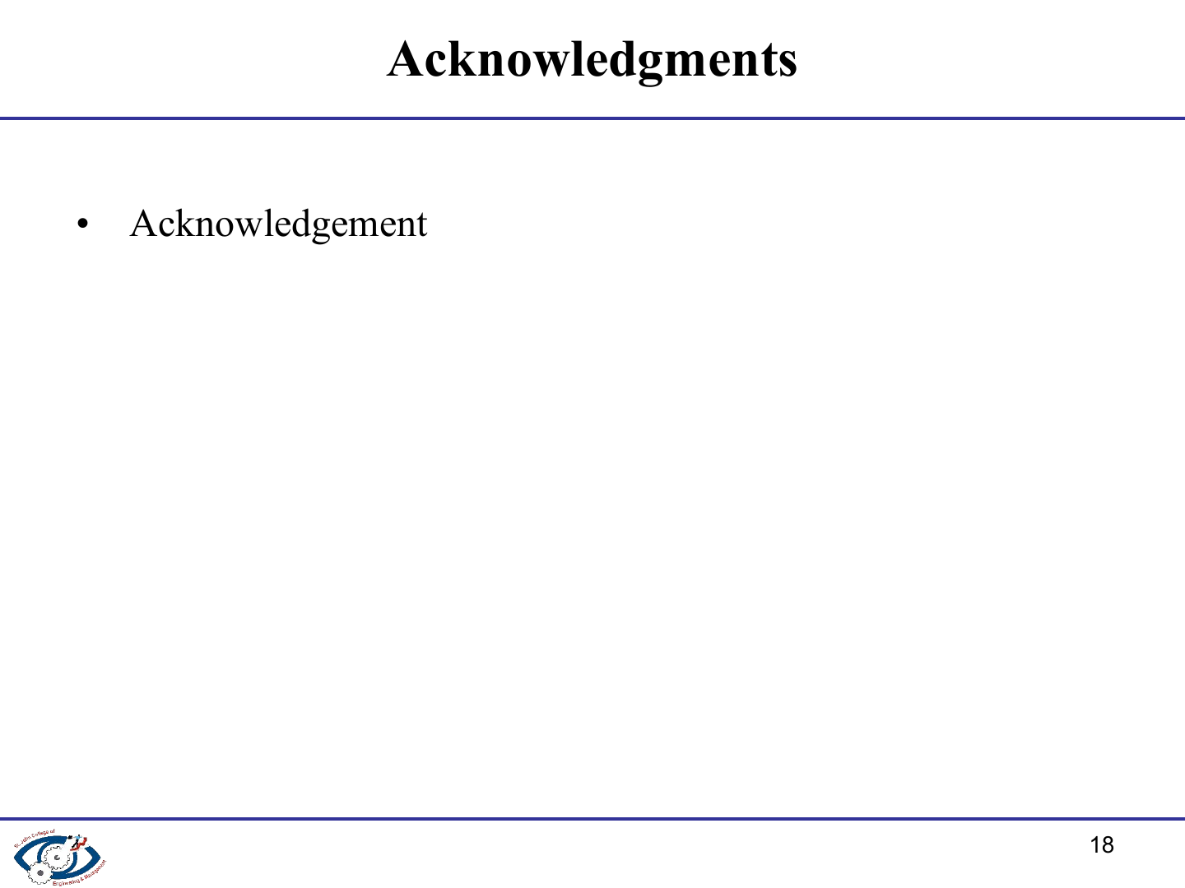
We thank our project guide for direction and review throughout this work. We also acknowledge the Department of Information Technology for the academic environment that supported the design, implementation, and evaluation of this project.
Notes:
Generic acknowledgement used because individual names were not supplied. It is editable in PowerPoint.

Slide 19

Notes:
Closing slide retained from the supplied template.

Slide 20

Notes:
Q&A slide retained from the supplied template.

