Slide 1

A. D. Patel Institute of Technology ( Mechanical Department )
Development of Graphical User Interface (GUI) for pump selection
1) Kartikey .S. Garasiya (140010119022)
2) Kunjan .P. Bhoye (140010119006)
3) Chirag .V. Patel (140010119072)
4) Vaghela .G. Hardik (150013119029)
Mentors : 1) Dr. Y. D. Patel
2) Prof. R. J. Desai

Slide 2
Introduction
The name MATLAB stands for MATrix LABoratory. MATLAB was written originally to provide easy access to matrix software developed by the LINPACK (linear system package) and EISPACK (Eigen system package) projects.
Applications of MATLAB
Algorithm development
Scientific and engineering graphics
Modeling, simulation, and prototyping
Application development, including Graphical User Interface building
Math and computation
Data analysis, exploration, and visualization

Slide 3
Conti…
A graphical user interface (GUI) is an interface through which a user interacts with electronic devices such as computers, hand-held devices and other appliances.
This interface uses icons, menus and other visual indicator (graphics) representations to display information and related user controls, unlike text-based interfaces, where data and commands are in text.

Slide 4
Conti…
A screw pump is a type of rotary pump which is equipped with screws that mesh together and rotate within a cylindrical cavity or liner. The fluid enters from the suction side of the pump and moves linearly along these intermeshing screws to the discharge side of the pump. The clearances between the screws and the liner are very small hence the fluid gains pressure while moving through pump.
Applications :-
fuel-injection
oil burners
hydraulics
fuel
lubrication

Slide 5
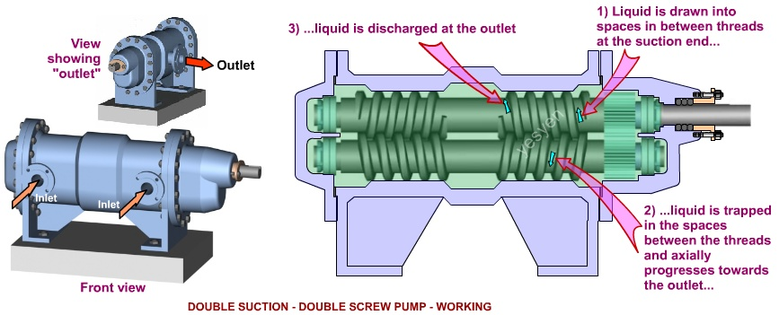
Conti…
Source: https://google.com/images

Slide 6
Screw pump
A screw pump is type of rotary pump which is Equipped with screws that mesh together and rotate within a Cylindrical cavity or liner. The fluid enters from the suction side of the pump and moves linearly along these intermeshing Screw to the discharge side of the pump.
Types of the screw pump:
One screw pump
Two screw pump
Three screw pump

Slide 7
Screw pump Applications
Due to their ability to provide high flow rates even in viscous liquids, screw pumps are ideal for fuel transfer, elevators, and other similar industrial applications.
Single screw pumps, or Archimedean screw pumps, are used for simple water movement such as for sewage inlet pumps, storm water pumping, drainage pumping, and to move industrial waste water.

Slide 8
About Project
Used .xls format data ,
Flow rate
Power
Viscosity
Pressure
Pitch
Diameter
Used MATLAB app designer software and developed this app for the user to find data easily by just input of flow rate , viscosity and pressure. According to that input data user get’s information about specific pump.

Slide 9
Literature review
Sr no. | Title | Publication detail | remarks
1 | Numerical Analysis for Twin Screw Pump Internal Flow | Applied Mechanics and Materials Vols. 130-134 (2012) 2011- 2012 Trans Tech Publications, Switzerland | Parameters of screw pump like flow rate, viscosity, pressure to design GUI
2 | Updates to Function Lab, a Matlab based GUI for handling receiver functions | Computers & Geosciences Volume 111, February 2018, Pages 260-271 Robert W. Porritt Meghan S. Miller | Studied how to implement interactive MATLAB GUI to assist in handling these large datasets.
3 | Study of Screw Pump Stator and Rotor Working Capacity to Increase the Output | K.E.Borisova Volume 206, 2017, Pages 688-691 | Learned Study of Screw Pump and its Working.

Slide 10
Literature review
Sr no. | Title | Publication detail | remarks
4 | Research Paper on Object Oriented Software Engineering | International Journal of Computer Science And Technology Vol. 7, Iss ue 4, Oct - Dec 2016 | About object oriented programming which also has been used in MATLAB app designer code.
5 | The control and drive of a micro pump system HENRIK | HENRIK LINDE Albin Michel, 2010-03-17 Pages 127-153 | The parameter identification and the controllers are implemented using Simulink, MATLAB and dSpace Real Time Interface RTI
6 | CFD simulation of multiphase twin screw pump | M. van Beijnum Report number: WPC 2007.08 Pages 652-680 | Learned different effects of flow rate and other factors.

Slide 11
Literature review
Sr no. | Title | Publication detail | remarks
7 | MATLAB -based GUI for data mining as a tool for environment managment | International Journal of Computer, Information Science and Engineering Vol:8 No:1, 2014 | the aim of these tool is to provide an interface for applying data mining method in the environmental application . Useing this interface to collect data from sensor and applying the data mining method
8 | Class project with GUI In MATLAB | Min-Sung Koh American society for engineering education 2007 | Prepare GUI for different data for pump by studied different example like class project.
9 | Classification of pump | Machine parts Hicks, Tyler G November 21,2013 Pages 83-90 | Understand different types of pump and terminology
10 | liteITD a MATLAB Graphical User Interface (GUI) program for topology design of continuum structures | Mariano Victoria 2016-07-12 ,pages 126-147 | MATLAB software environment of MathWorks under Windows operating system. GUIDE (Graphical User Interface Development Environment) was used to create a friendly Graphical User Interface (GUI).

Slide 12
Outcome of Literature Review
Pitch ,Flow rate ,Diameter ,Viscosity and Power are main parameter affect selection of pump.
Learned how to clean up unwanted data and arranging data.
Understand concept of object oriented programming.
Implementation of GUI with MATLAB code and plotting and finding data from a database.

Slide 13
Problem definition
Development of Graphical User Interface (GUI) for screw pump selection.

Slide 14
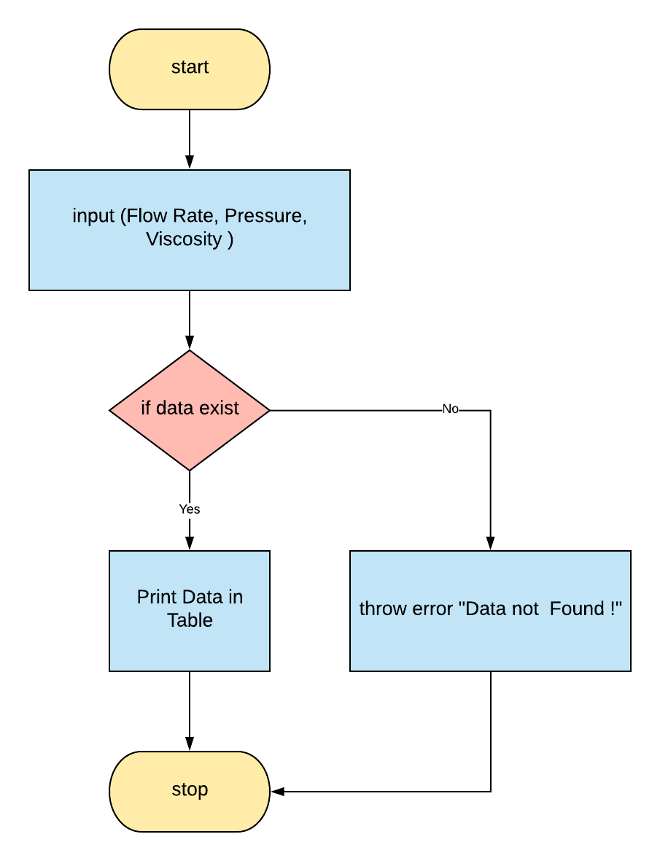
Methodology
Taking inputs from the user.
After obtaining the data using “find()” function.
Then using conditionals “if else” to check weather data is existing or not.
If not found matching data then we throw error as “data not found !”
If found matching data then going to print it’s diameter.

Slide 15
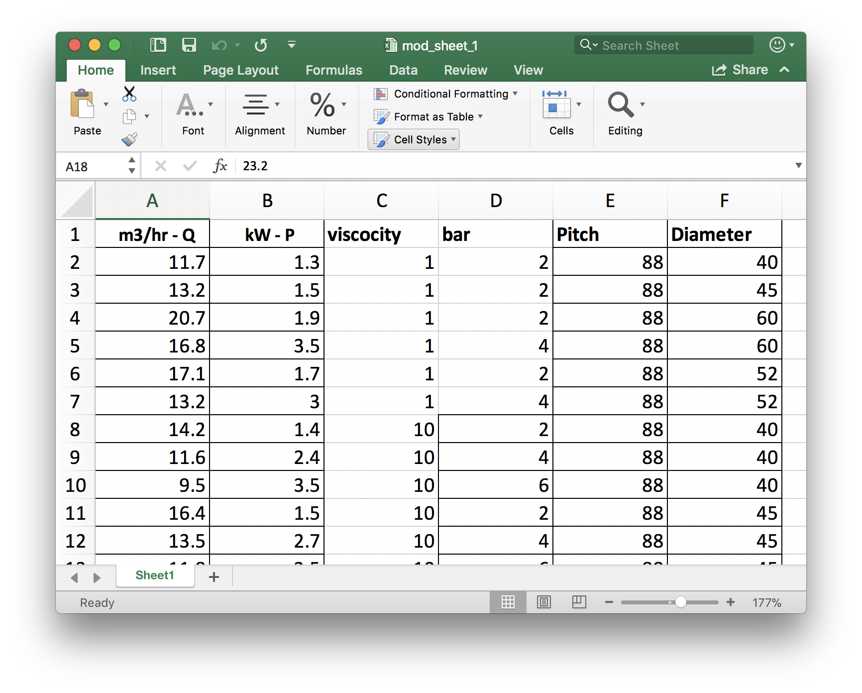
Screw pump data

Slide 16
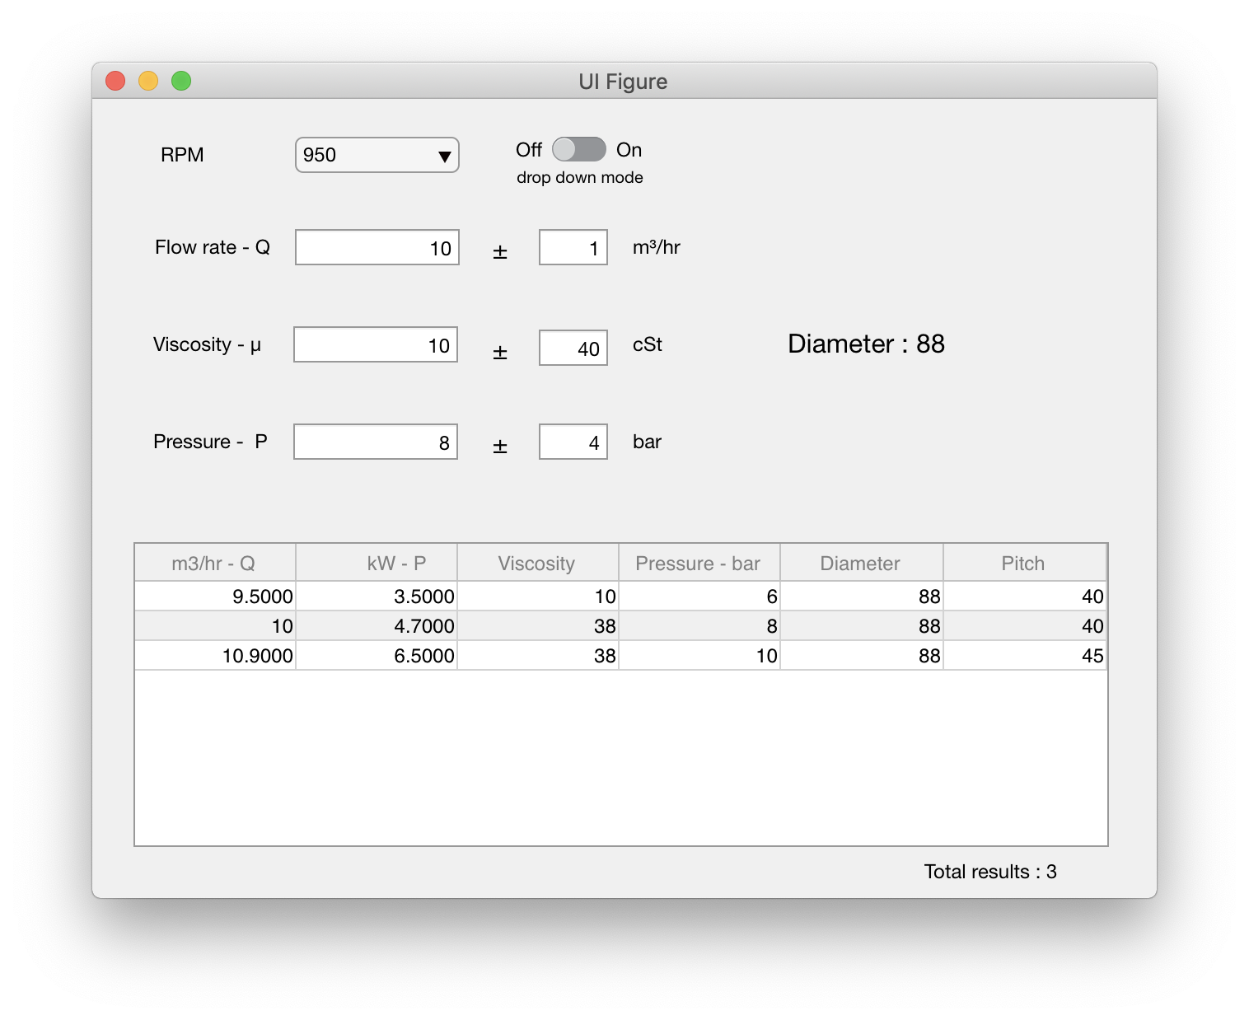
GUI developed under MATLAB (app designer) software

Slide 17
Work done in last semester
Learned MATLAB programming language and commands.
Collected required data for screw pump in excel sheet.
Converted excel data into MATLAB in .mat format.
Learned how to use App Designer and it’s programming language.
Created a GUI that takes Flow rate , Pressure and Viscosity as an input gives Diameter as an output based on the data.
Created a table that show all pump data in the data table.
Created a standalone program that can run without a MATLAB on the system.
Bug fix

Slide 18
Objectives
To develop a Graphical User Interface (GUI) for the selection of different screw pumps.
Based on selected pump calculate QF , QR , Coefficient of RPM , PP , PTH , PABS.
Curve generation of

Slide 19
Generation of Curves
In earlier section parameters like flow rate, viscosity and pressure get a range of pump.
Now in this section by adding some mathematical calculation get an graph ,two types of generation of curves :-
1)flow rate vs pressure
2)Power vs pressure

Slide 20
QF = flow rate (Cu m/hr)
QR = flow rate required (Cu m/hr)
PP = pump pressure (bar)
PTH = theoretical pressure (bar)
PABS = Absolute Pressure (bar)

Slide 21
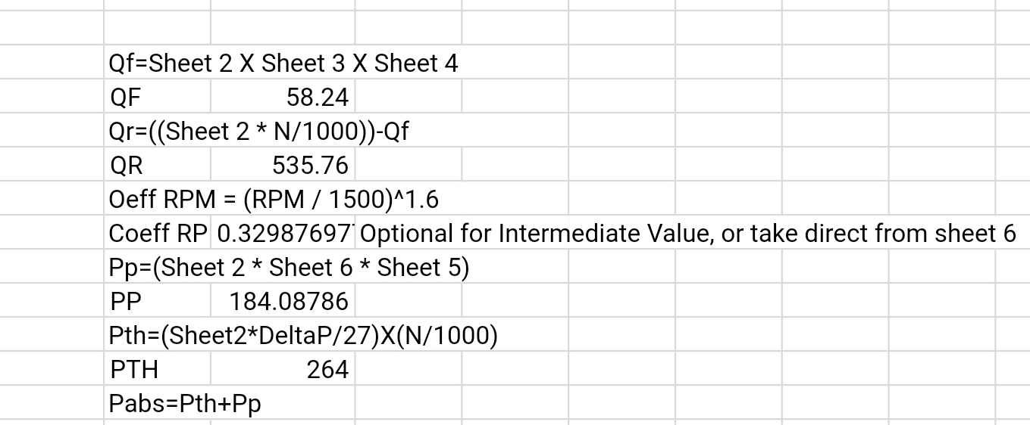
Calculations for Graphs

Slide 22
Example:
QF = 80*1.12*0.65
QF = 58.24
QR = (792*750/1000)-QF
= (792*750/1000)-58.24
= 535.76
Coeff RPM = (750/1500)^1.6
= 0.32987697

Slide 23
Pp = (67*0.33*8.326)
= 184.08786
Pth = (792*12/27)*(750/1000)
=264
PABS = Pp + Pth
= (184.08786)+(264)
= 448.08786

Slide 24
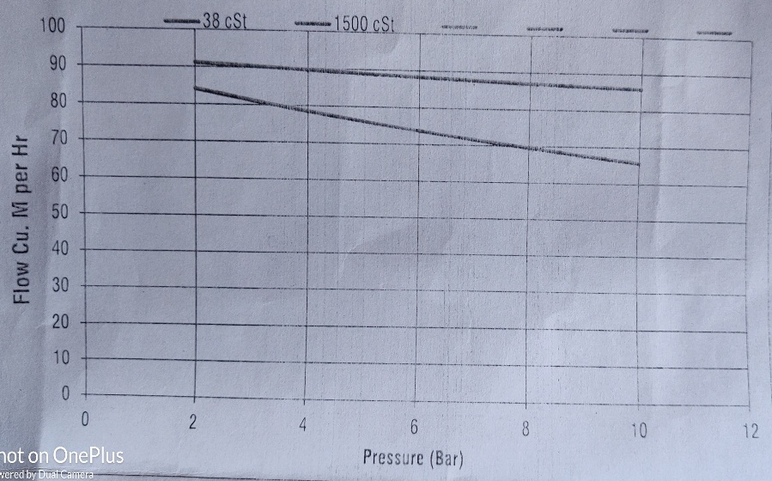
Graphs
Two types of Graphs for example
1)Flow rate vs pressure

Slide 25
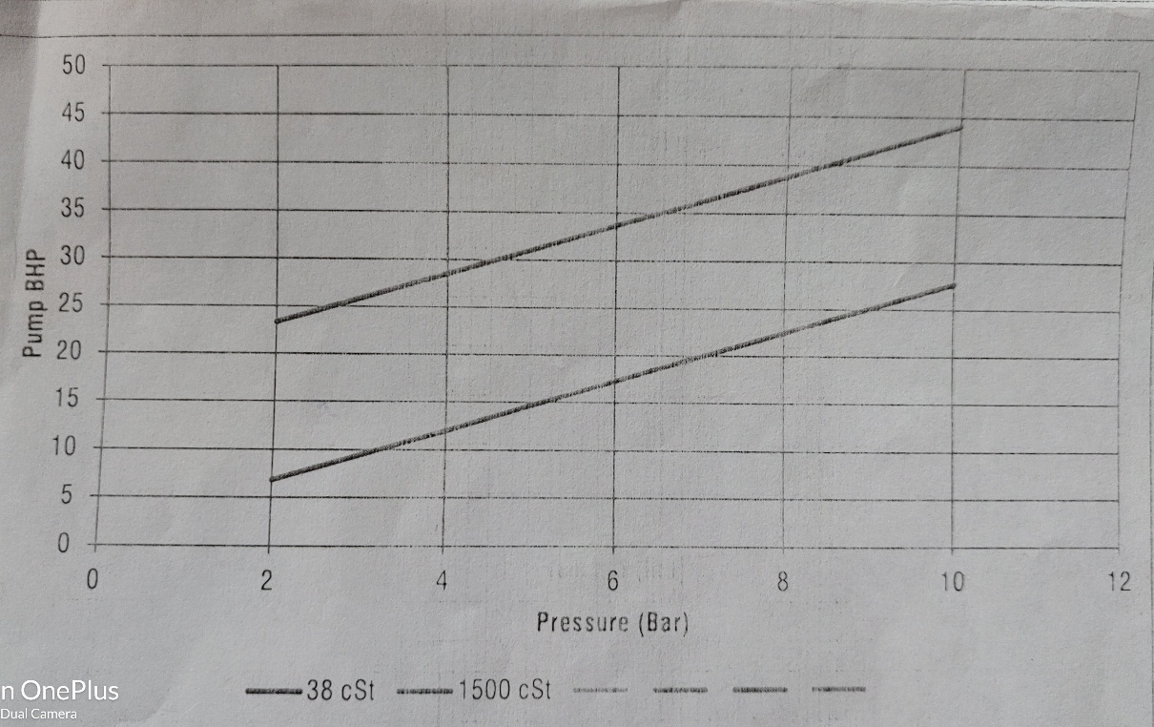
2)Power vs pressure

Slide 26
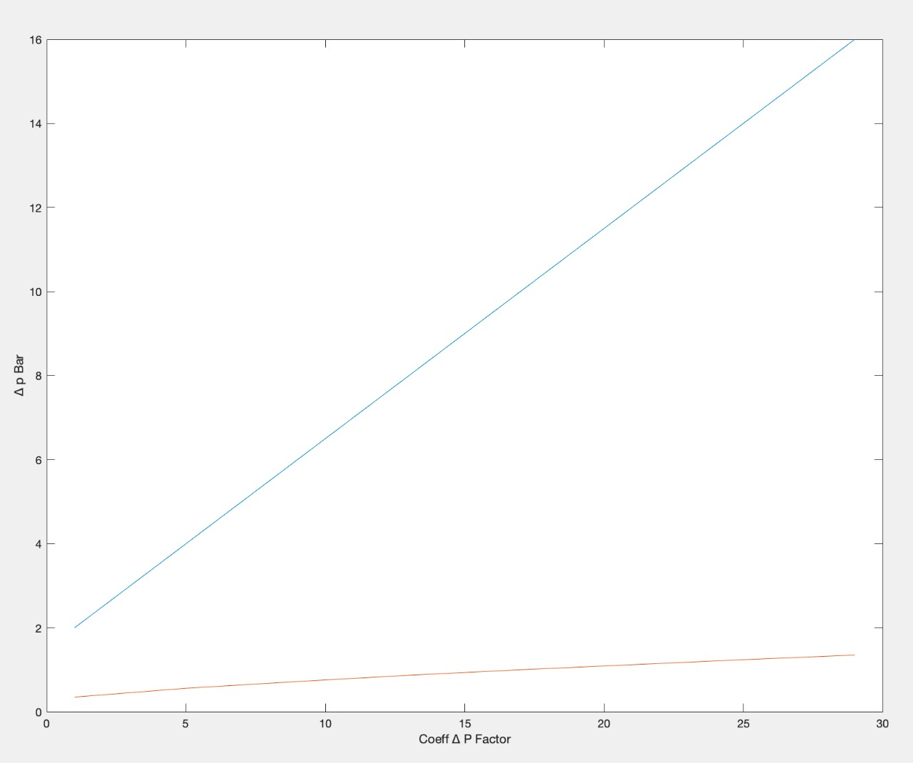
1)Flow rate vs pressure

Slide 27
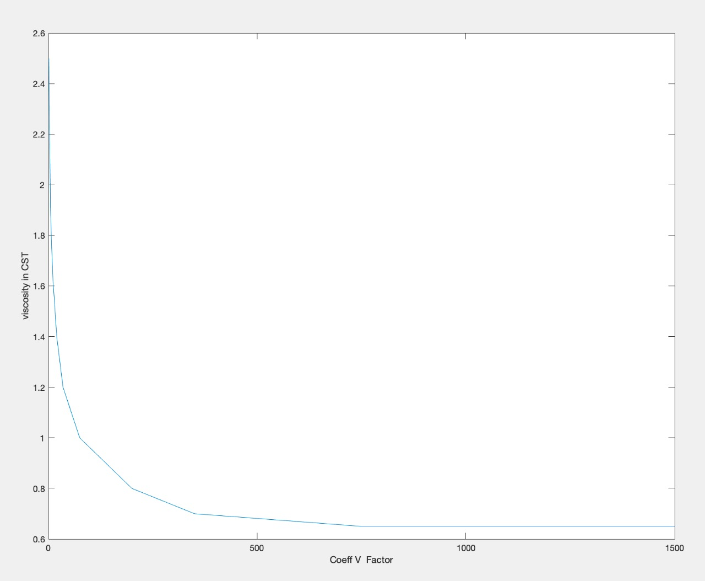
2)Power vs pressure

Slide 28
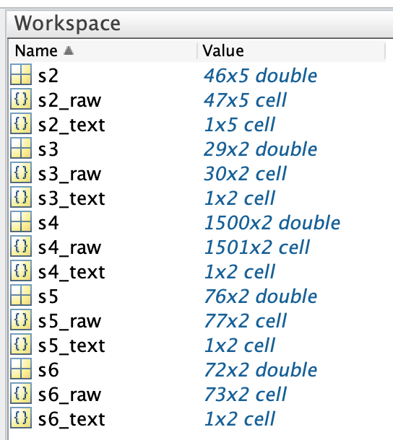
Data from excel sheet

Slide 29
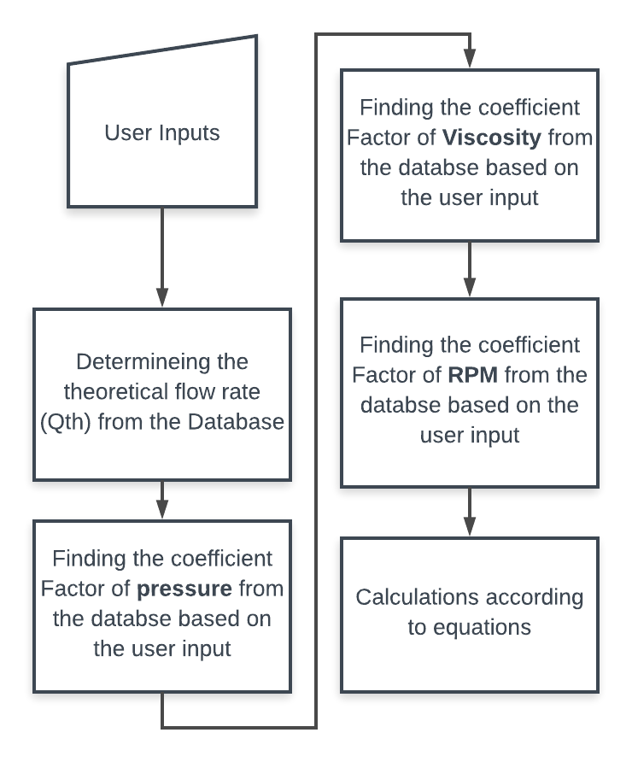
Work Flow of GUI

Slide 30
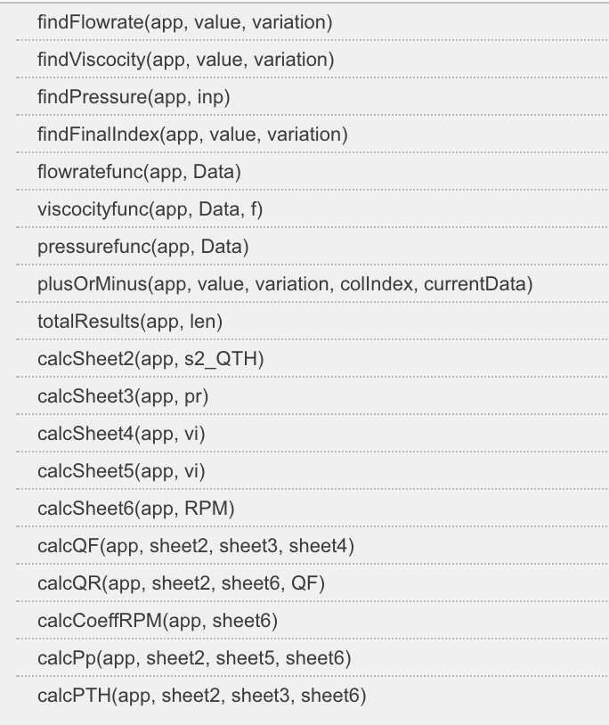
List of Functions in Appdesigner

Slide 31
Data from excel sheet

Slide 32
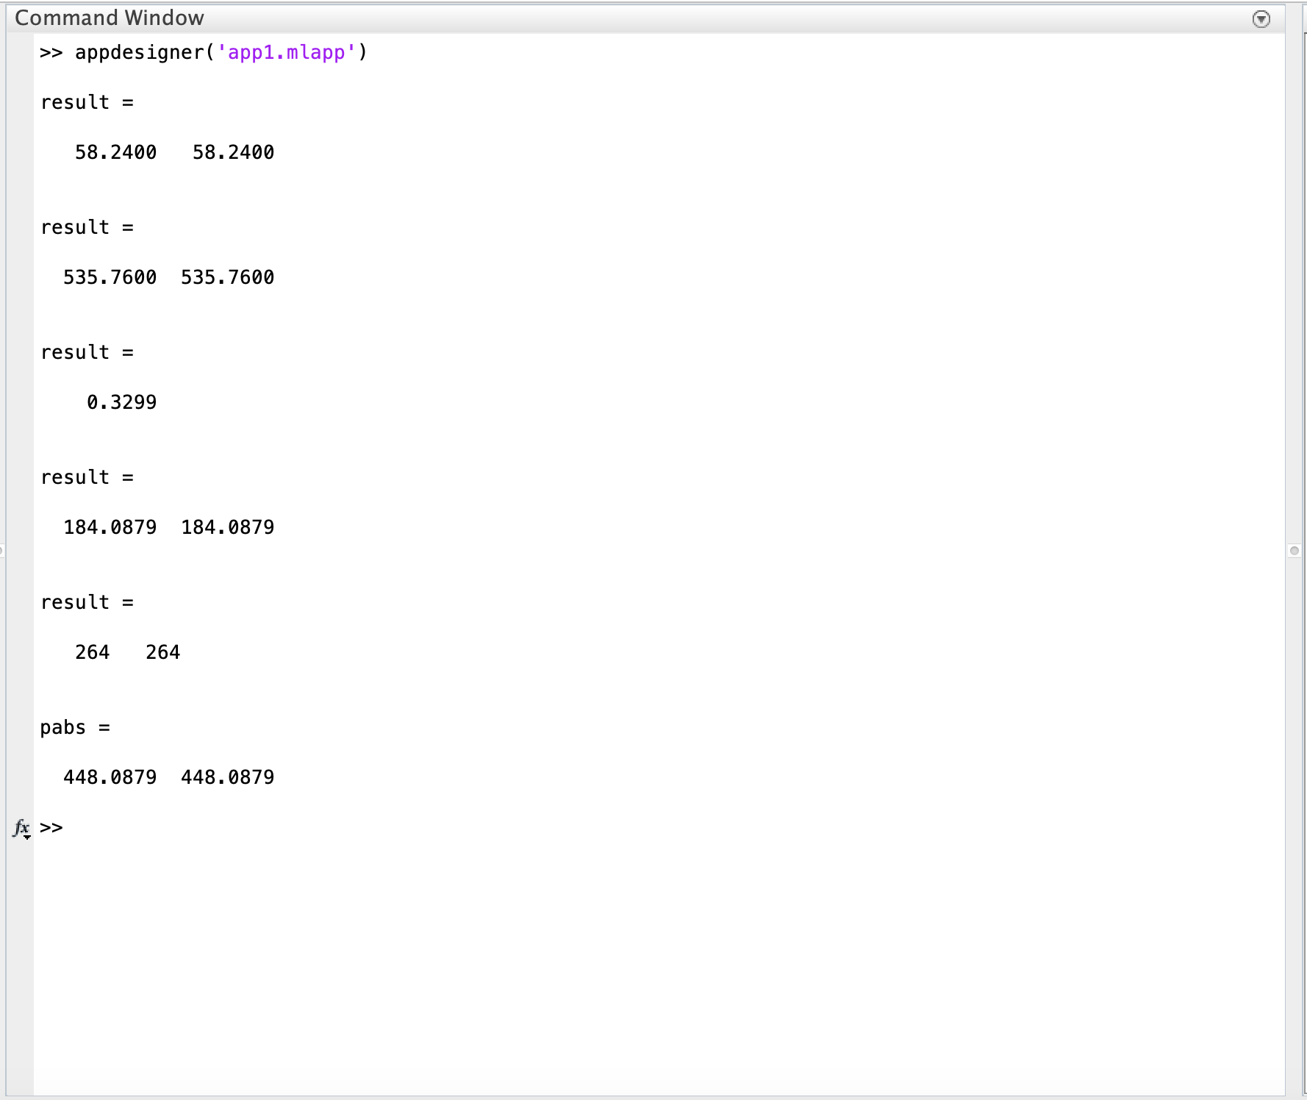
Output

Slide 33
Work done
Cleaning up the data from the company provided excel sheets.
Created a MATLAB script that convert excel data to MATLAB variables and save file in .mat format.
Created a database from excel data to .mat for each sheets.
Filled some missing require data with interpolation.
Integrated the new database with MATLAB’s Appdesigner GUI program.
Added new component and events in the frontend.
Created new functions for the calculations to find QF , QR , Coefficient of RPM etc.

Slide 34
Work remaining
Generation of curves.
Flow vs Pressure.
Power vs Pressure.
UI improvements.

Slide 35
References
Han Zhao , 2012 , Tech Publications, Switzerland.
Meghan S. Miller , 2018, Computers & Geosciences.
K.E.Borisova , 2017 ,Published by Elsevier Ltd.
Iqbaldeep Kaur,2016, International Journal of Computer Science And Technology
Albin Michel,2017, Master of Science Thesis Stockholm, Sweden 2010
M. van Beijnum,2007, Technische Universiteit Eindhoven
MATLAB,2014, International Journal of Computer
Min-Sung Koh, 2007, American society for engineering education
Hicks,2013, Classification of pump
Mariano Victoria,2016,not found

