Slide 1


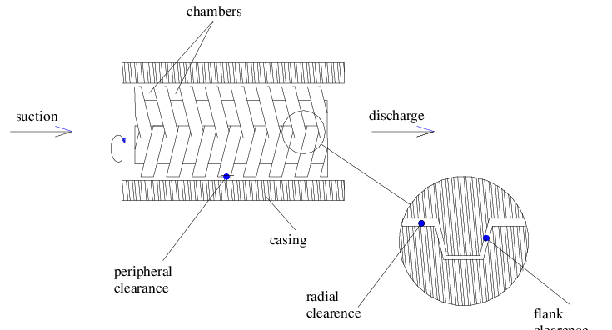
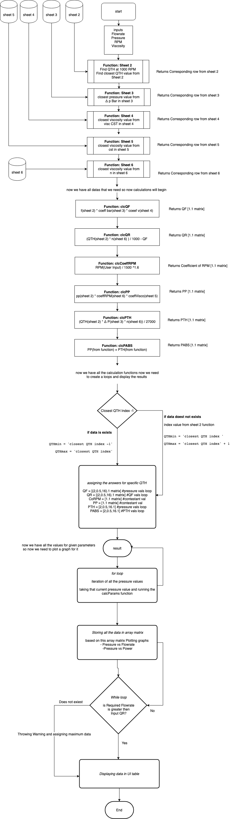
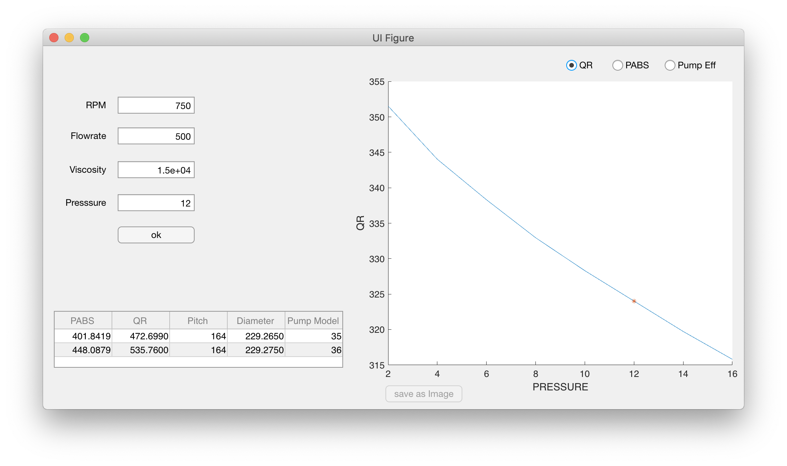
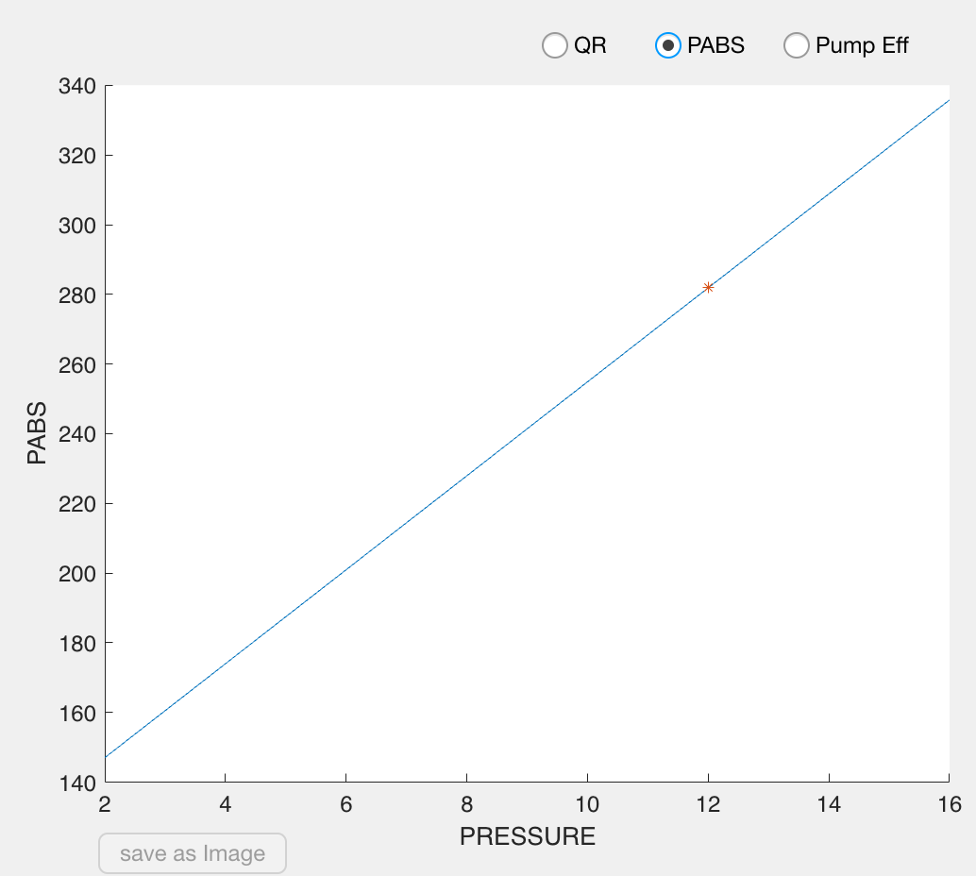
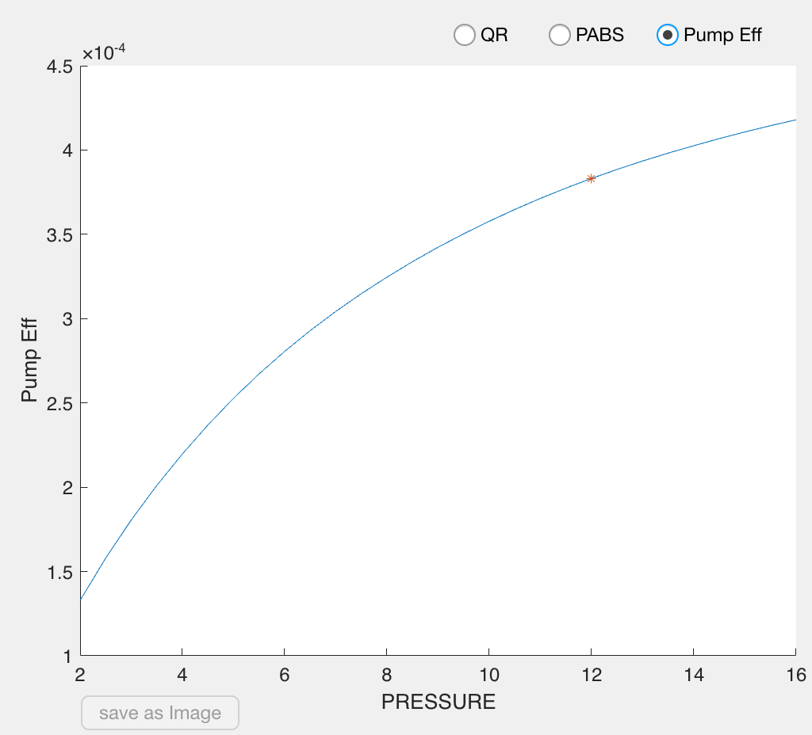
Development of twin screw pump selection software
Poster By : Kartikey S Garasiya (140010119022)
Chirag V Patel. (140010119072)
Kunjan P Bhoye (140010119022)
Hardik Vaghela (140010119022)
Guided by: Dr. Y. D. Patel &
Prof. R. J. Desai
Introduction
Pump is selected based on parameters like flow-rate, pressure viscosity and RPM but in most cases pump selection is over suited in terms of specifications due to that , Power consumption increases and it leads to lower efficiency. To improve the efficiency of the pump it should be selected carefully based on the requirement.
This software takes those parameter as an input and based on calculation it automatically selects suitable pump from the database in addition to that it generates some useful graphs like flow-rate vs pressure, power vs pressure and pump efficiency.
During selection of pump company has to select data manually from excel sheet which was taking more time, so company needed a software by which they input some parameter and get appropriate pump and to reduce time.
OBJECTIVE
Energy saving: correcting for pump oversizing can save 15% to 25% of electricity consumption for pumping.
Improve pump efficiency.
Flexible for various conditions at the best operating: from high to low viscous liquids.
Simple & easy maintenance with low service cost.
Twin screw pump
A twin screw pump is a positive displacement pump which means that the pump is transferring a certain volume of product in accordance to the speed and pitch of the screws. While turning, the two screws are forming closed chambers that are moving in an axial direction. This movement creates a vacuum at inlet side and a pressure at the outlet. Due to this double chamber technic there is an almost pulsation free working with high and low viscosity products.
Flow-chart
Working of the software
As shown in the Flowchart, this software takes inputs Flowrate Viscosity, Pressure and RPM. Then software calculates:
- Coefficient of leakage (QF)
- Required Flowrate (QR)
- Coefficient of RPM
- Pump Power (PP)
- Theoretical Power (PTH)
- Pressure Absolute (PABS)
Theoretical Flowrate at 1000 RPM.
As shown process on the flowchart, Program iterate all values of pressure from the database and calculate all values that shown above and store all answers in the matrix array from that matrix array, program selects the required flowrate which is higher than input flowrate or show the warning if flowrate is lower then the input flowrate.
Also according to the inputs program generates graphs as shown below.
Advantages after integrating the software
After integrating the software, the company will able to select the pump based on their customer needs without doing any calculations manually it can save significant amount of time.
Because the Pump is selected specifically based on the parameters it is more efficient therefore it will consume less power in compare to over suited pump.
Company can build a pump which take feedback of those parameters like Viscosity, Pressure, RPM, Flowrate and optimize the RPM to maintain flowrate at different type of viscus fluid.
Conclusion
Industry can save energy consumption and also make cost effective for the pump for the consumer.
Reduce the time of pump selection process
Reference
Pump and system magazine.
Pump square LLP.
MATLAB’s APPDESIGNER documentation.

Slide 2
Development twin screw pump selection software
Poster By : Kartikey Garasiya (140010119022)
Chirag .V. Patel (140010119072)
Hardik .G. Vaghela (150013119029)
Kunjan .P. Bhoye (140010119006)
Guided by: Dr. Y. D. Patel &
Prof. R. J. Desai
Introduction
Pump is selected based on parameters like flow-rate, pressure, viscosity and RPM but is most cases pump selection is over suited in terms of specifications due to that power consumption increases and leads to lower efficiency. To improve the efficiency pump is needed to selected carefully based on the parameters.
This software takes this parameter as an input and based on calculation it automatically selects suitable pump from the database in addition to that it generates some useful graphs like flow-rate vs pressure, power vs pressure and pump efficiency.
While selecting of pump company has to select manually data which take more time, so company needed a software by which they input some parameter and get appropriate pump and reduce time.
OBJECTIVE
Energy saving: correcting for pump oversizing can save 15% to 25% of electricity consumption for pumping.
Improve pump efficiency.
Flexible for various conditions at the best operating: from high to low viscous liquids.
Simple & easy maintenance with low service cost.
Twin screw pump
A twin screw pump is a positive displacement pump which means that the pump is transferring a certain volume of product in accordance to the speed and pitch of the screws. While turning, the two screws are forming closed chambers that are moving in an axial direction. This movement creates a vacuum at inlet side and a pressure at the outlet. Due to this double chamber technic there is an almost pulsation free working with high and low viscosity products.
Flow-chart
Working of the software
As shown in the Flowchart, this software takes inputs Flowrate Viscosity, Pressure and RPM. Then software calculates:
- Coefficient of leakage (QF)
- Required Flowrate (QR)
- Coefficient of RPM
- Pump Power (PP)
- Theoretical Power (PTH)
- Pressure Absolute (PABS)
-Theoretical Flowrate at 1000 RPM.
As shown process on the flowchart, Program iterate all values of pressure from the database and calculate all values that shown above and store all answers in the matrix array from that matrix array, program selects the required flowrate which is higher than input flowrate.
Advantages after integrating the software
After integrating the software, the company will able to select the pump based on their customer needs without doing any calculations manually it can save significant amount of time.
Because the Pump is selected specifically based on the parameters it is more efficient therefore it will consume less power in compare to over suited pump.
Company can build a pump which take feedback of those parameters like Viscosity, pressure, RPM, Flowrate and optimize the RPM to save power.
Conclusion:
This software helps for automation
Industry save energy consumption and also make cost effective for the pump industry.
Reference:
pump and system magazine.
pump square LLP.
MATLAB’s APPDESIGNER documentation.

