Slide 1
Melt House – Smart Restaurant Menu Chooser
Kartik Mutneja (2401730248)
Aryan Yadav (2401730245)

Slide 2
Problem Statement
Traditional menus are static and overwhelming.
Users lack an interactive platform to customize meals.
Restaurants struggle to personalize menu experiences efficiently.

Slide 3
Project Motivation
Rising demand for digital and dynamic menu experiences.
Desire for user-driven customization before ordering.
Improving customer satisfaction and restaurant efficiency.

Slide 4
Objectives
Simplify the restaurant menu selection process.
Build a responsive and attractive menu interface.
Enable real-time total pricing calculation.
Enhance overall user interaction and accessibility.

Slide 5
Tech Stack & Architecture
HTML5 – For structured page content.
Tailwind CSS – For a modern, responsive UI.
JavaScript – Logic for dropdowns and pricing.
VS Code & Browser Developer Tools – For development and debugging.

Slide 6
Key Features
Dynamic dropdown menus for food categories.
Live total bill updates based on selections.
Clean, responsive interface with visual feedback.
Reset option to clear and start over easily.

Slide 7
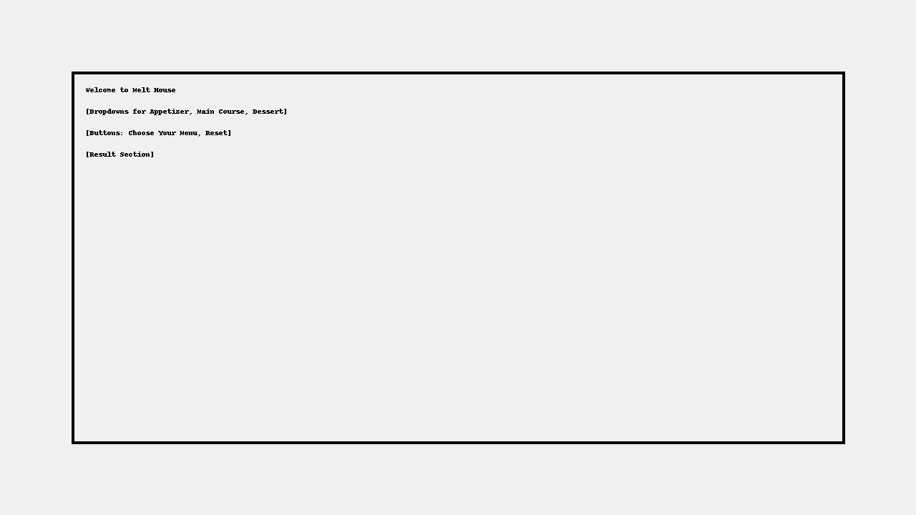
Project Screenshot

Slide 8
Conclusion & Future Work
Project successfully delivers a smart, engaging menu experience.
Future Enhancements:
- Backend integration with database.
- User login and order history system.
- Accessibility features and multi-language support.

Slide 9
Thank You
We appreciate your time and attention!
Open to questions and suggestions.
Presented by: Kartik Mutneja & Aryan Yadav

