Slide 1
School of Computer Science and Engineering B.Tech (CSE-AIML) 4th Semester
Minor Project ETE viva voce
Project ID- BPT2CSE020
Project Title- Credit Card Fraud Detection System Using Machine Learning
Team Members- Kartik Sharma, Chandan Mandal, Bhushan, Sumit Soni, Bhuwan

Slide 2
Abstract
• Credit card fraud has increased with digital payments, leading to financial loss and reduced user trust.
• This project uses machine learning on the European credit card dataset (284,807 transactions; only 492 fraud — 0.172%).
• Two models are applied: Logistic Regression (baseline) and Random Forest (comparison).
• Due to high class imbalance, accuracy alone is misleading; evaluation uses Precision, Recall, F1-Score, and Confusion Matrix.
• Logistic Regression Results: Accuracy 96.46, Recall 0.87, F1-Score 0.98.
• Random Forest shows slightly better overall performance based on comparison results.
• Key Takeaway: Proper evaluation metrics are essential for effective fraud detection in imbalanced datasets.

Slide 3
Introduction
• Credit cards are widely used for shopping, bill payments, recharges, travel booking, and food delivery.
• The rapid growth of digital payments has increased fraud risks, often detected only after financial loss.
• Traditional rule-based systems (e.g., unusual amount/location checks) are limited as fraud patterns continuously evolve.
• Machine Learning (ML) provides a smarter approach by learning from past transactions and detecting hidden fraud patterns.
• Motivation: Fraud detection is a high-impact real-world problem involving imbalanced data and practical ML challenges.
• Objectives: – Analyze imbalanced dataset – Build Logistic Regression baseline – Compare with Random Forest – Evaluate using Accuracy, Precision, Recall, F1-Score & Confusion Matrix – Identify the best-performing model

Slide 4
Literature Review
Approach | Benefit | Limitation
Feature Selection + ML (Ileberi et al.) | Improves performance through better preprocessing and relevant feature selection | Requires careful tuning; wrong features can reduce accuracy
Comparative ML Methods (Dornadula & Geetha) | Helps identify the most suitable model for fraud detection | No single model works best; performance varies on imbalanced data
Evaluation Metrics (Awoyemi et al.) | Promotes use of Recall, Precision, F1-score for better evaluation | Multiple metrics increase complexity in interpretation
Imbalanced Learning (Dal Pozzolo et al.) | Enhances detection of rare fraud cases by handling skewed data | Resampling techniques may introduce bias or overfitting

Slide 5
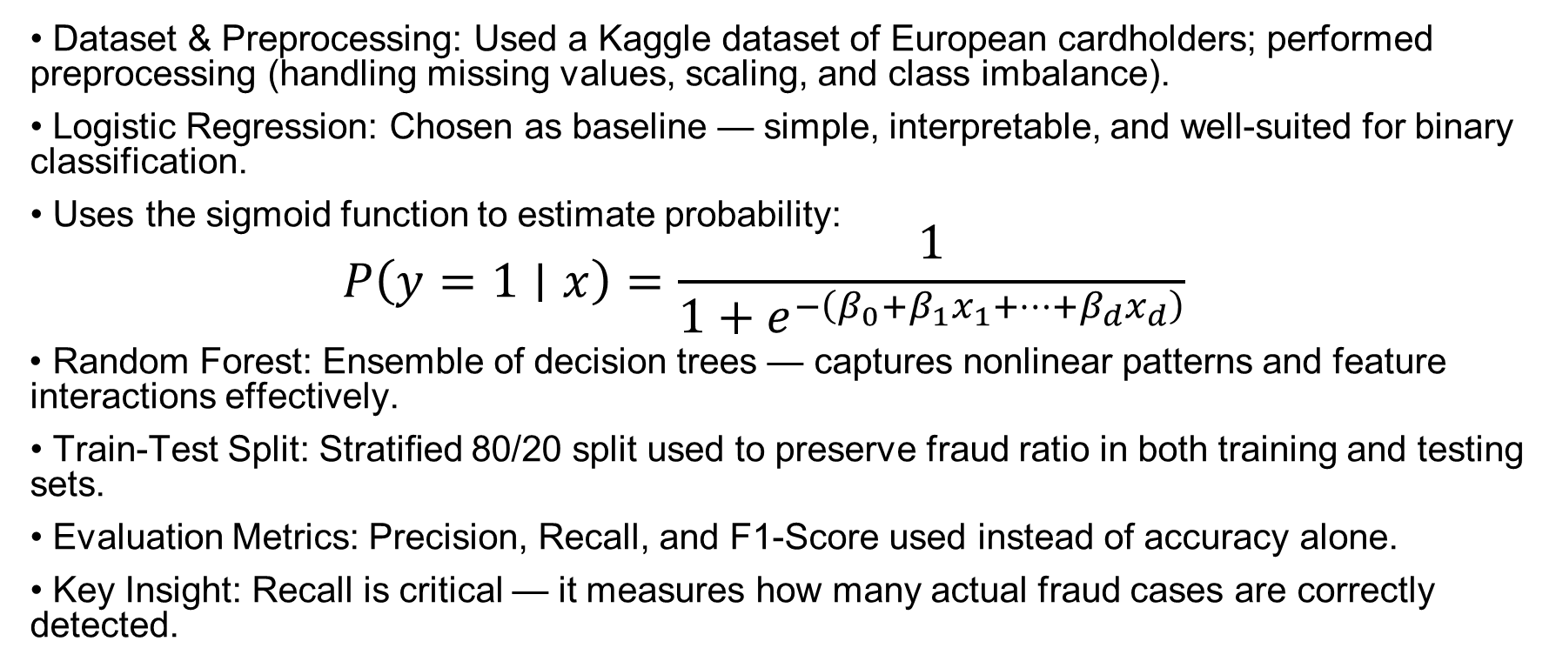
Implementation
• Dataset & Preprocessing: Used a Kaggle dataset of European cardholders; performed preprocessing (handling missing values, scaling, and class imbalance).
• Logistic Regression: Chosen as baseline — simple, interpretable, and well-suited for binary classification.
• Uses the sigmoid function to estimate probability: $$P\left(y=1∣x\right)=\frac{1}{1+e^{−\left(β_{0}+β_{1}x_{1}+⋯+β_{d}x_{d}\right)}}$$
• Random Forest: Ensemble of decision trees — captures nonlinear patterns and feature interactions effectively.
• Train-Test Split: Stratified 80/20 split used to preserve fraud ratio in both training and testing sets.
• Evaluation Metrics: Precision, Recall, and F1-Score used instead of accuracy alone.
• Key Insight: Recall is critical — it measures how many actual fraud cases are correctly detected.

Slide 6
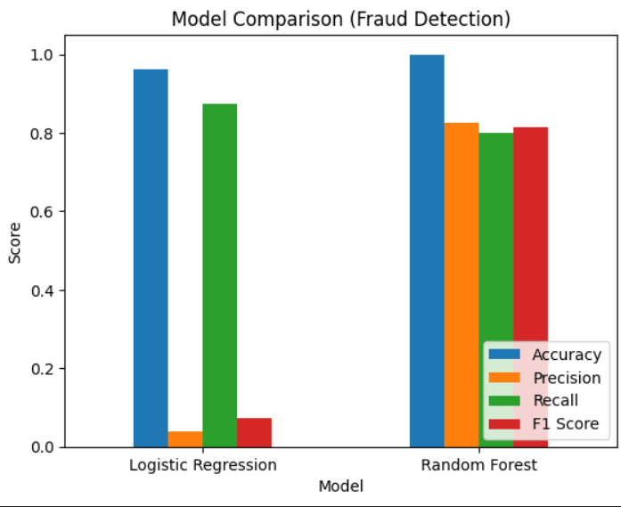
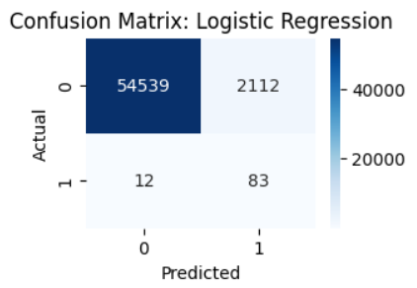
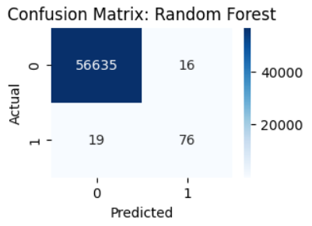
Results & Visual Analysis

Slide 7
Conclusion
• Discussion: High accuracy can be misleading on imbalanced data — Precision, Recall, and F1-score give a more reliable evaluation.
• Key Challenge: Class imbalance causes models to favor the majority class if not handled properly.
• Model Insight: Logistic Regression offers a strong, interpretable baseline, while Random Forest delivers better overall performance.
• Conclusion: Careful evaluation is essential in fraud detection; Random Forest is more suitable for this task.
• Limitations: Uses offline dataset; features are anonymized; Random Forest comparison based on project-level analysis.
• Future Work: Explore advanced models like XGBoost, SVM, and deep learning; apply threshold tuning and cost-sensitive learning.
• Future Extension: Develop a real-time web interface/API for live transaction-based fraud prediction.

Slide 8
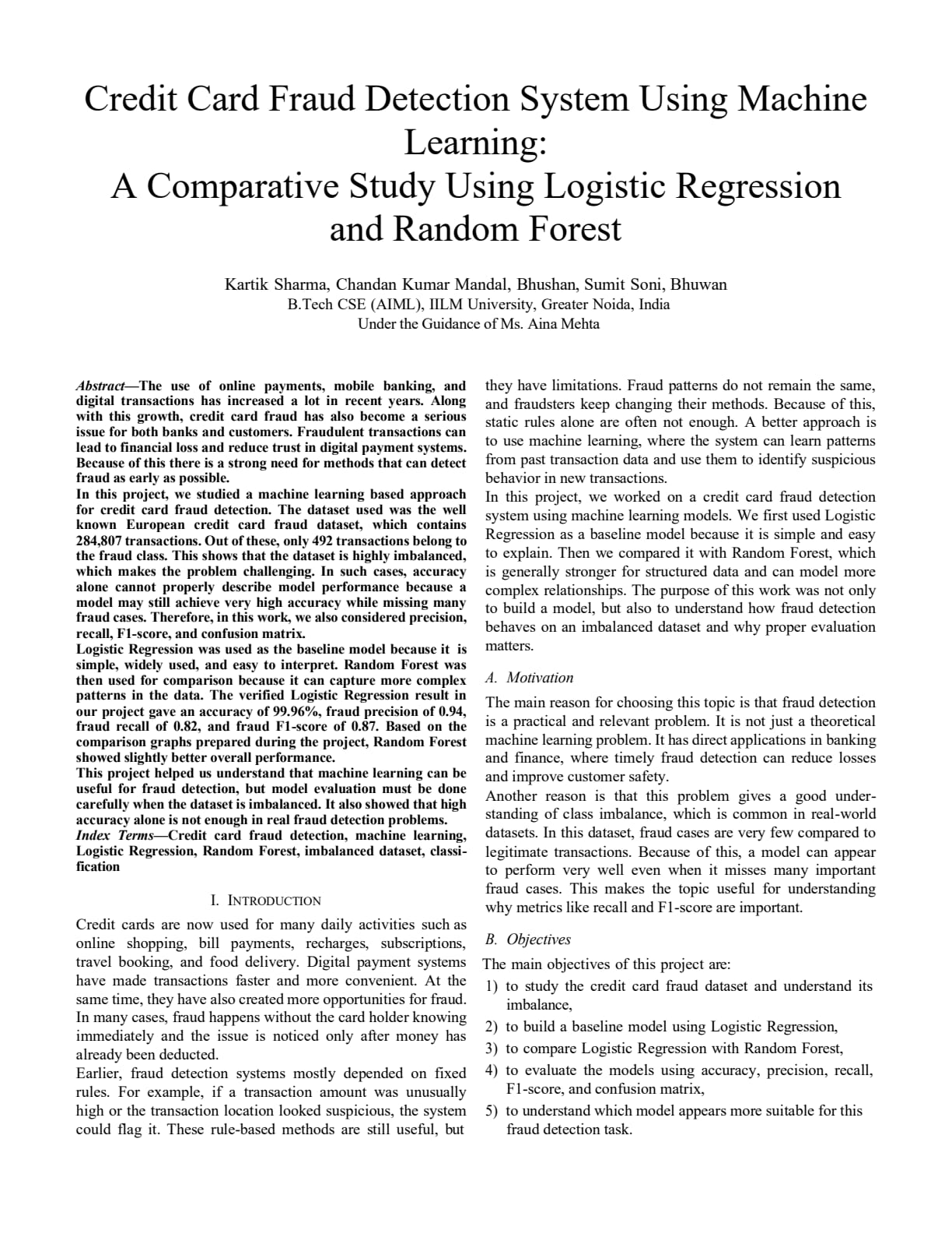
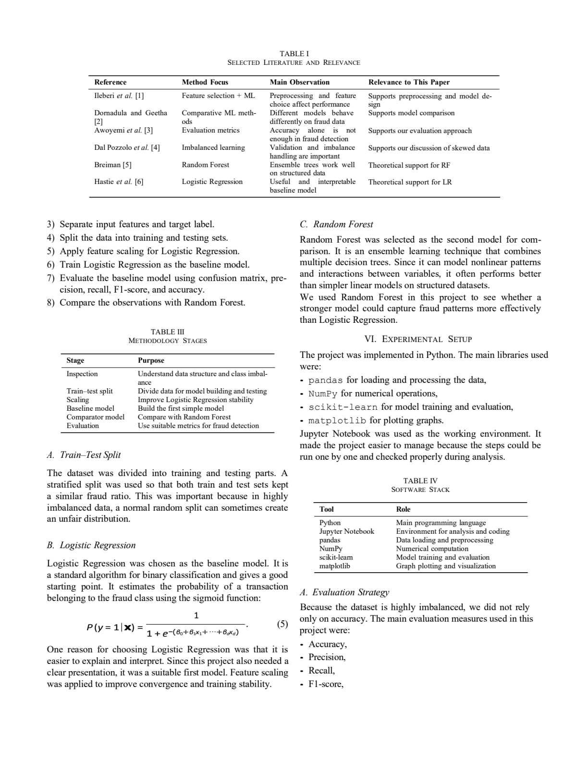
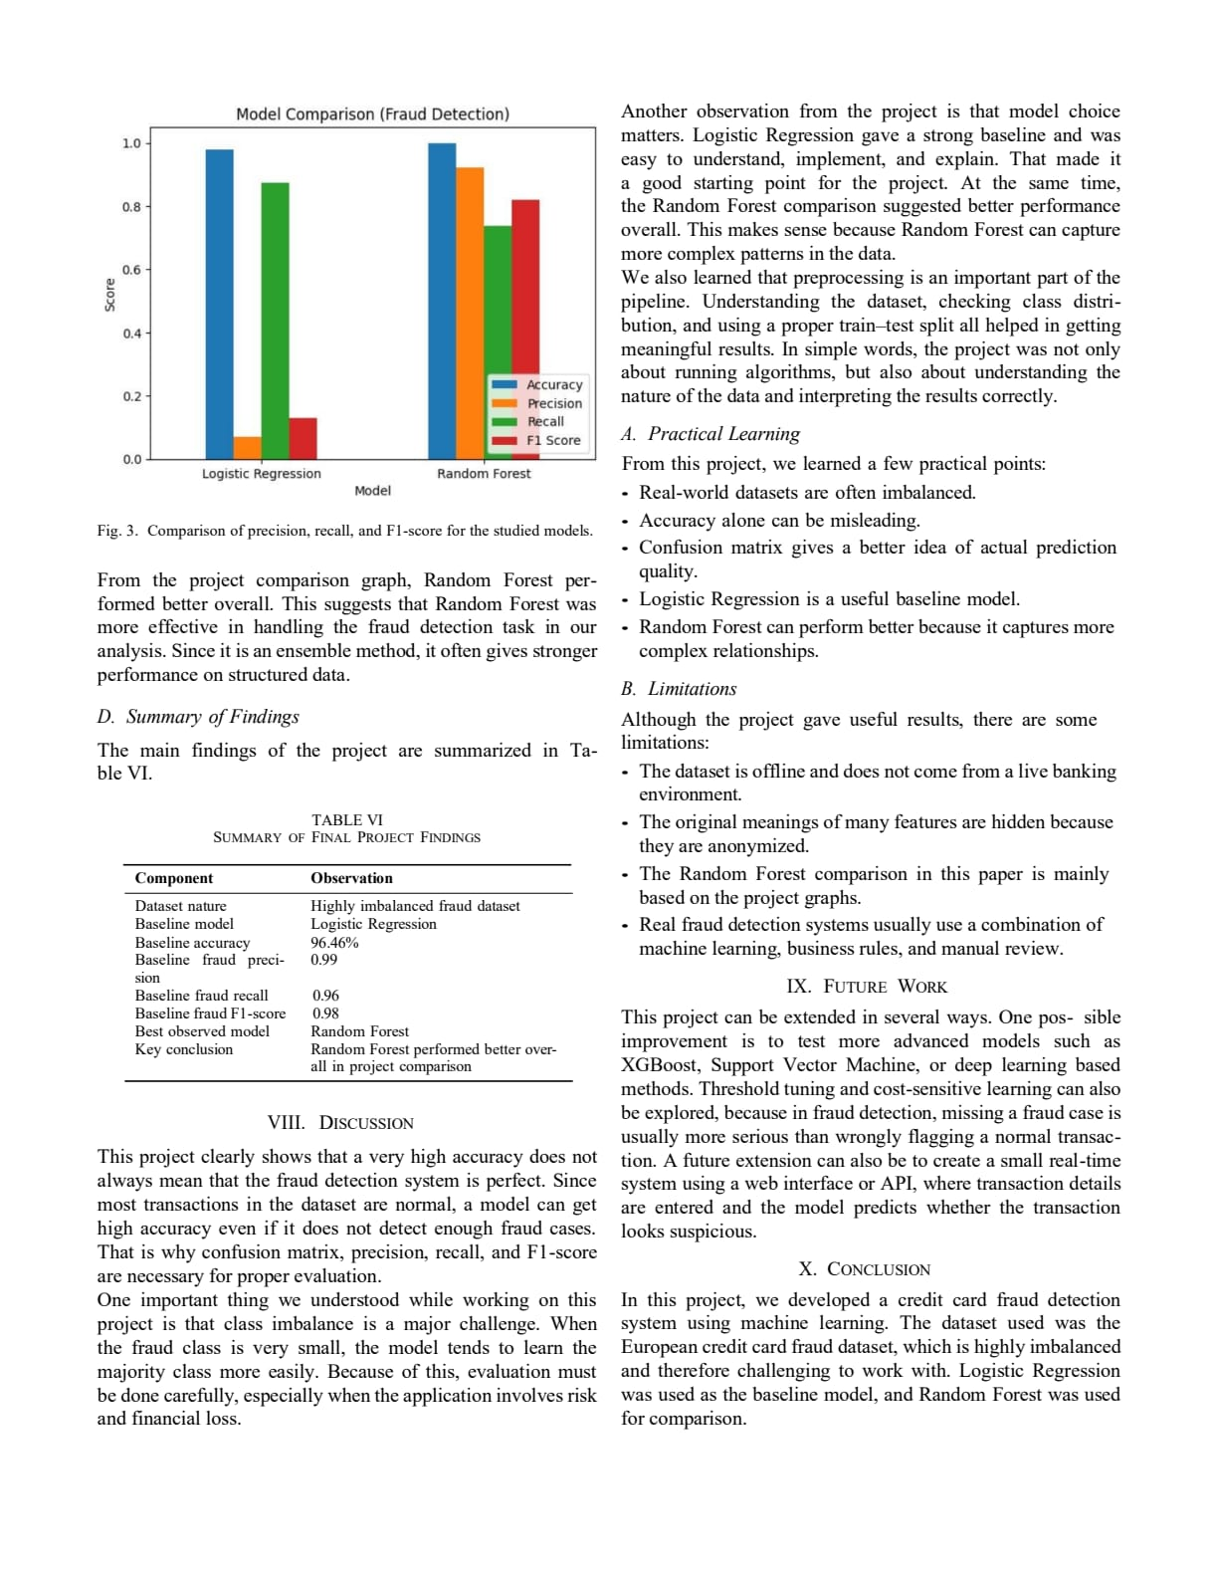
Research Paper

Slide 9
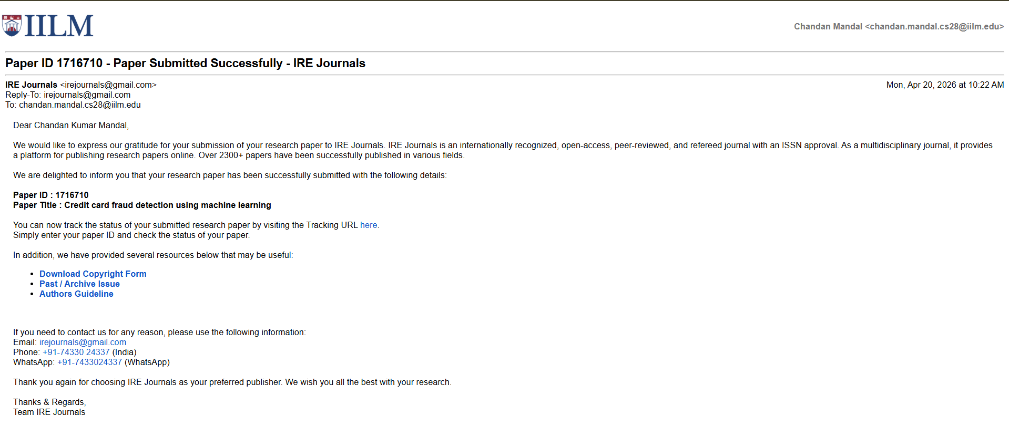
Publication
❖ Conference/Journal: International Peer-Reviewed Journal
❖ Track: Artificial Intelligence and Machine Learning
❖ Paper ID: 1716710
❖ Paper Title: Credit Card Fraud Detection
❖ Status: Submitted
❖ Submission Link -https://www.irejournals.com/submit-paper

Slide 10
Thank You

