Slide 1
Survival Outcome Prediction In Cancer Patients Name: Kartik Sutariya Class: MS Data Science

Slide 2
Index
Project Description 1
Models Used 2
Libraries Used 2
Predictive Modelling 3
GUI Model 3-5
Data Visualization 6
Thank You Page 7

Slide 3
Project Description
A predictive model using Machine Learning algorithms is created to distinguish between Benign and Malignant cancer cells using the “Breast Cancer Wisconsin (Diagnostic) Data Set”. In addition, a GUI model is created using Tkinter. It extracts the PDF we have selected from the computer system and displays it onto the Tkinter Canvas.
Name : Kartik Sutariya
1

Slide 4
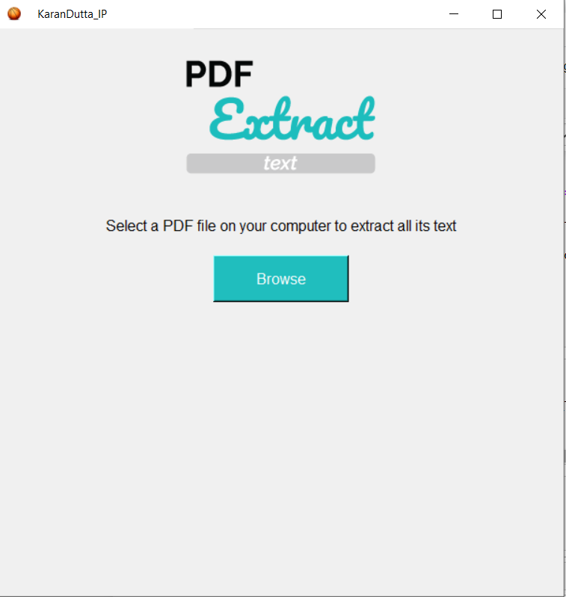

In this project we have used iconbitmap, buttons, textbox , canvas to create a PDF extractor GUI model. Button is linked to a function which asks to open the desired file and from getPage() function we can choose the page number we want to extract and then display it on the canvas.
4

Slide 5
ML Models Used: 1)Logistic Regression 2)Support Vector Machine (SVM) 3)K - Neighbors Classifier (KNN) 4)Decision Tree Classifier Algorithm 5)Random Forest Classifier Algorithm Libraries/Packages Used: 1)Pandas 2)NumPy 3)Seaborn 4)Matplotlib 5)Tkinter 6)PyPDF2
Name :Kartik Sutariya
2

Slide 6
7)Python Imaging Library (PIL) Predictive Model: After importation of the data set exploratory data analysis (EDA) is done on the data so that no Null values remain in data and irrelevant columns are also removed to improve the accuracy . After that data visualization is done and finally ML models are deployed. GUI Model: Tkinter offers easy methods to set up an interface window on which like Bootstrap we can define a container object called canvas on which we can place various buttons and labels linked through functions to print the desired layout/outputs.
Name : Kartik Sutariya
3

Slide 7
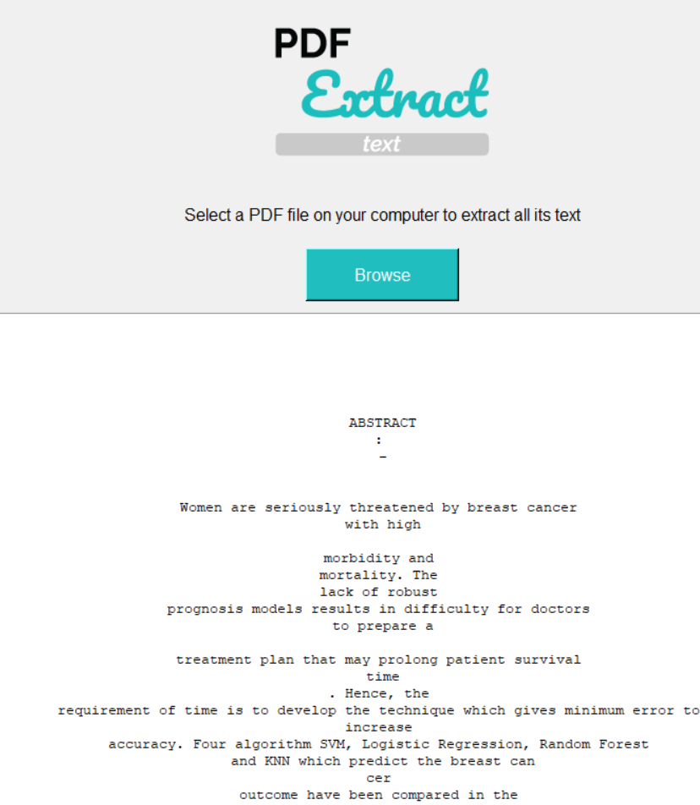
5

Slide 8
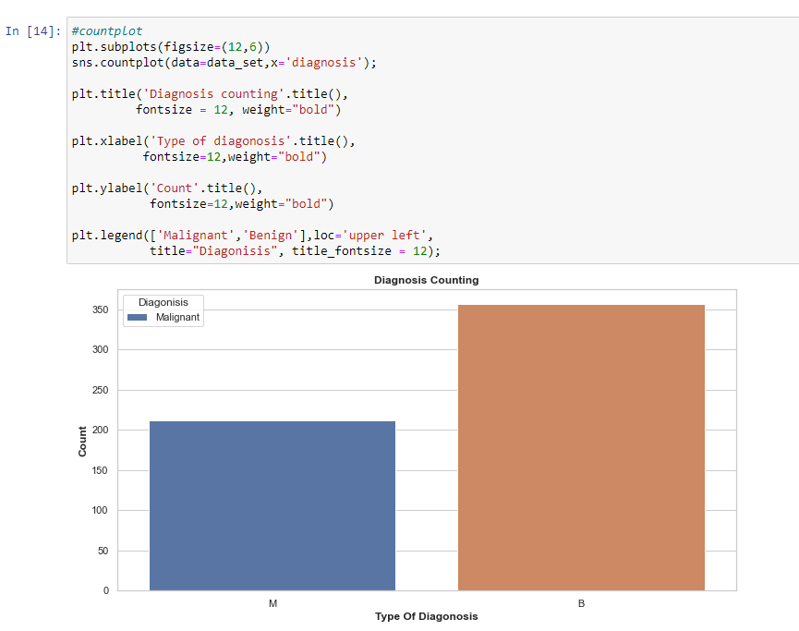
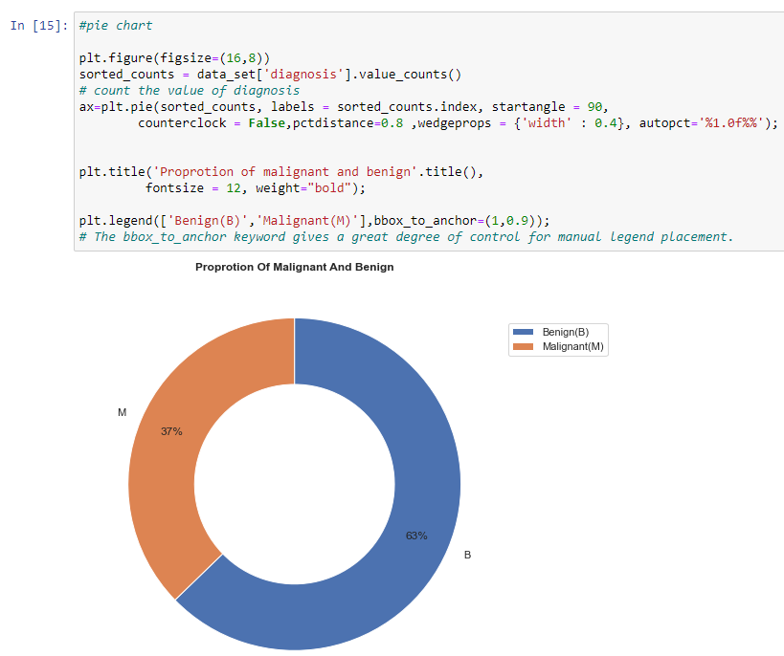
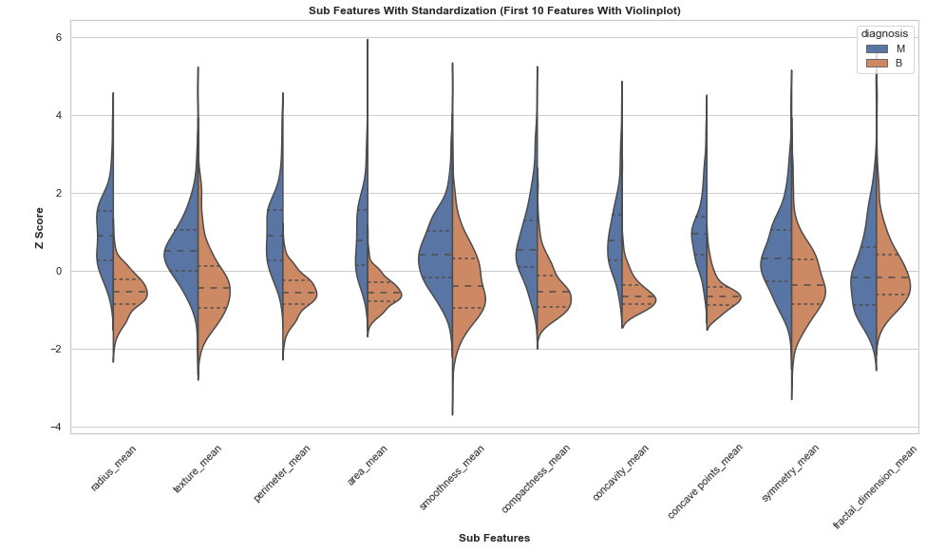
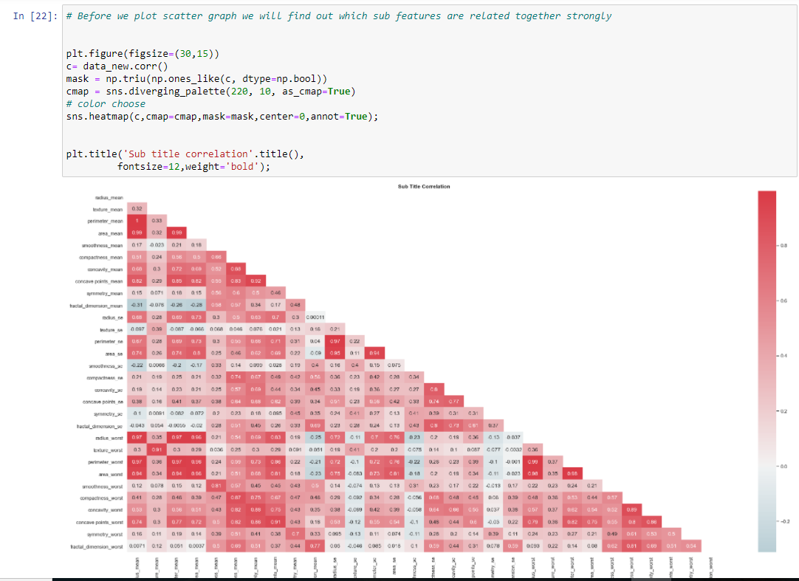
Data Visuals of Predictive Model:
6

Slide 9
Thank You !!
7

