Slide 1
Terrain.com
A Trekking & Mountaineering Portal

Slide 2

Back-End Project
Team Details:
Group No. 24
Harjas Singh Rai,2310992088
Himank Goel,2310992097
Kartik Joshi,2310992115
Rudraksh Bhandari,2310992512
Supervised by: Mr.Vikas Patel
Chitkara University Institute of Engineering and Technology, Chitkara University, Punjab

Slide 3
Table of Contents
Introduction
Frontend
Backend
Code Highlights
Output
Integration & Workflow
Challenges & Solutions
Demonstration
Future Enhancements
Conclusion

Slide 4
Introduction
Objective: To create an interactive web platform for trekkers and mountaineers.
Target Audience: Trekking enthusiasts, mountaineering clubs, adventurers, and enthusiasts.
Main Features:
Gear list for trekking with e-commerce links
Trek history and trails
Emergency helplines
Join clubs/community
Weather updates and live effects

Slide 5
Frontend - User Data Form
Features:
Collects user details: Name, Email,Password
User-friendly design with subtle styling
Validations for inputs
Code Example:
Highlights from the HTML form structure.
Show styled elements with CSS (e.g., buttons, input fields).

Slide 6
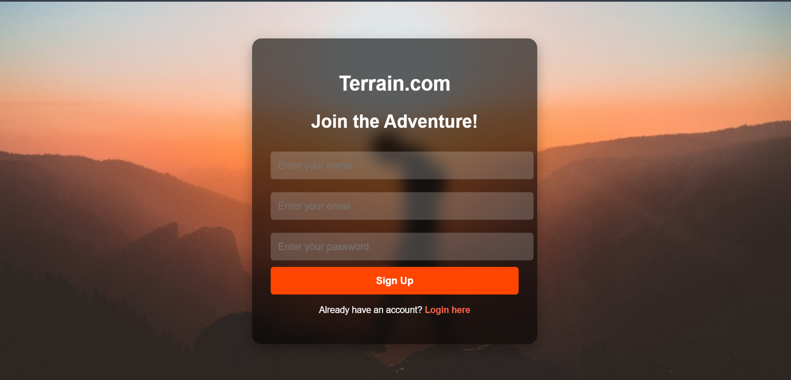
Sign-Up Page

Slide 7
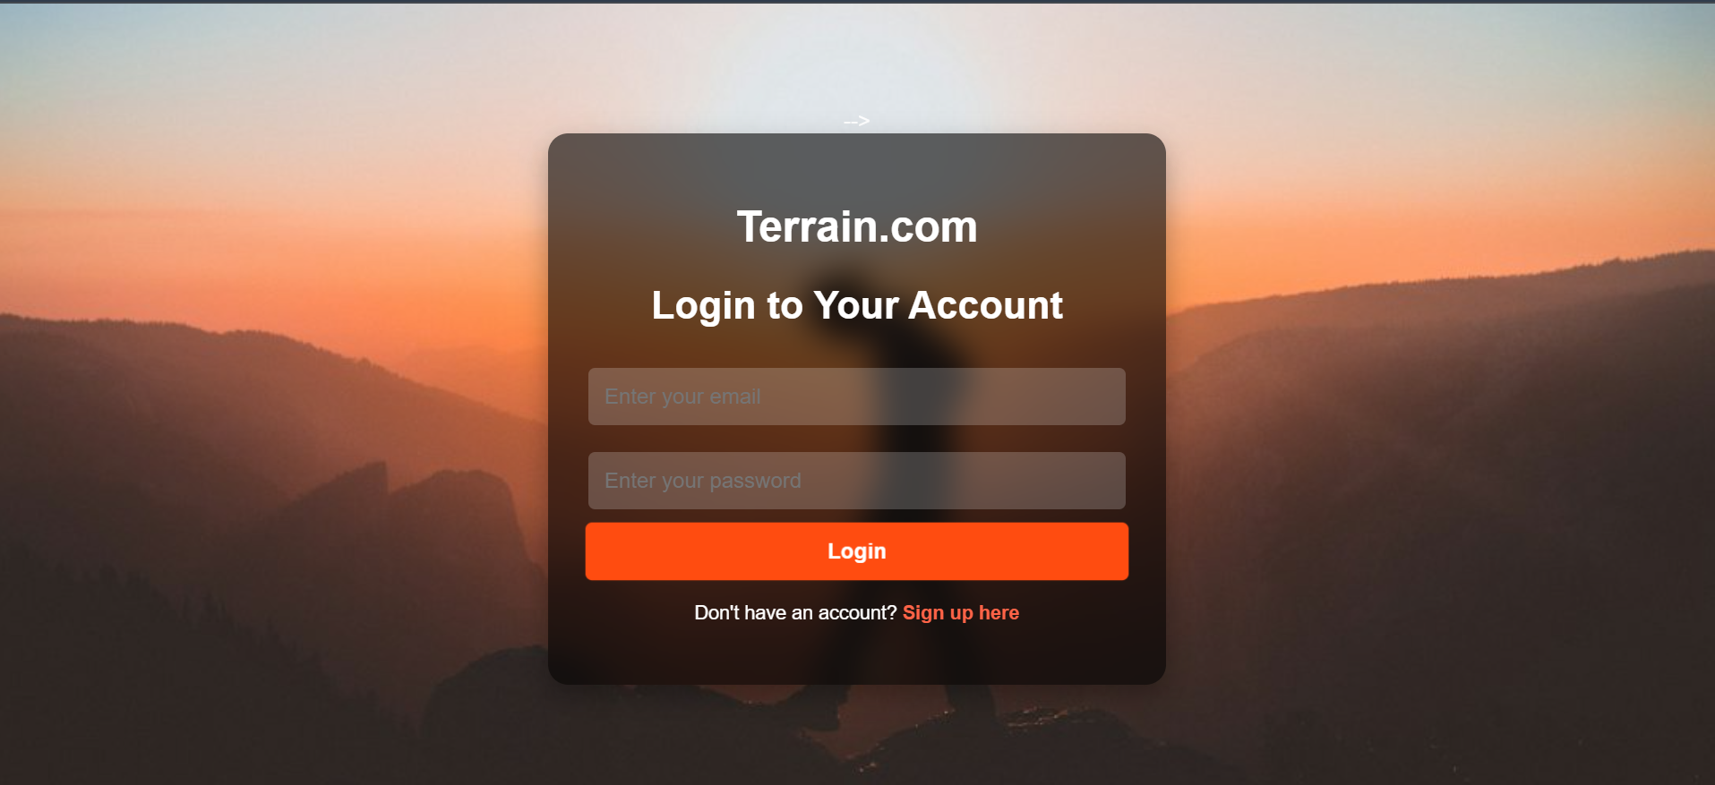
Login Page

Slide 8
Backend - API Overview
Technologies Used:
Node.js
Express.js
File System (for storing user data locally)
Endpoints:
POST /users: Saves user data to a JSON file
GET /users: Retrieves all saved user data

Slide 9
Backend-Code Highlights
File Handling:
Check the users.json file if not present.
POST Endpoint:
Parses and saves incoming user data.
GET Endpoint:
Reads and sends the stored user data.
Error Handling:
Catches and logs errors for both endpoints.

Slide 10
Integration and Workflow
Sign-Up Process:
Form Submission: User fills in the signup form with necessary details (e.g., username, email, password).
Validation: The form checks that all fields are filled and the email format is correct.
Confirmation: After successful registration, a confirmation message is shown, and the user is redirected to the
login page.
Fetch Data Process (fetch.html):
Fetching Data: When the user is logged in, they can view data (e.g., consignment details, trek history)
Display Data: The frontend fetches the data from the server using a GET request and displays it in the relevant
sections on fetch.html.
Data Sent to Backend: The form data is sent to the backend server (e.g., Node.js) via a POST request.

Slide 11

User’s log

Slide 12
User Authentication & Login
Login Page:
User Input: User enters their username and password on the login page.
Validation: The backend checks if the provided credentials match the data stored in the
database.
If the credentials are correct, you can access the website dashboard.
If incorrect, the system shows an error message asking the user to retry.
Accessing the Main Website:
Successful Login: On successful login, the user is redirected to the main website
(e.g., homepage or dashboard).
Main Features Accessed: The user can now access protected areas of the site, such as
the trekking gear list, consignment data, community features, etc.

Slide 13
Challenges and Solutions
Challenge: Handling file operations efficiently.
Solution: Ensure proper error handling and file checks.
Challenge: Managing seamless communication between frontend and backend.
Solution: Use clear API contracts and consistent JSON formatting.

Slide 14
Demonstration
Live Demo:
Submit data through the form.
Verify data storage in users.json.
Retrieve and display stored data via the GET endpoint.
Login with your credentials, you will land on dashboard of Terrain.com

Slide 15
Future Enhancements
Validation Improvements: Client-side and server-side validations.
Database Integration: Use MongoDB or MySQL instead of JSON file.
Frontend Enhancements: Add dynamic feedback for submissions.
Authentication: Secure user data with token-based authentication.

Slide 16
Conclusion
Summary:
Implemented a simple yet functional user data collection system.
Highlighted the seamless interaction between frontend and backend.
Next Steps: Explore database integration and enhanced features.

Slide 17


