Slide 1
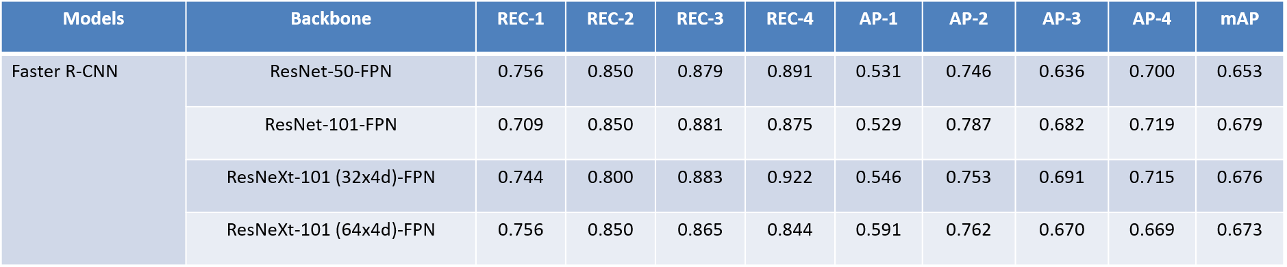
mmdetection for steel defect detection Kartik Joshi 17BLC1187
Initially established the baseline for faster rcnn
Tried it with different Faster RCNN Variants and there was corresponding enhancement in mAP value as expected

Slide 2
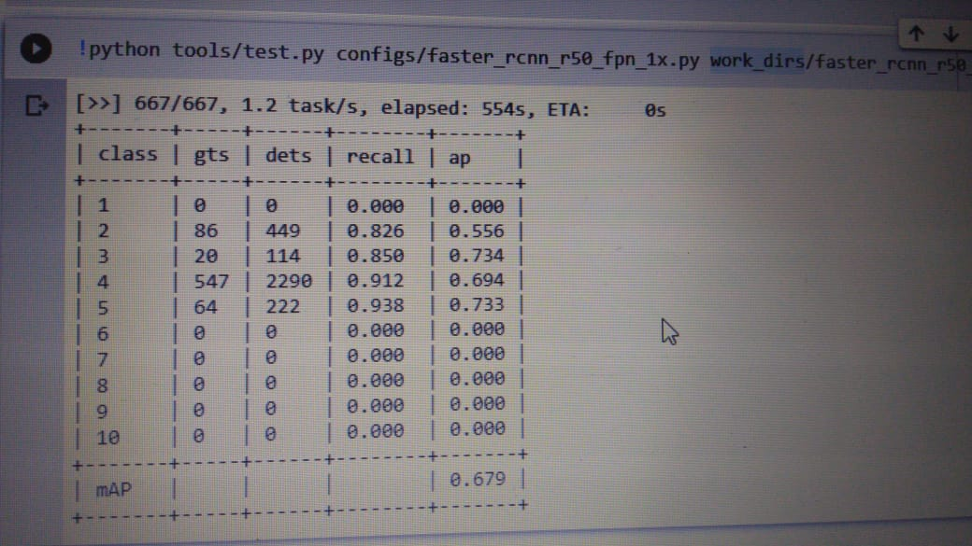
Faster RCNN Results with 20 epochs

Slide 3
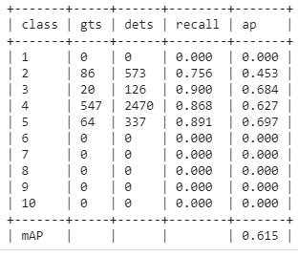
cascade_rcnn_x101_64x4d_fpn_1x with 10 epochs

Slide 4
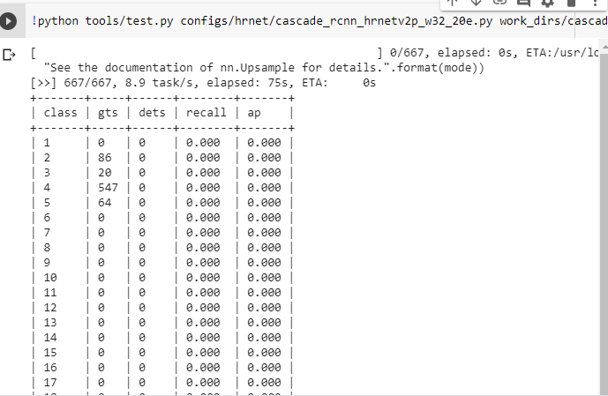
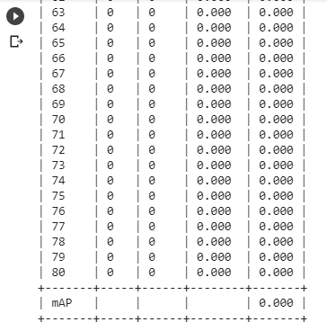
hrnet/cascade_rcnn_hrnetv2p_w32_20e

Slide 5
Why so!? Bizare results
High Resolution HRNets are primarily used for Segmentation problems
So, the HRNet models do not perform well for object detection tasks.
Our problem, being Object (Steel Defect) Detection, this model diverged and collapsed in terms of performance.
HRNets cannot be used for our purpose

Slide 6
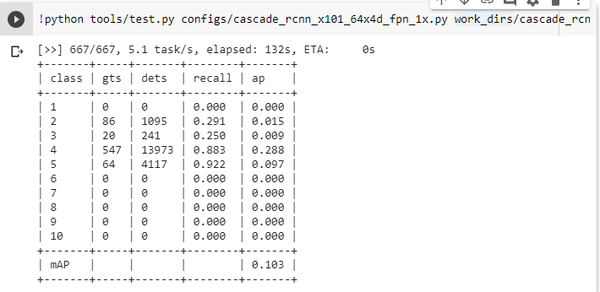
Cascade_rcnn_101

Slide 7
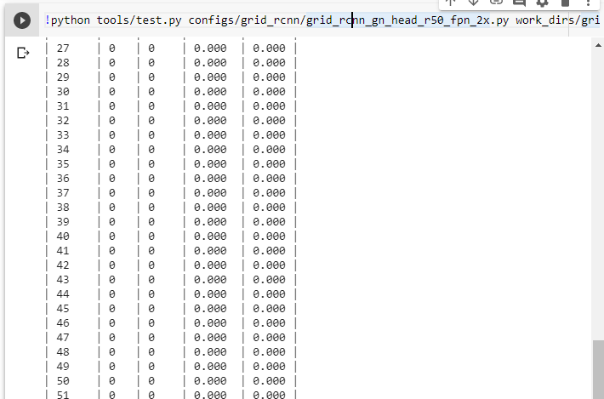
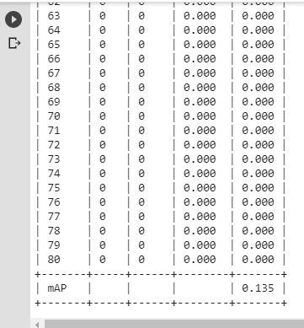
Grid_rcnn

Slide 8
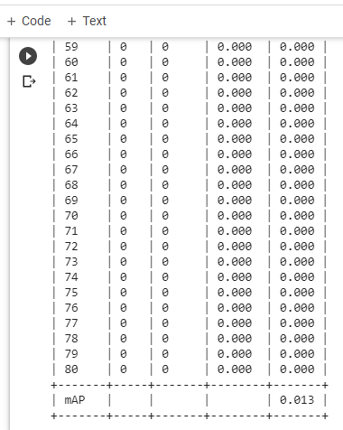
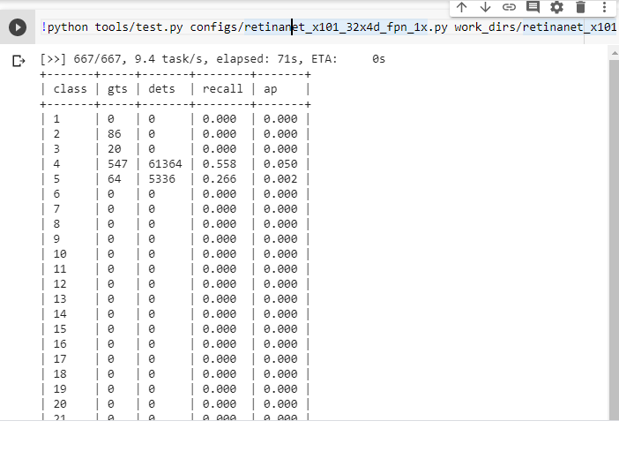
Retinanet_101,32x4d,fpn_1x

Slide 9
Mask_rcnn_101, 32x4d
Problem with the bounding box function

Slide 10
Faster RCNN with multiscale and Guided Anchoring
Ran for 24 epochs.
After epoch#12, introduced Guided Anchoring
After epoch#16, introduced Multiscale
Increased Anchor Stride to 96
#img_per_gpu = 1

Slide 11
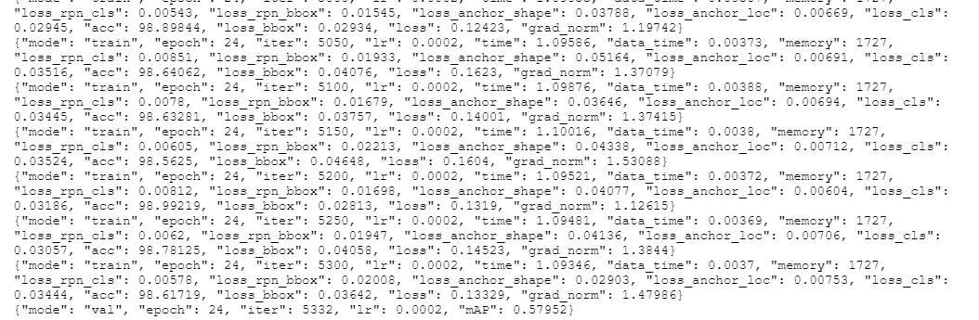
Results from Faster RCNN after Epoch 24
Training mAP value (Test was 62% mAP)

Slide 12
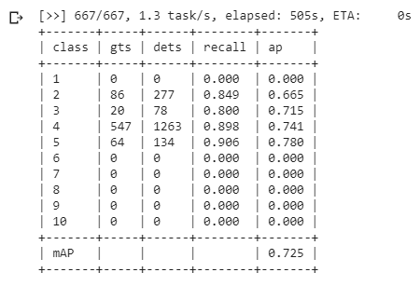
Cascade RCNN with Guided Anchoring, Multiscale
#img_per_gpu = 1
Anchor Stride – unchanged
Train mAP Value

Slide 13
Single Stage vs Multistage
Single Stage: SSD, RetinaNet, GHM, FCOS, FSAF, YOLO
Two Stage: Fast RCNN (64 mAP), Faster RCNN (67 mAP), R-FCN, Mask RCNN, Grid RCNN, Mask Scoring RCNN, Double Head RCNN
Multistage: Cascade RCNN(>73 mAP), Hybrid Task Cascade (>80 mAP), Group Recursive Learning
Single Stage Methods are faster.
Multistage Method are more accurate.

Slide 14
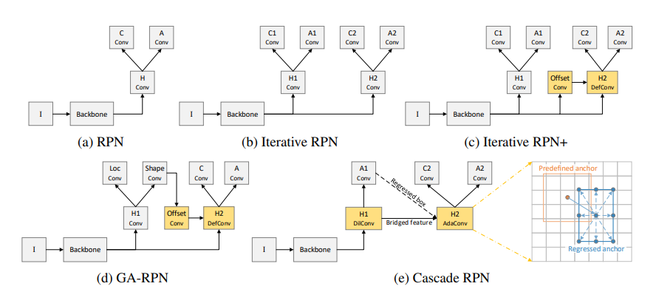
Region Proposal Networks

Slide 15
Region Proposal Networks, i.e. The First Stage
Inefficient due to slow and lengthy process.
Convolution Forward Pass is performed for each of the proposal.
Scope of improvement in terms of efficiency.
Improvements: Fast RCNN, Faster RCNN.
Shared Convolutional feature maps
2 pipelines, 1 dedicated for detecting ‘objectness’ and other for class labels.

Slide 16
Iterative RPN
2 stage Regression layer for learning the distribution
High Variance filtered out in stage 1
Anchor boxes are refined and variance is reduced
Limited Performance Improvement

Slide 17
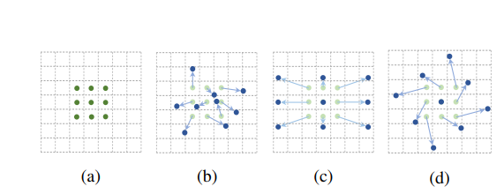
Iterative RPN+
Mainly includes Guided Anchoring and Siamese Cascaded RPN
Uses Deformable Convolution
Convolutions are subject to transformations
Accountable for different scales for different type of defects and their orientations

Slide 18
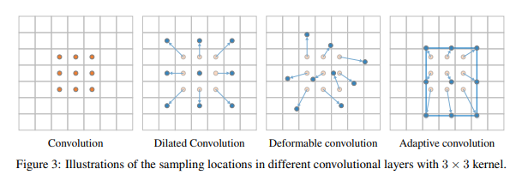
Cascade RPN
First phase: Dilated Convolution
Sampling of the feature maps is distributed (‘n’ dilations)
Second Phase: Adaptive Convolution
Input anchor drives the kernel function

Slide 19
CBNet
Composite Backbone
Backbones to be converted to db, tb format.
Memory Error for ResNet50.
Can train single stage methods for CBNet.(?)

Slide 20
Possible Extensions
Albumentations+GRoI
CBNet
HTC
MultiScale (Best values that gave max. mAP improvement)

Slide 21
Ensemble Object Detection
Options to be explored:
1. Affirmative : Initial prediction model considered
2. Consensus : Majority of methods are considered for drawing confidence
3. Unanimous : ALL the method MUST have confidence above threshold

Slide 22
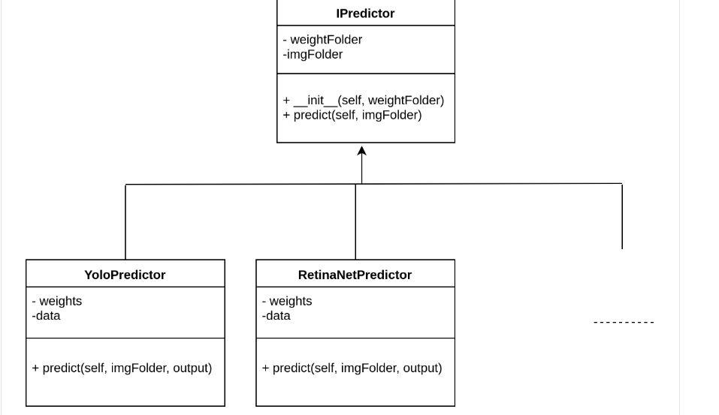
Ensemble Detection Flow
Link to Paper : https://drive.google.com/file/d/1ku8X8lHs6lethEa5Adhj7frzV44NTbl4/view

Slide 23
Test Time Augmentation
"avgBlur": Average blurring
"bilaBlur": Bilateral blurring
"blur": Blurring
"chanHsv": Change to hsv colour space
"crop": Crop
"dropOut": Dropout
"elastic": Elastic deformation

Slide 24
Test Time Augmentation (contd.)
"histo": Equalize histogram
Flip (Horizontal, Vertical, both simultaneously) 1.5 mAP improvement in train..!
"gamma": Gamma correction
"blurGau": Gaussian blurring
"avgNoise": Add Gaussian noise
"invert": Invert
"medianblur": Median blurring
Raise RGB : Not helpful for our dataset!
Raise HSV

Slide 25
Test Time Augmentation (contd.)
Rotation (++)
Salt and Pepper
"sharpen": Sharpen
"shiftChannel": Shift channel
"shearing": Shearing
"translation": Translation
NOTE:
1. Some of them are also applicable for train time augmentation.
2. Some augmentation techniques could be reproduced for test set as well.

Slide 26
References:
TDDNet (For PCB) : Tiny Defect Detection using Referential (Image Processing) and Non Referential (Computer Vision) techniques
Autonomous Structural Visual Inspection Using Region-Based Deep Learning for Detecting Multiple Damage Types (For steel surface)
Weighted Box Fusion : Needs bounding box coordinates…

Slide 27
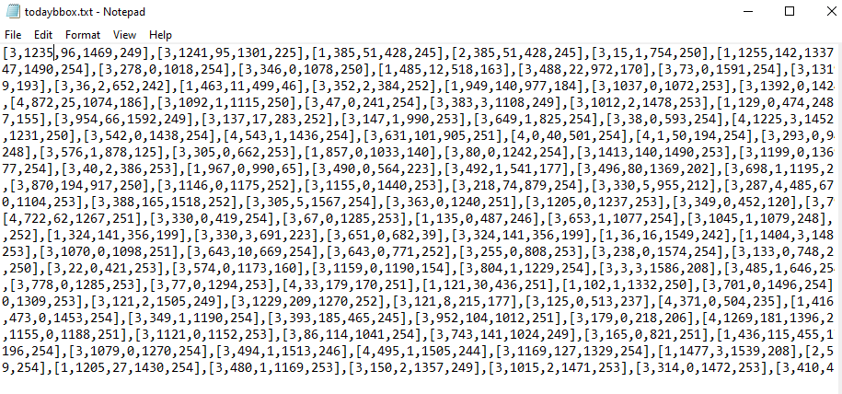
Ensemble bbox extraction
File extracted from mmcv

Slide 28
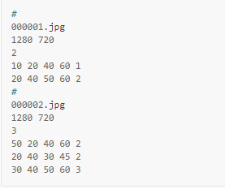
Required format
This followed by the individual confidence scorers….

Slide 29
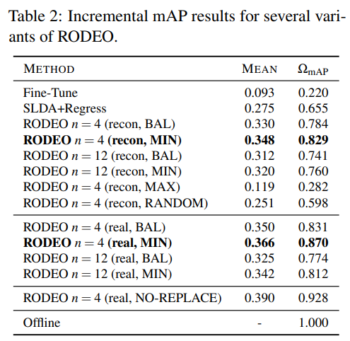
Research Papers to look upto.
1. RODEO : https://arxiv.org/abs/2008.06439v1
Replay for Online Object Detection
Incremental Learning
Memory efficient
SoTA for VOC style Object Detection

Slide 30
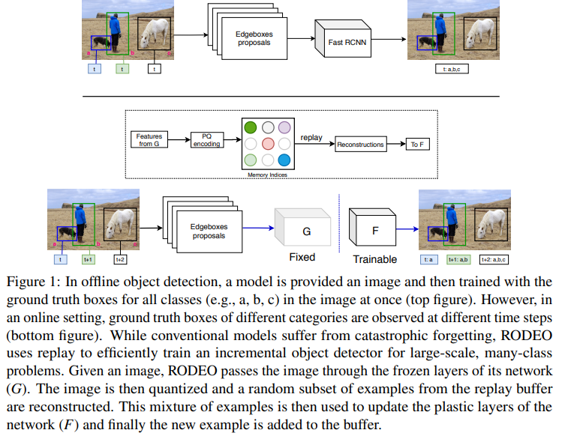

Slide 31
Other models:
2. YOLOv4
Back to Single Stage detector.
3. Unet
Effective for background removal.

Slide 32
Key Takeaways
MMDetection Toolbox
Compexity of class imbalance dataset
Industrial Problems
Team Work
Motivation for Higher Studies
Thank You Prof.!

