Slide 1
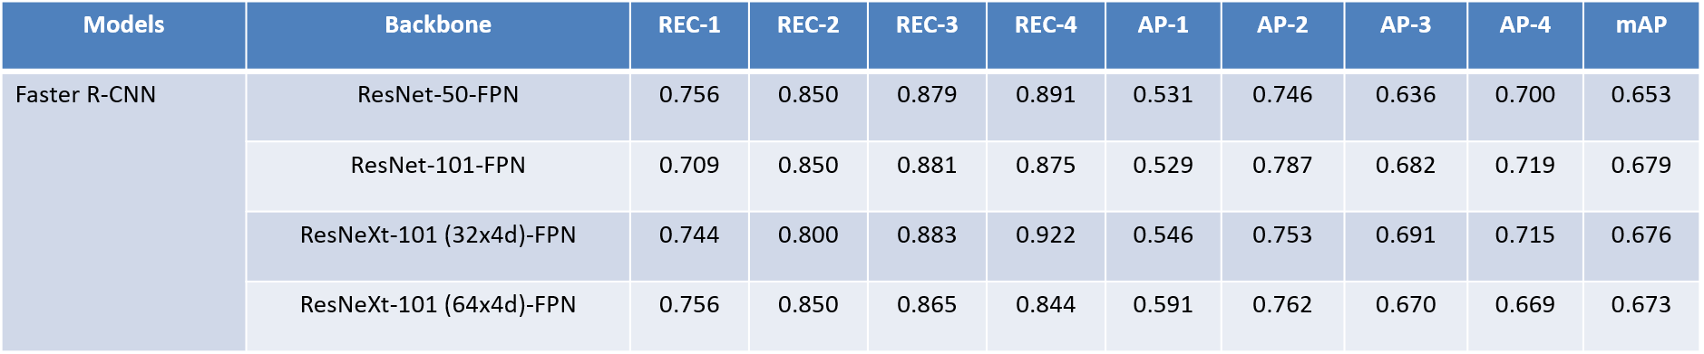
mmdetection for steel defect detection Kartik Joshi 17BLC1187
Initially established the baseline for faster rcnn
Tried it with different Faster RCNN Variants and there was corresponding enhancement in mAP value as expected

Slide 2
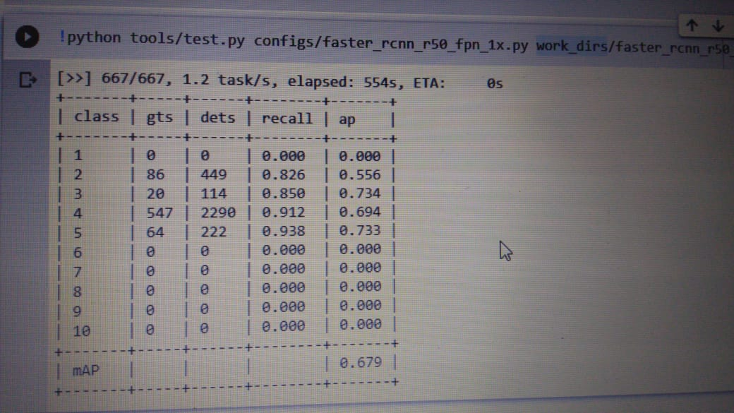
Faster RCNN Results with 20 epochs

Slide 3
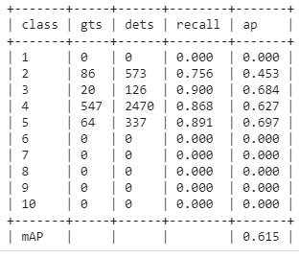
cascade_rcnn_x101_64x4d_fpn_1x with 10 epochs

Slide 4
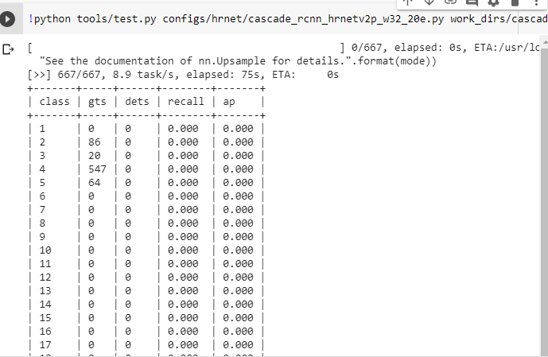
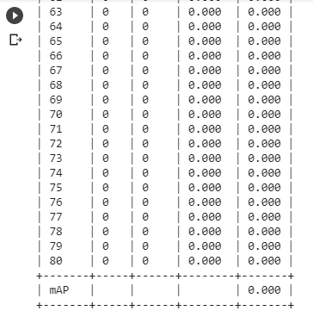
hrnet/cascade_rcnn_hrnetv2p_w32_20e

Slide 5
Why so!? Bizare results
High Resolution HRNets are primarily used for Segmentation problems
So, the HRNet models do not perform well for object detection tasks.
Our problem, being Object (Steel Defect) Detection, this model diverged and collapsed in terms of performance.
HRNets cannot be used for our purpose

Slide 6
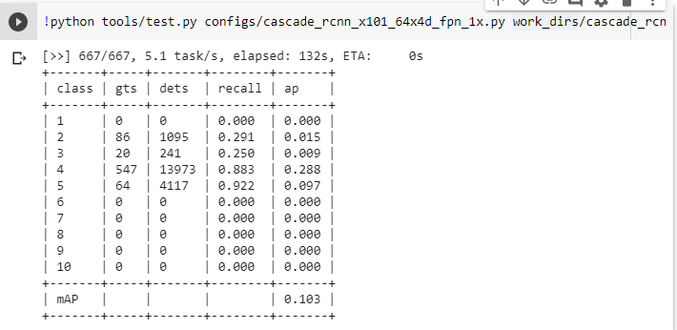
Cascade_rcnn_101

Slide 7
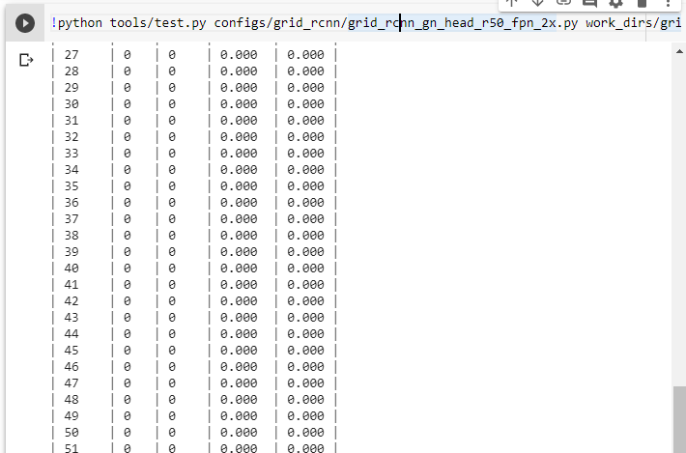
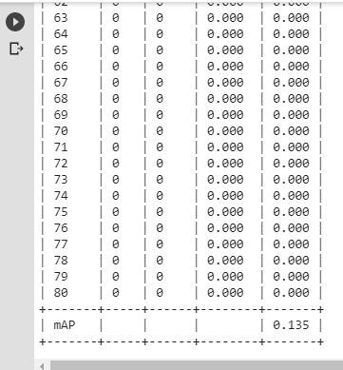
Grid_rcnn

Slide 8
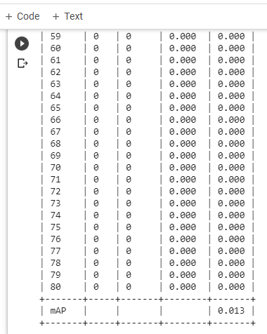
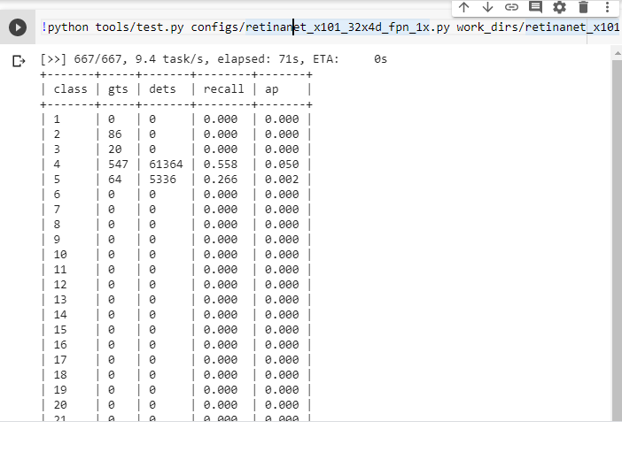
Retinanet_101,32x4d,fpn_1x

Slide 9
Mask_rcnn_101, 32x4d
Problem with the bounding box function

Slide 10
Faster RCNN with multiscale and Guided Anchoring
Ran for 24 epochs.
After epoch#12, introduced Guided Anchoring
After epoch#16, introduced Multiscale
Increased Anchor Stride to 96
#img_per_gpu = 1

Slide 11
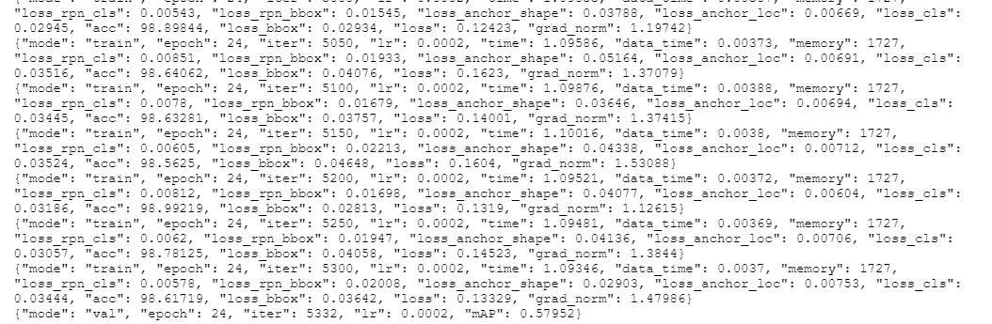
Results from Faster RCNN after Epoch 24
Training mAP value (Test was 62% mAP)

Slide 12
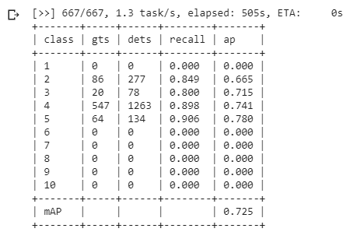
Cascade RCNN with Guided Anchoring, Multiscale
#img_per_gpu = 1
Anchor Stride – unchanged
Train mAP Value

Slide 13
Future Work
Albumentation
Changing the flip ratio
Other multistage models like SSD, et. al

