Slide 1
Relocation Project
Finding best location

Slide 2
Business Problem
When people want to relocate from one city to another in india, there is no mechanism to compare the cities and provide an option that is very similar to their existing city

Slide 3
Finding best city for relocation
Using Machine learning techniques the product aims to help people find best city for relocation based on familiarity of cities across India
Taking Users current area as input, we can provide best locations in the country for relocation

Slide 4
Methodology
Large volumes of areas are taken from Wikipedia
Foursquare API is used to find geographical location
Machine learning techniques used to cluster areas on similarity

Slide 5
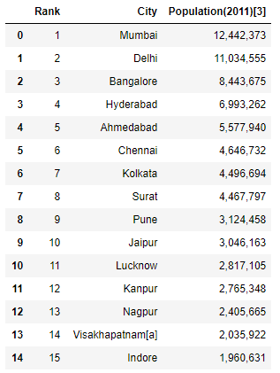
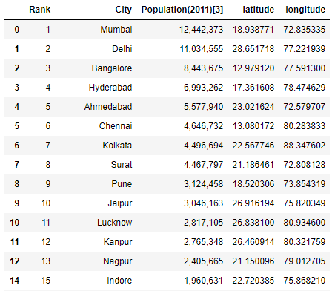
Wikipedia Data transformed with latitude & longitudes using Geolocator

Slide 6
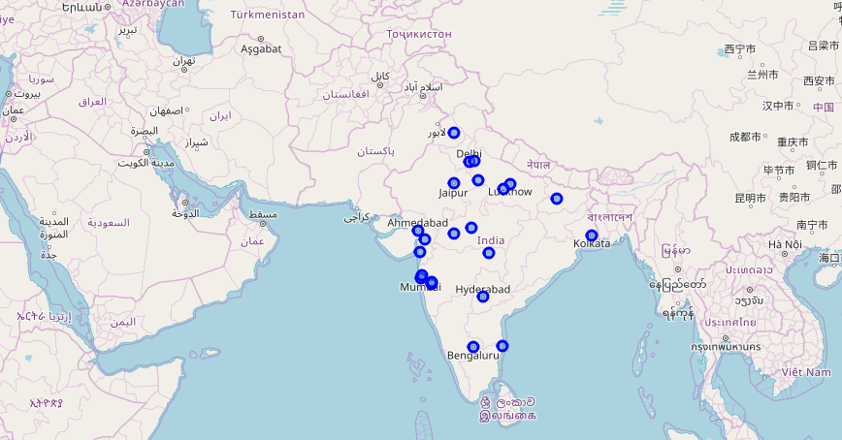
Geographical view of Cities

Slide 7
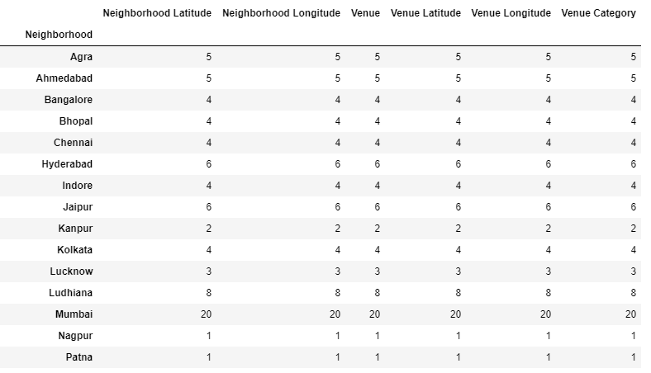
Venue information using FourSquare API For All cities venue data is collected

Slide 8
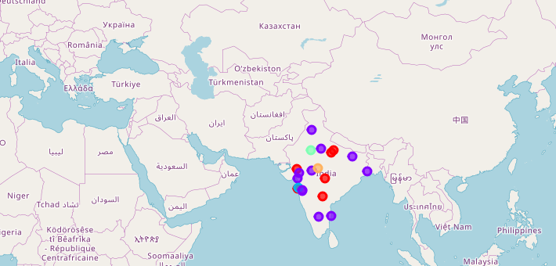
Geographical view of clustered cities [Cities marked with same colour belong to same cluster] KMEAN algorithm is used for clustering

Slide 9
Result
From the geographical representation we see the cities which are similar form a particular cluster and therefore help users relocate to cities under that cluster.
Example:
User from city Bangalore can relocate to following cities:
Chennai, Kolkata, Pune, etc

Slide 10
Extensibility
The product can target users per domain and help them in their endeavours
Example:
Finding best place to relocate across globe
Finding best location for startup or starting new branch for business across globe

