Slide 1
Link to YouTube Video Presentation:
https://www.youtube.com/watch?v=-C-7Fn6_G-8

Slide 2

Blockchain Fraud Prediction using Machine Learning by Kartik Srikumar
Harvard University Extension School
CSCI E-118 Spring 2021 Professor: Nodari Gogoberidze

Slide 3
Why Anomaly Detection?
Crypto values trending up; motive for bad actors
InfoSec teams need to prepare early and stay ahead
Nascent area
Open ML brings opportunities

Slide 4
Methodology
Supervised learning using classification models
Decision Tree
Logistic Regression
Random Forest
Gradient Boosting

Slide 5
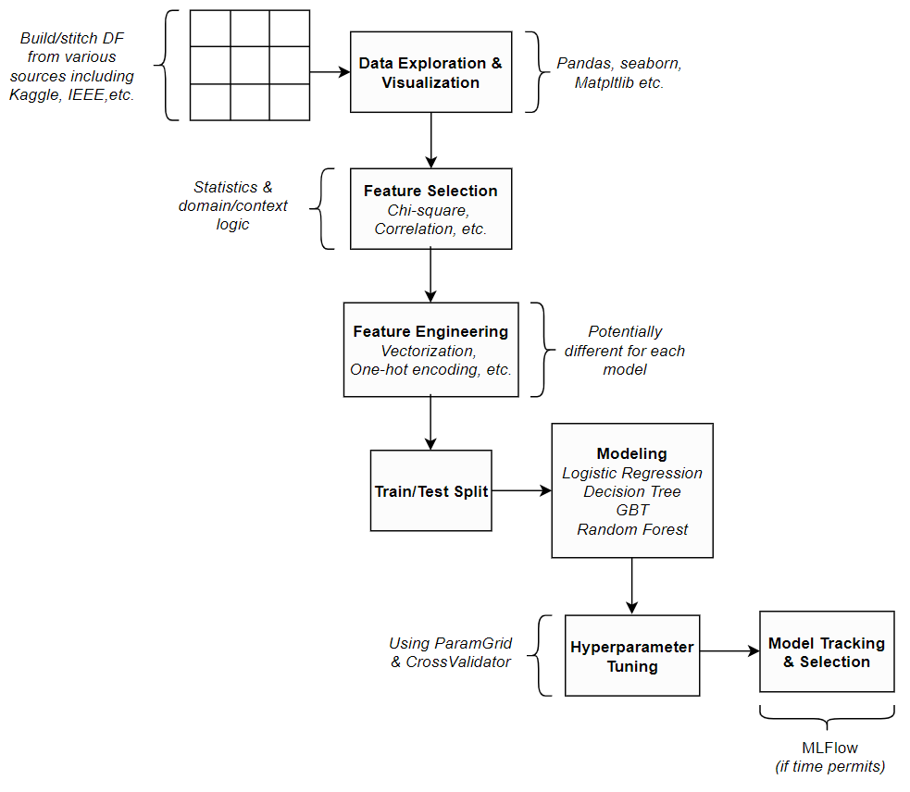
Pipeline/Architecture

Slide 6
Jupyter Notebook

Slide 7

Model Selection
Model | Recall* | False Positives
Decision Tree | 92.29 | 53
Logistic Regression | 0.48 | 2
Random Forest | 92.77 | 13
Gradient Boost | 87.23 | 11
True Positives
*Recall =
True Positives + False Negatives

Slide 8
Roadmap
Model Tuning
API’s
Open to community

