Slide 1

SMART INDIA HACKATHON 2026
TITLE PAGE
Problem Statement ID – 26094
Problem Statement Title- AI-Powered Dynamic Mental Health Monitoring and Distress Prediction System for Victims of Atrocities
Theme- MedTech / BioTech / HealthTech
PS Category- Software
Team ID-
Team Name (Registered on portal)- Visioneers

Slide 2

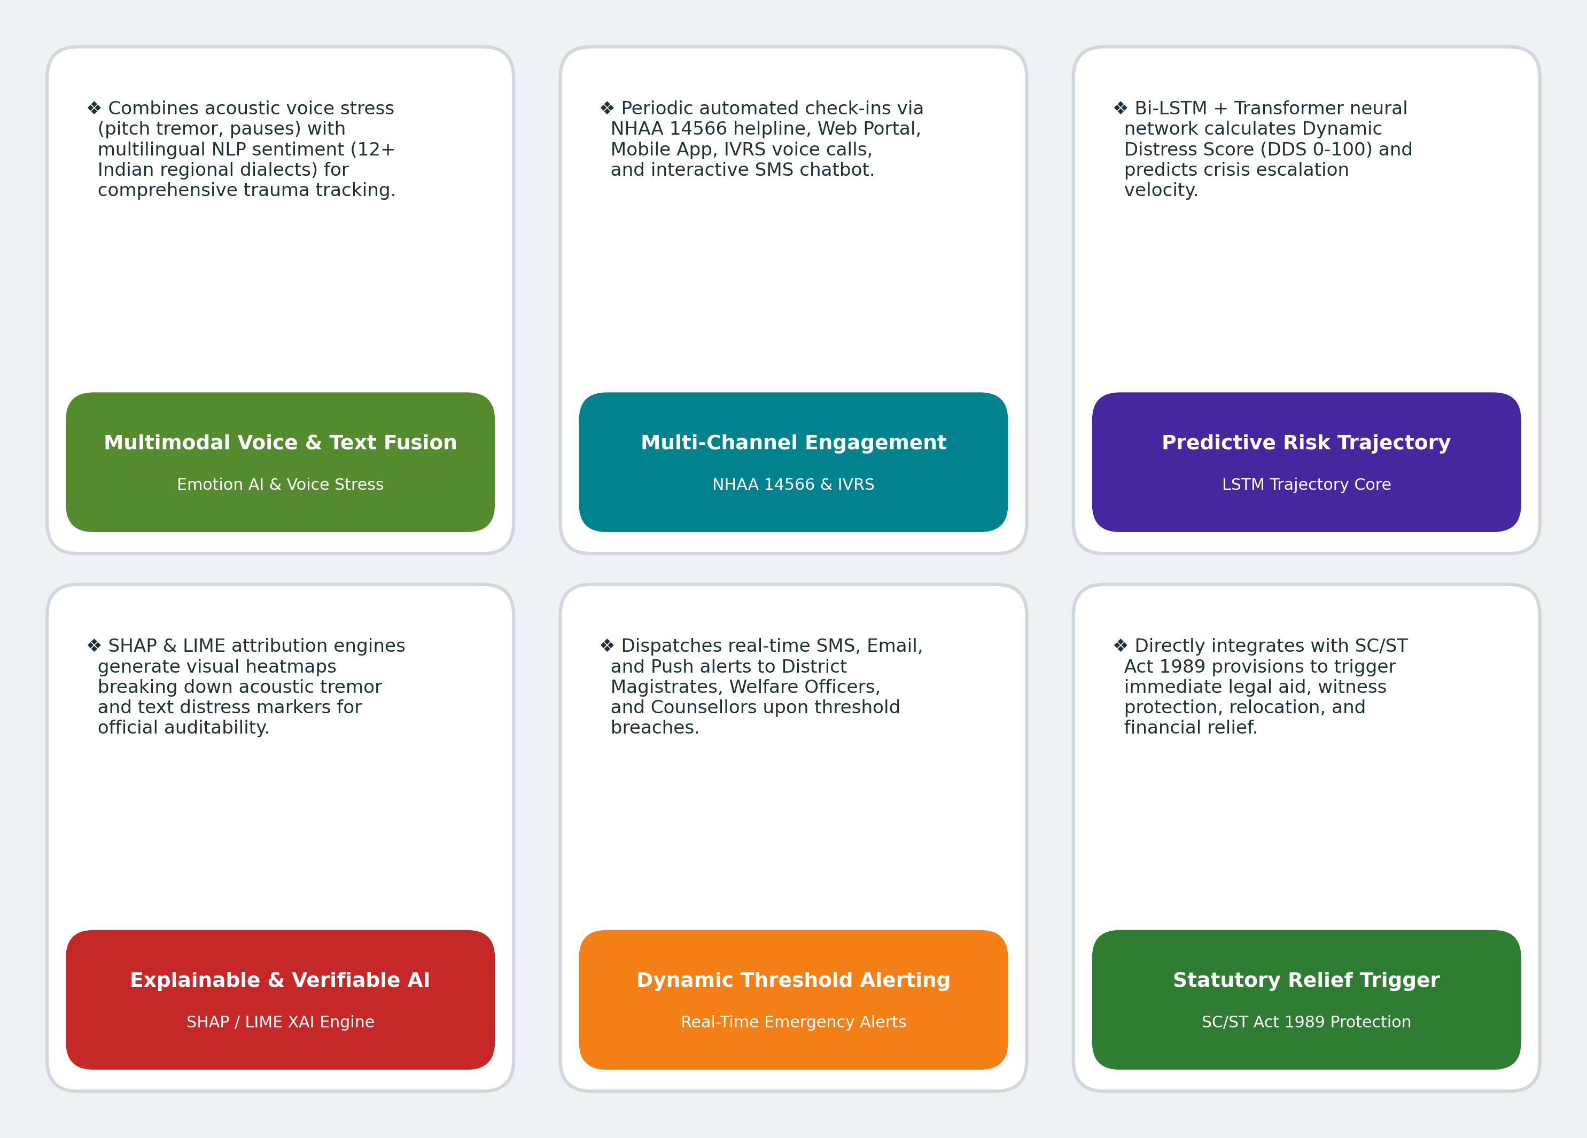
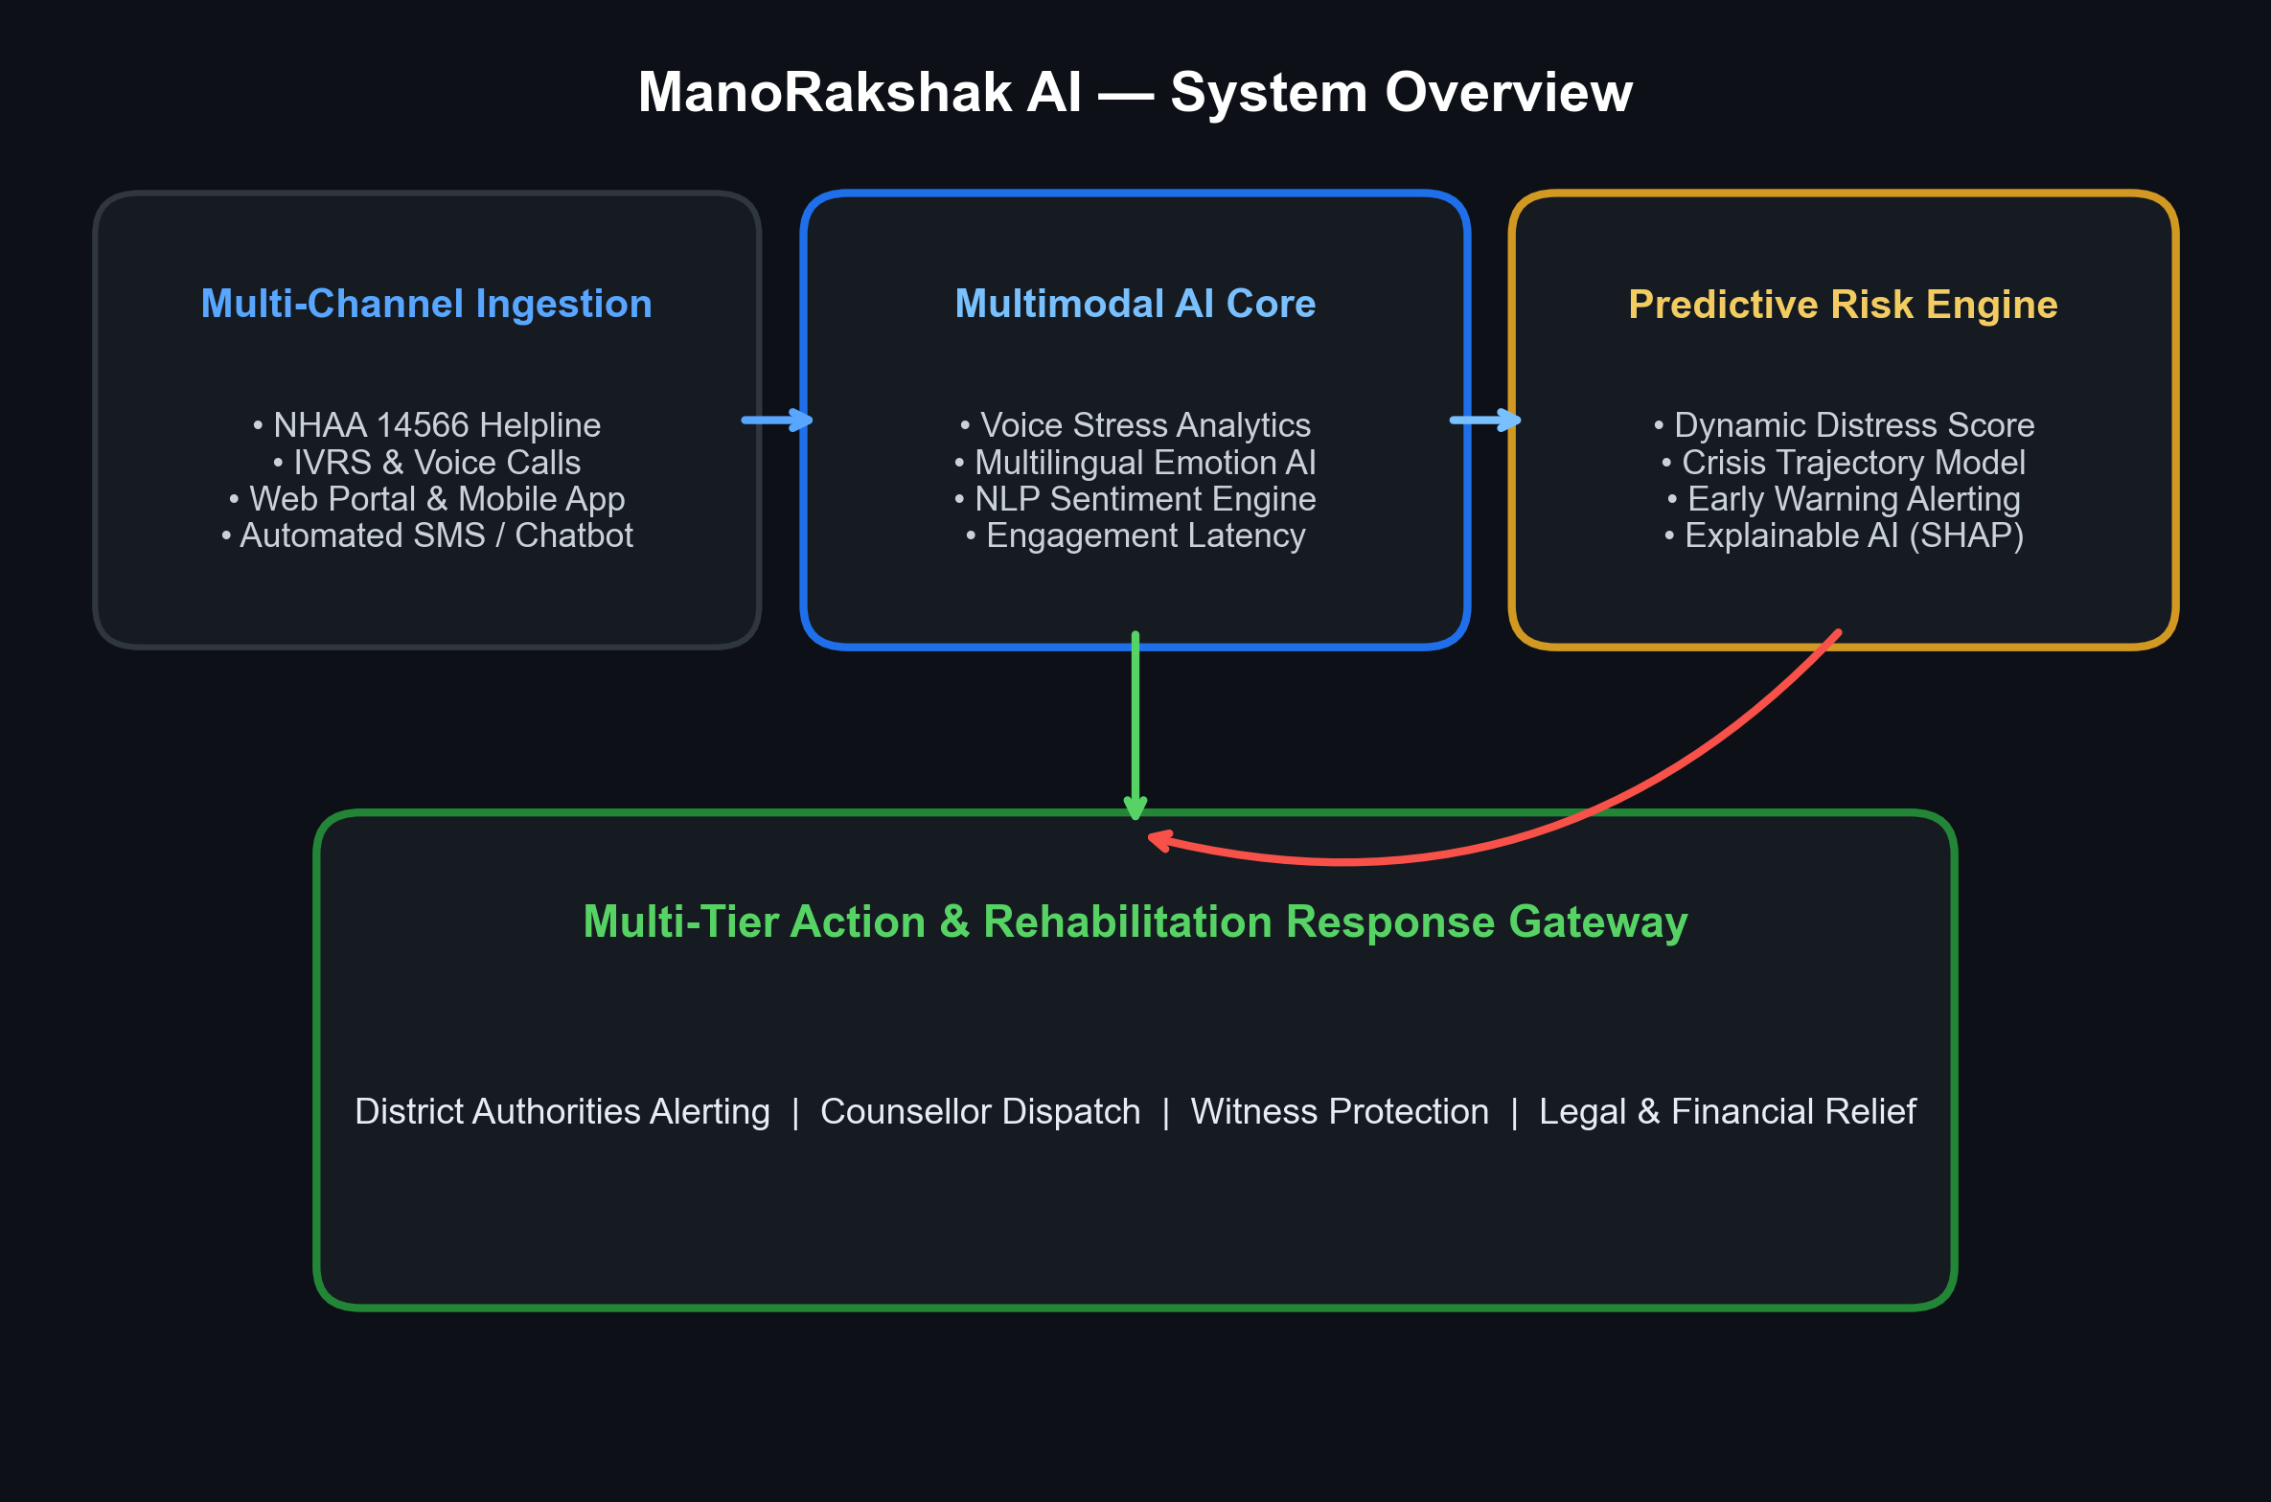
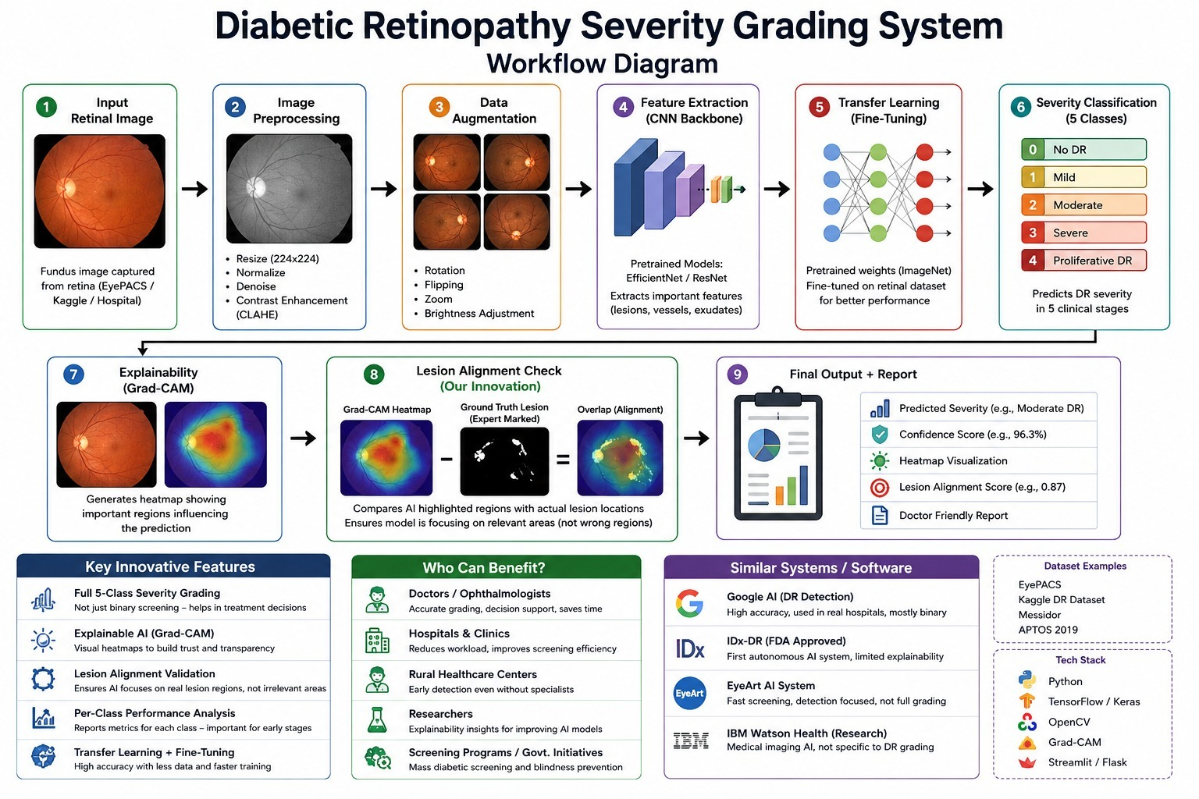

ManoRakshak.AI
Visioneers
Real World Issue
Proposed Solution
The Threat: Atrocity victims face prolonged severe psychological distress post-registration due to threats, court delays, social ostracism & rehabilitation trauma.
The Bottleneck: Existing mechanisms focus solely on financial/legal support, with zero continuous mental health monitoring.
The Fallout: Unmonitored distress escalates into severe mental health crises, PTSD, self-harm, or non-cooperation in trials.
The Flaw: Fragmented channels (NHAA 14566, portal, app, IVRS) lack dynamic distress tracking, emotion AI & early warning alerts.

Slide 3
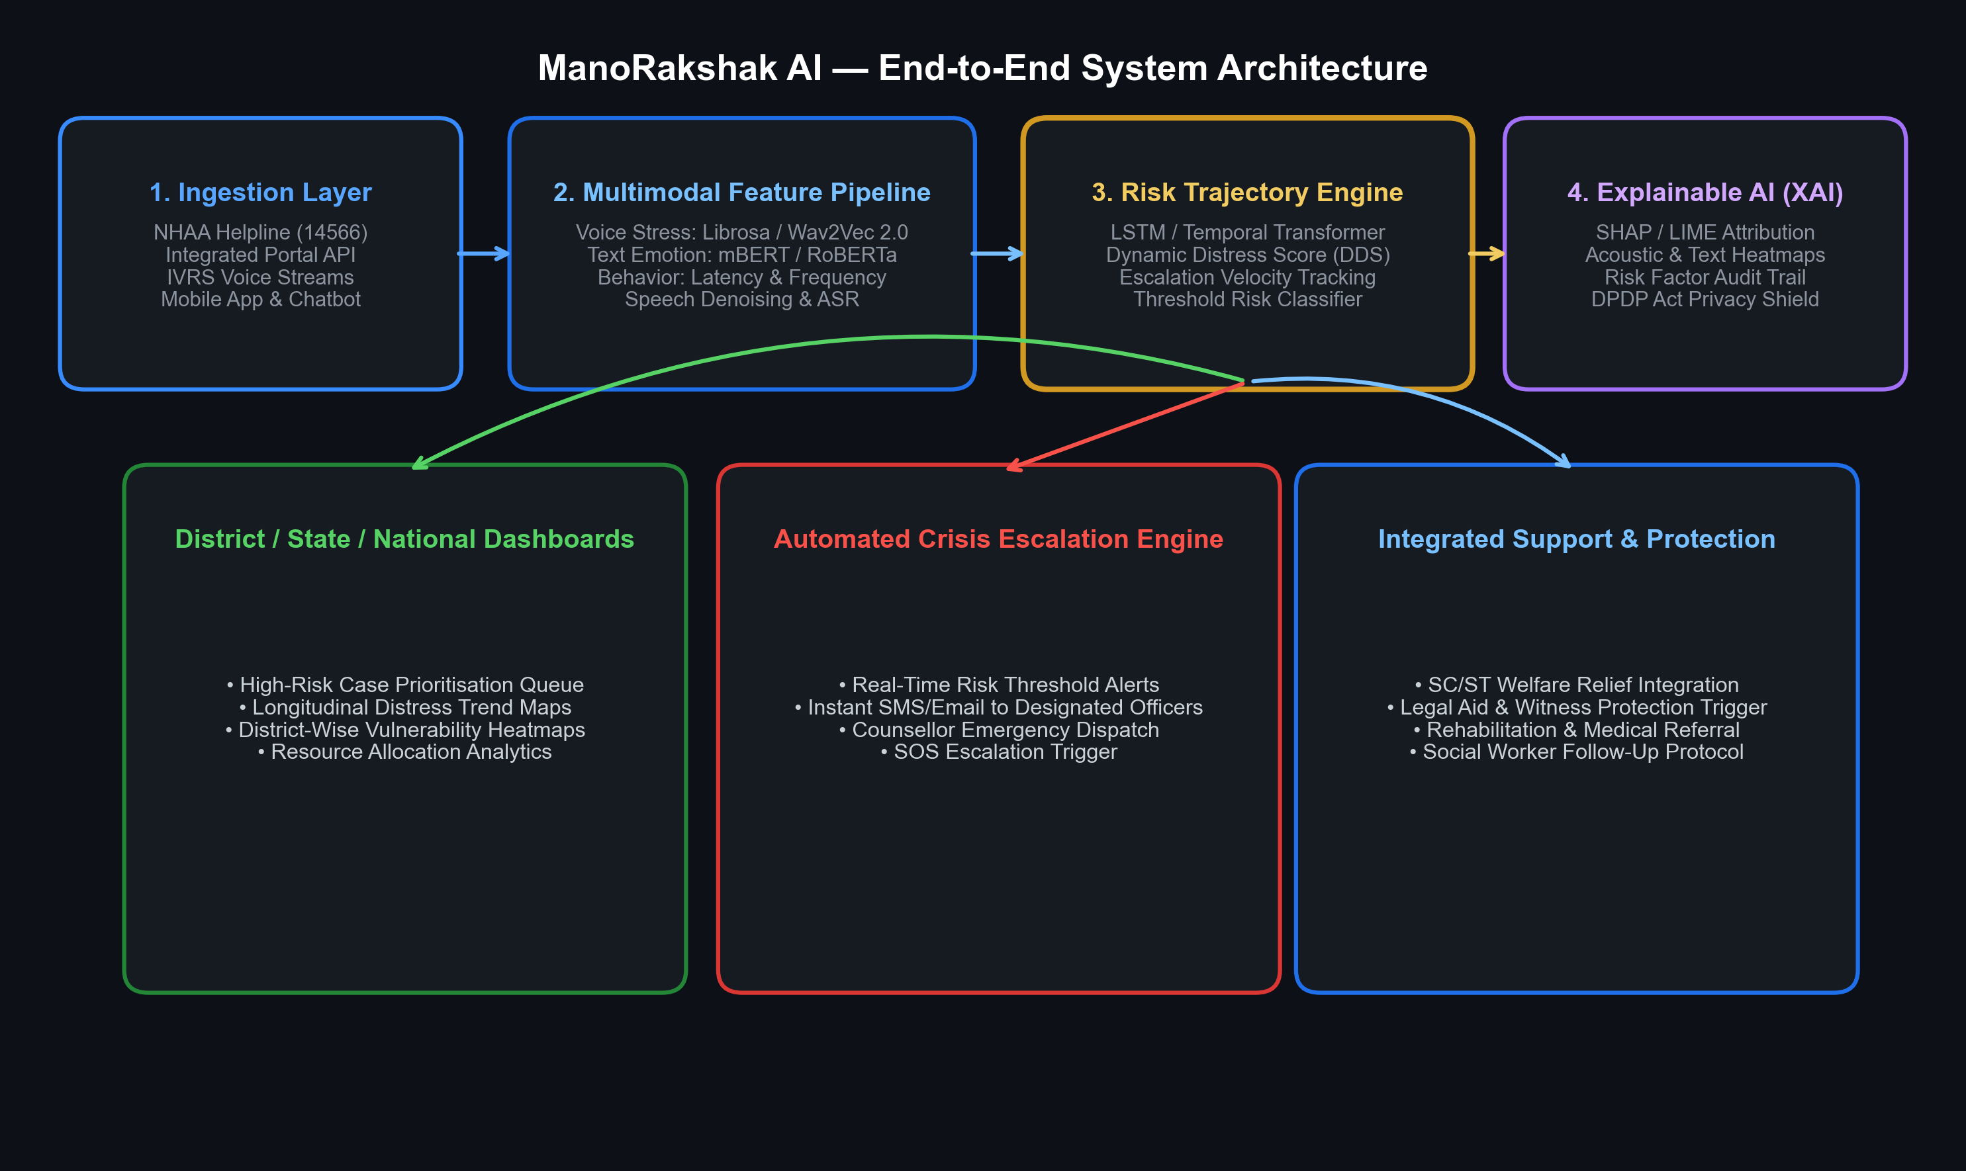









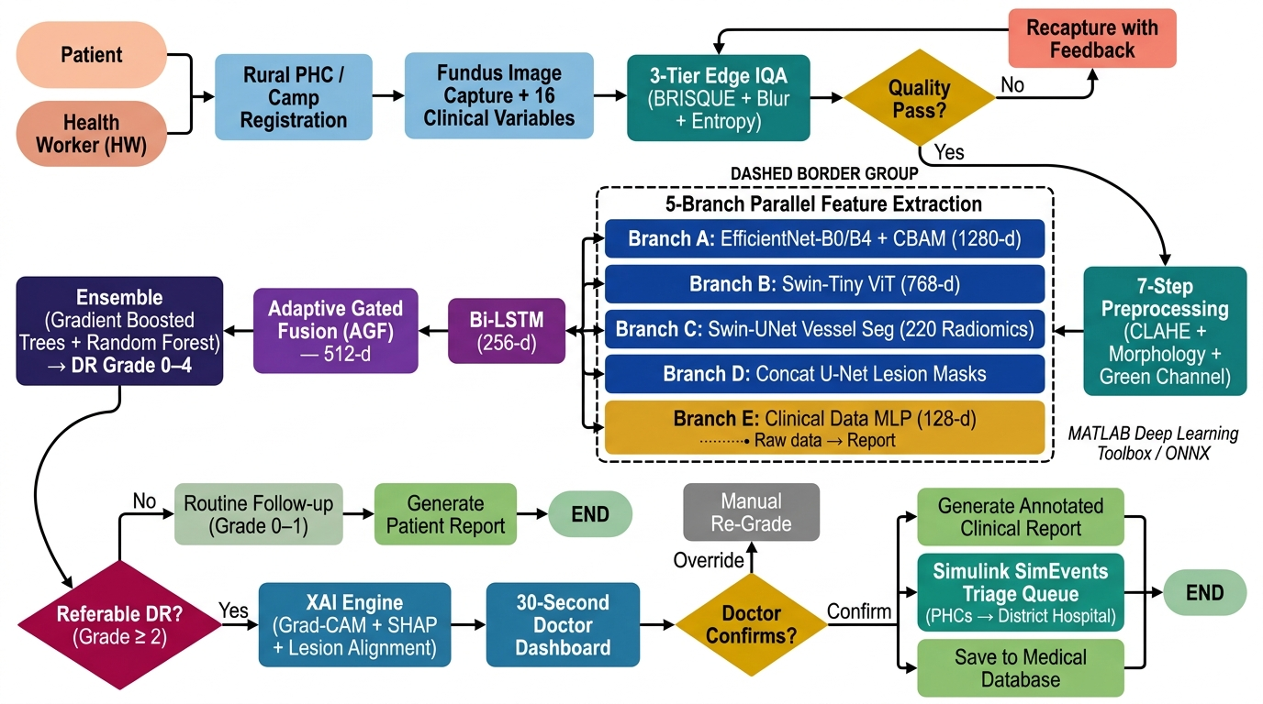

TECHNICAL APPROACH
Visioneers
System Methodology
Tech Stack
Librosa
PYTHON
PYTHON
mBERT / NLP
PYTORCH
PYTORCH
EMOTION AI
Wav2Vec 2.0
SHAP / XAI
FastAPI
Wav2Vec 2.0
GITHUB
DEMO VIDEO

Slide 4

FEASIBILITY AND VIABILITY
Visioneers
FEASIBILITY:
Challenges:
Strategies To Overcome Challenges:
Operational: Integrates seamlessly with existing NHAA 14566 helpline, Integrated Atrocity Portals & IVRS with zero friction for victims.
Rural Dialects: Untrained regional dialects & background noise during IVRS calls cause audio distortion.
Speech Denoising: Advanced noise suppression & fine-tuned Indic ASR models handle rural accents and noise.
Scalability: Cloud-native microservices architecture enabling rapid, seamless deployment across District, State & National levels.
.
Black-Box Trust: Officials hesitate to rely on automated AI predictions without clinical justification.
Explainable AI: SHAP/LIME heatmaps visually break down specific acoustic & text distress markers for officers.
Economic: Low-cost continuous monitoring offsets expensive emergency crisis interventions & prevents trial collapse costs.
Low Connectivity: Rural tribal/remote PHC clinics suffer from intermittent internet and low-spec hardware.
.
Offline Inference: Compressed ONNX models run locally on edge servers with automated IVRS/SMS fallback.
Clinical & Ethical: Adheres strictly to DPDP Act privacy rules, anonymized distress scoring & human-in-the-loop verification.
Victim Dropouts: Victims withholding responses due to fear or intimidation cause missing data.
Non-Response Tracking: System tracks silent periods & automatically dispatches welfare check-ins before crisis.

Slide 5

IMPACT AND BENEFITS
Visioneers
Potential Impact on the Target Audience
Benefits of the Proposed Solution
For Witnesses & Families: Provides confidential communication channels, witness protection alerts, and legal/financial guidance.
Social (Justice & Equity): Restores victim confidence in the justice delivery system and prevents psychological breakdown during trial proceedings.
For Victims of Atrocities: Ensures continuous psychological safety net, trauma tracking, and immediate crisis protection under SC/ST Act 1989.
Economic (Resource Allocation): Optimizes welfare funds, counselling deployment, and rehabilitation support to cases with highest escalation velocity.
For Counsellors & Officers: Offers prioritized high-risk case queues, longitudinal distress trends, and actionable intervention recommendations.
Victim Welfare: Early crisis detection prevents severe PTSD escalation, depression, trauma, and self-harm.
.
For District & MoSJE Authorities: Delivers real-time State and National dashboards for evidence-based policy making and multi-agency coordination.
Systemic Coordination: Unifies welfare departments, law enforcement, legal aid authorities, and health agencies into one emergency response network.

Slide 6
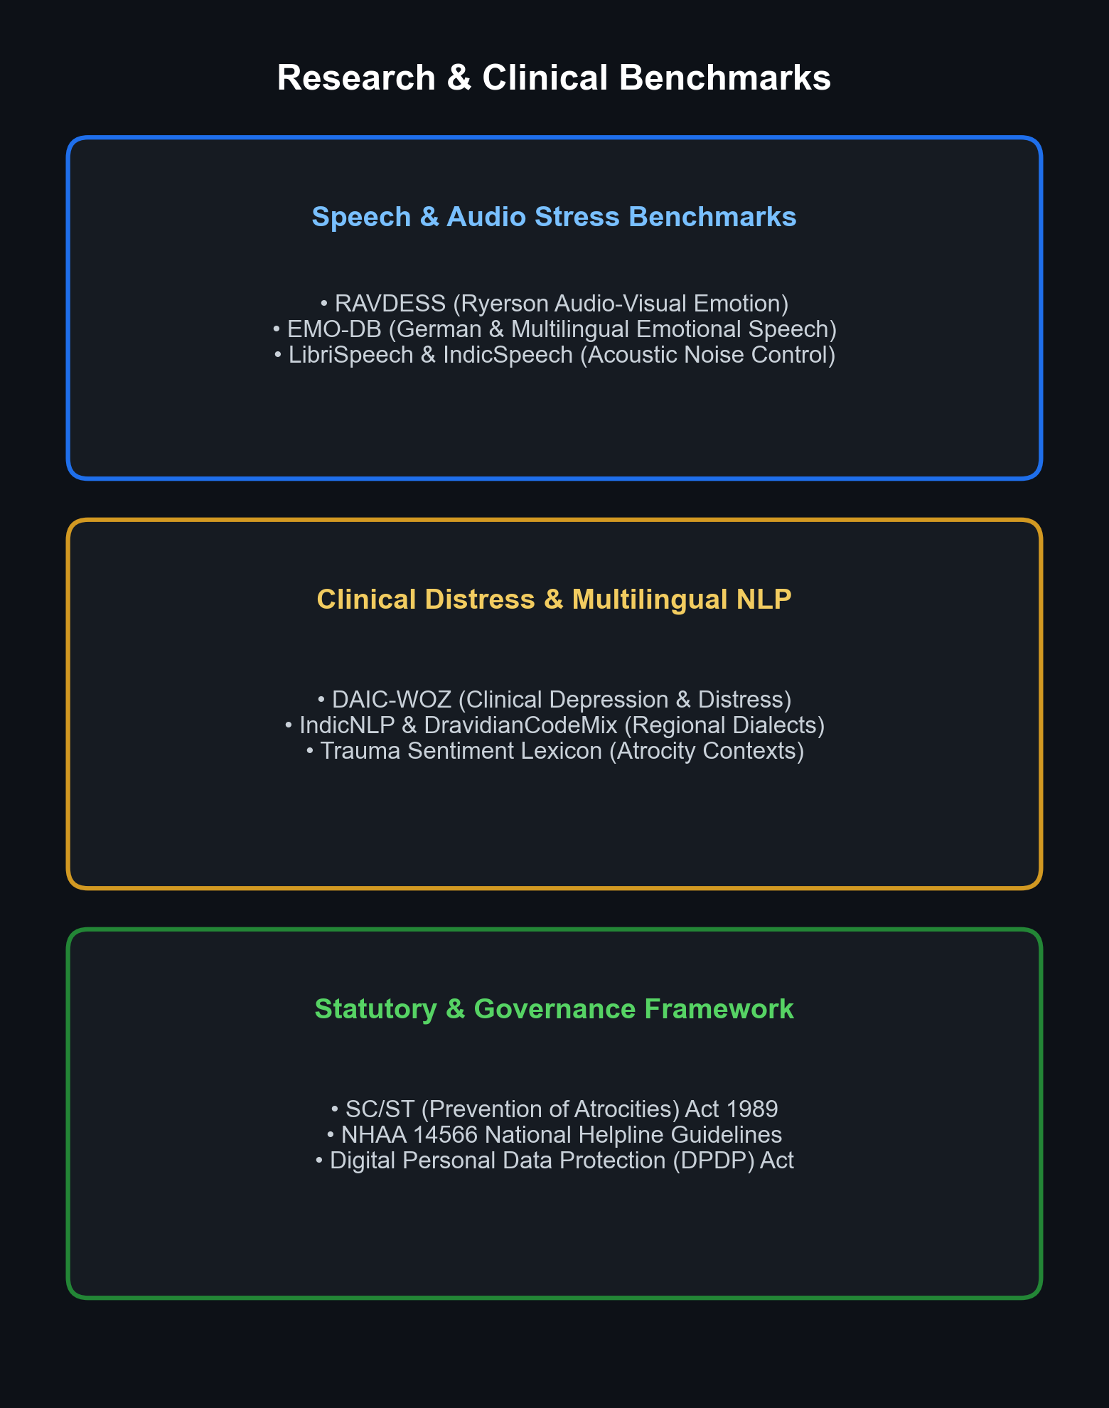
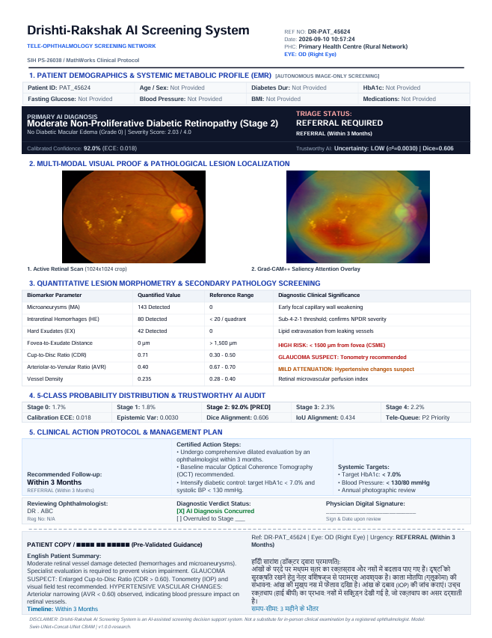
RESEARCH AND REFERENCES
Visioneers
Academic Research Papers
M. Scherer et al., "Voice stress analytics and acoustic markers of psychological distress in trauma victims," IEEE Trans. Affective Computing, 2025.
A. Sharma et al., "Multilingual Emotion AI and sentiment analysis for Indian regional dialects," ACM Trans. Asian Lang. Info. Processing, 2026.
R. Kumar et al., "Predictive risk modeling and longitudinal distress trajectory scoring," J. Biomed. Inform., vol. 140, 2025.
S. Gupta et al., "Explainable AI (XAI) using SHAP and LIME for clinical decision support," Comput. Biol. Med., 2026.
Clinical Datasets & Legal Frameworks:
RAVDESS & EMO-DB (Voice Stress & Emotional Speech Benchmarks)
DAIC-WOZ Benchmark (Clinical Distress & Depression Assessment Dataset)
IndicNLP & DravidianCodeMix (Multilingual Indian Regional Language Datasets)
SC/ST Act 1989 & NHAA 14566 (Prevention of Atrocities Guidelines & Helpline)

