Slide 1
Biology
A science deals with the living and non-living things.
Father of biology and zoology : Aristotle
Father of botany :Theophrastus

Slide 2

Human blood
Study of blood : Hematology
Fluid connective tissue, liquid.
Formation : bone marrow
Disease of bone marrow (Thalassemia and anaemia).
ph : 7.35 to 7.45

Slide 3
Blood in our body : 4.5-5.5 L
Blood of our body : 7%
Parts of blood
1. Plasma (55%)
2. Corpuscles (45%)

Slide 4
Plasma
Color : yellow
90% water.
10% protein, carbohydrates and fats
Protein : 7%
To maintain blood pressure

Slide 5
Corpuscles
RBC
WBC
Blood platelet

Slide 6
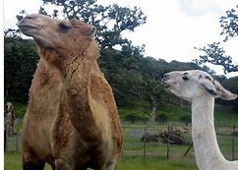
RBC
Red blood cell or Erythrocytes
Counting: 4.2 to 5.4 million/ cubic mm
Age : 120 days
Work: carry O2 and Co2
Diameter : 6 - 8 μm
No nucleus (exception camel and lama)

Slide 7
Largest RBC: camel
Smallest : deer
counting blood cells: hemocytometer
Deficiency: Malaria and Anemia.
Polycythaemia, also known as erythrocytosis

Slide 8
Maleria
mosquito-borne infectious disease
female Anopheles
Plasmodium injected in our body (sporozoites are injected into the skin)
discovery of the malarial parasite: Ronald Ross
medicine: Quinine (bark of a cinchona tree)

Slide 9

Baby (0-3) and fetus: Liver and spleen.
Bank of RBC: Spleen
Dead house: Spleen

Slide 10
RBC is to transport the oxygen by hemoglobin.
is the iron-containing oxygen-transport.
Male: 13.5 to 17.5 grams per deciliter
Female : 12.1 to 15.1 gm/dL.
Average : 12-16 gm/dL
Rbc count: Hemocytometer

Slide 11
WBC (White Blood Cell)
leukocytes or leucocytes
usually expressed as 4,000 to 11,000 white blood cells per microliter of blood.
Age : 2 – 4 days
Nucleus present
A decrease below the lower limit is called leukopenia.

Slide 12
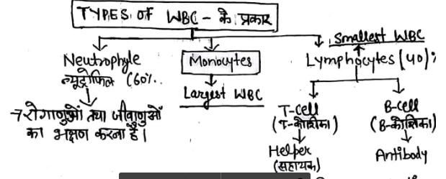

Slide 13
Blood platelet
also called thrombocytes.
Platelets are formed from what type of cell Ans- Megakaryocytes
150,000 to 450,000 per cubic millimeter
Clot
No nucleus
Non-clotting of blood is caused by defeciency of ? Ans- Vitamin K

Slide 14
Which gas in air pollution can affect blood stream leading to death ? Ans- Carbon monooxide
Human blood is a viscous "fluid due to Ans- Proteins in blood
What would happen if human blood becomes acidic ? Ans- Oxygen-carrying capacity of haemoglobin is decrease

Slide 15
After extracting febrinogen and protien out of plasma remaining plasma is called ____ Ans- Serum
___ blood protein regulates the amount of water in plasma ? Ans- Albumin
What would happen to red blood cells if the haem group were removed from haemoglobin? Ans- Red blood cells would not be able to bind oxygen.

