Slide 2
AGNI PRIME
DRDO will soon test the new missile Agni Prime, advanced version of the ‘Agni-1’ missile.
• Agni Prime’ is a short-range (surface to a surface) ballistic missile that will have a range of 1000 km to 1500 km and will have advanced features in agility and road mobility.
o It can carry a payload of around 1,000 Kg or a nuclear warhead.
• The double stage missile will be lighter and much sleeker than its predecessor ‘Agni-1’. • Agni-1 is a short-range (surface to a surface) nuclear capable ballistic missile. It has a strike range of 700 km 1,200 km.

Slide 3
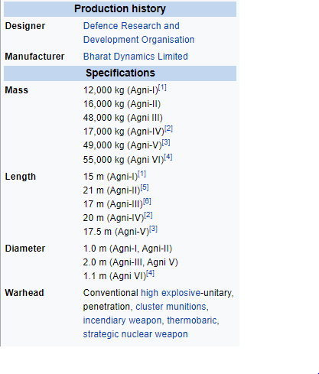

Slide 4
THE LEAF COALITION
The LEAF Coalition was launched by an initial group of governments (Norway, UK, US) and leading companies (like Amazon, Nestle etc.) to mobilise finance for protection of tropical forest.
• The LEAF (Lowering Emissions by Accelerating Forest finance) coalition aims to mobilize at least $1 billion in finance to support tropical and subtropical forest countries to move rapidly towards reducing emissions from deforestation.
• It is expected to become one of the largest public private efforts that support countries in achieving their Nationally Determined Contributions (NDCs) under the Paris Agreement and the Reducing Emissions from Deforestation and Forest Degradation (REDD+) mechanism.
• Reductions in emissions are to be made through programs that involve all key stakeholders, including Indigenous peoples and local communities

Slide 5
GENETICALLY MODIFIED (GM) RUBBER
Recently, world’s first GM rubber plant was planted in Assam.
• GM rubber plant, which is the first of its kind developed specifically for the northeast and is expected to flourish in the region’s climatic conditions.
• With additional copies of the gene MnSOD (manganese-containing superoxide dismutase) inserted in it, GM rubber plant is expected to tide over the severe cold conditions during winter which is a major factor affecting the growth of young rubber plants.
o Natural rubber is a native of warm humid Amazon forests and is not naturally suited for the colder conditions.
• It is developed by the Kerala-based Rubber Research Institute of India.

Slide 6
Mahseer
The Blue-Finned Mahseer, which was on the International Union for Conservation of Nature’s (IUCN) red list as ‘critically endangered’, has now moved to the ‘least concern’ status.
• The Mahseer (roughly translates as mahi – fish and sher – tiger, is also referred as “tiger among fish”). It is important indicator of freshwater ecosystems.

Slide 7
Out of 47 subspecies of Mahseer 15 are found in India and rest in other range countries in South Asia.
• Mahseer prefers clean, fast flowing and well oxygenated waters for breeding and migration.
• They are omnivorous.
• Threats faced: o Sensitive to dissolved oxygen levels, water temperature and sudden climatic changes o Pollution, habitat loss, over-fishing, construction of dams (impacting migration patterns) etc.
o Wildlife (Protection) Act 1972 does not explicitly draw attention to fish under the definition of ‘wild animal’

Slide 8
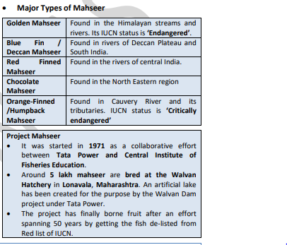

Slide 9
BHARITALASUCHUS TAPANI
It is a carnivorous reptile species that lived 240 million years ago and it might have been the largest predators in that ecosystems.
• It belongs to a genus and species previously unknown called Bharitalasuchustapani.
o In Telugu, Bhari means huge, Tala means head, and Suchus is the name of the Egyptian crocodile-headed deity.
• Fossils have been found on the rocks of the Yerrapalli Formation (Rock formation in the Pranhita–Godavari Basin in Telangana)

Slide 10

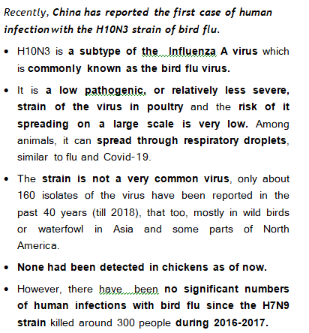

Slide 11
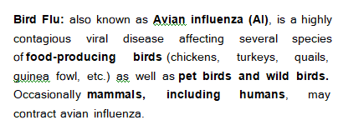

Slide 12
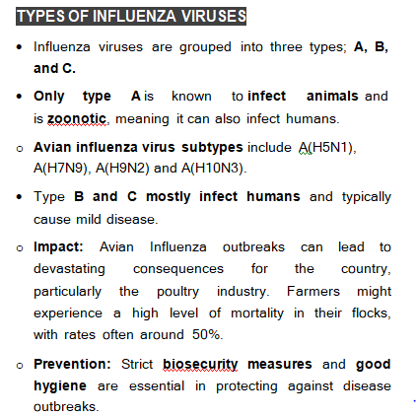

Slide 13
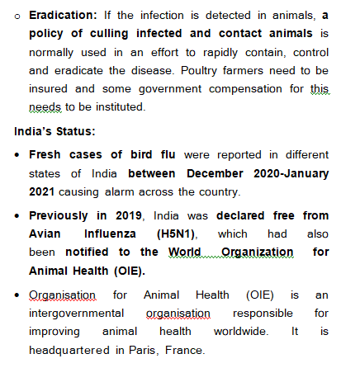

Slide 14
