Slide 1
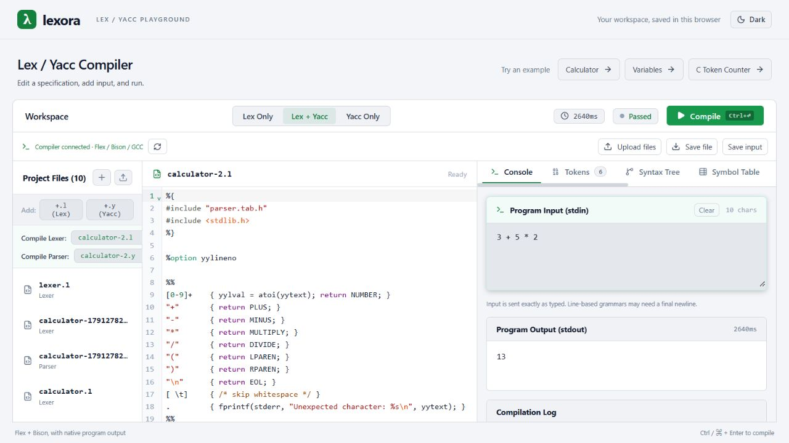
Lexora
A compiler-design
workbench
Real Lex/Yacc execution with visual explanations of compiler concepts.
COMPILER DESIGN PROJECT
01
Notes:
Project evidence: README.md; frontend/src/App.jsx; frontend/src/components/OutputPanel/OutputPanel.jsx. The screenshot shows the bundled calculator running successfully with stdin 3 + 5 * 2 followed by a newline and stdout 13.

Slide 2
Project overview
Lexora brings source editing,
native compilation, and compiler
analysis into one browser workspace.
Native execution
Educational analysis
Students compile selected Lex and Yacc specifications using Flex, Bison, and GCC.
A built-in analyzer explains supported input through syntax trees, symbols, and intermediate code.
02
Notes:
Project evidence: README.md; frontend/src/App.jsx; frontend/src/components/OutputPanel/OutputPanel.jsx.

Slide 3
Problem identification
The compilation process is
difficult to understand when
its intermediate steps
remain hidden.
Fragmented laboratory workflow
Students manage separate files and commands to generate, compile, and execute a lexer or parser.
Limited explanatory feedback
Program output alone does not explain syntax structure, symbol scope, or intermediate code.
03
Notes:
These are the teaching and workflow problems the project addresses. They do not represent measured findings from a formal user study. Project evidence: README.md; frontend/src/App.jsx; frontend/src/components/OutputPanel/OutputPanel.jsx.

Slide 4
Project objectives
01
Provide an integrated workspace
02
Execute real compiler tools
Students can edit specifications, select targets, and supply program input.
The backend generates C sources, builds an executable, and captures its output.
03
Explain compiler concepts
04
Support repeatable experiments
Visual views connect tokens and syntax structure with symbols and intermediate code.
Browser drafts, examples, and file downloads help students continue their work.
04
Notes:
Project evidence: README.md; frontend/src/App.jsx; frontend/src/components/OutputPanel/OutputPanel.jsx. Educational analysis covers the built-in language subset.

Slide 5
Literature survey
ANTLRWorks (2008) demonstrates visual grammar debugging to help developers inspect parser behavior [1]. Compiler Explorer provides browser-based compilation with visible compiler output [2]. Flex and Bison supply the scanner and parser generation used in traditional Lex/Yacc workflows [3, 4]. Together, these references motivate Lexora's focus on a dedicated teaching workspace that combines native specification execution with a separate analyzer for program structure and intermediate code.
Related work: ANTLRWorks [1], Compiler Explorer [2], Flex and Bison [3, 4].
05
Notes:
[1] Bovet, J. and Parr, T. (2008). ANTLRWorks: an ANTLR grammar development environment. Software: Practice and Experience, 38(12), 1305-1332. https://doi.org/10.1002/spe.872
[2] Compiler Explorer, official project documentation. https://github.com/compiler-explorer/compiler-explorer/blob/main/docs/WhatIsCompilerExplorer.md
[3] Flex manual. https://westes.github.io/flex/manual/Introduction.html
[4] GNU Bison manual. https://www.gnu.org/s/bison/manual/bison.html
The final sentence is a design synthesis from the reviewed approaches, rather than a claim that no comparable website exists. Lexora native execution and its educational analyzer remain separate.

Slide 6
Novelty and project contribution
A dedicated website for compiling
Lex/Yacc code and visualizing
compiler concepts.
Students can run selected specifications and inspect supported input in one dedicated workspace.
Selected .l / .y files
Flex + Bison + GCC
Native output
Program input
Built-in analyzer
Educational views
06
Notes:
Project evidence: README.md; frontend/src/App.jsx; frontend/src/components/OutputPanel/OutputPanel.jsx. Project evidence: backend/services/inputAnalysis.js; backend/services/astGenerator.js; backend/services/semanticAnalyzer.js; backend/services/tacGenerator.js; backend/services/optimizer.js; backend/services/basicBlocks.js. Lexora addresses the need for a dedicated website for Lex/Yacc compilation and visual learning. The contribution is application integration and the educational workflow, not a new compiler algorithm. An absolute claim that no related website exists is not substantiated; an online yacc/lex grammar editor/tester is documented at https://lists.gnu.org/archive/html/help-bison/2023-09/msg00000.html .

Slide 7
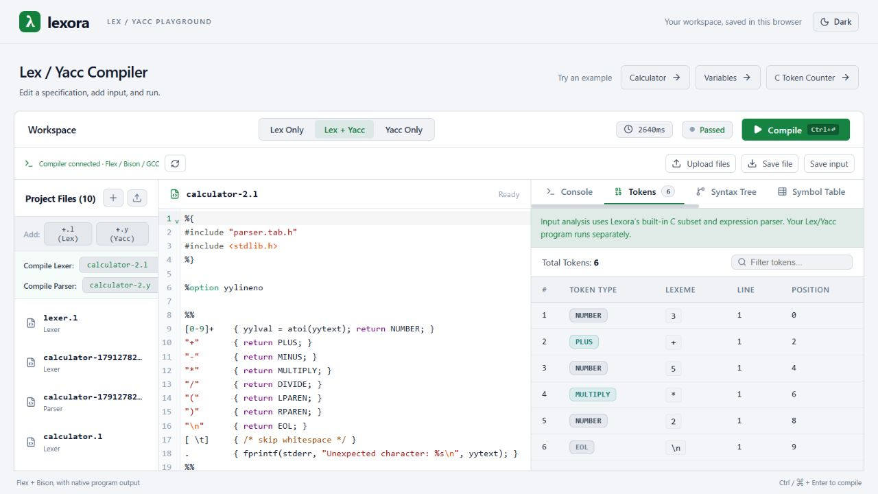
The Lexora workspace
Source editing
The editor holds the selected lexer or parser specification.
Analysis views
The token table records each lexeme and its position in the input.
07
Notes:
Project evidence: README.md; frontend/src/App.jsx; frontend/src/components/OutputPanel/OutputPanel.jsx. Actual local screenshot showing the calculator source and the built-in token table.

Slide 8
System architecture
HTTP / JSON
Browser interface
React + CodeMirror
Backend API
Node.js + Express
WSL Ubuntu
Flex + Bison + GCC
Browser localStorage
Workspace drafts
JavaScript analyzer
AST, symbols, and TAC
Temporary job directory
Sources and executable
The browser sends JSON requests. The backend returns output, errors, and analysis as JSON.
08
Notes:
Project evidence: README.md; frontend/src/App.jsx; frontend/src/components/OutputPanel/OutputPanel.jsx. Project evidence: backend/services/compiler.js; backend/services/wslRunner.js; backend/routes/compile.js; backend/middleware/validator.js. Project evidence: frontend/src/App.jsx; frontend/src/services/files.js; backend/services/tempDir.js; backend/services/compiler.js. Local development: Vite on port 3000 proxies /api to Express on port 3001. Windows uses WSL Ubuntu. Linux uses native Bash.

Slide 9
Working flowchart
Edit files and program input
Failures identify the failing phase and preserve available results.
Send code and input as JSON
Clean temporary files
and return results
Invalid
Validate request
Return a validation error
Valid
Analyze input and prepare files
Generate C, compile, and run
09
Notes:
Project evidence: backend/services/compiler.js; backend/services/wslRunner.js; backend/routes/compile.js; backend/middleware/validator.js. analyzeInput executes before the native stages. These paths are logically separate, not concurrent jobs. Cleanup is attempted in finally before the route sends the JSON response.

Slide 10
Data storage and lifecycle
Data | Location | Lifetime
Source drafts and input | Browser localStorage | Across reloads until cleared.
Sources and generated executable | Backend temporary job folder | One request, then cleanup.
Output and analysis results | Backend memory and browser state | Current request and result.
Downloaded source files | User-selected download location | Until the user removes them.
Lexora uses browser storage for drafts and temporary files for compilation. It has no application database.
10
Notes:
Project evidence: frontend/src/App.jsx stores drafts under lexora.workspace.v2 and theme under lexora.theme. backend/services/tempDir.js creates os.tmpdir()/lexora-UUID. backend/services/compiler.js attempts cleanup in finally. Results are held in memory and React state. No application database is configured.

Slide 11
Native compilation pipeline
Flex
Bison
GCC
Execution
lex.l produces
lex.yy.c.
parser.y produces
parser.tab.c and
parser.tab.h.
Generated C files
produce an executable
named compiler.
The executable reads
input.txt and writes
standard output.
gcc -o compiler lex.yy.c parser.tab.c -lfl -lm
Windows backend: WSL Ubuntu. The scanner uses the token header generated by Bison.
11
Notes:
Project evidence: backend/services/compiler.js; backend/services/wslRunner.js; backend/routes/compile.js; backend/middleware/validator.js. Actual combined-mode order: flex lex.l; bison -d parser.y; normalize generated-header references; regenerate scanner; gcc -o compiler lex.yy.c parser.tab.c -lfl -lm; ./compiler < input.txt. Lex Only skips Bison. Yacc Only skips Flex and requires its own yylex and main.

Slide 12
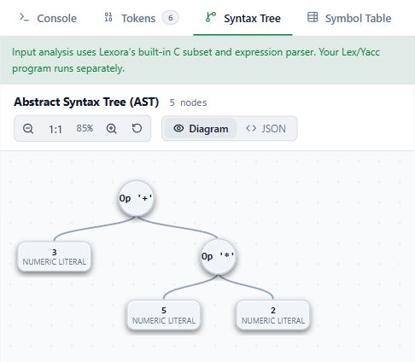
Educational analysis
Input: 3 + 5 * 2
The built-in parser groups multiplication before addition and constructs an abstract syntax tree.
The analyzer also derives scoped symbols, three-address code, optimization results, and basic blocks.
The built-in analyzer creates these views from supported input. The submitted Lex/Yacc grammar controls native execution.
12
Notes:
Project evidence: backend/services/inputAnalysis.js; backend/services/astGenerator.js; backend/services/semanticAnalyzer.js; backend/services/tacGenerator.js; backend/services/optimizer.js; backend/services/basicBlocks.js. The screenshot is the actual AST view for calculator stdin 3 + 5 * 2 followed by newline. The AST comes from Lexora’s own parser. It does not trace the uploaded grammar.

Slide 13
Symbol table and semantic checks
int x = 2 + 3 * 4;
int y = x + 1;
How entries are generated
The analyzer visits the syntax tree. Declarations create entries, and references mark names as used.
Name | Type | Scope | Declared | Used
x | int | global | Yes | Yes
y | int | global | Yes | No
Scope and error checks
Nested scopes control name lookup. Undeclared names and duplicate declarations produce errors.
The table records declarations and usage, rather than live runtime values.
13
Notes:
Project evidence: backend/services/semanticAnalyzer.js and backend/services/inputAnalysis.js. Observed input: int x = 2 + 3 * 4; int y = x + 1;. Both global variables are declared. x is read and y is not read. The AST traversal creates records and marks references. Scope lookup uses a stack of Maps. A separate observation of int x = missing + 1; reports missing as used before declaration / assignment. This is educational analysis, independent of the submitted grammar.

Slide 14
Worked example: intermediate code
int x = 2 + 3 * 4;
Declare x : int
Original TAC
Optimized TAC
t1 = 3 * 4
t2 = 2 + t1
x = t2
t1 = 12
t2 = 14
x = 14
+
2
*
Constant folding evaluates arithmetic.
Constant propagation substitutes known values.
3
4
14
Notes:
Project evidence: backend/services/inputAnalysis.js; backend/services/astGenerator.js; backend/services/semanticAnalyzer.js; backend/services/tacGenerator.js; backend/services/optimizer.js; backend/services/basicBlocks.js. Observed analyzeInput("int x = 2 + 3 * 4;"): AST declaration x:int with addition of 2 and multiplication 3*4. Symbol x global, declared true. TAC and optimized TAC shown exactly. Three assignments remain, so no instruction-count or speed claim applies.

Slide 15
Basic blocks and control flow
int x = 1;
if (x < 3) { x = x + 1; }
B1: Test condition
x = 1
t1 = x < 3
ifFalse t1 goto L1
True
A basic block contains consecutive instructions with no internal branch.
B2: Execute body
t2 = x + 1
x = t2
False
Lexora identifies block leaders and records the successor relationships in the original TAC.
B3: Continue
L1:
15
Notes:
Project evidence: backend/services/inputAnalysis.js; backend/services/astGenerator.js; backend/services/semanticAnalyzer.js; backend/services/tacGenerator.js; backend/services/optimizer.js; backend/services/basicBlocks.js. Observed analyzeInput("int x = 1; if (x < 3) { x = x + 1; }"): B1 x=1, t1=x<3, ifFalse t1 goto L1; B2 t2=x+1, x=t2; B3 L1:. Successors: B1 to B2 and B3, B2 to B3. These blocks use original TAC.

Slide 16
Demonstration and observed results
Check | Input | Observed result
Native calculator | 3 + 5 * 2 | 13
Parentheses and precedence | (3 + 5) * 2 | 16
Semantic analysis | int x = missing + 1; | Undeclared name reported.
Analyzer scope boundary | int a[2]; | Unsupported syntax reported.
Calculator inputs end with a newline. The last two checks exercise the separate built-in analyzer.
16
Notes:
Verification date: 8 October 2026. Actual results from backend/services/compiler.js with examples/calculator/calculator.l and calculator.y: 3 + 5 * 2 followed by newline returns success true and stdout 13; (3 + 5) * 2 followed by newline returns success true and stdout 16. Separate built-in analyzer observations: int x = missing + 1; reports an undeclared reference. int a[2]; returns analysisStatus unsupported with no AST or TAC. These observations validate representative cases, not all possible inputs.

Slide 17
Scope, limitations, and next steps
Current implementation
Next steps
The analyzer supports a C subset. Arrays, structures, and pointer declarations remain outside its current scope.
Expand language support and connect analysis views to the submitted grammar.
Programs run through WSL with temporary job folders and timeouts. A dedicated security sandbox is not implemented.
Use isolated execution workers with restricted file and network access before public deployment.
17
Notes:
Current evidence: backend/services/wslRunner.js uses wsl.exe -d Ubuntu -- bash on Windows and a native Bash process on Linux. timeout limits child command execution. backend/services/tempDir.js creates separate temporary job folders. These controls do not constitute a dedicated security sandbox. The analyzer covers a supported C subset, independently from the submitted .l/.y grammar. Expanded syntax, grammar-linked visualization, and isolated public execution workers are future work.

Slide 18
Conclusion
Lexora makes compiler-design
experiments easier to run
and easier to explain.
The project combines native tool execution with educational representations of program input in a persistent browser workspace.
18
Notes:
Project evidence: README.md; frontend/src/App.jsx; frontend/src/components/OutputPanel/OutputPanel.jsx. Project evidence: backend/services/inputAnalysis.js; backend/services/astGenerator.js; backend/services/semanticAnalyzer.js; backend/services/tacGenerator.js; backend/services/optimizer.js; backend/services/basicBlocks.js.

Slide 19
References
01
Bovet and Parr (2008): ANTLRWorks
Software: Practice and Experience 38(12), 1305-1332.
https://doi.org/10.1002/spe.872
02
Compiler Explorer
Official project documentation for interactive compilation.
https://github.com/compiler-explorer/compiler-explorer
03
Official Flex documentation
Scanner generation from lexical rules.
https://westes.github.io/flex/manual/Introduction.html
04
Official GNU Bison documentation
Parser generation from grammar specifications.
https://www.gnu.org/s/bison/manual/bison.html
05
Official GCC documentation
Compilation stages and executable generation.
https://gcc.gnu.org/onlinedocs/gcc/Overall-Options.html
19
Notes:
Bovet, J. and Parr, T. (2008). ANTLRWorks: an ANTLR grammar development environment. Software: Practice and Experience, 38(12), 1305-1332. https://doi.org/10.1002/spe.872
Compiler Explorer, official project documentation. https://github.com/compiler-explorer/compiler-explorer/blob/main/docs/WhatIsCompilerExplorer.md
Flex manual. https://westes.github.io/flex/manual/Introduction.html
GNU Bison manual. https://www.gnu.org/s/bison/manual/bison.html
GCC manual. https://gcc.gnu.org/onlinedocs/gcc/Overall-Options.html

