Slide 1
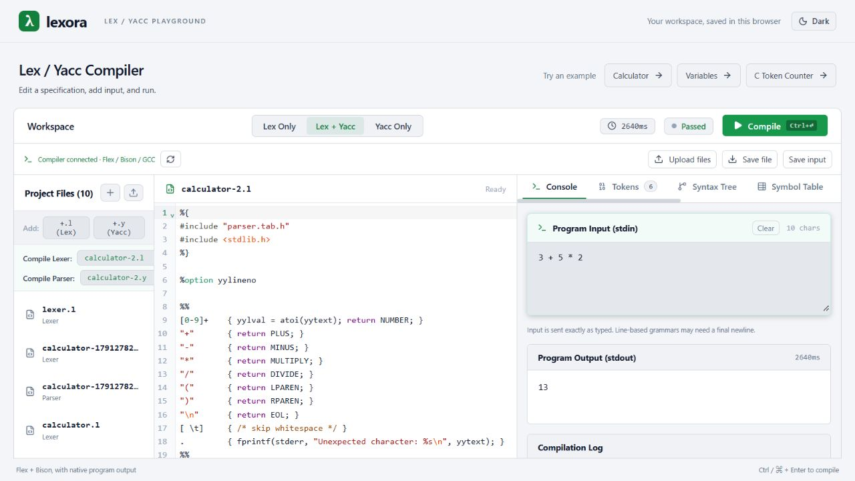
Lexora
A compiler-design
workbench
Real Lex/Yacc execution with visual explanations of compiler concepts.
COMPILER DESIGN PROJECT
01
Notes:
Project evidence: README.md; frontend/src/App.jsx; frontend/src/components/OutputPanel/OutputPanel.jsx. The screenshot shows the bundled calculator running successfully with stdin 3 + 5 * 2 followed by a newline and stdout 13.

Slide 2
Project overview
Lexora brings source editing,
native compilation, and compiler
analysis into one browser workspace.
Native execution
Educational analysis
Students compile selected Lex and Yacc specifications using Flex, Bison, and GCC.
A built-in analyzer explains supported input through syntax trees, symbols, and intermediate code.
02
Notes:
Project evidence: README.md; frontend/src/App.jsx; frontend/src/components/OutputPanel/OutputPanel.jsx.

Slide 3
Problem identification
The compilation process is
difficult to understand when
its intermediate steps
remain hidden.
Fragmented laboratory workflow
Students manage separate files and commands to generate, compile, and execute a lexer or parser.
Limited explanatory feedback
Program output alone does not explain syntax structure, symbol scope, or intermediate code.
03
Notes:
These are the teaching and workflow problems the project addresses. They do not represent measured findings from a formal user study. Project evidence: README.md; frontend/src/App.jsx; frontend/src/components/OutputPanel/OutputPanel.jsx.

Slide 4
Project objectives
01
Provide an integrated workspace
02
Execute real compiler tools
Students can edit specifications, select targets, and supply program input.
The backend generates C sources, builds an executable, and captures its output.
03
Explain compiler concepts
04
Support repeatable experiments
Visual views connect tokens and syntax structure with symbols and intermediate code.
Browser drafts, examples, and file downloads help students continue their work.
04
Notes:
Project evidence: README.md; frontend/src/App.jsx; frontend/src/components/OutputPanel/OutputPanel.jsx. Educational analysis covers the built-in language subset.

Slide 5
Literature survey: existing tools
Flex and Bison
Flex creates a scanner from rules for words, numbers, and symbols. Bison creates a parser from grammar rules. Together, they support Lex/Yacc experiments, but students usually manage the files and run several compilation commands themselves.
Compiler Explorer
Compiler Explorer lets users compile code in a browser and inspect the generated compiler output. It provides a useful example of presenting the source code and compilation results together in one interface.
ANTLRWorks (2008)
The ANTLRWorks research describes a grammar editor with an interpreter and a visual debugger. These features help users inspect parsing behavior, investigate grammar errors, and understand how the grammar handles a given input.
Sources: Flex and Bison manuals, Compiler Explorer documentation, ANTLRWorks research.
05
Notes:
Flex manual: https://westes.github.io/flex/manual/Introduction.html
GNU Bison manual: https://www.gnu.org/s/bison/manual/bison.html
Compiler Explorer official documentation: https://github.com/compiler-explorer/compiler-explorer/blob/main/docs/WhatIsCompilerExplorer.md
Bovet, J. and Parr, T. (2008). ANTLRWorks: an ANTLR grammar development environment. Software: Practice and Experience, 38(12), 1305-1332. https://doi.org/10.1002/spe.872

Slide 6
Literature survey: findings for Lexora
What the reviewed work shows
The reviewed tools address different parts of compiler learning. Flex and Bison generate working scanners and parsers, Compiler Explorer provides browser-based experimentation, and ANTLRWorks explains grammar behavior through visual tools.
How Lexora applies these ideas
Lexora brings these approaches into a dedicated workspace for Lex/Yacc laboratory practice. Students can edit specifications, run them using Flex, Bison, and GCC, and examine syntax trees, symbols, and intermediate code for supported input.
Scope of the project contribution
Lexora's contribution is the connection between execution and learning views. Its built-in analyzer runs separately from the submitted Lex/Yacc grammar, so the visual results describe Lexora's supported input language.
06
Notes:
Flex manual: https://westes.github.io/flex/manual/Introduction.html
GNU Bison manual: https://www.gnu.org/s/bison/manual/bison.html
Compiler Explorer official documentation: https://github.com/compiler-explorer/compiler-explorer/blob/main/docs/WhatIsCompilerExplorer.md
Bovet, J. and Parr, T. (2008). ANTLRWorks: an ANTLR grammar development environment. Software: Practice and Experience, 38(12), 1305-1332. https://doi.org/10.1002/spe.872
The relationship between the reviewed approaches and Lexora is a design synthesis. Lexora-specific claims derive from backend/services/compiler.js and backend/services/inputAnalysis.js. The project does not claim that no related website exists, or that it traces every submitted grammar.

Slide 7
Novelty and project contribution
A dedicated website for compiling
Lex/Yacc code and visualizing
compiler concepts.
Lexora brings specification editing, real tool execution, and educational analysis into one workspace.
Selected .l / .y files
Flex + Bison + GCC
Native output
Program input
Built-in analyzer
Educational views
07
Notes:
Project evidence: README.md; frontend/src/App.jsx; frontend/src/components/OutputPanel/OutputPanel.jsx. Project evidence: backend/services/inputAnalysis.js; backend/services/astGenerator.js; backend/services/semanticAnalyzer.js; backend/services/tacGenerator.js; backend/services/optimizer.js; backend/services/basicBlocks.js. Lexora addresses the need for a dedicated website for Lex/Yacc compilation and visual learning. The contribution is application integration and the educational workflow, not a new compiler algorithm. An absolute claim that no related website exists is not substantiated; an online yacc/lex grammar editor/tester is documented at https://lists.gnu.org/archive/html/help-bison/2023-09/msg00000.html .

Slide 8
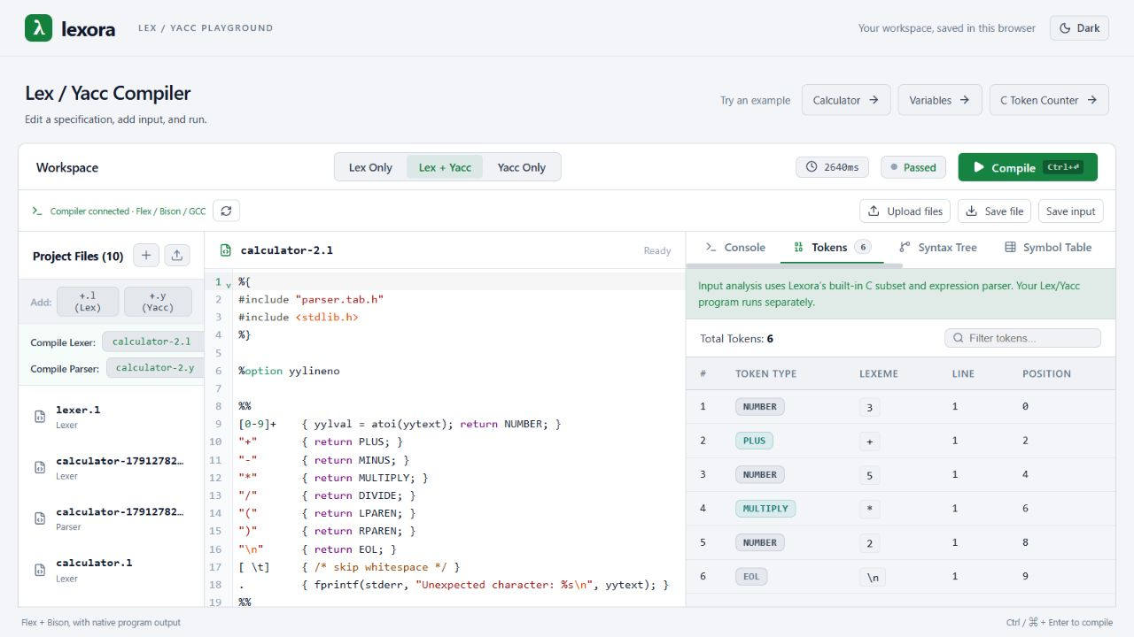
The Lexora workspace
Source editing
The editor holds the selected lexer or parser specification.
Analysis views
The token table records each lexeme and its position in the input.
08
Notes:
Project evidence: README.md; frontend/src/App.jsx; frontend/src/components/OutputPanel/OutputPanel.jsx. Actual local screenshot showing the calculator source and the built-in token table.

Slide 9
System architecture
HTTP / JSON
Browser interface
React + CodeMirror
Backend API
Node.js + Express
Native tools
Flex + Bison + GCC
Browser localStorage
Workspace drafts
JavaScript analyzer
AST, symbols, and TAC
Temporary job directory
Sources and executable
The browser manages editing. The backend performs input analysis and native compilation.
09
Notes:
Project evidence: README.md; frontend/src/App.jsx; frontend/src/components/OutputPanel/OutputPanel.jsx. Project evidence: backend/services/compiler.js; backend/services/wslRunner.js; backend/routes/compile.js; backend/middleware/validator.js. Project evidence: frontend/src/App.jsx; frontend/src/services/files.js; backend/services/tempDir.js; backend/services/compiler.js. Local development: Vite on port 3000 proxies /api to Express on port 3001. Windows uses WSL Ubuntu. Linux uses native Bash.

Slide 10
Working flowchart
Edit files and program input
Failures identify the failing phase and preserve available results.
Submit compilation request
Return results and clean job files
Invalid
Validate request
Return a validation error
Valid
Analyze input and create job files
Generate C, compile, and run
10
Notes:
Project evidence: backend/services/compiler.js; backend/services/wslRunner.js; backend/routes/compile.js; backend/middleware/validator.js. analyzeInput executes before the native stages. These paths are logically separate, not concurrent jobs. Cleanup is attempted in finally before the route sends the JSON response.

Slide 11
Native compilation pipeline
Flex
Bison
GCC
Execution
lex.l produces
lex.yy.c.
parser.y produces
parser.tab.c and
parser.tab.h.
Generated C files
produce an executable
named compiler.
The executable reads
input.txt and writes
standard output.
gcc -o compiler lex.yy.c parser.tab.c -lfl -lm
The backend aligns parser-header references and regenerates the scanner before GCC runs.
11
Notes:
Project evidence: backend/services/compiler.js; backend/services/wslRunner.js; backend/routes/compile.js; backend/middleware/validator.js. Actual combined-mode order: flex lex.l; bison -d parser.y; normalize generated-header references; regenerate scanner; gcc -o compiler lex.yy.c parser.tab.c -lfl -lm; ./compiler < input.txt. Lex Only skips Bison. Yacc Only skips Flex and requires its own yylex and main.

Slide 12
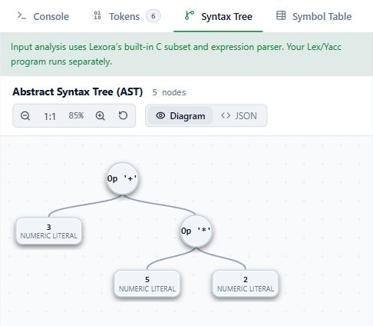
Educational analysis
Input: 3 + 5 * 2
The built-in parser groups multiplication before addition and constructs an abstract syntax tree.
The analyzer also derives scoped symbols, three-address code, optimization results, and basic blocks.
Educational analysis uses Lexora’s supported C subset. Native execution follows the submitted specifications.
12
Notes:
Project evidence: backend/services/inputAnalysis.js; backend/services/astGenerator.js; backend/services/semanticAnalyzer.js; backend/services/tacGenerator.js; backend/services/optimizer.js; backend/services/basicBlocks.js. The screenshot is the actual AST view for calculator stdin 3 + 5 * 2 followed by newline. The AST comes from Lexora’s own parser. It does not trace the uploaded grammar.

Slide 13
Worked example: intermediate code
int x = 2 + 3 * 4;
Declare x : int
Original TAC
Optimized TAC
t1 = 3 * 4
t2 = 2 + t1
x = t2
t1 = 12
t2 = 14
x = 14
+
2
*
Constant folding evaluates arithmetic.
Constant propagation substitutes known values.
3
4
13
Notes:
Project evidence: backend/services/inputAnalysis.js; backend/services/astGenerator.js; backend/services/semanticAnalyzer.js; backend/services/tacGenerator.js; backend/services/optimizer.js; backend/services/basicBlocks.js. Observed analyzeInput("int x = 2 + 3 * 4;"): AST declaration x:int with addition of 2 and multiplication 3*4. Symbol x global, declared true. TAC and optimized TAC shown exactly. Three assignments remain, so no instruction-count or speed claim applies.

Slide 14
Basic blocks and control flow
int x = 1;
if (x < 3) { x = x + 1; }
B1: Test condition
x = 1
t1 = x < 3
ifFalse t1 goto L1
True
A basic block contains consecutive instructions with no internal branch.
B2: Execute body
t2 = x + 1
x = t2
False
Lexora identifies block leaders and records the successor relationships in the original TAC.
B3: Continue
L1:
14
Notes:
Project evidence: backend/services/inputAnalysis.js; backend/services/astGenerator.js; backend/services/semanticAnalyzer.js; backend/services/tacGenerator.js; backend/services/optimizer.js; backend/services/basicBlocks.js. Observed analyzeInput("int x = 1; if (x < 3) { x = x + 1; }"): B1 x=1, t1=x<3, ifFalse t1 goto L1; B2 t2=x+1, x=t2; B3 L1:. Successors: B1 to B2 and B3, B2 to B3. These blocks use original TAC.

Slide 15
Current scope and future development
Implemented scope
Future development
Lexora supports selected .l and .y targets and an educational subset of C.
Language and project-file support can expand beyond the current teaching subset.
The analyzer currently excludes arrays, structures, pointer declarations, and several other C constructs.
Public execution would require isolated workers with restricted filesystem and network access.
15
Notes:
Project evidence: README.md; frontend/src/App.jsx; frontend/src/components/OutputPanel/OutputPanel.jsx. Project evidence: backend/services/inputAnalysis.js; backend/services/astGenerator.js; backend/services/semanticAnalyzer.js; backend/services/tacGenerator.js; backend/services/optimizer.js; backend/services/basicBlocks.js. Project evidence: backend/services/compiler.js; backend/services/wslRunner.js; backend/routes/compile.js; backend/middleware/validator.js. Future development items are proposals. Native C actions execute with backend-user privileges. The current model serves trusted local or access-controlled demonstrations.

Slide 16
Conclusion
Lexora makes compiler-design
experiments easier to run
and easier to explain.
The project combines native tool execution with educational representations of program input in a persistent browser workspace.
16
Notes:
Project evidence: README.md; frontend/src/App.jsx; frontend/src/components/OutputPanel/OutputPanel.jsx. Project evidence: backend/services/inputAnalysis.js; backend/services/astGenerator.js; backend/services/semanticAnalyzer.js; backend/services/tacGenerator.js; backend/services/optimizer.js; backend/services/basicBlocks.js.

Slide 17
References
01
Official Flex documentation
Scanner generation from regular-expression rules.
https://westes.github.io/flex/manual/Introduction.html
02
Official GNU Bison documentation
Parser generation from annotated context-free grammars.
https://www.gnu.org/s/bison/manual/bison.html
03
Official GCC documentation
Compilation stages and executable generation.
https://gcc.gnu.org/onlinedocs/gcc/Overall-Options.html
17
Notes:
Primary source links are listed on the slide. Lexora-specific claims derive from the current source code and README. The current dependencies are React 19, CodeMirror 6, Vite 8, Node.js, and Express 5.

