Slide 1
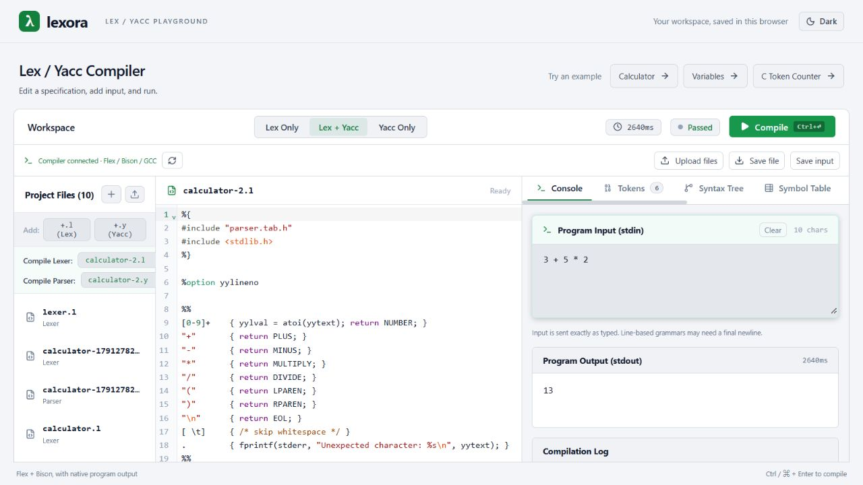
Lexora
A compiler-design
workbench
Real Lex/Yacc execution with visual explanations of compiler concepts.
COMPILER DESIGN PROJECT
01
Notes:
Project evidence: README.md; frontend/src/App.jsx; frontend/src/components/OutputPanel/OutputPanel.jsx. The screenshot shows the bundled calculator running successfully with stdin 3 + 5 * 2 followed by a newline and stdout 13.

Slide 2
Project overview
Lexora brings source editing,
native compilation, and compiler
analysis into one browser workspace.
Native execution
Educational analysis
Students compile selected Lex and Yacc specifications using Flex, Bison, and GCC.
A built-in analyzer explains supported input through syntax trees, symbols, and intermediate code.
02
Notes:
Project evidence: README.md; frontend/src/App.jsx; frontend/src/components/OutputPanel/OutputPanel.jsx.

Slide 3
Problem identification
The compilation process is
difficult to understand when
its intermediate steps
remain hidden.
Fragmented laboratory workflow
Students manage separate files and commands to generate, compile, and execute a lexer or parser.
Limited explanatory feedback
Program output alone does not explain syntax structure, symbol scope, or intermediate code.
03
Notes:
These are the teaching and workflow problems the project addresses. They do not represent measured findings from a formal user study. Project evidence: README.md; frontend/src/App.jsx; frontend/src/components/OutputPanel/OutputPanel.jsx.

Slide 4
Project objectives
01
Provide an integrated workspace
02
Execute real compiler tools
Students can edit specifications, select targets, and supply program input.
The backend generates C sources, builds an executable, and captures its output.
03
Explain compiler concepts
04
Support repeatable experiments
Visual views connect tokens and syntax structure with symbols and intermediate code.
Browser drafts, examples, and file downloads help students continue their work.
04
Notes:
Project evidence: README.md; frontend/src/App.jsx; frontend/src/components/OutputPanel/OutputPanel.jsx. Educational analysis covers the built-in language subset.

Slide 5
Literature survey
Foundation | Relevant method | Application in Lexora
Aho et al. (2007) [1] | Compiler phases and intermediate representations | The analyzer exposes the textbook phases.
Flex manual [2] | Scanner generation from regular-expression rules | Flex generates the C scanner from a .l file.
Bison manual [3] | Parser generation from context-free grammars | Bison generates the parser and token header.
GCC manual [4] | C compilation and linking | GCC builds the generated C sources.
Lexora applies established compiler methods through an integrated teaching interface.
05
Notes:
[1] Aho, Lam, Sethi and Ullman. Compilers: Principles, Techniques, and Tools, 2nd ed., 2007. https://www.cs.columbia.edu/~aho/books.html
[2] Flex manual: https://westes.github.io/flex/manual/Introduction.html
[3] GNU Bison manual: https://www.gnu.org/s/bison/manual/bison.html
[4] GCC manual: https://gcc.gnu.org/onlinedocs/gcc/Overall-Options.html
The application column is an explanation of Lexora’s implementation.

Slide 6
Novelty and project contribution
One workspace connects practical
Lex/Yacc experiments with visible
compiler representations.
Selected .l / .y files
Flex + Bison + GCC
Native output
Program input
Built-in analyzer
Educational views
06
Notes:
Project evidence: README.md; frontend/src/App.jsx; frontend/src/components/OutputPanel/OutputPanel.jsx. Project evidence: backend/services/inputAnalysis.js; backend/services/astGenerator.js; backend/services/semanticAnalyzer.js; backend/services/tacGenerator.js; backend/services/optimizer.js; backend/services/basicBlocks.js. The contribution is application integration and the educational workflow. It does not claim a new compiler algorithm.

Slide 7
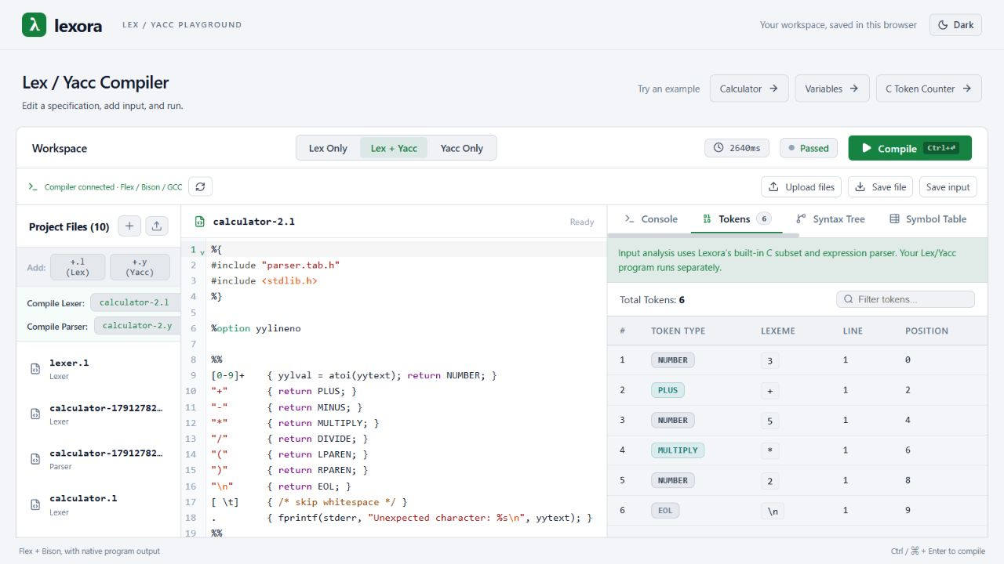
The Lexora workspace
Source editing
The editor holds the selected lexer or parser specification.
Analysis views
The token table records each lexeme and its position in the input.
07
Notes:
Project evidence: README.md; frontend/src/App.jsx; frontend/src/components/OutputPanel/OutputPanel.jsx. Actual local screenshot showing the calculator source and the built-in token table.

Slide 8
System architecture
HTTP / JSON
Browser interface
React + CodeMirror
Backend API
Node.js + Express
Native tools
Flex + Bison + GCC
Browser localStorage
Workspace drafts
JavaScript analyzer
AST, symbols, and TAC
Temporary job directory
Sources and executable
The browser manages editing. The backend performs input analysis and native compilation.
08
Notes:
Project evidence: README.md; frontend/src/App.jsx; frontend/src/components/OutputPanel/OutputPanel.jsx. Project evidence: backend/services/compiler.js; backend/services/wslRunner.js; backend/routes/compile.js; backend/middleware/validator.js. Project evidence: frontend/src/App.jsx; frontend/src/services/files.js; backend/services/tempDir.js; backend/services/compiler.js. Local development: Vite on port 3000 proxies /api to Express on port 3001. Windows uses WSL Ubuntu. Linux uses native Bash.

Slide 9
Working flowchart
Edit files and program input
Failures identify the failing phase and preserve available results.
Submit compilation request
Return results and clean job files
Invalid
Validate request
Return a validation error
Valid
Analyze input and create job files
Generate C, compile, and run
09
Notes:
Project evidence: backend/services/compiler.js; backend/services/wslRunner.js; backend/routes/compile.js; backend/middleware/validator.js. analyzeInput executes before the native stages. These paths are logically separate, not concurrent jobs. Cleanup is attempted in finally before the route sends the JSON response.

Slide 10
Data storage and lifecycle
Data | Storage location | Lifetime
Workspace drafts and input | Browser localStorage lexora.workspace.v2 | Persists across reloads until cleared.
Job files and executable | Backend OS temporary directory lexora-<UUID> | One request, followed by cleanup.
Output and analysis results | Backend memory and browser React state | Available during the current run.
Downloaded source and input | The user’s download destination | Remains until the user removes it.
Lexora uses browser drafts and temporary job files without an application database.
10
Notes:
Project evidence: frontend/src/App.jsx; frontend/src/services/files.js; backend/services/tempDir.js; backend/services/compiler.js. There is no application database. Browser storage is specific to the browser origin and may be blocked or cleared. Cleanup failures are logged.

Slide 11
Native compilation pipeline
Flex
Bison
GCC
Execution
lex.l produces
lex.yy.c.
parser.y produces
parser.tab.c and
parser.tab.h.
Generated C files
produce an executable
named compiler.
The executable reads
input.txt and writes
standard output.
gcc -o compiler lex.yy.c parser.tab.c -lfl -lm
The backend aligns parser-header references and regenerates the scanner before GCC runs.
11
Notes:
Project evidence: backend/services/compiler.js; backend/services/wslRunner.js; backend/routes/compile.js; backend/middleware/validator.js. Actual combined-mode order: flex lex.l; bison -d parser.y; normalize generated-header references; regenerate scanner; gcc -o compiler lex.yy.c parser.tab.c -lfl -lm; ./compiler < input.txt. Lex Only skips Bison. Yacc Only skips Flex and requires its own yylex and main.

Slide 12
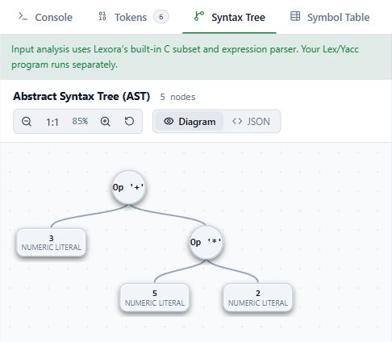
Educational analysis
Input: 3 + 5 * 2
The built-in parser groups multiplication before addition and constructs an abstract syntax tree.
The analyzer also derives scoped symbols, three-address code, optimization results, and basic blocks.
Educational analysis uses Lexora’s supported C subset. Native execution follows the submitted specifications.
12
Notes:
Project evidence: backend/services/inputAnalysis.js; backend/services/astGenerator.js; backend/services/semanticAnalyzer.js; backend/services/tacGenerator.js; backend/services/optimizer.js; backend/services/basicBlocks.js. The screenshot is the actual AST view for calculator stdin 3 + 5 * 2 followed by newline. The AST comes from Lexora’s own parser. It does not trace the uploaded grammar.

Slide 13
Worked example: intermediate code
int x = 2 + 3 * 4;
Declare x : int
Original TAC
Optimized TAC
t1 = 3 * 4
t2 = 2 + t1
x = t2
t1 = 12
t2 = 14
x = 14
+
2
*
Constant folding evaluates arithmetic.
Constant propagation substitutes known values.
3
4
13
Notes:
Project evidence: backend/services/inputAnalysis.js; backend/services/astGenerator.js; backend/services/semanticAnalyzer.js; backend/services/tacGenerator.js; backend/services/optimizer.js; backend/services/basicBlocks.js. Observed analyzeInput("int x = 2 + 3 * 4;"): AST declaration x:int with addition of 2 and multiplication 3*4. Symbol x global, declared true. TAC and optimized TAC shown exactly. Three assignments remain, so no instruction-count or speed claim applies.

Slide 14
Basic blocks and control flow
int x = 1;
if (x < 3) { x = x + 1; }
B1: Test condition
x = 1
t1 = x < 3
ifFalse t1 goto L1
True
A basic block contains consecutive instructions with no internal branch.
B2: Execute body
t2 = x + 1
x = t2
False
Lexora identifies block leaders and records the successor relationships in the original TAC.
B3: Continue
L1:
14
Notes:
Project evidence: backend/services/inputAnalysis.js; backend/services/astGenerator.js; backend/services/semanticAnalyzer.js; backend/services/tacGenerator.js; backend/services/optimizer.js; backend/services/basicBlocks.js. Observed analyzeInput("int x = 1; if (x < 3) { x = x + 1; }"): B1 x=1, t1=x<3, ifFalse t1 goto L1; B2 t2=x+1, x=t2; B3 L1:. Successors: B1 to B2 and B3, B2 to B3. These blocks use original TAC.

Slide 15
Demonstration: the calculator
Program input
Native output
13
3 + 5 * 2
Flex generates the scanner, Bison generates the parser, and GCC builds the program that prints the result.
The bundled calculator expects a newline after each expression.
15
Notes:
Project evidence: backend/services/compiler.js; backend/services/wslRunner.js; backend/routes/compile.js; backend/middleware/validator.js. The bundled calculator was executed through the current backend and through the UI. Input was exactly "3 + 5 * 2\n". Observed stdout was "13\n" with successful Flex, Bison, GCC and execution stages. The grammar uses EOL to finish an expression.

Slide 16
Current scope and future development
Implemented scope
Future development
Lexora supports selected .l and .y targets and an educational subset of C.
Language and project-file support can expand beyond the current teaching subset.
The analyzer currently excludes arrays, structures, pointer declarations, and several other C constructs.
Public execution would require isolated workers with restricted filesystem and network access.
16
Notes:
Project evidence: README.md; frontend/src/App.jsx; frontend/src/components/OutputPanel/OutputPanel.jsx. Project evidence: backend/services/inputAnalysis.js; backend/services/astGenerator.js; backend/services/semanticAnalyzer.js; backend/services/tacGenerator.js; backend/services/optimizer.js; backend/services/basicBlocks.js. Project evidence: backend/services/compiler.js; backend/services/wslRunner.js; backend/routes/compile.js; backend/middleware/validator.js. Future development items are proposals. Native C actions execute with backend-user privileges. The current model serves trusted local or access-controlled demonstrations.

Slide 17
Conclusion
Lexora makes compiler-design
experiments easier to run
and easier to explain.
The project combines native tool execution with educational representations of program input in a persistent browser workspace.
17
Notes:
Project evidence: README.md; frontend/src/App.jsx; frontend/src/components/OutputPanel/OutputPanel.jsx. Project evidence: backend/services/inputAnalysis.js; backend/services/astGenerator.js; backend/services/semanticAnalyzer.js; backend/services/tacGenerator.js; backend/services/optimizer.js; backend/services/basicBlocks.js.

Slide 18
References
01
Aho, Lam, Sethi, and Ullman (2007)
Compilers: Principles, Techniques, and Tools, second edition.
https://www.cs.columbia.edu/~aho/books.html
02
Official Flex documentation
Scanner generation from regular-expression rules.
https://westes.github.io/flex/manual/Introduction.html
03
Official GNU Bison documentation
Parser generation from annotated context-free grammars.
https://www.gnu.org/s/bison/manual/bison.html
04
Official GCC documentation
Compilation stages and executable generation.
https://gcc.gnu.org/onlinedocs/gcc/Overall-Options.html
18
Notes:
Primary source links are listed on the slide. Lexora-specific claims derive from the current source code and README. The current dependencies are React 19, CodeMirror 6, Vite 8, Node.js, and Express 5.

