Slide 1

AUTOMATIC PLANT WATERING SYSTEM
KAMLA NEHRU INSTITUTE OF TECHNOLOGY
SUBMITTED TO ;
Prof VARUN SONKAR
SUBMITTED BY ;
KARTIKAY AGARWAL(23538)

Slide 2
TABLE OF CONTENTS
INTRODUCTION
OBJECTIVES
COMPONENETS USED
CIRCUIT DIAGRAM
WORKING PRINCIPLE
RESULTS
ADVANTAGES
CONCLUSION
REFRENCES

Slide 3
Introduction
Brief overview of the project
Importance of automated plant watering
How the system works: Monitoring soil moisture and activating the pump

Slide 4
Objectives
Main Goal: Automate plant watering to save time and resources
Reduce water wastage
Maintain optimal soil moisture for healthy plant growth

Slide 5
Components Used
Hardware:
- Arduino Board (e.g., Uno,)
- Relay Module
- Soil Moisture Sensor
- Water Pump
- Power Supply
Software:
- Arduino IDE for programming

Slide 6
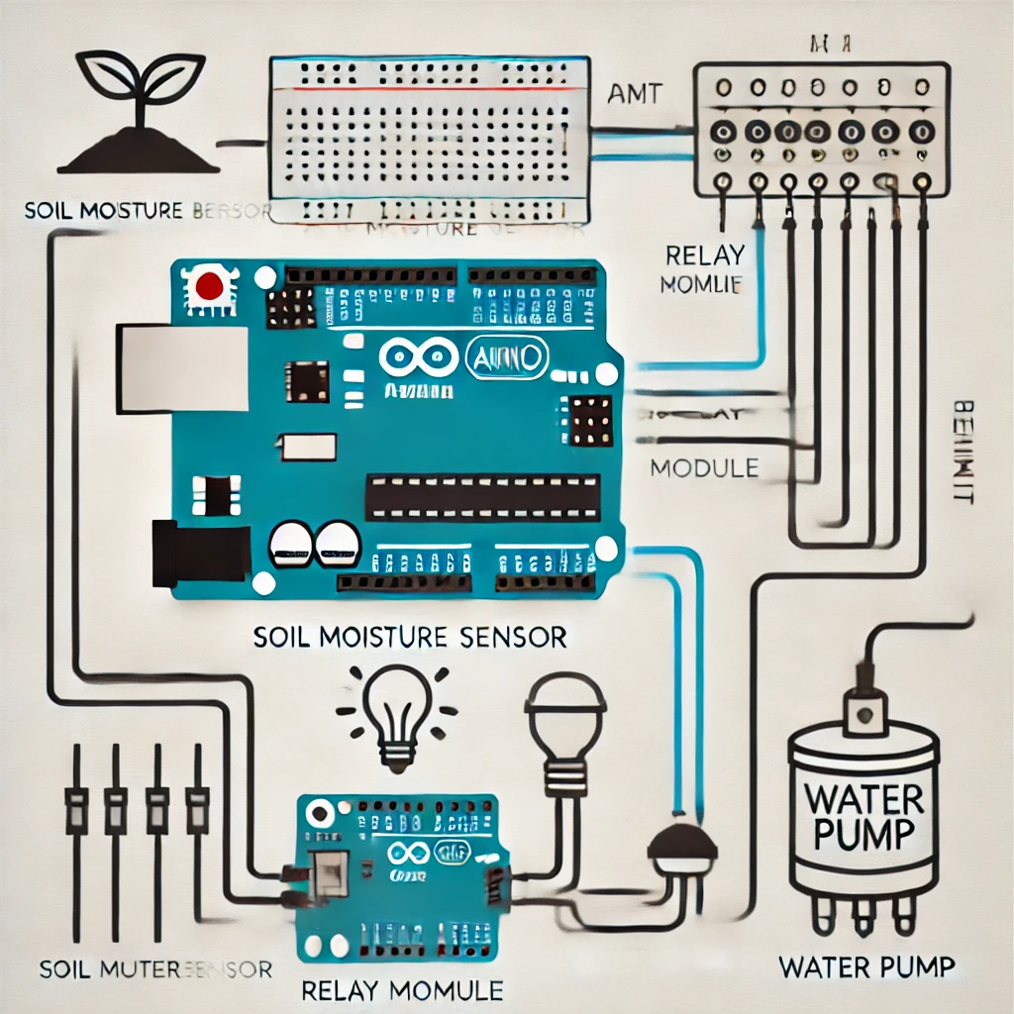
Circuit Diagram
Include a neat circuit diagram showing connections:
- Soil moisture sensor to Arduino
- Arduino to relay module
- Relay module to water pump

Slide 7
Working Principle
Soil moisture sensor checks soil humidity.
If moisture is low, Arduino sends a signal to the relay module.
Relay activates the water pump to water the plants.
System stops once the soil is adequately moist.

Slide 8
Procedures
Set up the Arduino Environment:
Install the Arduino IDE on your computer.
Connect the Arduino board to your computer via USB.
Assemble the Circuit:
Connect the soil moisture sensor to the Arduino's analog input.
Wire the relay module to a digital pin on the Arduino.
Connect the water pump to the relay module.

Slide 9
Procedures
Write and Upload Code:
Write the code to read soil moisture levels and control the relay.
Upload the code to the Arduino board using the Arduino IDE.
Test the System:
Place the soil moisture sensor in the soil.
Observe the pump activating when the soil is dry and turning off when moist.
Finalize Setup:
Secure all components.
Ensure the water pump and sensor are placed appropriately for regular use.

Slide 10
Advantages
Fully automated and low maintenance
Saves water and time
Scalable for larger gardens

Slide 11
Results
Show images or videos of the system in action
Graphs showing moisture levels before and after watering (if applicable)

Slide 12
Conclusion
Summarize the success of the project
Emphasize its real-world applications

Slide 13
References
1. Arduino Official Documentation: https://www.arduino.cc/en/Guide/HomePage
2. Soil Moisture Sensor Guide: https://randomnerdtutorials.com/soil-moisture-sensor/
3. Relay Module Basics: https://components101.com/modules/relay-module
4. Water Pump Selection Guide: https://www.electronicsforu.com/
5. Programming with Arduino IDE: https://www.arduino.cc/en/Guide/Environment

Slide 14
Thank You

