Slide 1
MobileNet V2
by USCoders
Carolina Souza, Derek Lim, Kartik Balodi, Kelly Huang, Rohan Sanjay

Slide 2
Mobilenet V2
MobileNet-v2 is a convolutional neural network that is 53 layers deep.
Optimised for mobile devices
Improved version of MobileNetV1
35 percent faster with the same accuracy than MobileNetV1
Effective feature extractor for object detection and segmentation
Classify images into 1000 object categories, such as keyboard, mouse, pencil, and many animals
Notes:
Carolina - 35% quicker and efficient mobilenet v1
52 layer deep convolutional neural network
Small and efficient tnough to be used on small mobile devices

Slide 3
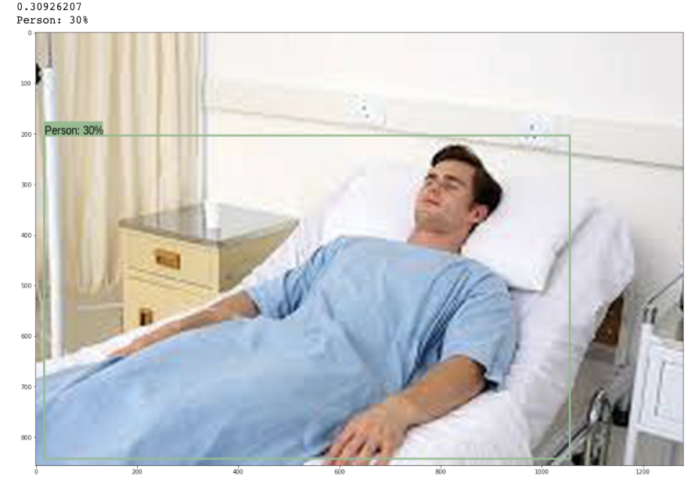
COCO Object Detection
Notes:
Rohan

Slide 4
Specific Improvement
Linear bottlenecks between the layers
using linear layers is crucial as it prevents nonlinearities from destroying too much information
Shortcut connections between the bottlenecks
shortcuts enable faster training and better accuracy
2 times fewer operations, has higher accuracy, needs 30 percent fewer parameters
Notes:
Derek

Slide 5
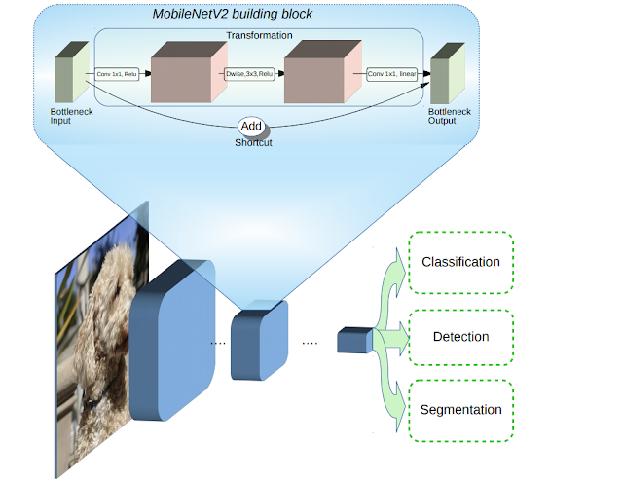
Notes:
Kartik - MobileNetV2 builds upon the ideas from MobileNetV1 [1], using depthwise separable convolution as efficient building blocks. However, V2 introduces two new features to the architecture: 1) linear bottlenecks between the layers, and 2) shortcut connections between the bottlenecks¹. The basic structure is shown in the diagram above.
The intuition is that the bottlenecks encode the model’s intermediate inputs and outputs while the inner layer encapsulates the model’s ability to transform from lower-level concepts such as pixels to higher level descriptors such as image categories. Finally, as with traditional residual connections, shortcuts enable faster training and better accuracy.

Slide 6
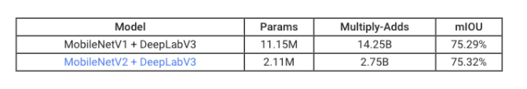
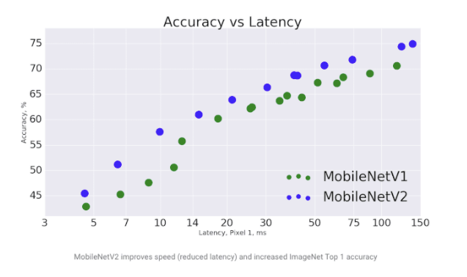
MobileNetV1 vs MobileNetV2
Notes:
Kelly - In V1 the pointwise convolution either kept the number of channels the same or doubled them. In V2 it does the opposite: it makes the number of channels smaller. This is why this layer is now known as the projection layer — it projects data with a high number of dimensions (channels) into a tensor with a much lower number of dimensions.The idea behind V1 was to replace expensive convolutions with cheaper ones, even if it meant using more layers. That was a great success.
The second new thing in MobileNet V2’s building block is the residual connection. This works just like in ResNet and exists to help with the flow of gradients through the network.
In all of these metrics, V2 scores better than V1, showing consistent improvement in this new version of Mobilenet.

