Slide 1
Group 1
Carolina Souza, Derek Lim, Kartik Balodi, Kelly Huang, Rohan Sanjay

Slide 2
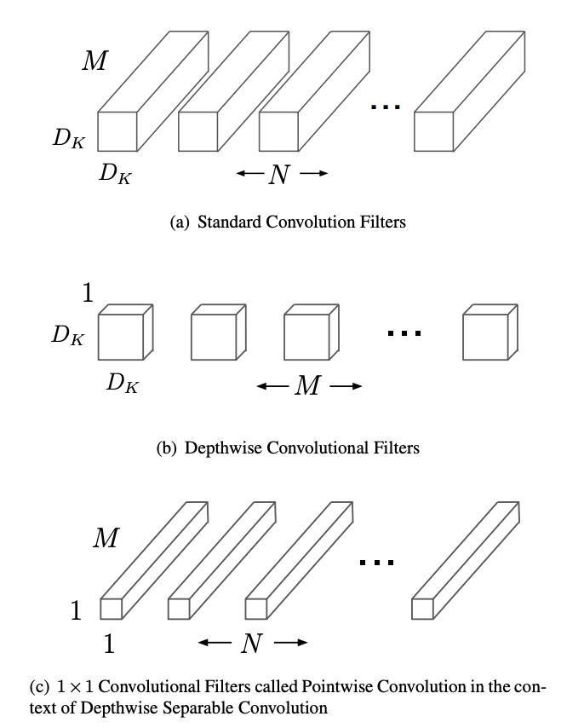
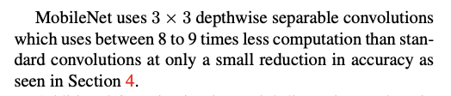
Literature Review 1
https://arxiv.org/abs/1704.04861

Slide 3
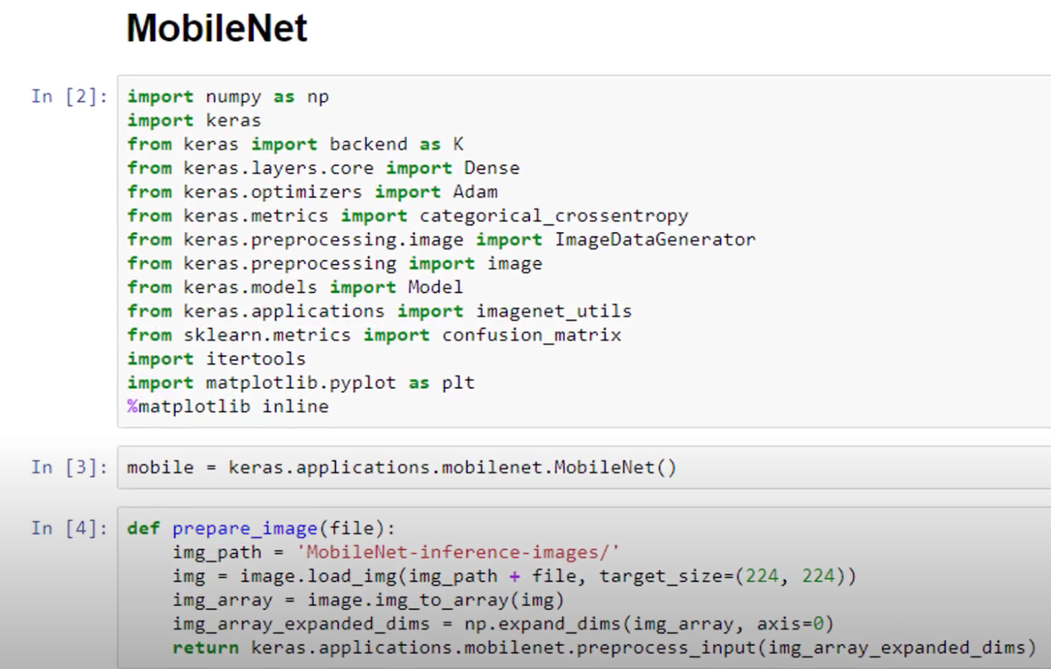
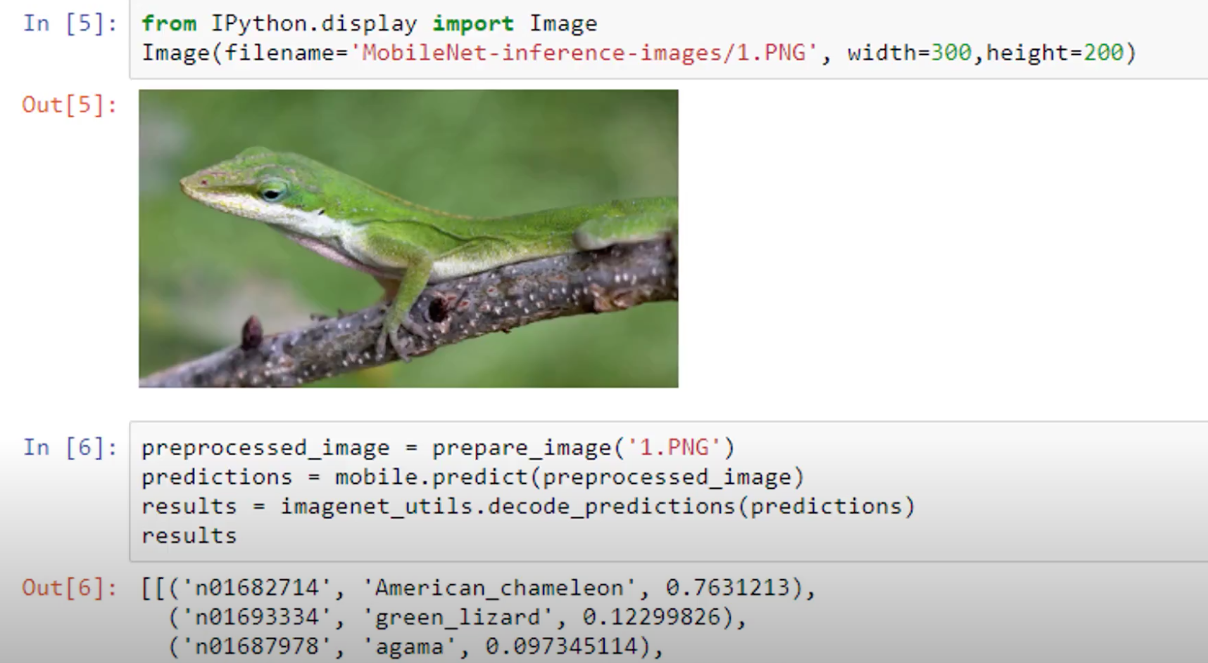
Literature Review 2
https://www.youtube.com/watch?v=OO4HD-1wRN8&feature=youtu.be

Slide 4
What is MobileNet
MobileNet is a Convolutional Neural Network architecture model used for Image Classification and Mobile Vision. Create lightweight, deep neural networks
Very small, low-latency, low-power models used for CNN tasks like classification and detection. Good for use on mobile devices because of their small size.
Unique because it requires much less computational power (even without a GPU) to run or apply transfer learning to compared to other models
Because MobileNets are smaller and faster than major networks, the tradeoff is accuracy. But they’re still perform very well.

Slide 5
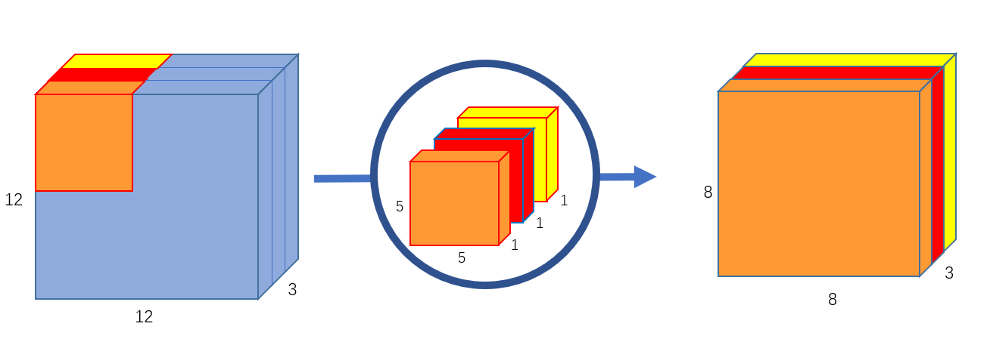
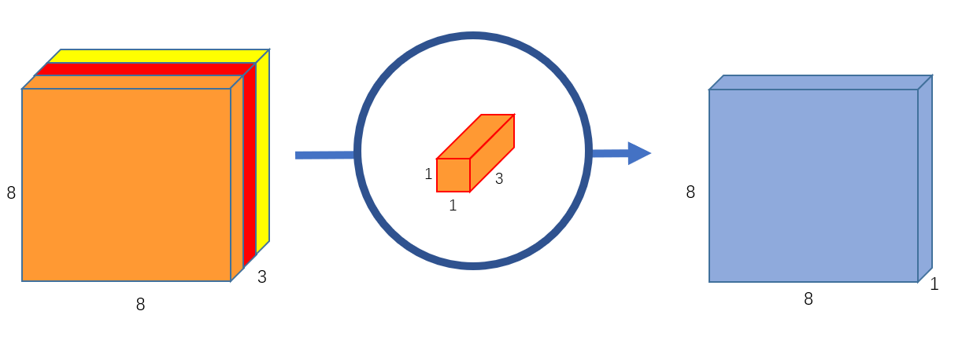
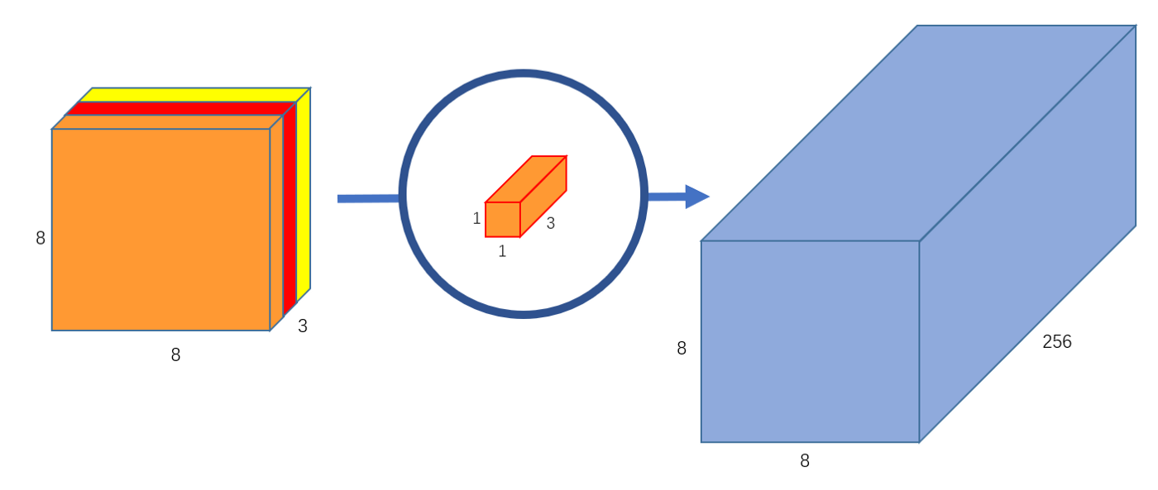
Depthwise Separable Convolution
Depthwise Convolution - one convolution for each channel (ex. 12X12X3 use a 5X5X1 filter to get an 8X8X3 image)
Pointwise Convolution - convolution using a filter of 1X1Xm, where m is the number of input channels. Then you can increase the number of channels outputted by doing multiple pointwise convolutions with different 1X1 filters
https://towardsdatascience.com/a-basic-introduction-to-separable-convolutions-b99ec3102728
Notes:
Source of example and pictures + basic overview: https://towardsdatascience.com/a-basic-introduction-to-separable-convolutions-b99ec3102728
Why is this faster? (It reduces the number of multiplications; it uses 8-9 times less computations): In a depthwise separable convolution, you don’t have to keep on transforming the image to get the desired number of channels like in standard convolutions -- instead, you do it once, and the extra channels come with the pointwise convolutions, which require fewer multiplications.

Slide 6
What do our constraints mean
Two or fewer person case
One or two people in the image
One person case
Only one person in the image

Slide 7
How we’re applying MobileNet
Keras package
Creating function
Separating images into test & train

Slide 8
Team Strengths and Goals
Carolina: Strengths - Mathematics, organization, presentational skills, research. Goals - build on my coding knowledge and become more fluent in python
Rohan: Strength - coding & research, goal: mathematical understanding
Derek: Strengths: Math, Goals: coding, implementation
Kartik: Strengths - Probability, presentation Goals: Learn ML-based coding/linear algebra intuition
Kelly: Strengths - Coding, Time, Goals: Math, understanding

