Slide 1

SMART INDIA HACKATHON 2026
Problem Statement ID – 26108
Problem Statement Title- AI-Powered Recommendation Engine for Identifying Applicable Indian Standards for Procurement Specifications
Theme- Smart Automation
PS Category- Software
Team ID- 173137
Team Name – ProCode
BharatStandAI

Slide 2


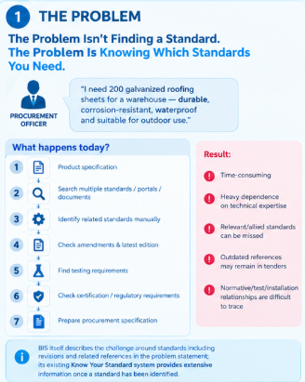
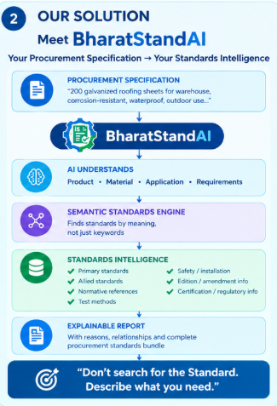
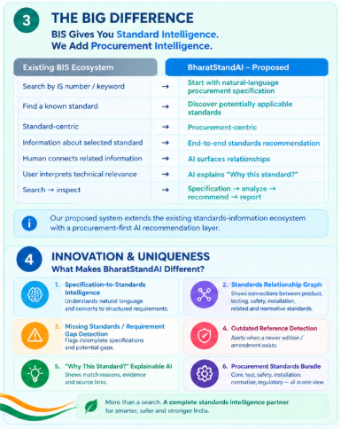
BharatStandAI
From Procurement Specifications to the Right Indian Standards
AI Powered Recommendation Engine For Recommending Indian Standards According To The Procurement Specifications

Slide 3
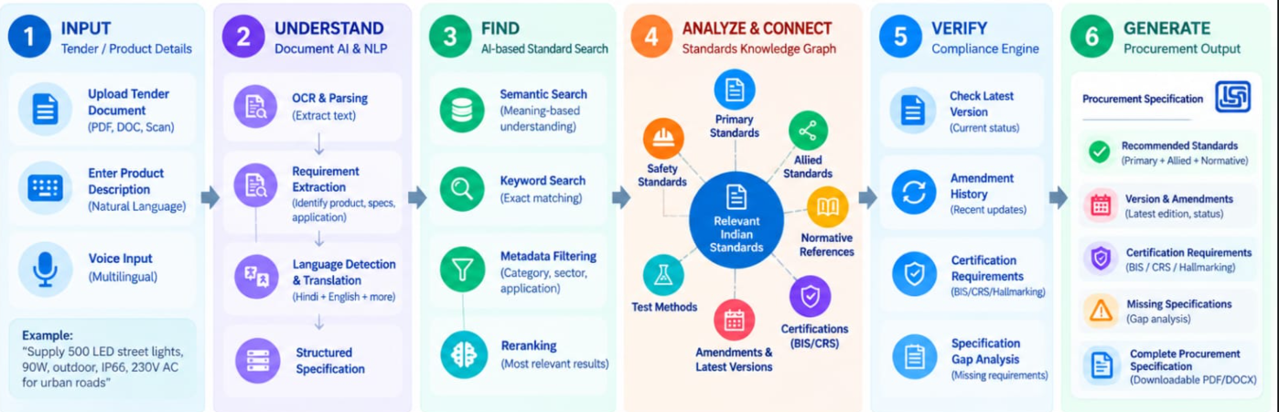
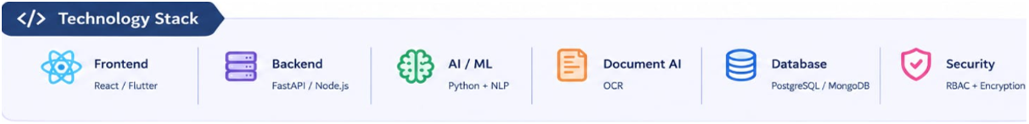
TECHNICAL APPROACH
From Tender to Trusted Standards- Powered by AI

Slide 4
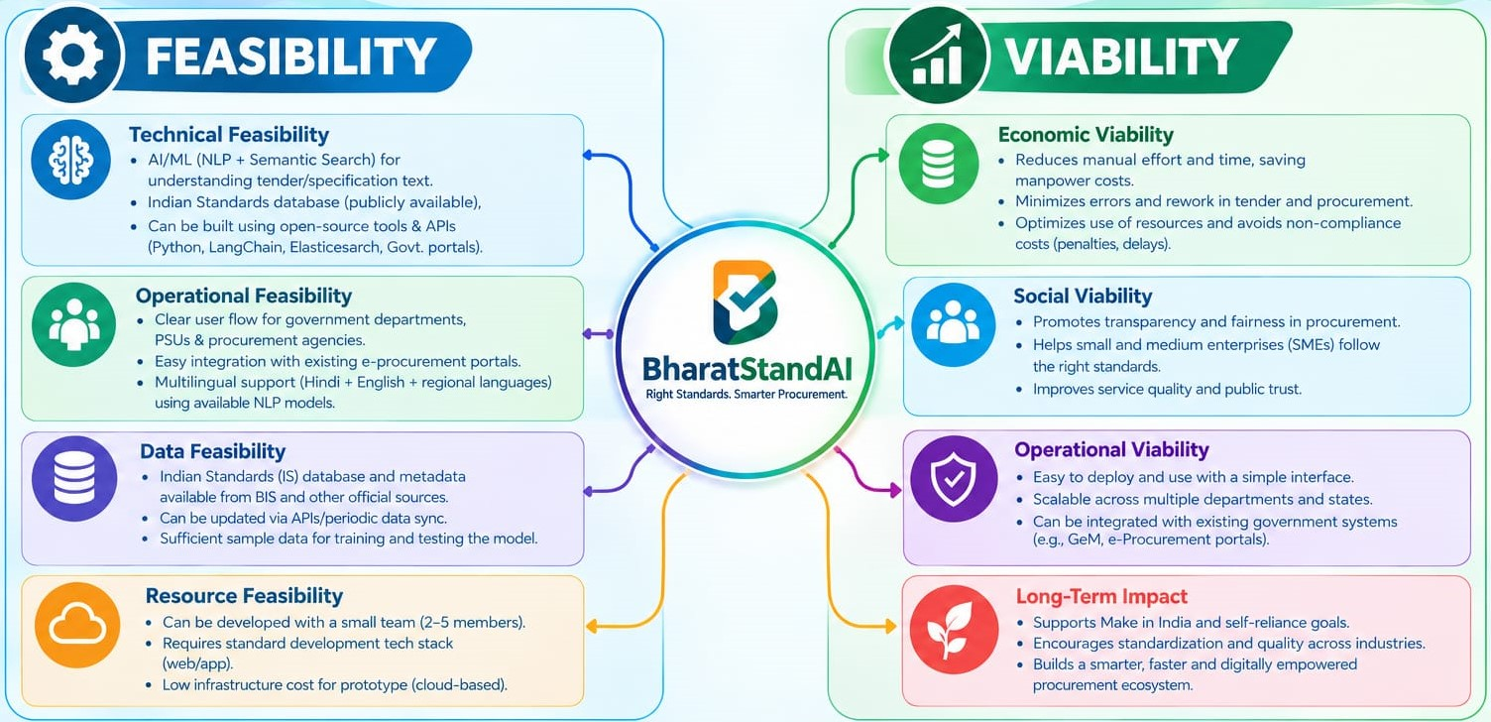

FEASIBILITY AND VIABILITY

Slide 5
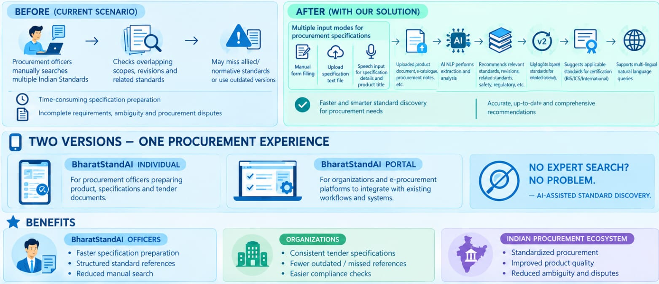
IMPACT AND BENEFITS

Slide 6
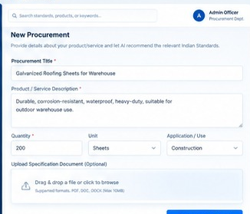
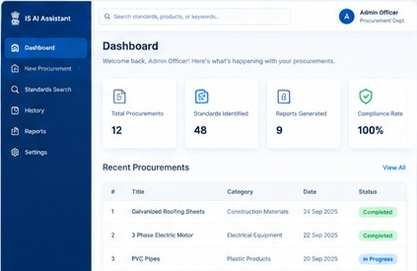
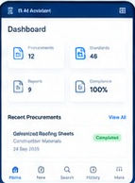
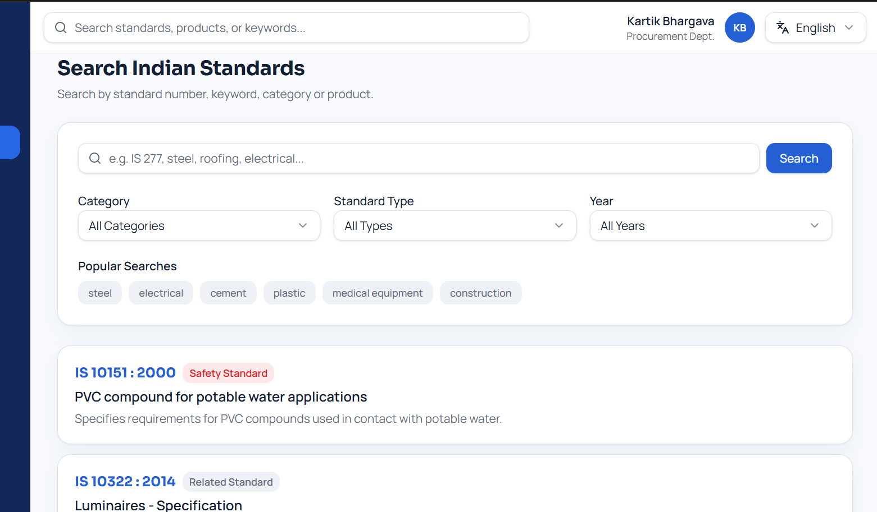
RESEARCH AND REFERENCES
DASHBOARD VIEW
PROCUREMENT SPECIFICATION
Research and Reference
Bureau of Indian Standards — Know Your Standards : https://www.bis.gov.in/
BIS Standards Catalogue : https://standards.bis.gov.in/
Department of Expenditure — Manual for procurement of goods 2024 : https://doe.gov.in/files/circulars_document/Manual_Goods_2024.pdf
SUITABLE FOR ANY DEVICE
INDIAN STANDARDS INFORMATION
Prototype Development and Other Links
Prototype link =
Demonstration Video Link(YouTube)=
GitHub link=https://github.com/kartikbhargava514-cmd/bharat-standards-ai.git/
Research Report & Version Information=

