Slide 1
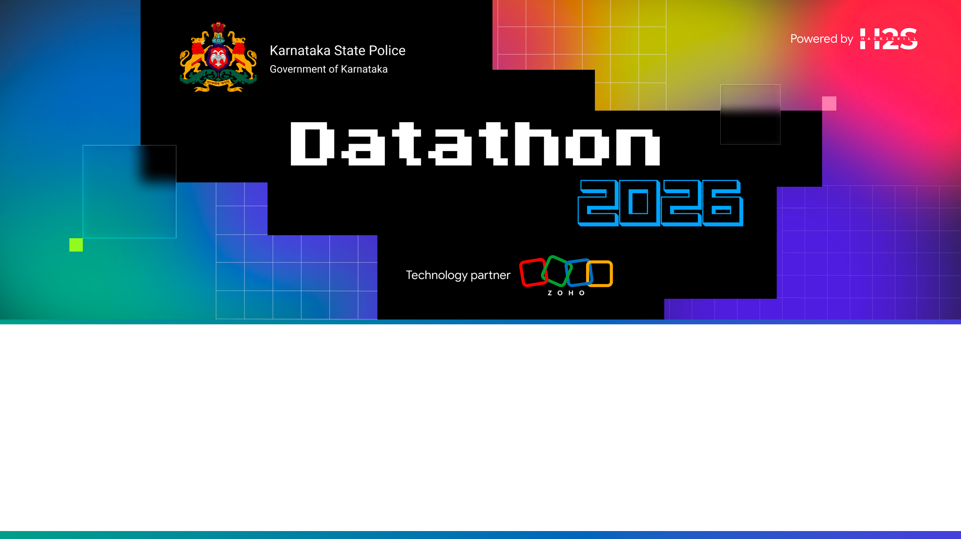
Team Details
Team Name: Quicx Labs
Team Leader: Sanchit Gupta
Team Size: 2 Members
Problem Statement: Challenge #2 - AI-Driven Crime Analytics & Visualization Platform

Slide 2

The Problem: Crime Data Trapped in Silos
Karnataka’s FIRs, suspects, and case files live in disconnected spreadsheets — patterns invisible, hours wasted, connections missed.
Thousands
of FIRs, accused, and victim records trapped in disconnected tables
Hundreds
of repeat accused whose case history and network links stay hidden
Buried
cross-table links between cases, accused, arrests, and legal acts go unnoticed

Slide 3
Brief About the Solution
KSP IntelHub — Crime Intelligence & Analytical Platform
A state-of-the-art AI-driven platform built for the Karnataka State Police (KSP) / State Crime Records Bureau (SCRB). It replaces siloed, Excel-based crime records with an integrated intelligence hub delivering:
• Interactive geospatial analytics with KDE-predicted crime hotspots across all 31 districts
• 3D criminal network graph with key-player identification & Adamic-Adar link prediction
• Ridge + Fourier seasonality forecasting engine with 8-week predictive lookahead
• Multi-factor recidivism risk index (0–100) scoring habitual offenders across 6 weighted criteria
• NLP-driven FIR narrative auto-classifier achieving >90% validation accuracy
• Multilingual AI copilot (English & Kannada) with dynamic search across 26 relational tables
• DBSCAN patrol dispatch optimization with geo-clustered risk zone recommendations
• Comprehensive CCTNS registry search: Officers, Vehicles, Courts, Missing Persons & Cyber Cases
Platform Scale: 26 relational DB tables │ 8 ML/AI models │ 12 REST API endpoints │ Full Docker containerization

Slide 4
Opportunities & USP
How is it different?
• 8 ML/AI models working in concert vs static dashboards
• Unified knowledge graph linking suspects, cases & cyber IDs
• Real-time AI copilot grounded in live crime data
• Explainable AI for all anomaly detections
• Unclustered 3D criminal network visualization
• Native full screen command center mode
• Voice + text multilingual query interface
How does it solve the problem?
• Replaces Excel silos with integrated intelligence platform
• Proactive policing via predictive KDE hotspot mapping
• Surfaces hidden networks invisible in spreadsheets
• Automates case linking using NLP on FIR narratives
• Predicts alliances with Adamic-Adar algorithms
• AI-optimized patrol dispatch to high-risk zones
• Automated suspect risk scoring for faster triage
Unique Selling Proposition
• Only platform combining geospatial + network + behavioral AI + LLM copilot
• Fully deployed via Docker, one-command setup
• Graceful degradation: partial data never breaks API
• Cost-effective: all 8 ML models run on CPU
• Scalable stateless microservices backend
• Zero GPU costs — entire engine on CPU
• Zoho Catalyst native (AppSail + Web Client)

Slide 5
Features: Intelligence & Analytics (1 of 3)
• Interactive Crime Heatmap: KDE-predicted spatial hotspots across all districts
• Unclustered 3D Criminal Network Graph: Unclustered force-directed graph with sub-graph targeted extraction
• Behavioral Anomaly Detection: Isolation Forest spotting unusual crime patterns
• NLP Modus Operandi Matching: TF-IDF cosine similarity for modus operandi
• Crime Forecasting Engine: Ridge + Fourier seasonality for 8-week lookahead
• Emerging Trend Alerts: Real-time 30-day spike detection across regions
• AI Investigative Copilot: NVIDIA NIM conversational agent with 26-table dynamic AI context
• Criminal Link Prediction: Adamic-Adar predicting emerging gang alliances

Slide 6
Features: Operational Tools (2 of 3)
• Patrol Dispatch Centre: AI-optimized geographical patrol deployment
• Suspect Dossier: Repeat-offender profile & network centrality score
• Case Files Dossier: Crime-scene map & AI-recommended similar cases
• Recidivism Risk Index: Multi-factor 0-100 severity & risk scoring
• Socio-Economic Correlation: Pearson analysis for crime pattern matching
• Crime-Type Classifier: TF-IDF + LogReg automated categorization
• Fraud Ring Detection: Cyber-identifier graph for structured crime
• CCTNS Registry Search: Officers, vehicles, courts, and missing persons

Slide 7
Features: UX & Intelligence (3 of 3)
• Multilingual AI Voice Console: English & Kannada voice + text HUD query interface
• Smart Contextual Routing: AI agent auto-navigates to relevant pages on query
• Command Center Mode: Native fullscreen toggle hiding browser chrome for ops
• Dark-Theme Command UI: Glassmorphic dark panels for NOC/SOC wall displays
• Real-Time KPI Metrics: Live counters for cases, arrests, convictions & clearance rates
• Dynamic Drill-Down: Click any chart/district to filter data contextually
• Suspect Detail Dossier: Profile with linked cases, network centrality & risk score
• Case File Intelligence: Crime-scene GPS map + AI-recommended similar cases

Slide 8
Process Flow & Data Pipeline
DATA INGESTION
• CaseMaster FIRs (GPS, BriefFacts, CrimeHeads)
• Accused & Victim records per case
• FIR narratives (BriefFacts — NLP text)
• Arrest/Surrender events with IO linkage
• Full CCTNS relational schema
- Employees, Ranks & Designations
- Courts, Acts & Sections
- Complainant demographics
Source: KSP relational database
loaded on first API request
INTELLIGENCE ENGINE
• NetworkX knowledge graph build
• KDE hotspot boundary prediction
• DBSCAN spatial clustering (eps=1km)
• Isolation Forest anomaly scoring
• TF-IDF MO vectorization
• Logistic Reg. Crime Classifier
• Ridge forecasting (8-wk horizon)
• Adamic-Adar link probability
• Recidivism risk multi-factor score
• NVIDIA NIM LLM copilot agent
INTERACTIVE FRONTEND
• Command Dashboard (metrics, alerts)
• Google Maps heatmap overlay
• 3D force-directed network graph
• Detailed Case & Suspect dossiers
• Searchable FIR database with filters
• Natural language AI chat interface
• Patrol dispatch deployment centre
• Analytics (forecasts & clustering)
• Real-time system health & settings
▶
▶

Slide 9
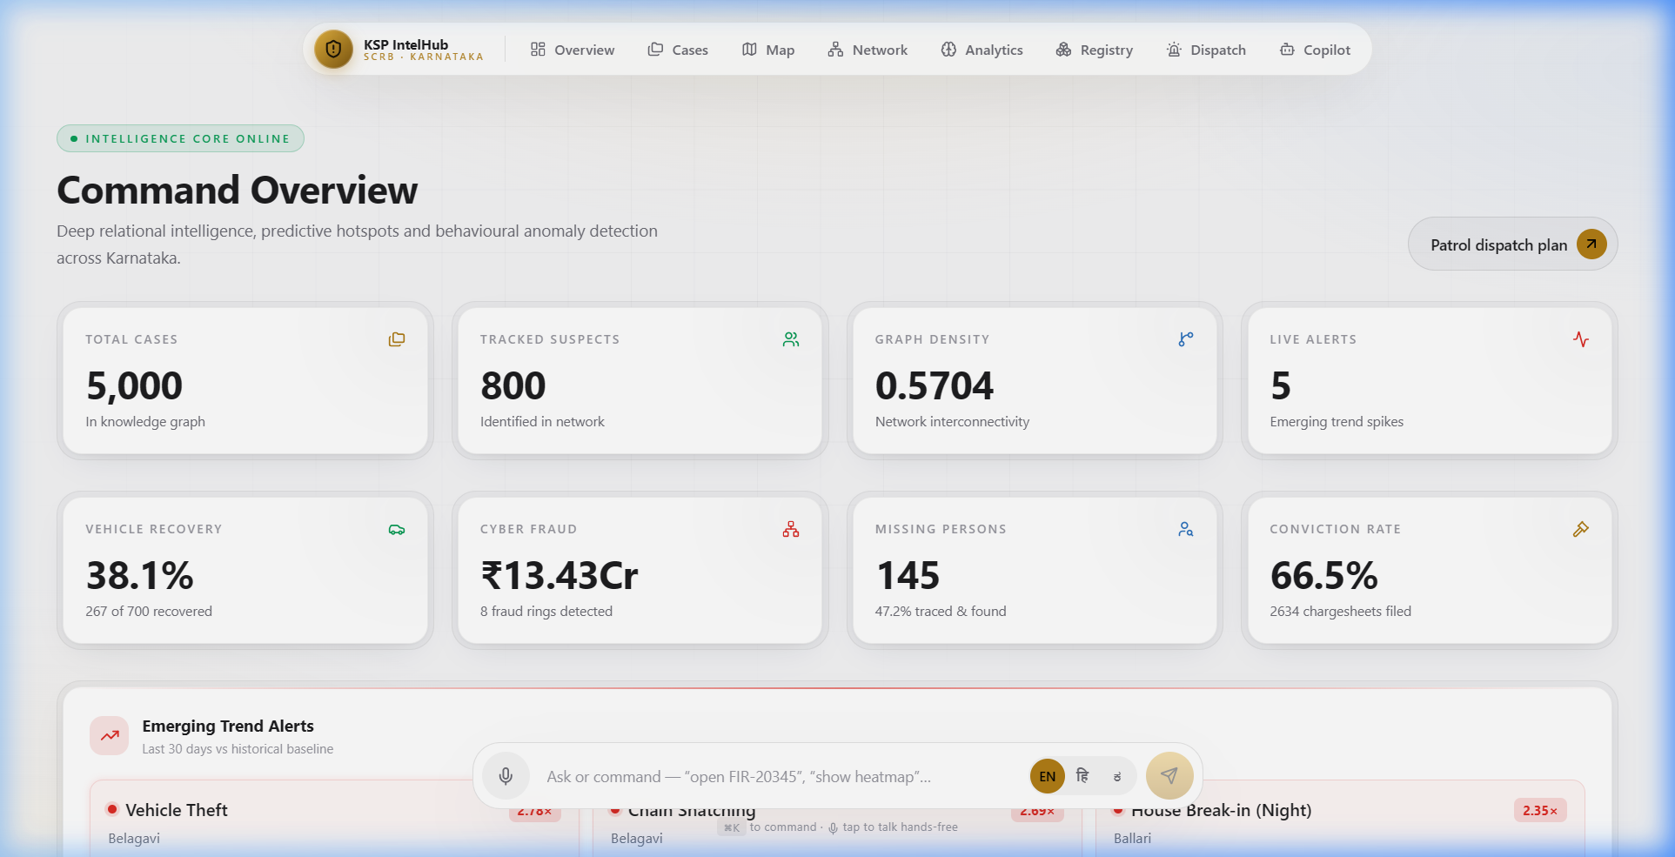
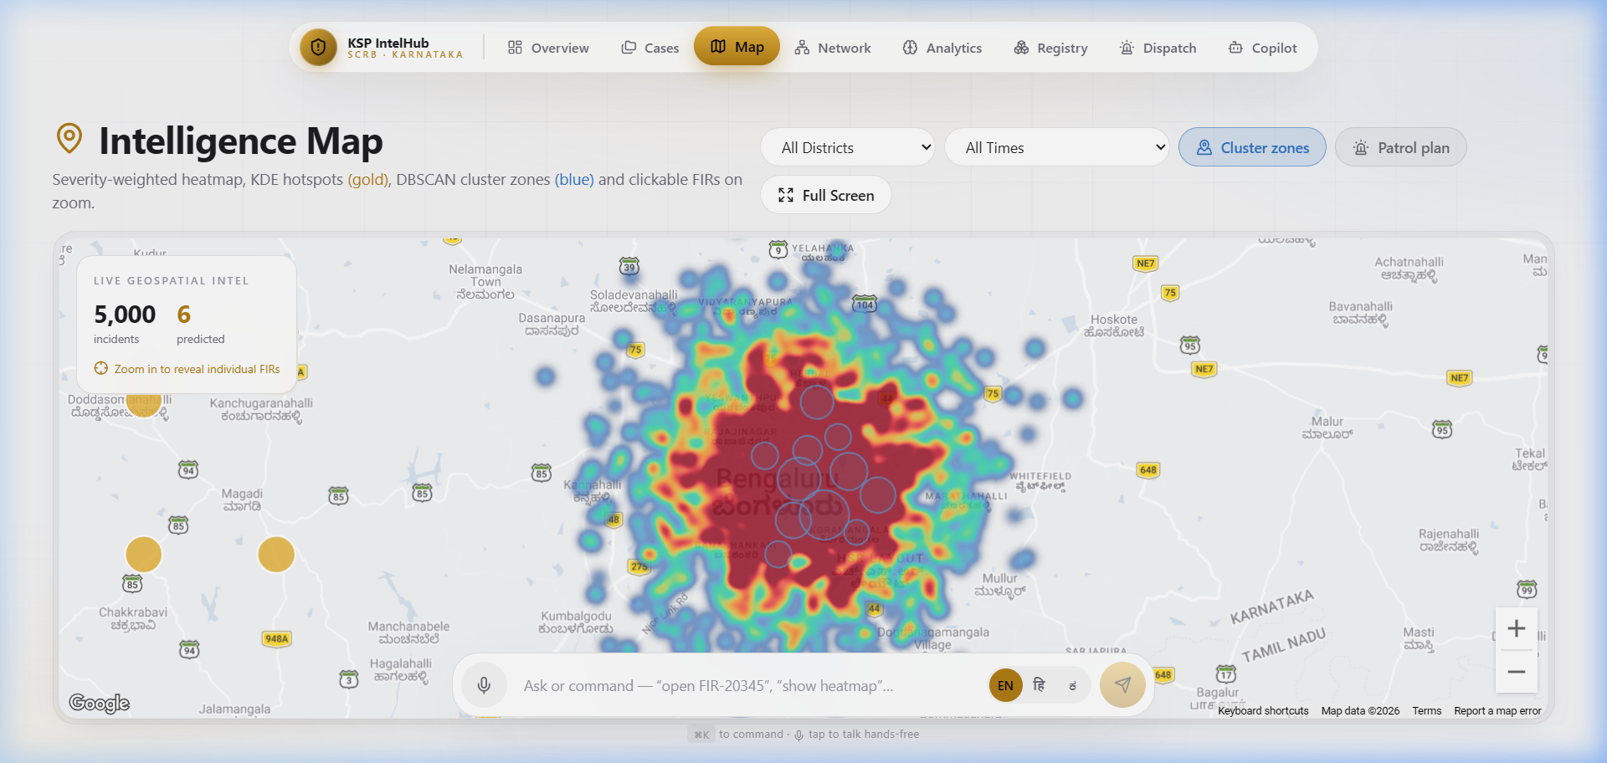
Live Platform - Dashboard & Heatmap
Dashboard - Intelligence Overview
Predictive Crime Heatmap

Slide 10
System Architecture
Three-tier architecture deployed on Zoho Catalyst
PRESENTATION LAYER | Catalyst Web Client
Next.js 16 (App Router) • React 19 • TypeScript • Tailwind CSS 4 • Framer Motion • Google Maps API • react-force-graph-3d + Three.js • Recharts • Static export served under /app/
▼
APPLICATION LAYER | Catalyst AppSail (Python 3.11)
Flask + gunicorn (512 MB) • 12 RESTful API endpoints • Lazy-load on first request • In-memory model caching • CORS via Catalyst gateway • NaN/Infinity sanitization • Env var injection
▼
INTELLIGENCE LAYER | In-Memory ML/AI Engine
pandas + numpy • NetworkX (knowledge graph + centrality) • scikit-learn: KDE, DBSCAN, IsolationForest, TF-IDF, LogReg, Ridge • OpenAI SDK → NVIDIA NIM (Llama 3.3 70B)

Slide 11
Responsible AI & Human Oversight
Predictive tools for policing carry real stakes — every flag stays explainable, reviewable, and never the final word.
Human-in-the-Loop
Every anomaly flag and risk score is a recommendation — officers make the final call.
• Risk scores are advisory only
• Officers retain full override authority
• No automated arrests or actions
Explainable by Design
Isolation Forest and Recidivism Index expose contributing factors, not black-box scores.
• Factor breakdown for every score
• Transparent ML parameters
• Keyword extraction for FIR class
Built-in Safeguards
Audit logs, fairness checks, and graceful fallback when data is incomplete.
• NaN/Inf sanitization on all endpoints
• Graceful API degradation
• Env variable injection for secrets

Slide 12
Technologies Used in the Solution
FRONTEND
• Next.js 16 (App Router)
• React 19 + TypeScript
• Tailwind CSS 4
• Framer Motion
• Recharts
• Google Maps API
• react-force-graph-3d
• Three.js (3D rendering)
• lucide-react (icons)
BACKEND / ML
• Python 3.11
• Flask + gunicorn
• pandas 2.2 + numpy 1.26
• scikit-learn 1.4
• NetworkX 3.3
• OpenAI SDK 1.40
• httpx 0.27
• requests 2.32
AI / LLM
• NVIDIA NIM API
• Meta Llama 3.3 70B
• TF-IDF Vectorizer
• Kernel Density Estimation
• DBSCAN Clustering
• Isolation Forest
• Ridge Regression
• Logistic Regression
• Adamic-Adar Index

Slide 13
Zoho Catalyst Services Used
Catalyst AppSail - Backend Hosting
• Flask + gunicorn Python 3.11 as managed app
• 512 MB memory for in-memory ML inference
• Managed HTTPS, auto-scaling & health monitoring
• Env variable injection • Vendored Linux deps
Catalyst Web Client - Frontend Hosting
• Hosts static Next.js export (React SPA) under /app/ basePath
• Serves interactive dashboard, maps, 3D graphs, and AI copilot
• Serverless CDN delivery with automatic SSL
• Version-controlled deployments via client-package.json
Catalyst CORS Gateway - Security Layer
• Automatic CORS header injection (reflected Origin, credentials)
• Production-ready cross-origin security without manual config

Slide 14
Estimated Implementation Cost
Annual Operational Cost Breakdown
Component
Zoho Catalyst AppSail (512 MB, Python 3.11)
Zoho Catalyst Web Client (static hosting)
Google Maps Platform (Heatmap API)
NVIDIA NIM API (Llama 3.3 70B, ~5K queries/mo)
Domain & SSL Certificate
Monthly
Free*
Free*
~Rs. 1,500
~Rs. 2,000
~Rs. 200
Annual
Free*
Free*
~Rs. 18,000
~Rs. 24,000
~Rs. 2,400
TOTAL OPERATIONAL COST
~Rs. 3,700/mo
~Rs. 44,400/yr
* Zoho Catalyst provides generous free tiers for development. Production pricing scales with usage.
All ML models run in-memory within the AppSail container - no separate ML hosting or GPU costs. The entire intelligence engine (8 models) runs on CPU.

Slide 15
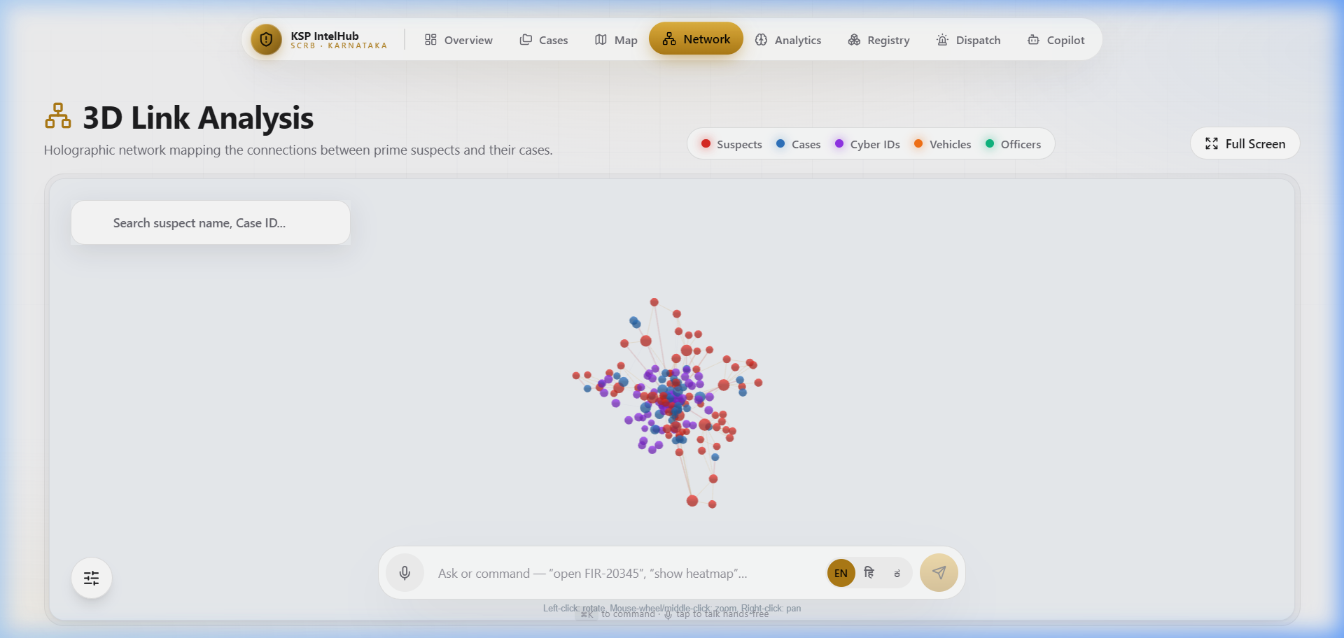
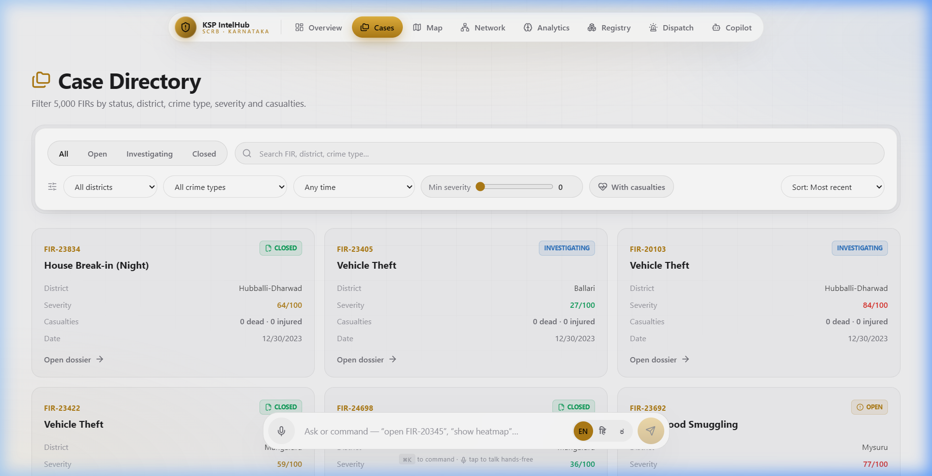
Snapshots of the Prototype
3D Criminal Network Intelligence
Case Files Directory

Slide 16
ML Model Performance (1 of 2)
KDE Hotspot Prediction
bandwidth=0.02, haversine, 6 zones
Isolation Forest
n_est=120, contamination=3%, top 8 flagged
DBSCAN Clustering
eps=1km, min_samples=12, up to 20 zones
TF-IDF + LogReg
ngram(1,2), 8K features, 80/20 stratified
Ridge Forecasting
alpha=2.0, Fourier (52/26/13-wk periods)
NLP MO Matching
TF-IDF cosine + weapon/vehicle/target/time
Adamic-Adar
Co-offender graph, top 12 predicted links
Recidivism Index
6-factor weighted (0-100), 4 risk bands

Slide 17
System Performance (2 of 2)
Dataset Scale
KSP CaseMaster FIRs with Accused, Victims, Arrests, Acts & Sections
Knowledge Graph
Dynamically scaled graph from relational CCTNS tables (cases + accused + officers + courts)
Cold Start
~3-5 seconds (lazy load + 8 ML models build)
Warm API Response
<100ms (all models cached in memory)
Memory Footprint
<512 MB (fits within AppSail allocation)
Frontend
Static export, zero SSR, instant CDN delivery
API Endpoints
12 REST endpoints with NaN/Inf sanitization
Concurrency
gunicorn multi-worker, thread-safe model cache

Slide 18
Project Links
GitHub Public Repository
https://github.com/kartikbhartiya/Datathon
Demo Video Link (3 Minutes)
https://youtu.be/w6tLhWYlt4k
Deployed Link (Live on Zoho Catalyst)
https://ksp-intelligence-60073837993.development.catalystserverless.in/app/index.html

Slide 19
Future Development Roadmap
Phase 1: Data Integration | 0-6 Months
• Real-time CCTNS/ICJS data pipeline via secure APIs
• Live FIR ingestion with auto-classification & severity scoring
• Multi-language NLP for Kannada/Hindi FIR narratives
• Automated evidence chain-of-custody tracking
Phase 2: Advanced Intelligence | 6-12 Months
• Deep learning models (LSTM/Transformer) for temporal prediction
• CCTV footage integration with facial recognition
• Mobile companion app for field officers with real-time alerts
• Graph Neural Networks for enhanced network analysis
Phase 3: Statewide Expansion | 12-24 Months
• Scale to all 31 Karnataka districts with district-specific models
• Multi-state federation for inter-state criminal network analysis
• Dynamic beat optimization with predictive resource allocation
• Integration with judiciary systems for end-to-end case tracking

Slide 20


