Slide 1
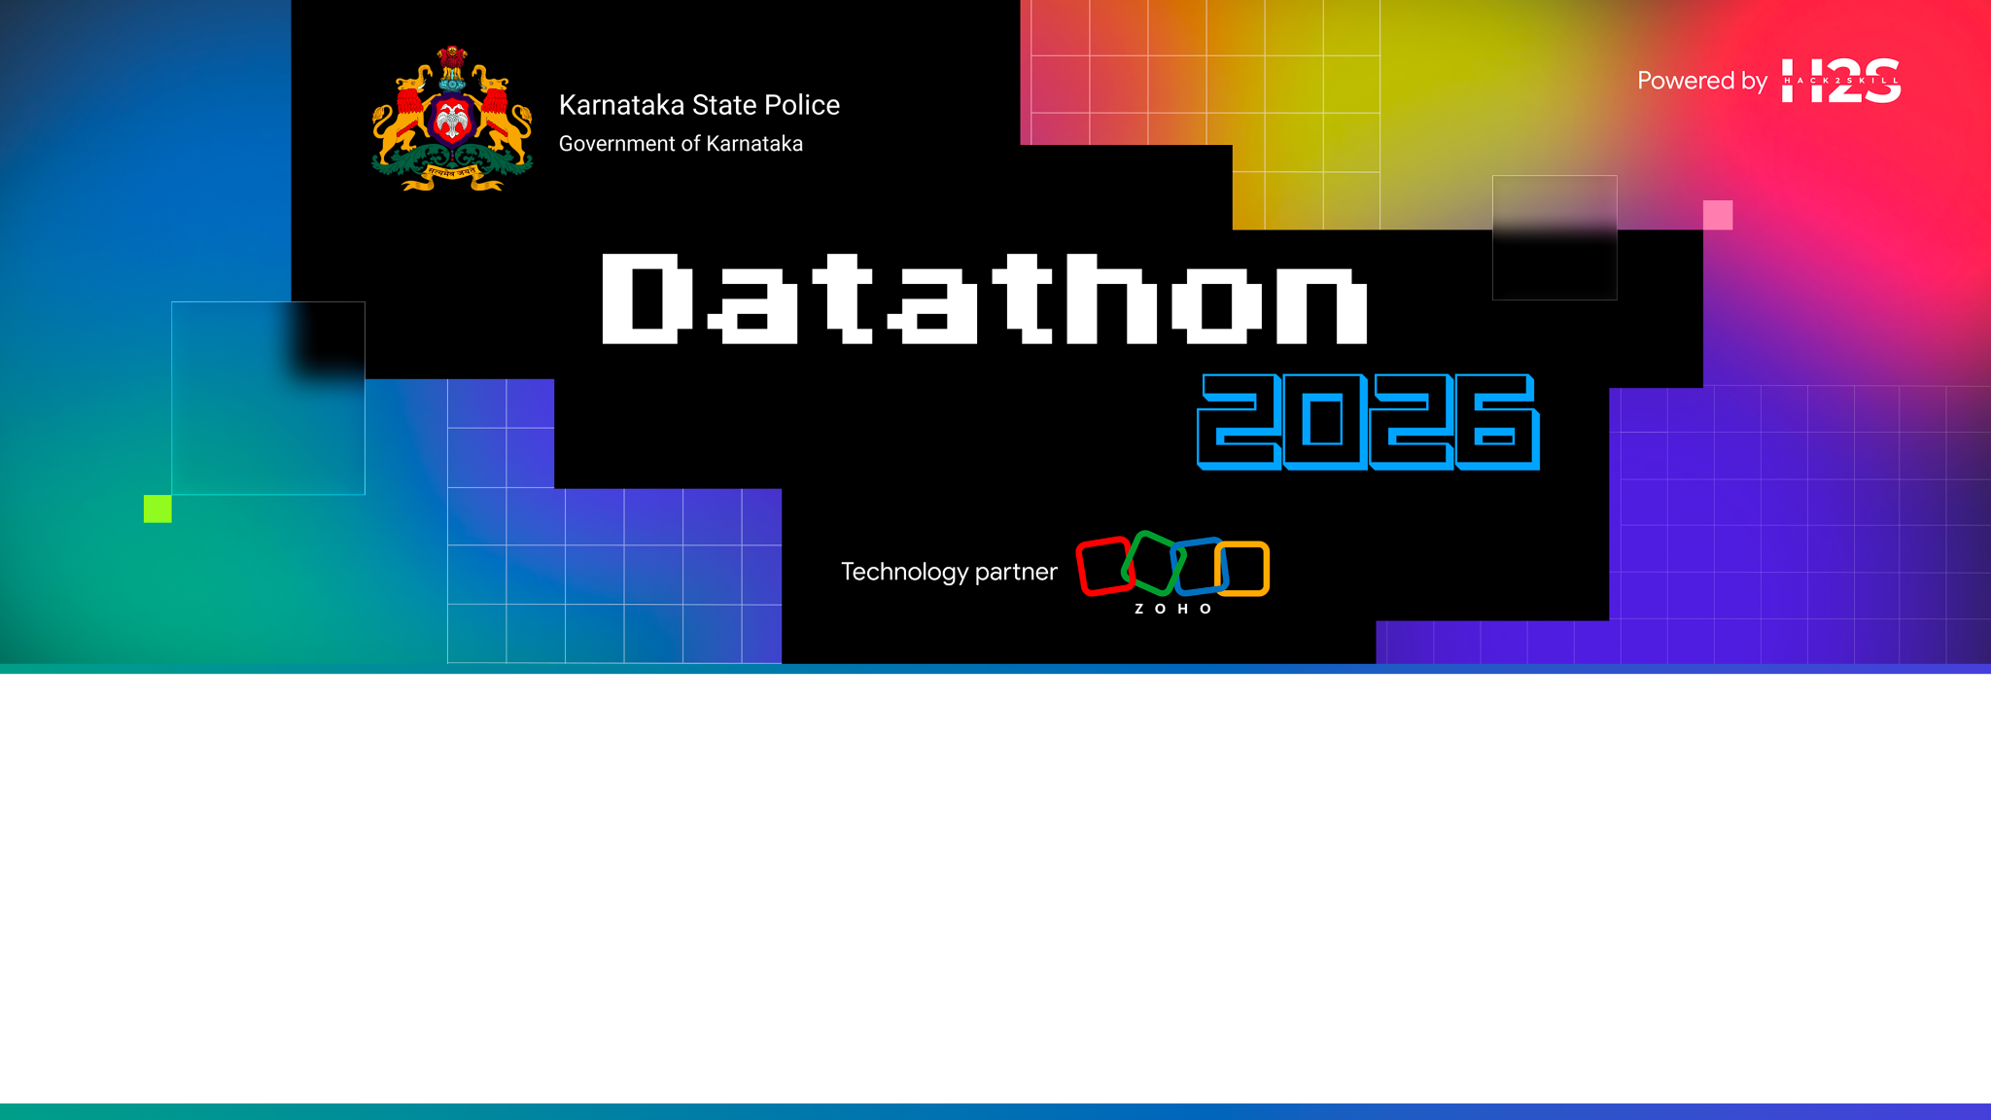
Team Details
Team Name: Quicx Labs
Team Leader: Sanchit Gupta
Team Size: 2 Members
Problem Statement: Challenge #2 - AI-Driven Crime Analytics & Visualization Platform

Slide 2

The Problem: Crime Data Trapped in Silos
Karnataka’s FIRs, suspects, and case files live in disconnected spreadsheets — patterns invisible, hours wasted, connections missed.
5,000+
FIRs sitting in spreadsheets with no way to cross-reference suspects or MOs
800+
repeat suspects whose case history and network links stay hidden
Manual
cross-referencing is still the only way investigators link related cases

Slide 3
Brief About the Solution
KSP IntelHub - Crime Intelligence & Analytical Platform
A state-of-the-art AI-driven platform built for the Karnataka State Police (KSP) / State Crime Records Bureau (SCRB). It replaces siloed, Excel-based crime records with an integrated intelligence hub delivering:
• Interactive geospatial analytics with KDE-predicted crime hotspots
• 3D criminal network graph with key-player identification via degree centrality
• Behavioral anomaly detection using Isolation Forest (explainable AI)
• NLP-based Modus Operandi matching using TF-IDF + cosine similarity
• Crime forecasting with Ridge regression + Fourier seasonality (8-week horizon with Ridge + Fourier seasonality)
• Investigative AI Copilot powered by Dynamic 26-Table In-Memory Relational Engine
• Socio-economic crime correlation and recidivism risk scoring
• DBSCAN spatial clustering and Adamic-Adar criminal link prediction
Processing 5,000+ FIRs across 10 districts with 800+ suspects in a unified knowledge graph of 19,008+ edges.

Slide 4
Opportunities & USP
How is it different?
• 12 ML/AI models & AI Copilot working in concert vs static dashboards
• Unified knowledge graph linking suspects, cases, and cyber IDs
• Real-time AI copilot grounded in live crime data
• Explainable AI for all behavioral anomaly detections
• Dynamic 3D criminal network visualization (Three.js)
How does it solve the problem?
• Replaces Excel silos with an integrated, searchable platform
• Enables proactive policing through predictive KDE hotspot mapping
• Surfaces hidden criminal networks invisible in isolated spreadsheets
• Automates case linking using NLP on FIR narratives
• Predicts emerging alliances with Adamic-Adar algorithms
Unique Selling Proposition
• Only platform combining geospatial, network, behavioral AI, and an LLM copilot
• Fully deployed on Zoho Catalyst with zero external infrastructure
• Graceful degradation: partial data never breaks the API
• Extremely cost-effective architecture running models entirely in memory
• Highly scalable microservices-based stateless backend

Slide 5
Features: Intelligence & Analytics (1 of 2)
1. Interactive Crime Heatmap
KDE-predicted spatial hotspots across all districts
2. Topological 3D Link Visualizer
Sub-graph topological pruning & zero-clumping d3 physics
3. Behavioral Anomaly Detection
Isolation Forest spotting unusual crime patterns
4. NLP Modus Operandi Matching
TF-IDF cosine similarity for modus operandi
5. Crime Forecasting Engine
Ridge + Fourier seasonality for 8-week lookahead
6. Emerging Trend Alerts
Real-time 30-day spike detection across regions
7. AI Intelligence Copilot
Dynamic 26-table retrieval in English, Hindi & Kannada
8. Criminal Link Prediction
Adamic-Adar predicting emerging gang alliances

Slide 6
Features: Operational Tools (2 of 2)
9. Patrol Dispatch Centre
AI-optimized geographical patrol deployment
10. Suspect Dossier
Repeat-offender profile & network centrality score
11. Case Files Dossier
Crime-scene map & AI-recommended similar cases
12. Recidivism Risk Index
Multi-factor 0-100 severity & risk scoring
13. Socio-Economic Correlation
Pearson analysis for crime pattern matching
14. Crime-Type Classifier
TF-IDF + LogReg automated categorization
15. Cyber Ring & Conviction AI
8 multi-case cyber rings + Random Forest conviction model
16. Rowdy-Sheeter & CCTNS Registry
205 Rowdy-Sheeters, 182 History-Sheeters, Warrants, Courts

Slide 7
Process Flow & Data Pipeline
DATA INGESTION
• 5,000 FIRs across 26 Relational Tables
• 800 suspects + 205 Rowdy-Sheeters + 143 Warrants
• 5,000 FIR narratives (NLP text)
• 19,008 graph edges across 6,759 nodes
• CCTNS registries integration
- Officers database
- Vehicles & Cyber IDs
- Missing persons registry
Format: CSV files loaded lazily
into memory on first API request
INTELLIGENCE ENGINE
• NetworkX knowledge graph build
• KDE hotspot boundary prediction
• DBSCAN spatial clustering (eps=1km)
• Isolation Forest anomaly scoring
• TF-IDF MO vectorization
• Logistic Reg. Crime Classifier
• Ridge forecasting (8-wk horizon)
• Adamic-Adar link probability
• Recidivism risk multi-factor score
• NVIDIA NIM LLM copilot agent
INTERACTIVE FRONTEND
• Command Dashboard (metrics, alerts)
• Google Maps heatmap overlay
• 3D force-directed network graph
• Detailed Case & Suspect dossiers
• Searchable FIR database with filters
• Natural language AI chat interface
• Patrol dispatch deployment centre
• Analytics (forecasts & clustering)
• Real-time system health & settings
▶
▶

Slide 8
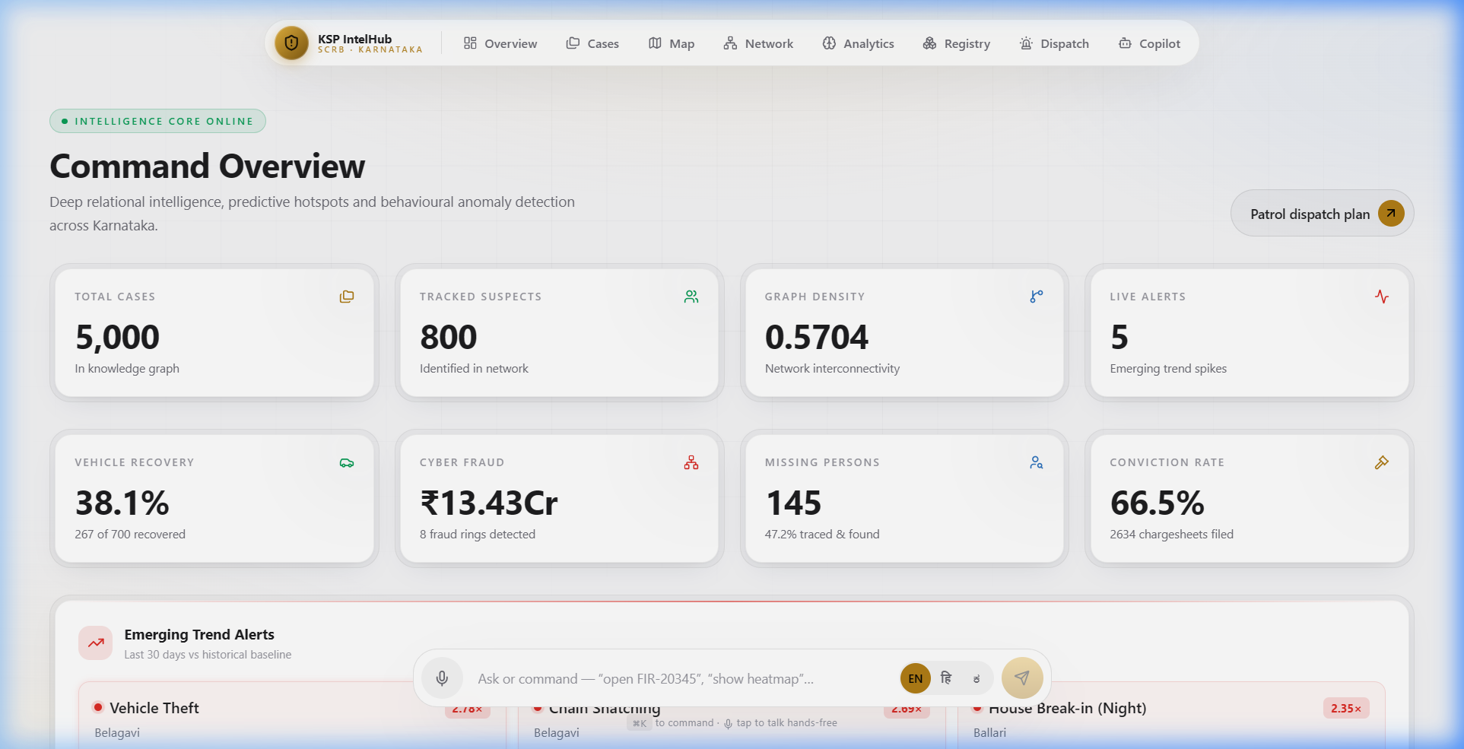
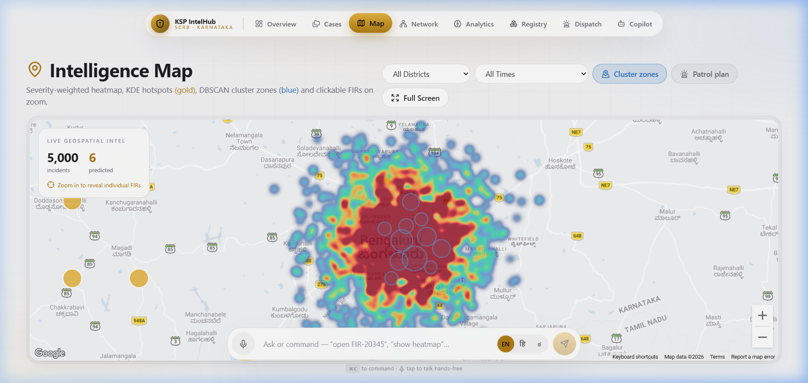
Live Platform - Dashboard & Heatmap
Dashboard - Intelligence Overview
Predictive Crime Heatmap

Slide 9
System Architecture
Three-tier architecture deployed on Zoho Catalyst
PRESENTATION LAYER | Catalyst Web Client
Next.js 16 (App Router) • React 19 • TypeScript • Tailwind CSS 4 • Framer Motion • Google Maps API • react-force-graph-3d + Three.js • Recharts • Static export served under /app/
▼
APPLICATION LAYER | Catalyst AppSail (Python 3.11)
Flask + gunicorn (512 MB) • 15 RESTful API endpoints + Dynamic 26-Table Search • Lazy-load on first request • In-memory model caching • CORS via Catalyst gateway • NaN/Infinity sanitization • Env var injection
▼
INTELLIGENCE LAYER | In-Memory ML/AI Engine
pandas + numpy • NetworkX (knowledge graph + centrality) • scikit-learn: KDE, DBSCAN, IsolationForest, TF-IDF, LogReg, Ridge • OpenAI SDK → NVIDIA NIM (Llama 3 70B)

Slide 10
Responsible AI & Human Oversight
Predictive tools for policing carry real stakes — every flag stays explainable, reviewable, and never the final word.
Human-in-the-Loop
Every anomaly flag and risk score is a recommendation for review — officers make the final call, not the model.
Explainable by Design
Isolation Forest and the Recidivism Index expose the contributing factors behind every flag, not just a black-box score.
Built-in Safeguards
Audit logs on every AI-assisted lookup, fairness checks across groups, and graceful fallback when data is incomplete.

Slide 11
Technologies Used in the Solution
FRONTEND
• Next.js 16 (App Router)
• React 19 + TypeScript
• Tailwind CSS 4
• Framer Motion
• Recharts
• Google Maps API
• react-force-graph-3d
• Three.js (3D rendering)
• lucide-react (icons)
BACKEND / ML
• Python 3.11
• Flask + gunicorn
• pandas 2.2 + numpy 1.26
• scikit-learn 1.4
• NetworkX 3.3
• OpenAI SDK 1.40
• httpx 0.27
• requests 2.32
AI / LLM
• NVIDIA NIM API
• Meta Llama 3 70B
• TF-IDF Vectorizer
• Kernel Density Estimation
• DBSCAN Clustering
• Isolation Forest
• Ridge Regression
• Logistic Regression
• Adamic-Adar Index
• Random Forest Allocation Predictor
• Random Forest Conviction Model
• Docker & Docker Compose

Slide 12
Zoho Catalyst Services Used
Catalyst AppSail - Backend Hosting
• Hosts Flask + gunicorn Python 3.11 backend as managed application
• 512 MB memory for in-memory ML model inference
• Managed HTTPS, auto-scaling, and health monitoring
• Environment variable injection for API keys
• Vendored Linux dependencies via CLI deployment
Catalyst Web Client - Frontend Hosting
• Hosts static Next.js export (React SPA) under /app/ basePath
• Serves interactive dashboard, maps, 3D graphs, and AI copilot
• Serverless CDN delivery with automatic SSL
• Version-controlled deployments via client-package.json
Catalyst CORS Gateway - Security Layer
• Automatic CORS header injection (reflected Origin, credentials)
• Production-ready cross-origin security without manual config

Slide 13
Estimated Implementation Cost
Annual Operational Cost Breakdown
Component
Zoho Catalyst AppSail (512 MB, Python 3.11)
Zoho Catalyst Web Client (static hosting)
Google Maps Platform (Heatmap API)
NVIDIA NIM API (Llama 3 70B, ~5K queries/mo)
Domain & SSL Certificate
Monthly
Free*
Free*
~Rs. 1,500
~Rs. 2,000
~Rs. 200
Annual
Free*
Free*
~Rs. 18,000
~Rs. 24,000
~Rs. 2,400
TOTAL OPERATIONAL COST
~Rs. 3,700/mo
~Rs. 44,400/yr
* Zoho Catalyst provides generous free tiers for development. Production pricing scales with usage.
All ML models run in-memory within the AppSail container - no separate ML hosting or GPU costs. The entire intelligence engine (8 models) runs on CPU.

Slide 14
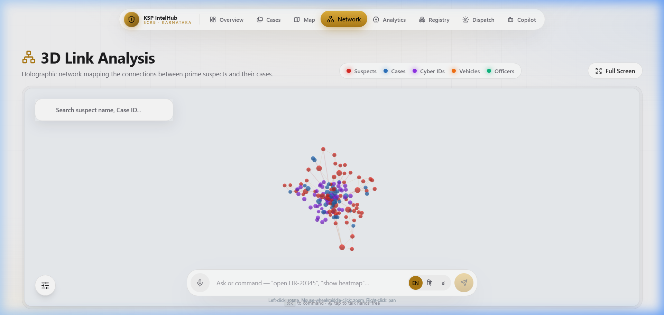
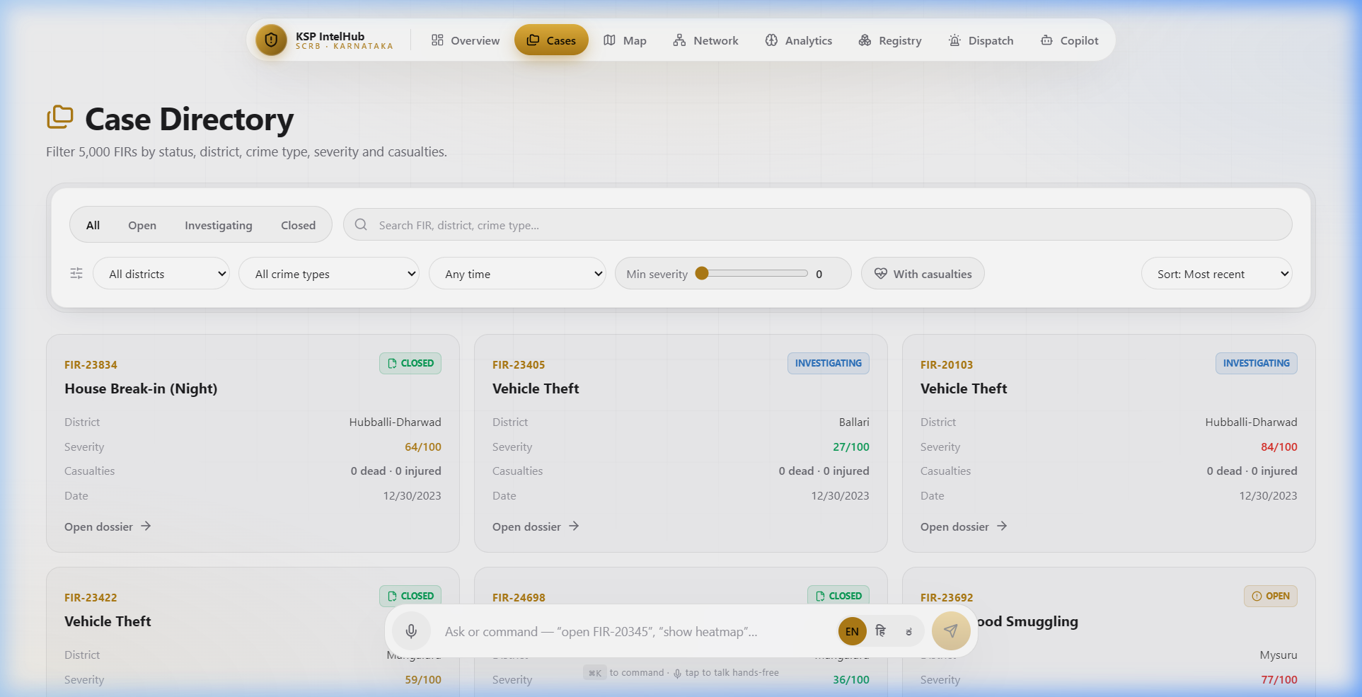
Snapshots of the Prototype
3D Criminal Network Intelligence
Case Files Directory

Slide 15
ML Model Performance (1 of 2)
KDE Hotspot Prediction
bandwidth=0.02, haversine, 6 zones
Isolation Forest
n_est=120, contamination=3%, top 8 flagged
DBSCAN Clustering
eps=1km, min_samples=12, up to 20 zones
TF-IDF + LogReg
ngram(1,2), 8K features, 80/20 stratified
Ridge Forecasting
alpha=2.0, Fourier (52/26/13-wk periods)
NLP MO Matching
TF-IDF cosine + weapon/vehicle/target/time
Adamic-Adar
Co-offender graph, top 12 predicted links
Recidivism Index
6-factor weighted (0-100), 4 risk bands

Slide 16
System Performance (2 of 2)
Dataset Scale
5,000 FIRs x 22 cols, 800 suspects, 5K narratives, 19,008 links
Knowledge Graph
~6,759 nodes, 19,008+ edges (cases, suspects, officers, vehicles, cyber)
Cold Start
~3-5 seconds (lazy load + 12 ML models build)
Warm API Response
<100ms (all models cached in memory)
Memory Footprint
<512 MB (fits within AppSail allocation)
Frontend
Static export, zero SSR, instant CDN delivery
API Endpoints
12 REST endpoints with NaN/Inf sanitization
Concurrency
gunicorn multi-worker, thread-safe model cache

Slide 17
Project Links
GitHub Public Repository
https://github.com/kartikbhartiya/Datathon
Demo Video Link (3 Minutes)
⚠ Add link before final submission
Deployed Link (Live on Zoho Catalyst)
https://ksp-intelligence-60073837993.development.catalystserverless.in/app/index.html

Slide 18
Future Development Roadmap
Phase 1: Data Integration | 0-6 Months
• Real-time CCTNS/ICJS data pipeline via secure APIs
• Live FIR ingestion with auto-classification & severity scoring
• Multi-language NLP for Kannada/Hindi FIR narratives
• Automated evidence chain-of-custody tracking
Phase 2: Advanced Intelligence | 6-12 Months
• Deep learning models (LSTM/Transformer) for temporal prediction
• CCTV footage integration with facial recognition
• Mobile companion app for field officers with real-time alerts
• Graph Neural Networks for enhanced network analysis
Phase 3: Statewide Expansion | 12-24 Months
• Scale to all 31 Karnataka districts with district-specific models
• Multi-state federation for inter-state criminal network analysis
• Dynamic beat optimization with predictive resource allocation
• Integration with judiciary systems for end-to-end case tracking

Slide 19
