Slide 1
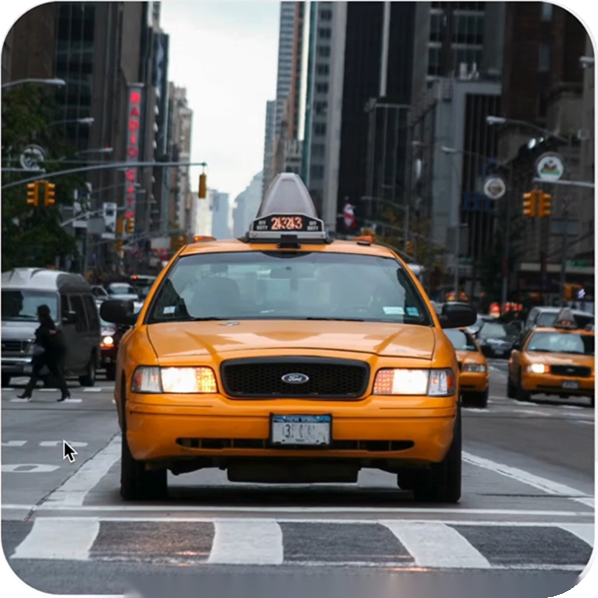
MAXIMIZING
REVENUE FOR
DRIVERS
Through Payment Type
Through Payment Type
1

Slide 2
MAXIMIZING REVENUE FOR DRIVERS
Agenda
• Problem Statement
• Analysis and Findings
• Research Question
• Hypothesis Testing
• Data Overview
• Recommendations
• Methodology
Through Payment Type
2

Slide 3

MAXIMIZING REVENUE FOR DRIVERS
Problem Statement
Visual area — add image later
In the fast-paced taxi booking sector, making the most of
revenue is essential for long-term success and driver
happiness.
Our goal is to use data-driven insights to maximize
revenue streams for taxi drivers in order to meet this need.
Our research aims to determine whether payment
methods have an impact on fare pricing by focusing on the
relationship between payment type and fare amount..
Through Payment Type
3

Slide 4
MAXIMIZING REVENUE FOR DRIVERS
Research Question
Is there a relationship between fare amount and payment type?
Can we nudge customers towards payment methods that generate higher revenue for drivers,
without negatively impacting customer experience?
Through Payment Type
4

Slide 5
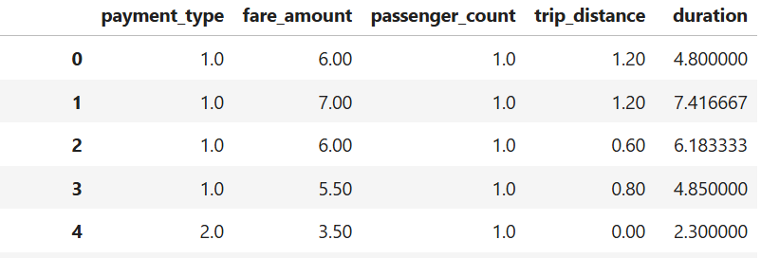
MAXIMIZING REVENUE FOR DRIVERS
Data Overview
For this analysis, we utilized the comprehensive dataset of NYC Taxi Trip records, used data
cleaning and feature engineering procedures to concentrate solely on the relevant columns
essential for our investigation.
Relevant columns used for this research:
• passenger_count (1 to 5)
Chart area — add chart later
• payment_type (card or cash)
• fare_amount
• trip_distance (miles)
• duration (minutes)
Through Payment Type
5

Slide 6
MAXIMIZING REVENUE FOR DRIVERS
Methodology
Step
Description
Descriptive Analysis
Performed statistical analysis to summarize key aspects of the data, focusing on fare
amounts and payment types.
Hypothesis Testing
Conducted a T-test to evaluate the relationship between payment type and fare
amount, testing the hypothesis that different payment methods influence fare
amounts.
Through Payment Type
6

Slide 7
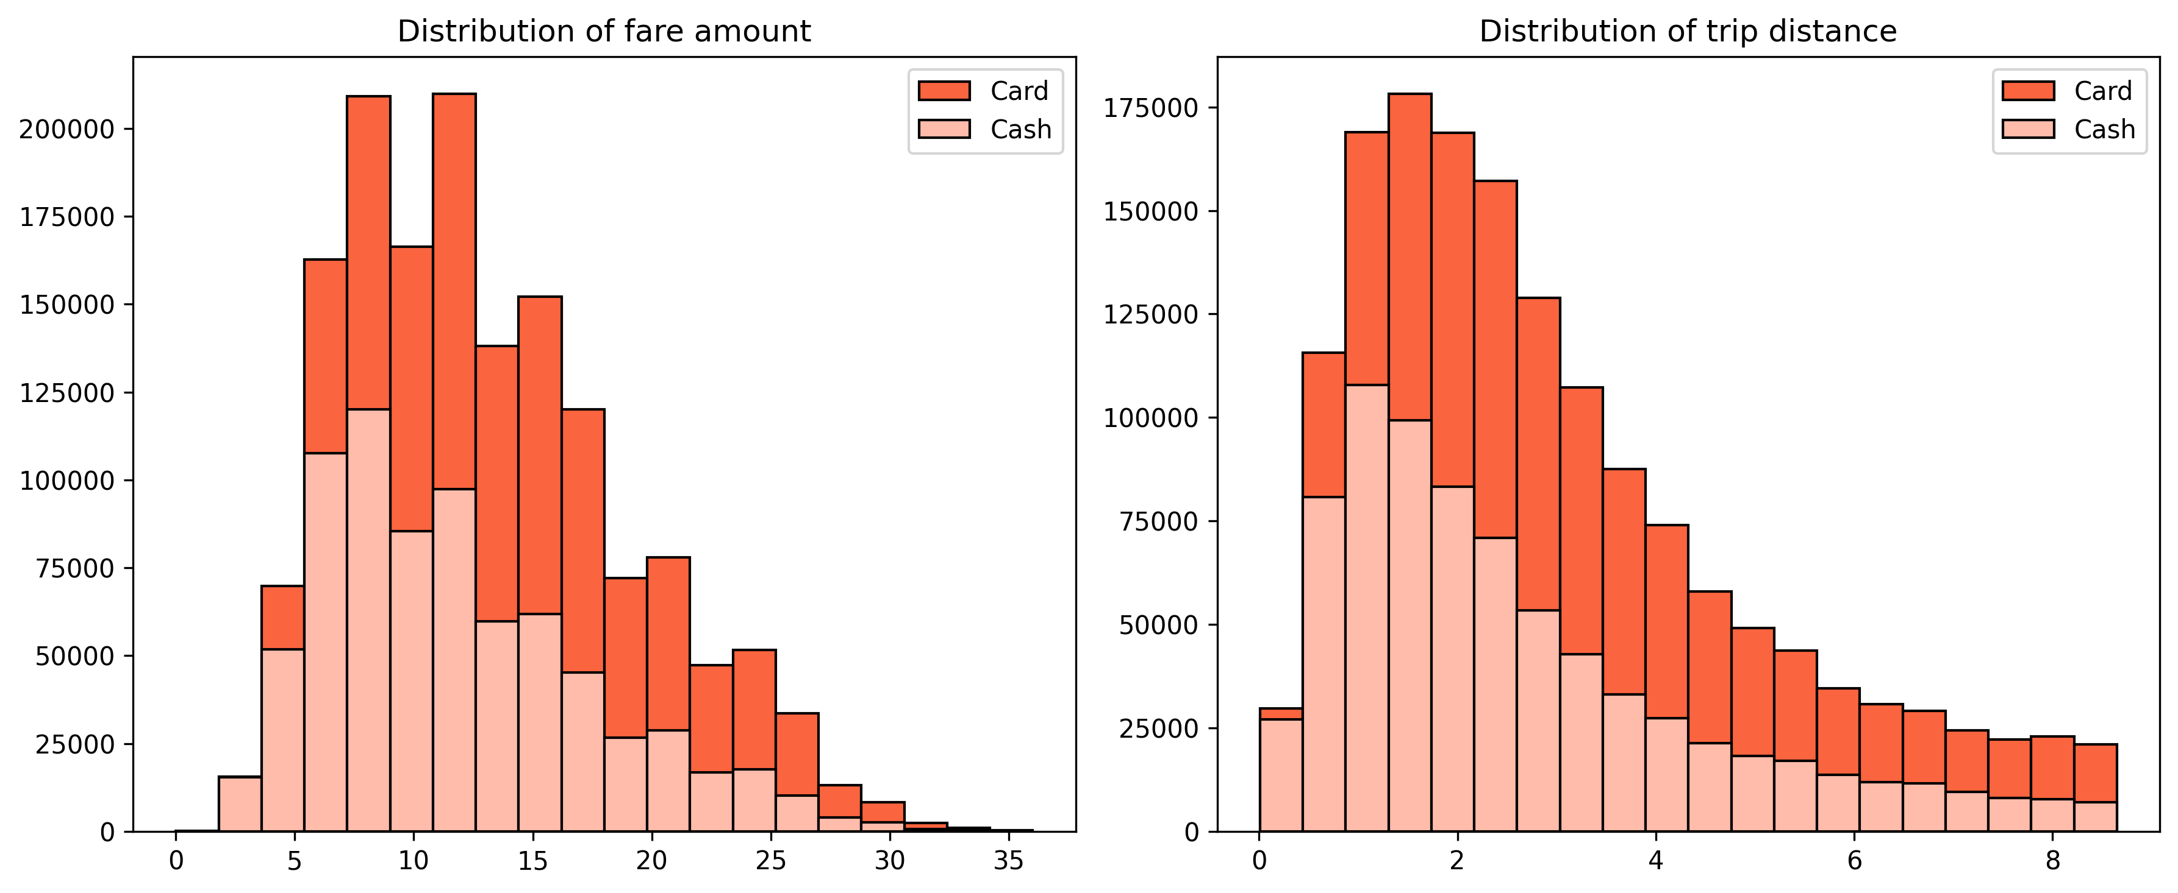
MAXIMIZING REVENUE FOR DRIVERS
Journey Insights
• Customers paying with cards tend to have a slightly higher average trip distance and fare amount
compared to those paying with cash.
• Indicates that customers prefers to pay more with cards when they have high fare amount and
long trip distance.
Payment
Type
Mean
Standard
Deviation
Fare
amount
Card
13.7
6.5
Cash
12.25
6.2
Trip
Distance
Card
3.23
2.32
Cash
2.8
2.23
Through Payment Type
7

Slide 8
MAXIMIZING REVENUE FOR DRIVERS
Chart area — add chart later
Preference of Payment Types
• The proportion of customers paying with cards is significantly higher than those paying with cash, with card payments accounting for 67.5% of all transactions compared to cash payments at 32.5%.
• This indicates a strong preference among customers for using card payments over cash, potentially due to convenience, security, or incentives offered for card transactions.
Through Payment Type
8

Slide 9
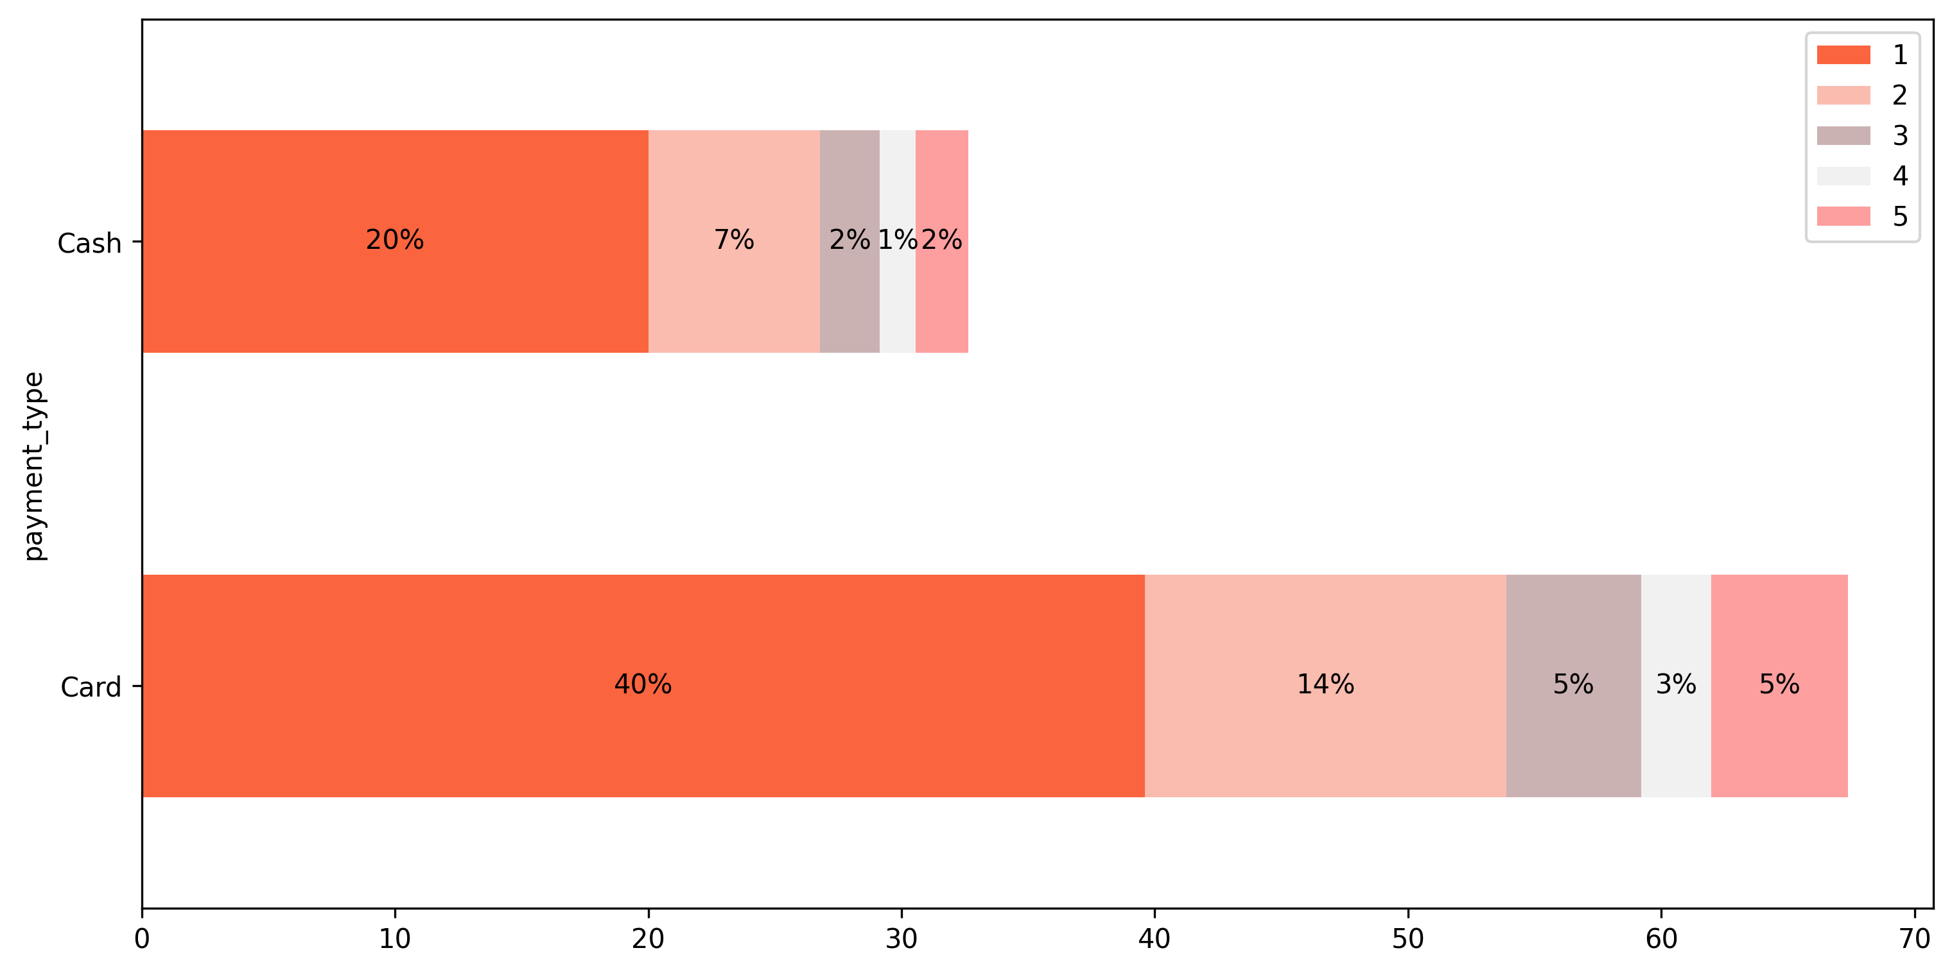
MAXIMIZING REVENUE FOR DRIVERS
Passenger Count Analysis
• Among card payments, rides with a single passenger passenger count = 1 comprise the largest proportion,
constituting 40.08% of all card transactions.
• Similarly, cash payments are predominantly associated with single-passenger rides, making up 20.04% of all
cash transactions.
• There is a noticeable decrease in the percentage of transactions as the passenger count increases, suggesting
that larger groups are less likely to use taxis or may opt for alternative payment methods.
• These insights emphasize the importance of considering both payment method and passenger count when
analyzing transaction data, as they provide valuable insights into customer behavior and preferences.
Chart area — add chart later
Through Payment Type
9

Slide 10
MAXIMIZING REVENUE FOR DRIVERS
Hypothesis Testing
Null hypothesis: There is no difference in average fare between customers who use credit cards
and customers who use cash.
Alternative hypothesis: There is a difference in average fare between customers who use credit
cards and customers who use cash
With a T-statistic of 165.5 and a P-value of less than 0.05, we reject the null hypothesis, suggesting
that there is indeed a significant difference in average fare between the two payment methods.
Through Payment Type
10

Slide 11
MAXIMIZING REVENUE FOR DRIVERS
Recommendations
Encourage customers to pay with credit cards to capitalize on the potential for
generating more revenue for taxi cab drivers.
Implement strategies such as offering incentives or discounts for credit card
transactions to incentivize customers to choose this payment method.
%
Provide seamless and secure credit card payment options to enhance customer
convenience and encourage adoption of this preferred payment method.
✓
Through Payment Type
11

Slide 12
MAXIMIZING REVENUE FOR DRIVERS
Thank You
MAXIMIZING REVENUE FOR DRIVERS
Through Payment Type
12

