Slide 1
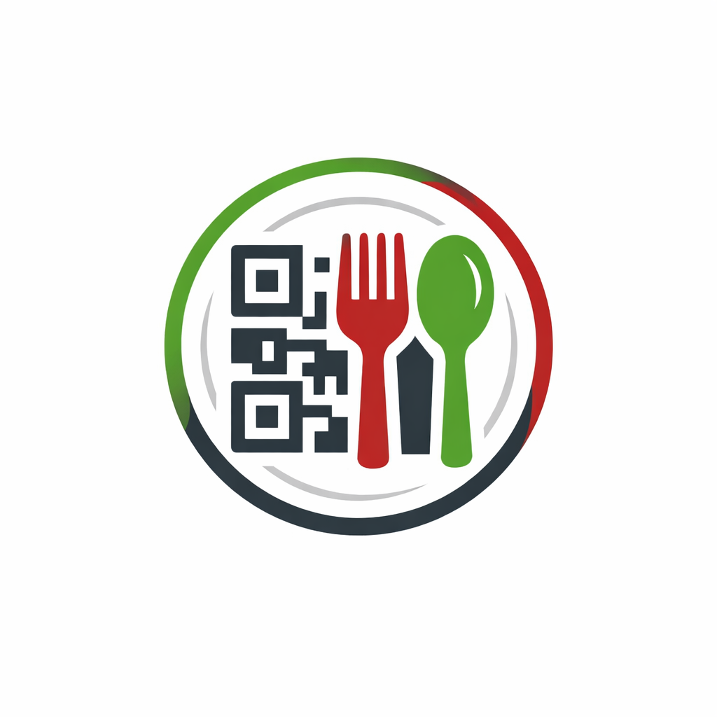
Digital Restaurant Menu
Foodie QR
Presented By
Satyajeet Kundalwal & Kartik Borana

Slide 2
Problem: Traditional paper menus are unhygienic, expensive to
reprint for small price changes, and often outdated (items out of stock).
Waiters take time to attend to tables during peak hours.
Solution: This web application allows customers to view a digital
menu (via QR code or link), filter items instantly, and place orders
directly to the kitchen without waiting for staff.
Introduction

Slide 3
Technology Used
We used Java Spring-Boot as backend and React JS as Frontend in our Project.
Spring-Boot :–
The main goal of the Spring Boot framework is to reduce overall development time and increase efficiency. React has become the first choice for frontend because it gives developers the ability to work with a virtual browser (more friendly than the real browser). Also, a JavaScript developer can become a productive developer in a few hours because there is a small API to learn, a few functions, and how to use them…
React :– Creates a fast, responsive "Virtual Browser" experience. Essential for a menu that needs to load quickly on customers' mobile phones without reloading the page for every category switch.
The main purpose of React is to be fast, scalable, and simple.

Slide 4



User Classes
Customer
Admin
Staff
In this module Admin can manage Customers and Staffs . Will maintain one to one relation.
Updates food items, prices, and availability (In/Out of stock)
In this module Staff can register by admin & login and can View incoming customer orders , Update order status .
In this module a customer will register, login himself or search from various categories available ordered food .

Slide 5
OBJECTIVE
01
The Digital Restaurant Menu System is a web-based application designed to modernize the restaurant ordering process using QR codes.
02
The system provides a contactless, fast, and user-friendly experience for customers, staff, and administrators.
03
This application eliminates the need for physical menus and manual order taking.
04
It helps restaurants manage menus, orders, and users efficiently through a centralized system.
05
The project focuses on improving customer experience, reducing errors, and increasing operational efficiency.

Slide 6
Customer Module
After scanning the QR code and successful access, the Customer can:
View the digital food menu with categories and prices
Add food items to cart and modify quantities
Place orders directly from the table
Track real-time order status (Pending → Preparing → Completed)
Enjoy a fast, contactless dining experience

Slide 7
Staff Module
After successful registration and authentication from Admin , the Staff can
View incoming customer orders in real time
Update order status (Accepted, Preparing, Ready, Completed)
Manage kitchen workflow efficiently
Reduce order mistakes caused by manual communication
Ensure faster service and better coordination

Slide 8
Admin Module
The Admin has complete control over the system and can:
Manage food menu (Add / Update / Delete items)
Manage staff accounts and roles
Monitor all customer orders
Control restaurant operations through the admin dashboard
Ensure smooth functioning of the entire system

Slide 9
Key Features
QR Code–based Ordering System
Role-based Authentication (Admin, Staff, Customer)
Real-time Order Management
Secure Login using JWT Authentication
Responsive and User-friendly UI

Slide 10
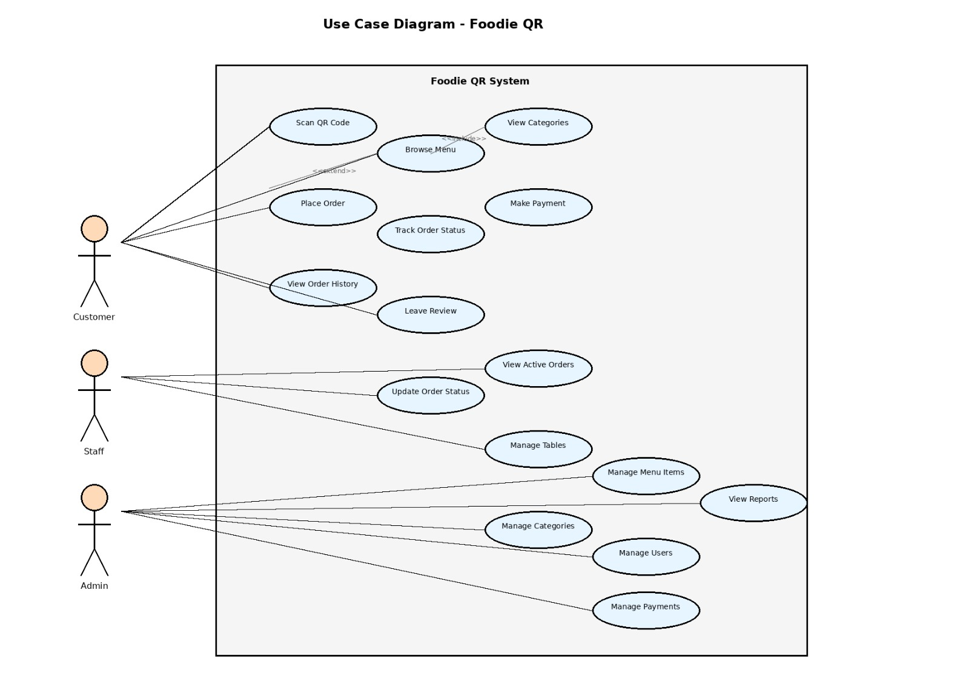
Use Case

Slide 11
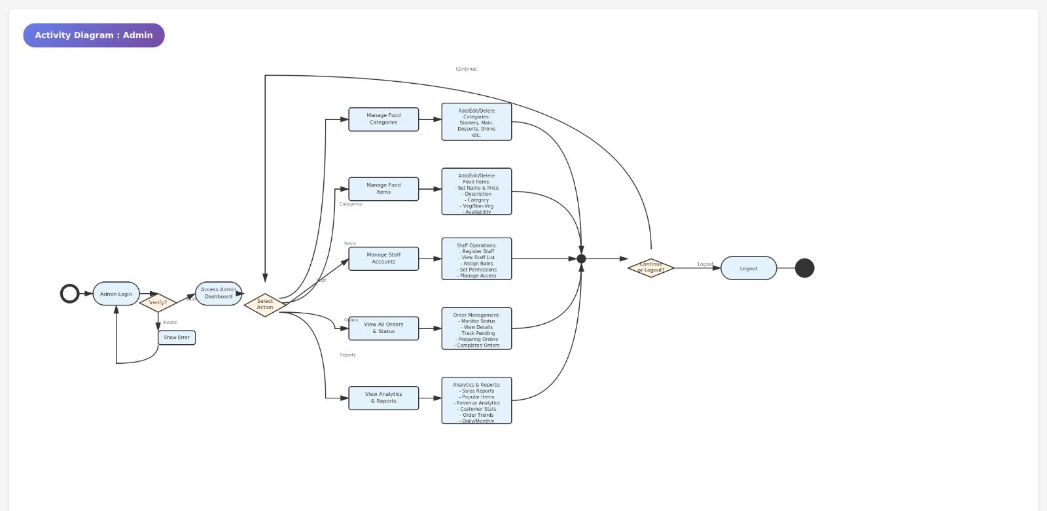
Activity Diagram : Admin

Slide 12
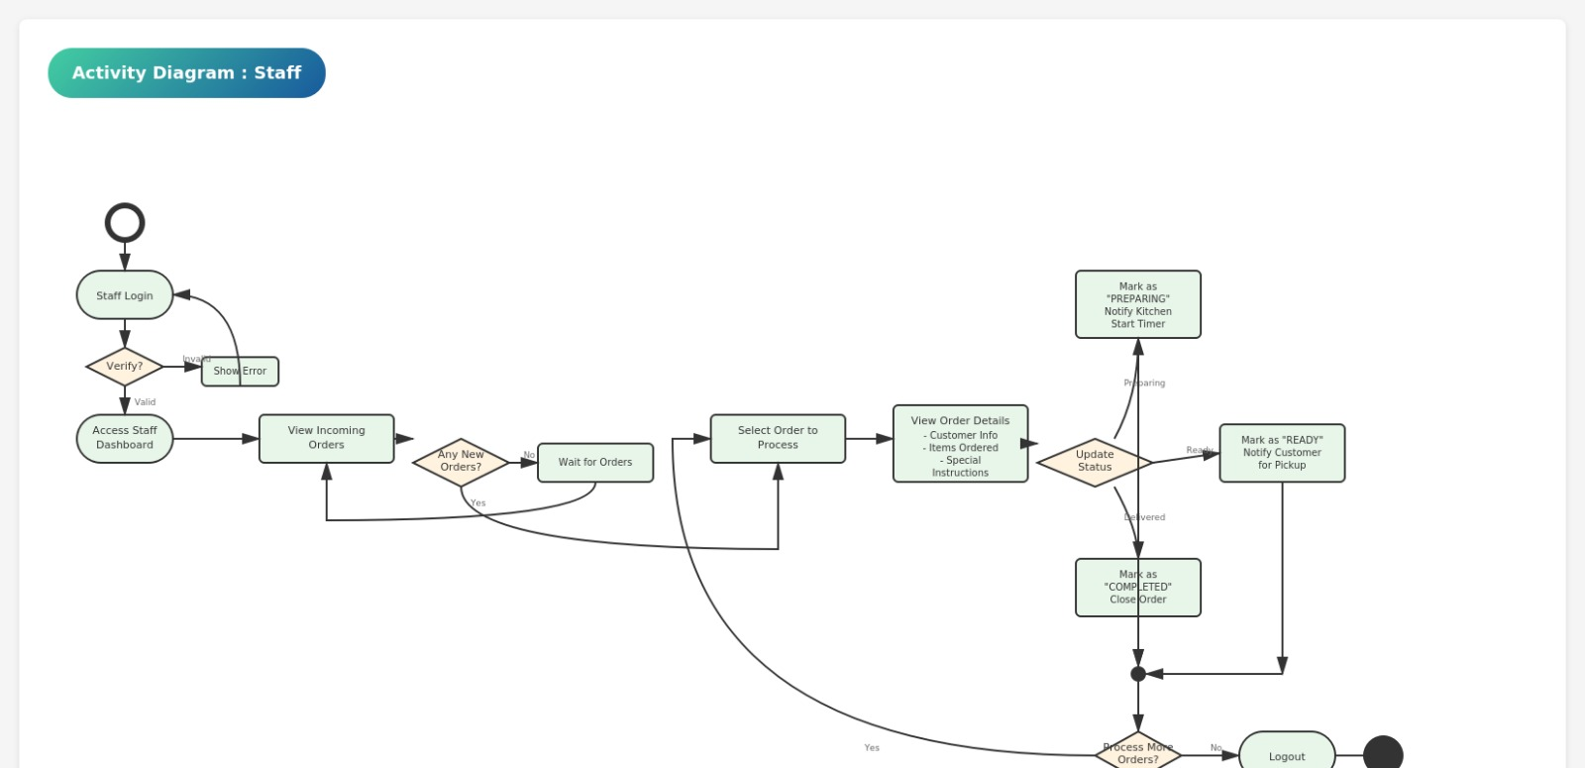
Activity Diagram : Staff

Slide 13
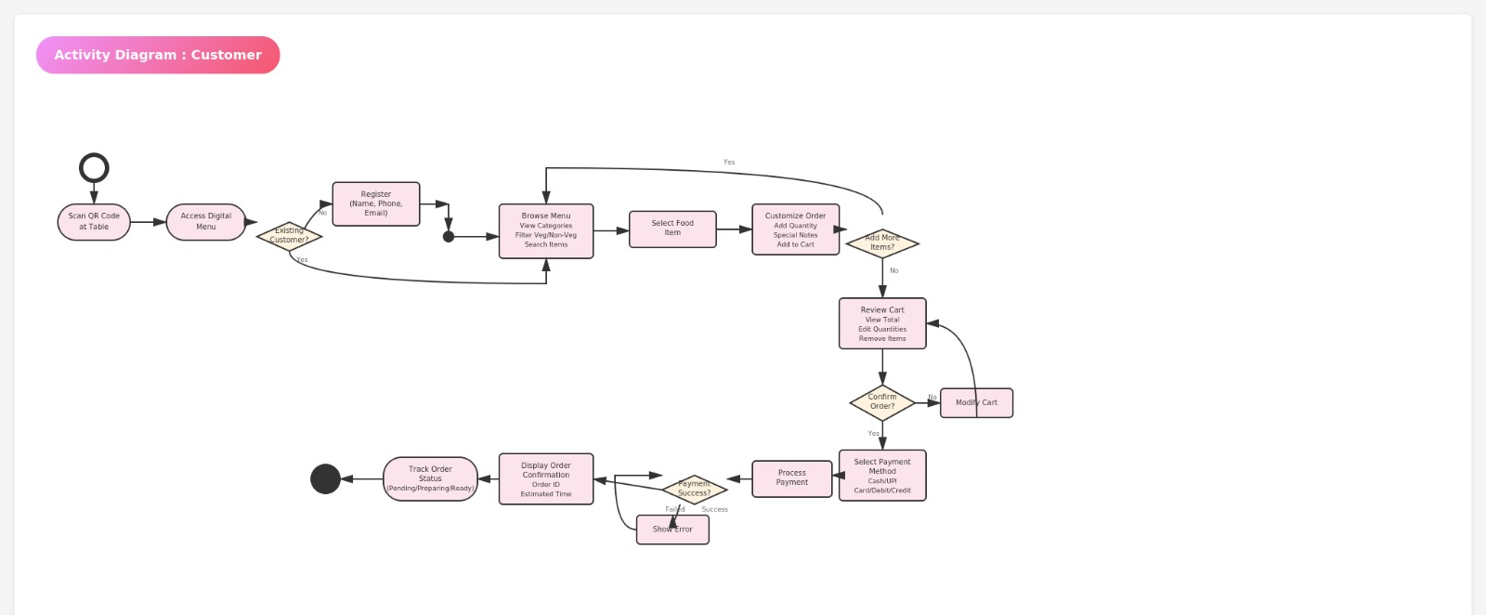
Activity Diagram : Customer

Slide 14
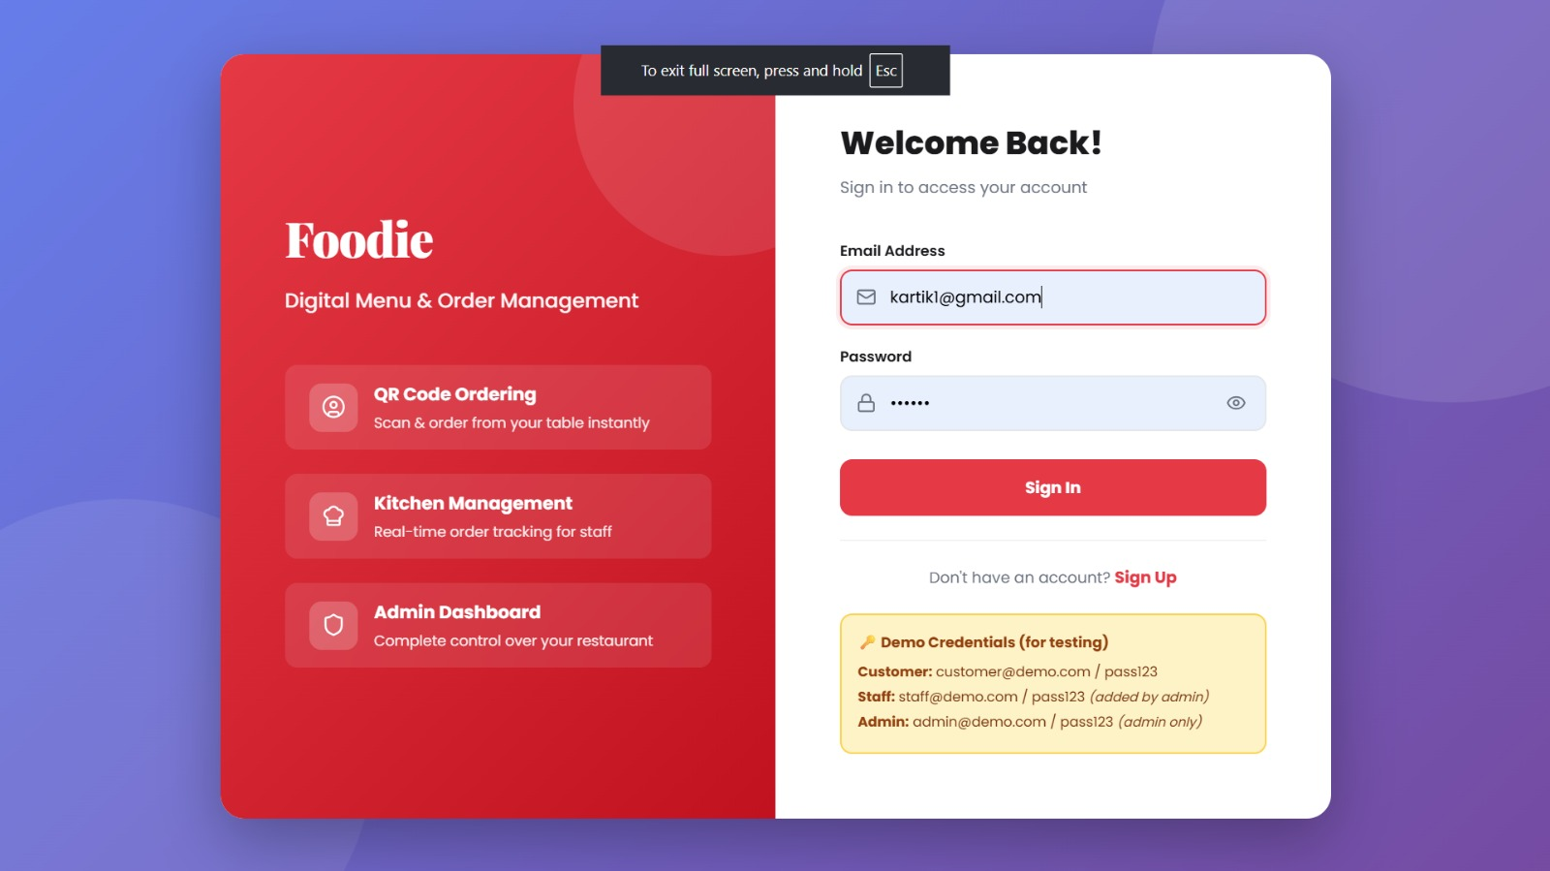
Login Page

Slide 15
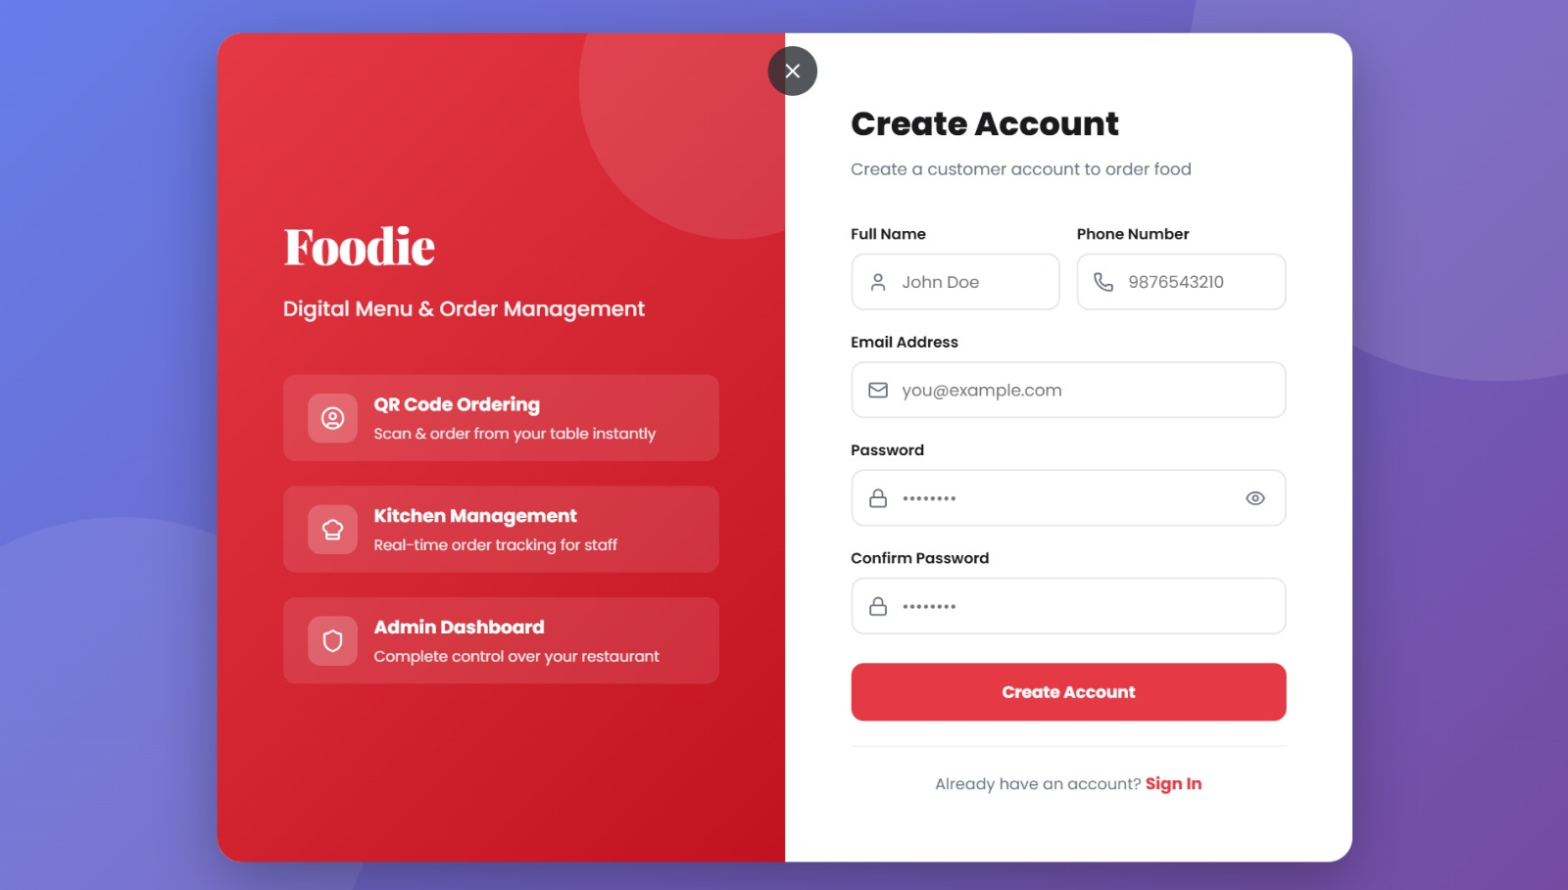
Customer Sign Up

Slide 16
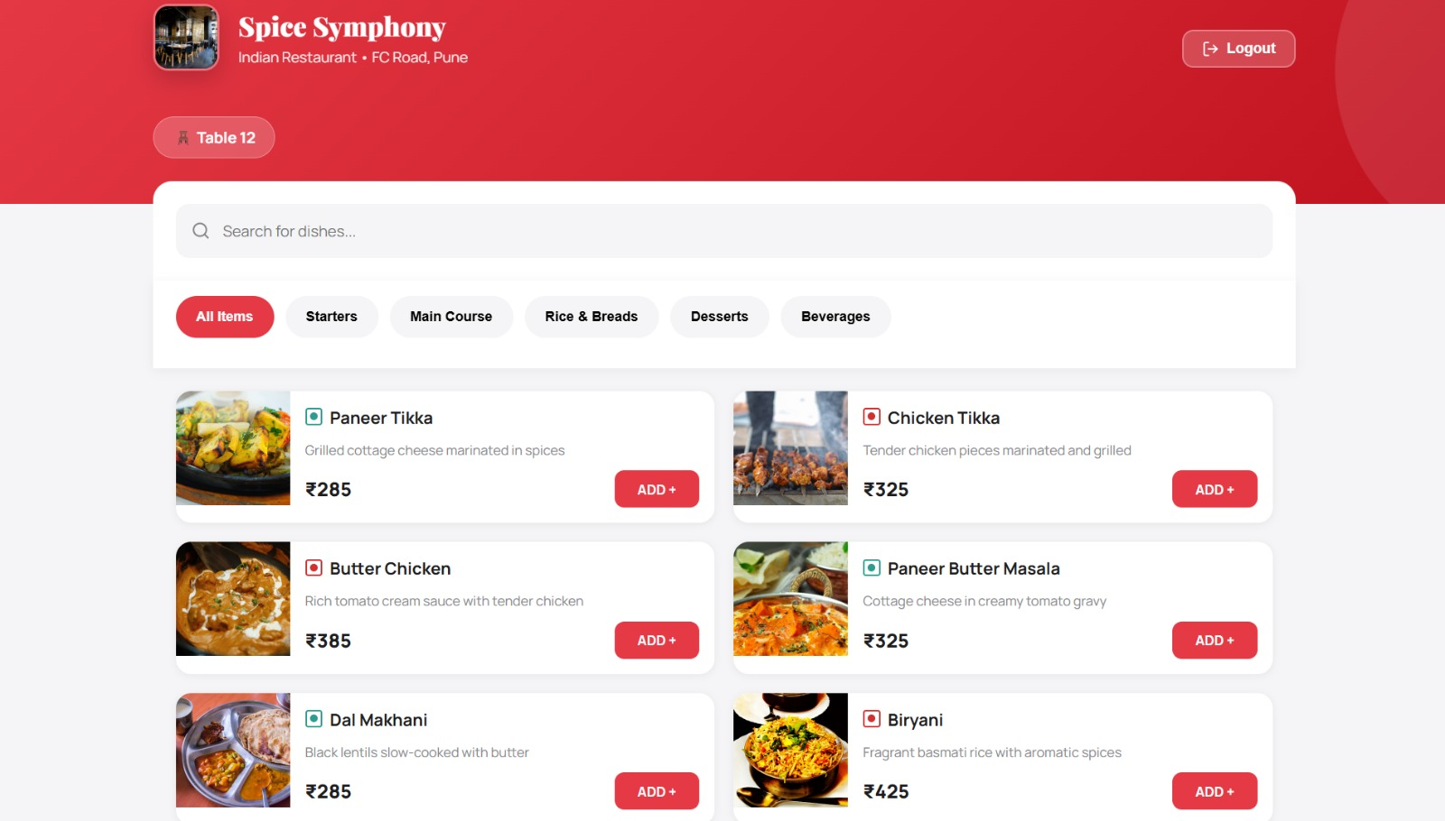
Customer Dashboard

Slide 17
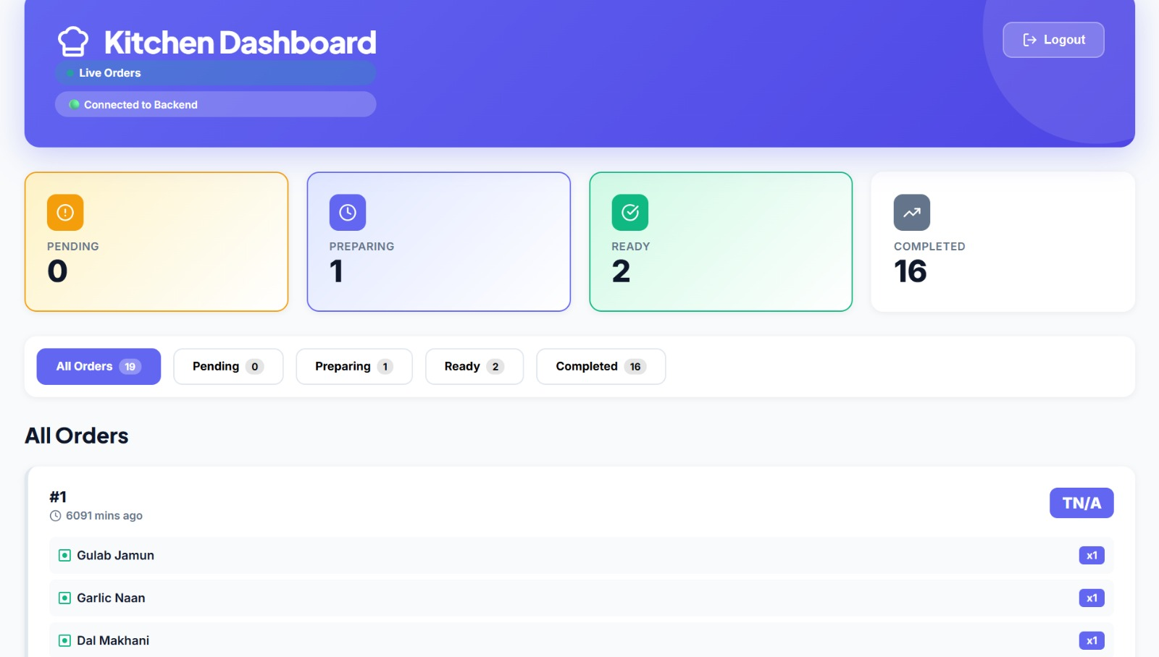
Staff Dashboard

Slide 18
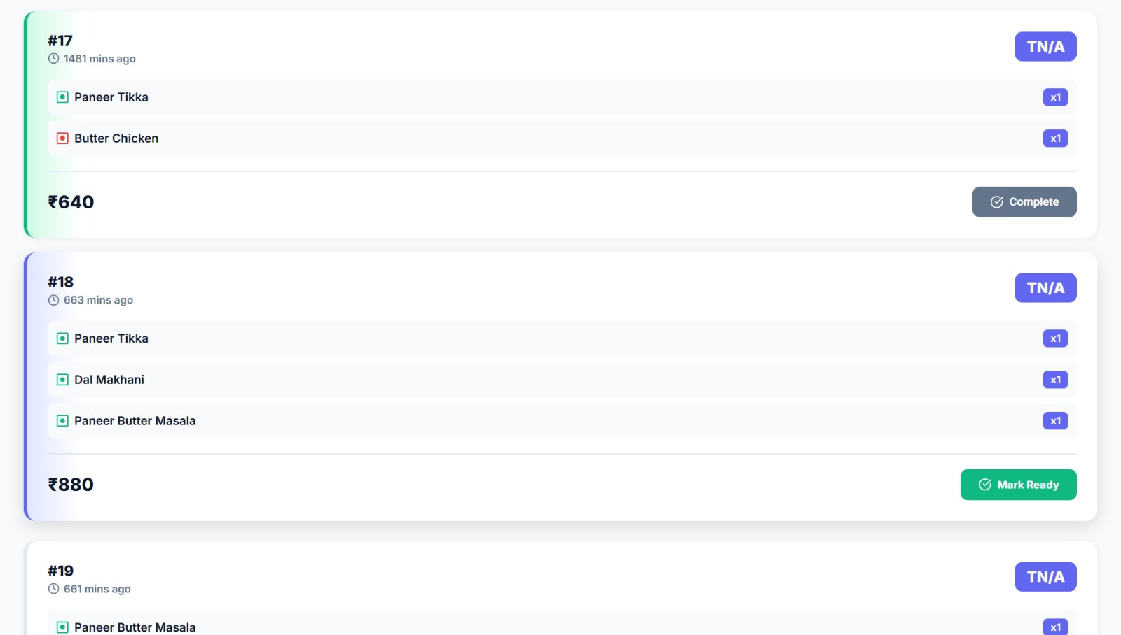
Staff Manages Order & its Status

Slide 19
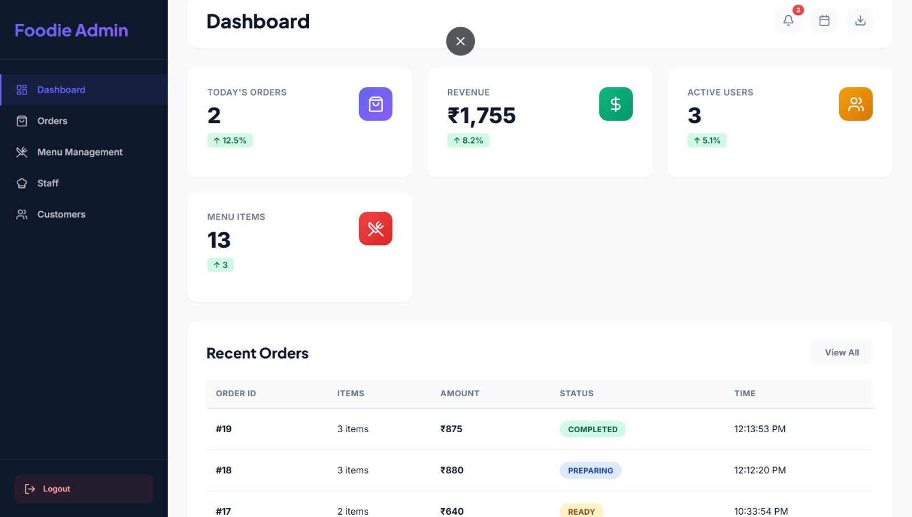
Admin Dashboard

Slide 20
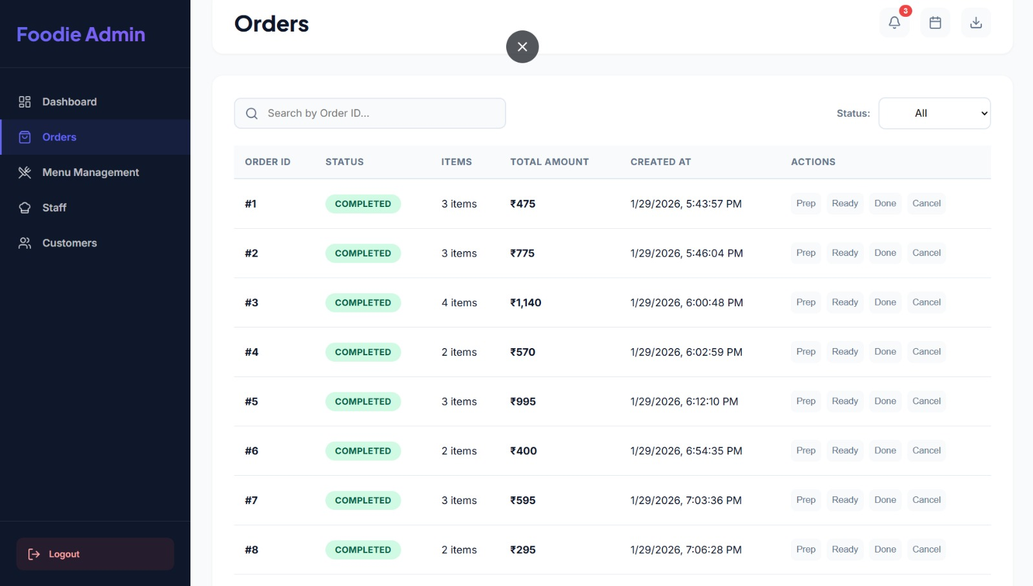
Orders view -Admin

Slide 21
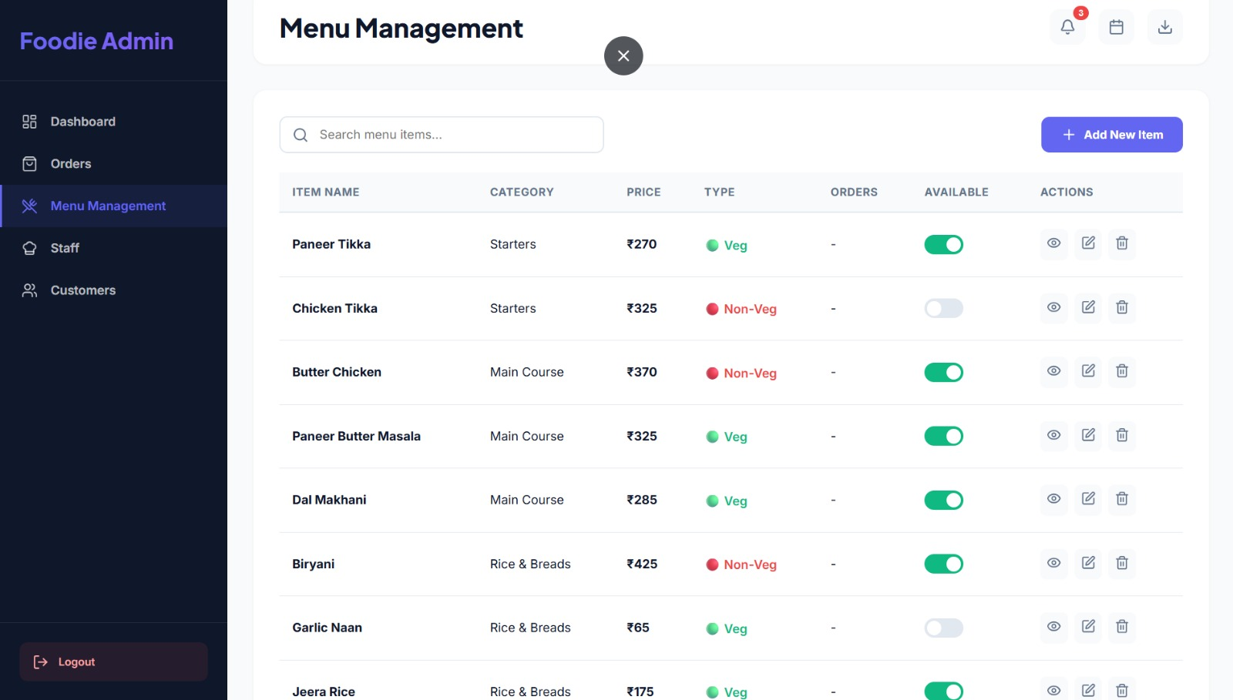
Menu management view -Admin

Slide 22
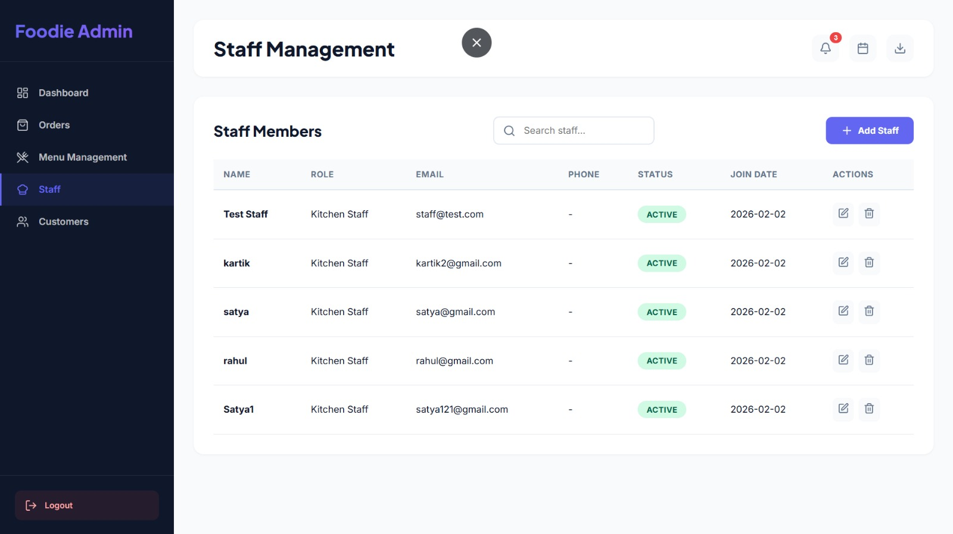
Staff Management -Admin

Slide 23
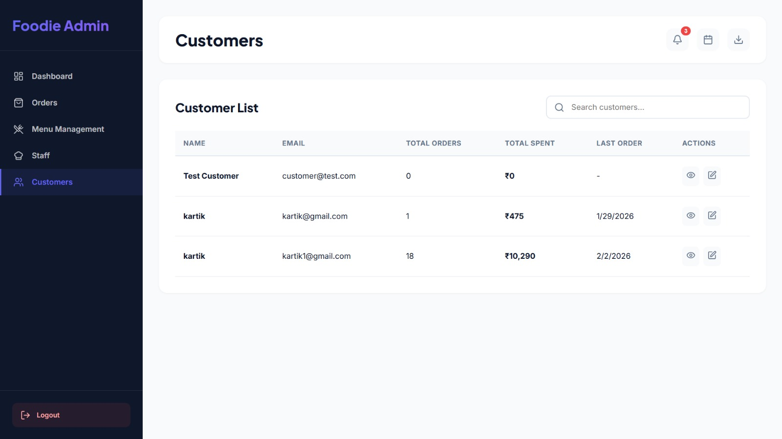
Customer view -Admin

Slide 24
Thank You

