Slide 1
Orthographic Languages Similarity Measurements
CSE-443 Natural Language Processing Project
Aayush Mishra (16095001)
Kartikey Singh (16095029)

Slide 2
Problem Assigned
To extract similar words between Orthographic languages along with their distance by using provided corpora with the help of Longest Common Substring (LCS) using Suffix Trees and n-gram.

Slide 3
What We Did
To solve the task mentioned, we primarily used three methods:
Suffix Tree and Longest Common Substring(LCS) matching.
n-gram similarity measurements.
DICE algorithm for similarity measurements.

Slide 4
What is Orthography?
An orthography is a set of conventions for writing a language. It includes norms of spelling, hyphenation, capitalization, word breaks, emphasis and punctuation.
It defines the set of symbols used in writing a language, and the rules regarding how to use those symbols.

Slide 5
Languages Used
In this project, we have used three pairs of orthographic languages
Hindi and Bhojpuri
Hindi and Magahi
Hindi and Maithili
All these languages are part of the Indo-Aryan language family and are mostly spoken in northern and northeastern parts of India.

Slide 6
Cognates
The task can also be seen as that of Cognate identification.
Cognates are words in different languages that have similar spelling and meaning.
Examples:
name - नाम (English and Hindi)
action - acciòn (English and Spanish)
visitor - visiteur (English and French)

Slide 7
Preprocessing
The corpus provided was unfiltered and had a lot of undesired content, so to obtain a structured corpus we did some preprocessing.
The steps of preprocessing included:
Removing unknown files and files of very big size.
Removing undesired headers from some of the files.
Deleting any special characters and numeric characters.
Using Unicode to make sure only characters from Devanagari script were left.
Generating a list of unique words of length greater than 2 from the filtered files.

Slide 8
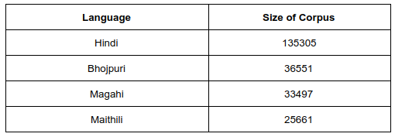
After all the preprocessing, the size of the corpus for each language was:

Slide 9
Suffix Trees
A Suffix Tree for a given text is a compressed trie for all suffixes of the given text.
Suffix trees are used to implement multitude of string operations faster.
Time taken to build a suffix tree from a text of size n is O(n) and the space used is also O(n).
After the tree is built any pattern searching can be done in O(m) where m is the length of the pattern.

Slide 10
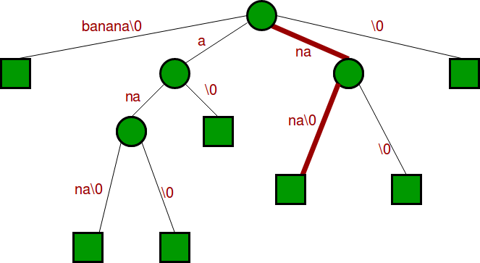
Suffix Tree for “banana”

Slide 11
n-gram Models
n-gram is a contiguous sequence of n items from a given sample of text or speech.
They are used to build natural language models.
The models are based on Markov assumption.
Markov models are the class of probabilistic models that assume that we can predict the probability of some future unit without looking too far in the past.

Slide 12
Suffix Trees and LCS matching
To start, we first created a suffix tree from our Hindi corpus.
tree = SuffixTree(True , hindi_list)
Then picking a word from the lists of orthographic languages. We then used, the function,
match_list = tree.findString(word)
which returns to us a list of matches for that word from the Hindi suffix tree.
After that we can analyze the list to determine whether it was an Empty match, a Partial match or an exact match.

Slide 13
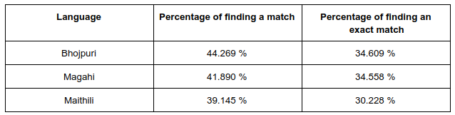
The table shows the percentage of finding a match and the percentage of finding an exact match for all the three languages.

Slide 14
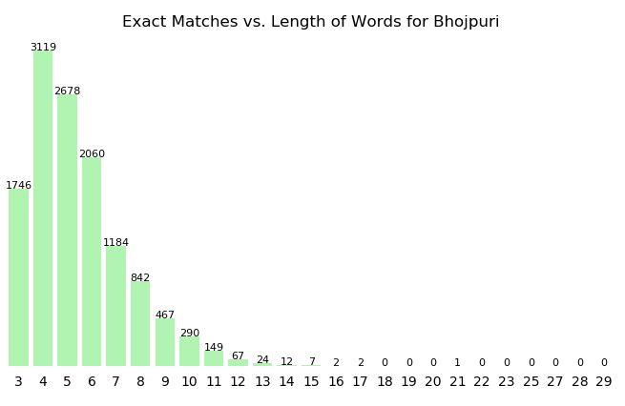
The following graphs represent a relation between number of exact matches found and the length of the word for different languages

Slide 15
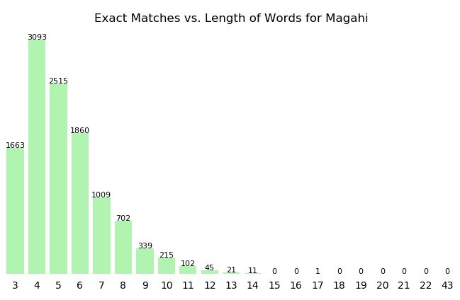

Slide 16
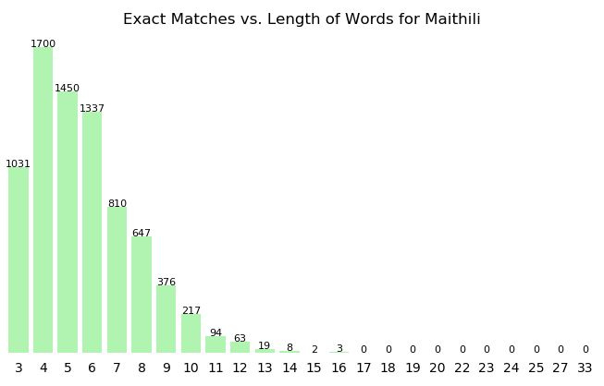

Slide 17
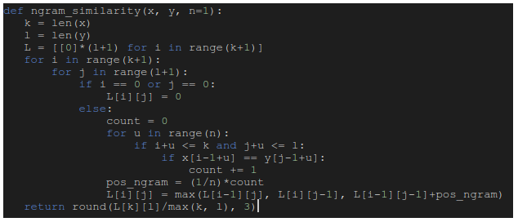
n-gram Similarity Measurement
The core idea behind n-gram similarity is to generalize the concept of the longest common subsequence to encompass n-grams, rather than just unigrams.

Slide 18
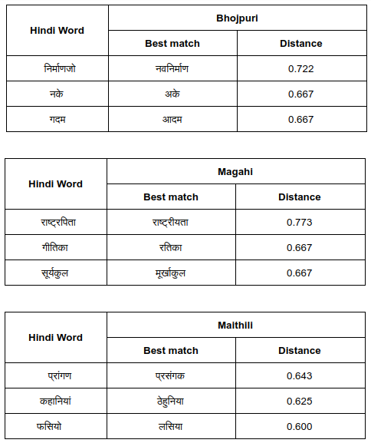
The following display the best approximate match for a Hindi word in different languages along with their distance.

Slide 19
DICE algorithm for similarity measurement
DICE algorithm works on the concept of character n-gram model. The basic formula that is used in this method is,
DICE(x, y) = 2*|ngram(x) ⋂ ngram(y)|/(|ngram(x)|+|ngram(y)|)
For computing n-gram we used the following function:

Slide 20
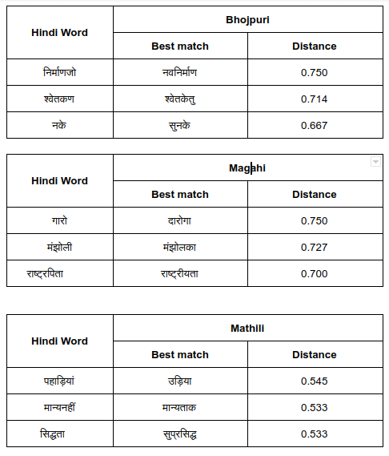
The following display the best approximate match for a Hindi word in different languages along with their distance.

Slide 21
Conclusion
We found similar trends for exact and partial matches for all the three languages Bhojpuri, Magahi and Maithili while using Suffix tree and LCS matching.
Most of the matches were found for word length 3-6, so we concluded that these languages are mostly made up of words of these word lengths.
But while using n-gram similarity and DICE algorithm, we found better matches for Bhojpuri and Magahi as compared to Maithili.

Slide 22
THANK YOU

