Slide 1
GROUP 15 · FINAL YEAR PROJECT (CSE) · AKGEC, GHAZIABAD (AKTU)
AI-Driven Multimodal Sentiment Analysis for
Mental Health Monitoring on Social Media
A Resource-Constrained Comparative Study
Kartikey Tiwari · Akshat Sharma · Karan Sharma · Lalit Sharma
Supervisor: Dr. Avdhesh Gupta | Dept. of CSE | Session 2023–2027

Slide 2
MOTIVATION
The Problem
1
Half the signal, missed
A social media post pairs text with an image. Text-only or image-only sentiment analysis each discard the other modality's signal.
2
A testable question
Does combining both actually improve sentiment classification? This project tests it with real, same-dataset experiments rather than assuming the answer.
Text
Image
3
Why it matters here
Two signals,
one post
Framed explicitly as mental-health-related sentiment monitoring support — never diagnosis (Section VIII).
AI-Driven Multimodal Sentiment Analysis for Mental Health Monitoring
2

Slide 3
WHY THIS RESEARCH AREA
Motivation
1
Digital-first awareness
Mental-health awareness and expression is increasingly happening on social media first.
2
A large, real data source
Social platforms generate a vast, real (not simulated) record of expressed sentiment.
3
Support, not replacement
AI can support mental-health-related monitoring and research — never replace a qualified professional. This non-clinical framing is maintained everywhere: code, UI, paper, and this deck.
AI-Driven Multimodal Sentiment Analysis for Mental Health Monitoring
3

Slide 4
RELATED WORK
Existing Approaches
Text-based
Image-based
Multimodal
• NLP / transformers (e.g. MentalBERT)
• Strong language understanding
• Limitation: ignores visual content
• CNN-based emotion recognition
• Strong visual feature extraction
• Limitation: ignores textual meaning
• Active, well-populated research area
• Mature fusion-strategy taxonomy exists
• Gap: lacks controlled same-metrics comparison on real social data
AI-Driven Multimodal Sentiment Analysis for Mental Health Monitoring
4

Slide 5
WHAT'S MISSING
Research Gap
100
4,511
CPU-only
pairs — closest prior
social-media comparison
real pairs — this
project's comparison
most literature is GPU-scale;
we report what this costs
• No located prior work does a controlled, same-dataset, same-metrics text-vs-image-vs-multimodal comparison on adequately-sized real social-media data.
• This project addresses that gap directly, and documents the real resource constraints of doing so on consumer CPU-only hardware.
AI-Driven Multimodal Sentiment Analysis for Mental Health Monitoring
5

Slide 6
RESEARCH DESIGN
Objectives
1
Build and compare Text-only, Image-only, and Multimodal models on the same data and metrics
2
Determine whether — and under what conditions — fusion helps
3
Analyze modality conflict and errors honestly, including where fusion underperforms
4
Document resource-constrained reproduction on CPU-only hardware
AI-Driven Multimodal Sentiment Analysis for Mental Health Monitoring
6

Slide 7
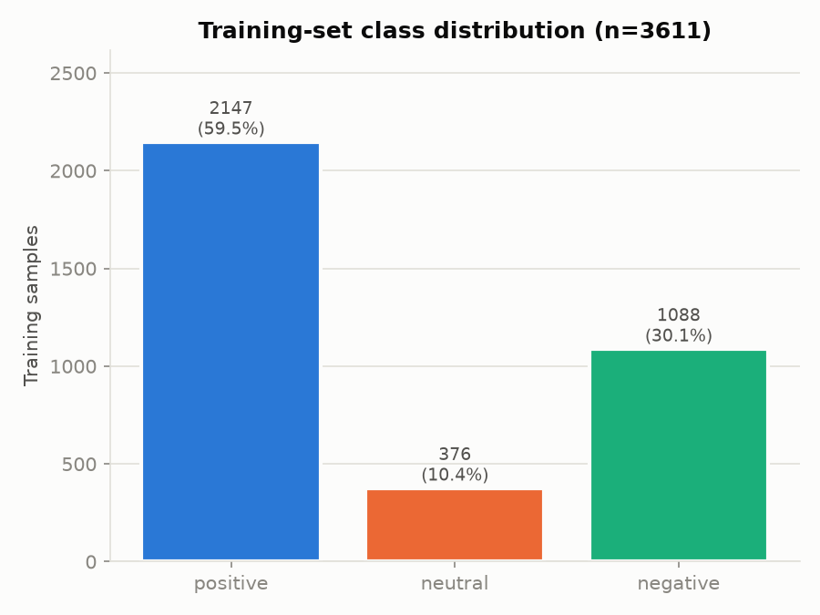
RESEARCH PROGRESS
Dataset — MVSA-Single
• 4,511 real Twitter image+text pairs (after standard cleaning), 3-class sentiment
• Published train/dev/test split (3,611 / 450 / 450) from CLMLF (NAACL 2022) for comparability
• Real acquisition challenge: the official distribution link was dead (404) — we found and content-verified a HuggingFace mirror instead
• Class imbalance motivates macro-F1 as the primary metric
AI-Driven Multimodal Sentiment Analysis for Mental Health Monitoring
7

Slide 8
RESEARCH DESIGN
Proposed Architecture
Text Pipeline
(cleaning -> embedding)
Image Pipeline
(resize -> embedding)
Fusion
(feature concatenation)
Classification Head
(MLP, 3-class softmax)
Output: Sentiment
(positive / neutral / negative)
Full rationale: PROJECT_ARCHITECTURE.md
AI-Driven Multimodal Sentiment Analysis for Mental Health Monitoring
8

Slide 9
RESEARCH DESIGN
Text Pipeline
Raw tweet
text
Clean
(URL / mention / emoji)
Embed
(TF-IDF or DistilBERT)
Classify
(Logistic Regression)
A1 — TF-IDF baseline
A2 — Frozen DistilBERT
• Unigrams + bigrams, 10k features
• Class-weighted Logistic Regression
• Test: 60.9% accuracy / 52.0% macro-F1
• distilbert-base-uncased, mean-pooled
• Chosen for CPU-only feasibility
• Test: 61.6% accuracy / 54.6% macro-F1
AI-Driven Multimodal Sentiment Analysis for Mental Health Monitoring
9

Slide 10
RESEARCH DESIGN
Image Pipeline
Raw
image
Resize /
normalize
Embed
(CNN or ResNet18)
Classify
(Logistic Regression)
B1 — CNN from scratch
B2 — Frozen ResNet18
• Small 4-layer CNN, trained from scratch
• Reduced to 96x96 / 3 epochs (CPU budget)
• Test: 47.6% accuracy / 42.9% macro-F1
• ImageNet-pretrained, frozen feature extractor
• Transfer learning over from-scratch training
• Test: 52.7% accuracy / 42.8% macro-F1
AI-Driven Multimodal Sentiment Analysis for Mental Health Monitoring
10

Slide 11
RESEARCH DESIGN
Multimodal Fusion
Text embedding
(768-dim)
Concatenate
(1280-dim)
MLP classifier
(dropout, softmax)
Image embedding
(512-dim)
Primary vs. ablation
• Primary: feature-level (early) concatenation fusion — cheap to train on CPU, standard first fusion strategy in the literature
• Ablation: late (decision-level) fusion — independent text/image classifiers' probabilities combined by averaging and by a validation-tuned weight (w_text = 0.80)
AI-Driven Multimodal Sentiment Analysis for Mental Health Monitoring
11

Slide 12
RESEARCH PROGRESS
Experimental Setup
Seed = 42
CPU-only
Macro-F1
3,611 / 450 / 450
fixed throughout
no GPU, 8GB RAM
prioritized metric
train / val / test
• Evaluation: accuracy, precision/recall/F1 (macro + weighted), confusion matrix
• All numbers read directly from results/*.json, generated by actually-executed scripts under src/
AI-Driven Multimodal Sentiment Analysis for Mental Health Monitoring
12

Slide 13
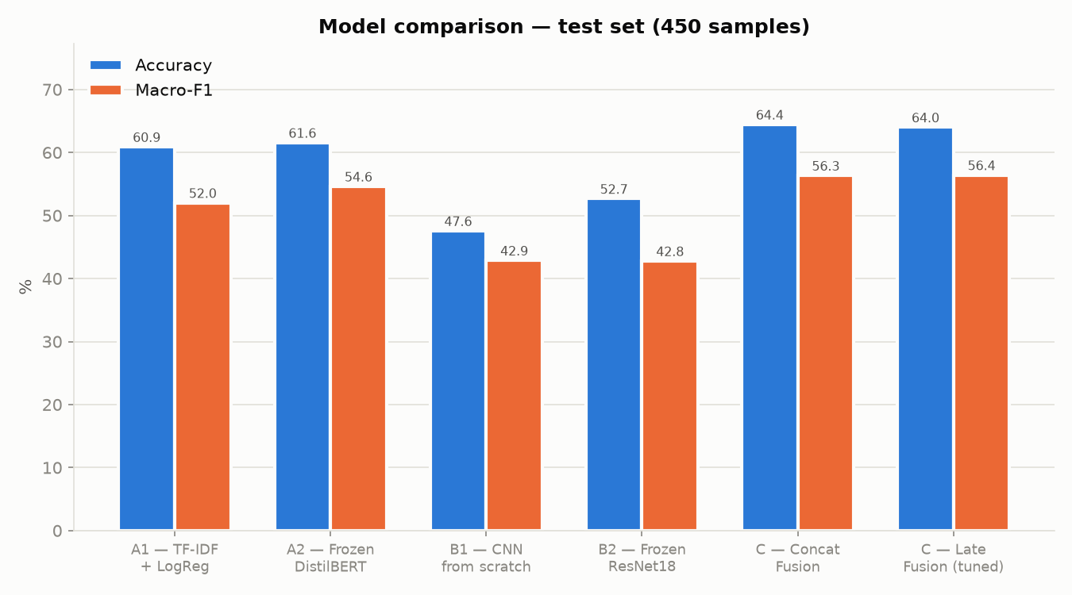
RESULTS & VALIDATION
Results
Multimodal fusion beats every unimodal model on every metric: 64.4% accuracy / 56.3% macro-F1.
AI-Driven Multimodal Sentiment Analysis for Mental Health Monitoring
13

Slide 14
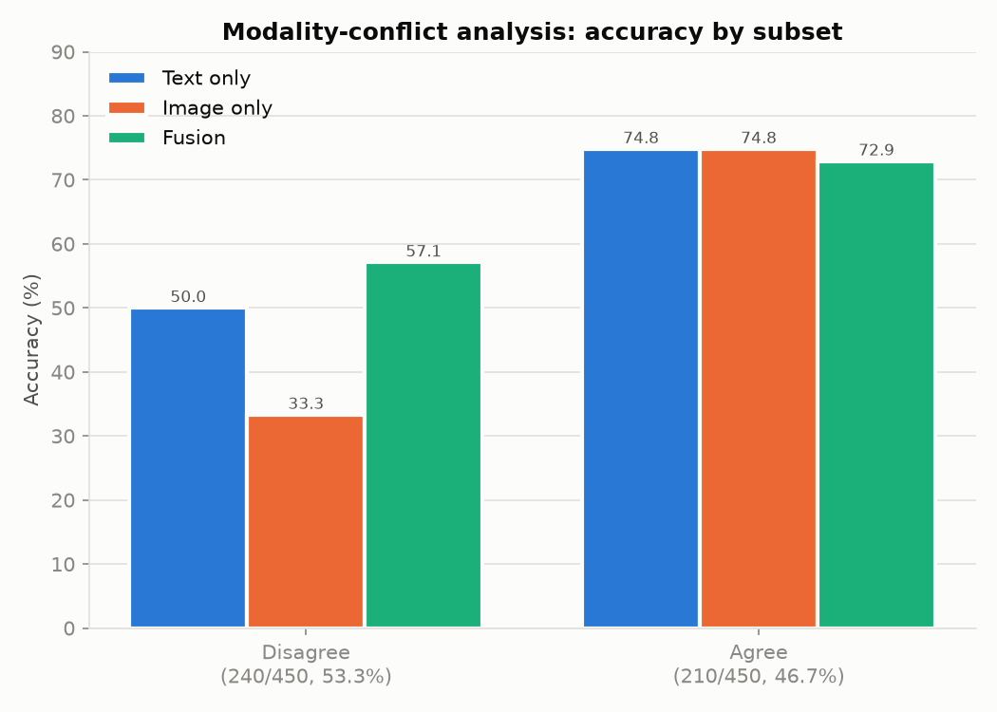
RESULTS & VALIDATION
Modality Conflict Analysis
• Text and image models disagree on 53.3% of test posts
• On disagreement cases, fusion clearly wins: 57.1% vs. 50.0% (text) vs. 33.3% (image)
• On agreement cases, a small regression: fusion 72.9% vs. text 74.8%
• An honest finding — not a blanket “multimodal always wins”
AI-Driven Multimodal Sentiment Analysis for Mental Health Monitoring
14

Slide 15
IMPLEMENTATION
Explainability
1
Text
Gradient x input token saliency — no extra library required
2
Image
Grad-CAM via forward/backward hooks on ResNet18's last conv block
3
Multimodal
Modality-ablation: zero one branch, observe the prediction shift
Exploratory — not a rigorously validated attribution method (documented limitation).
AI-Driven Multimodal Sentiment Analysis for Mental Health Monitoring
15

Slide 16
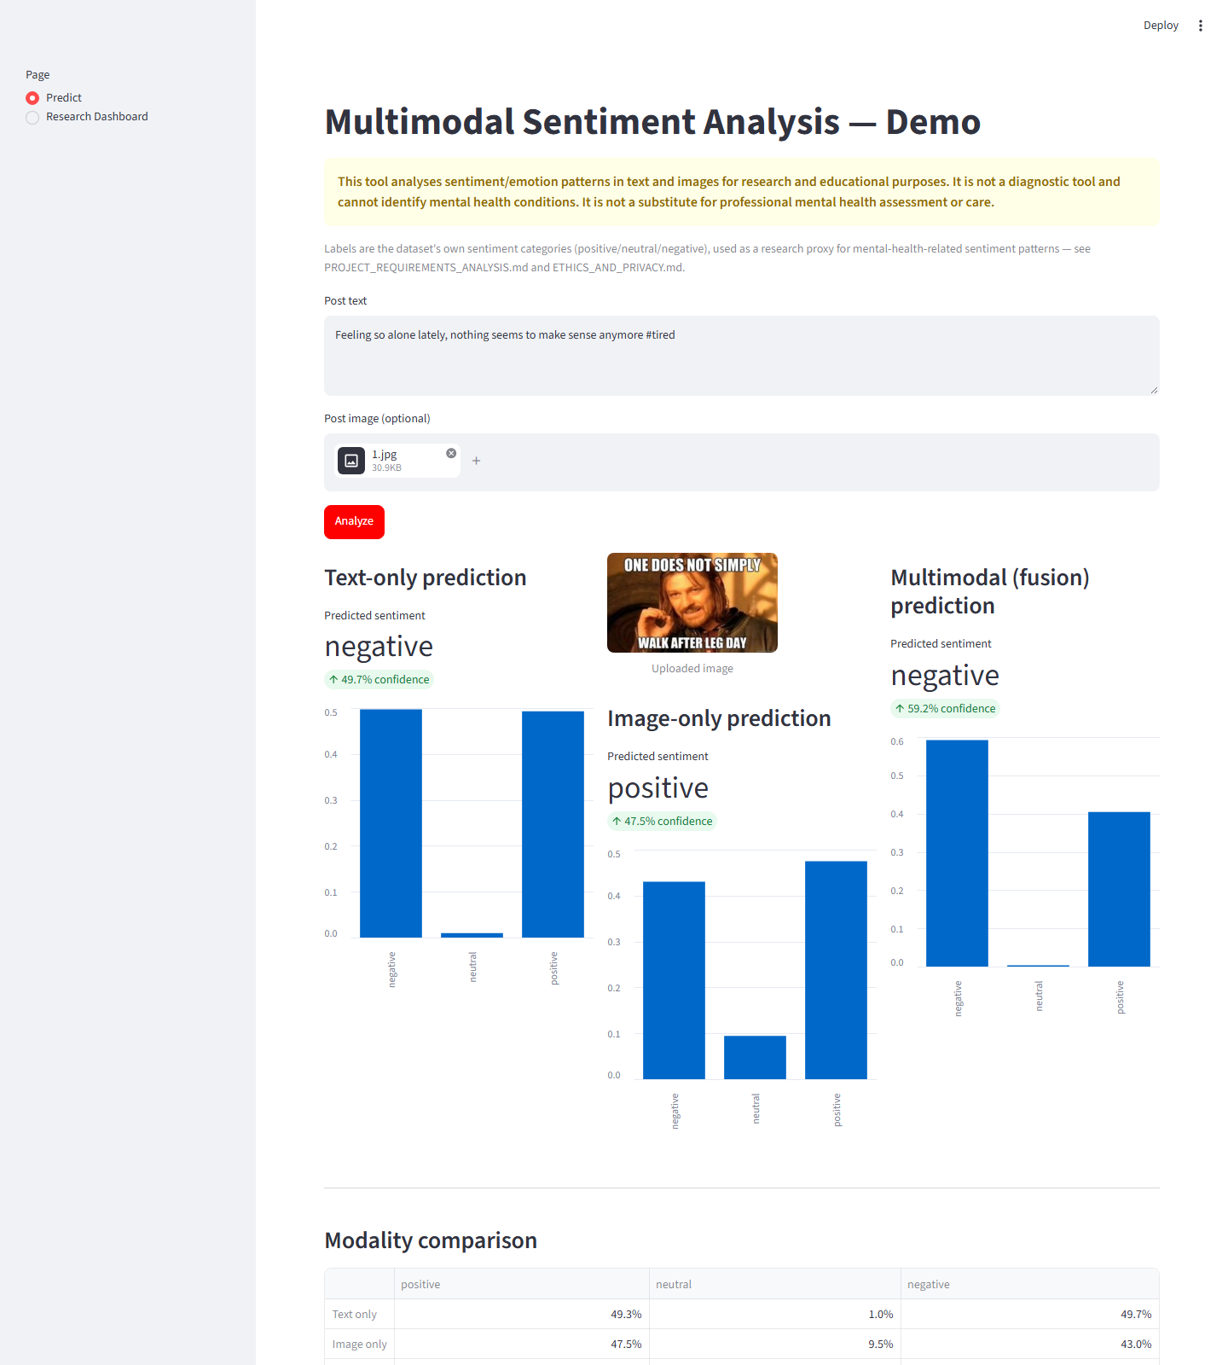
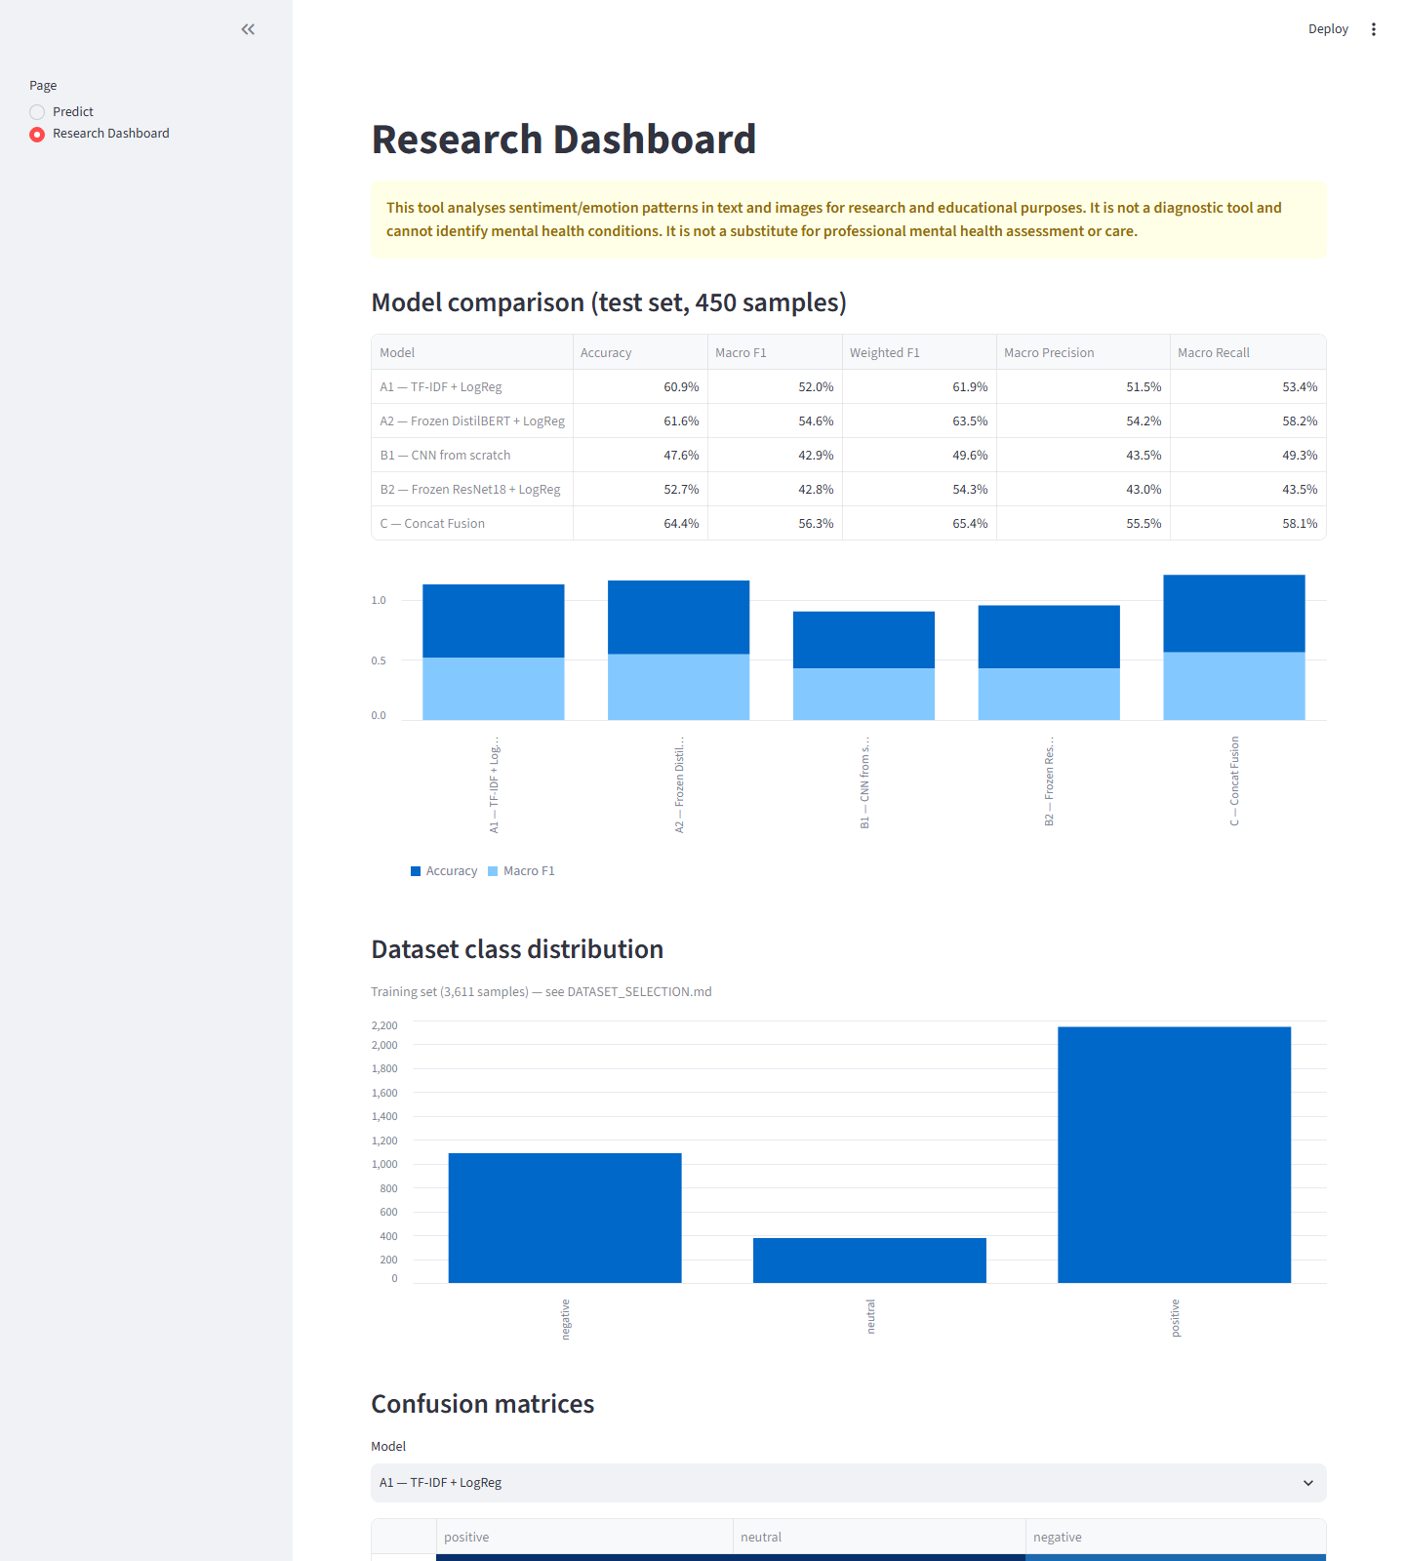
IMPLEMENTATION — LIVE DEMO
Application & Dashboard
Predict page — real text + image analyzed live
Research dashboard — model comparison & confusion matrices
AI-Driven Multimodal Sentiment Analysis for Mental Health Monitoring
16

Slide 17
DISCUSSION
Contribution & Limitations
Contribution
Limitations
• Real, same-conditions unimodal-vs-multimodal comparison on adequately-sized social-media data
• Honest modality-conflict analysis, not a blanket “multimodal wins” claim
• Documented resource-constrained reproduction (CPU-only, 8GB RAM)
• Sentiment labels, not mental-health-specific labels (documented proxy)
• English-language, 2015–16-era Twitter data only
• Small (~1–2%) cross-split duplication in the published split used
• From-scratch CNN baseline was compute-constrained
AI-Driven Multimodal Sentiment Analysis for Mental Health Monitoring
17

Slide 18
CONCLUSION
Multimodal fusion provides a real, measurable, but conditional
improvement — concentrated where modalities disagree.
• Future work: multilingual extension
• Future work: cross-modal attention fusion at scale
• Future work: validation against a genuinely mental-health-labeled multimodal dataset, if one becomes openly available
AI-Driven Multimodal Sentiment Analysis for Mental Health Monitoring | Group 15 | 18

