Slide 1
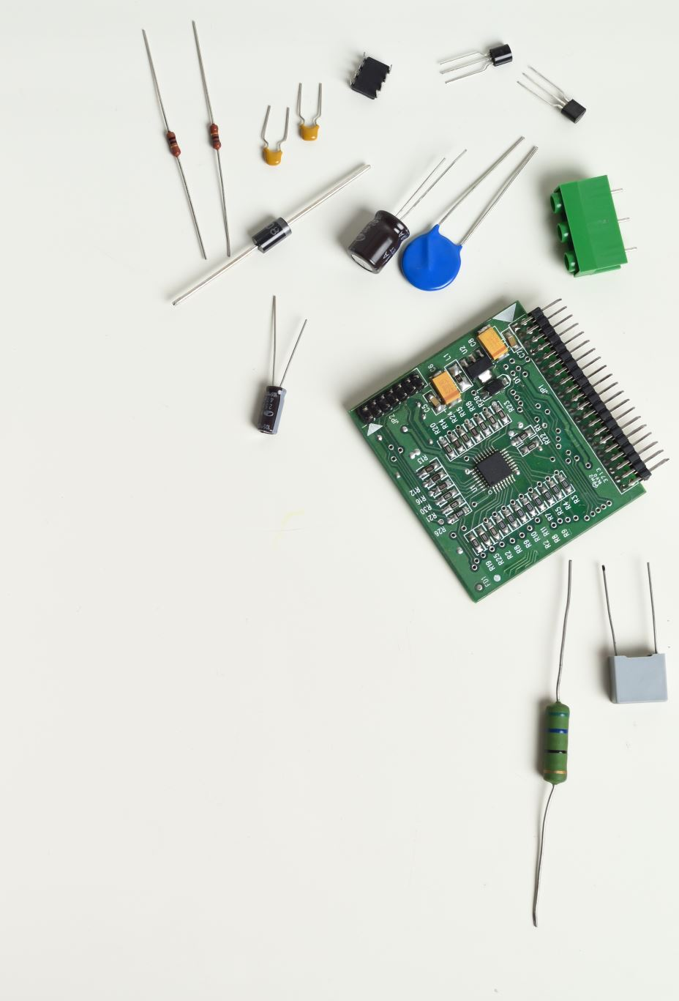
Farmer’s Techie - IOTC & ML
Sri Vasavi Peravarapu
Sumanth Kumar Sivadi
Kaushik Ram Koteshwar Venna
Varsha Pravallika Valavala
Hema Likhitha Adapa

Slide 2
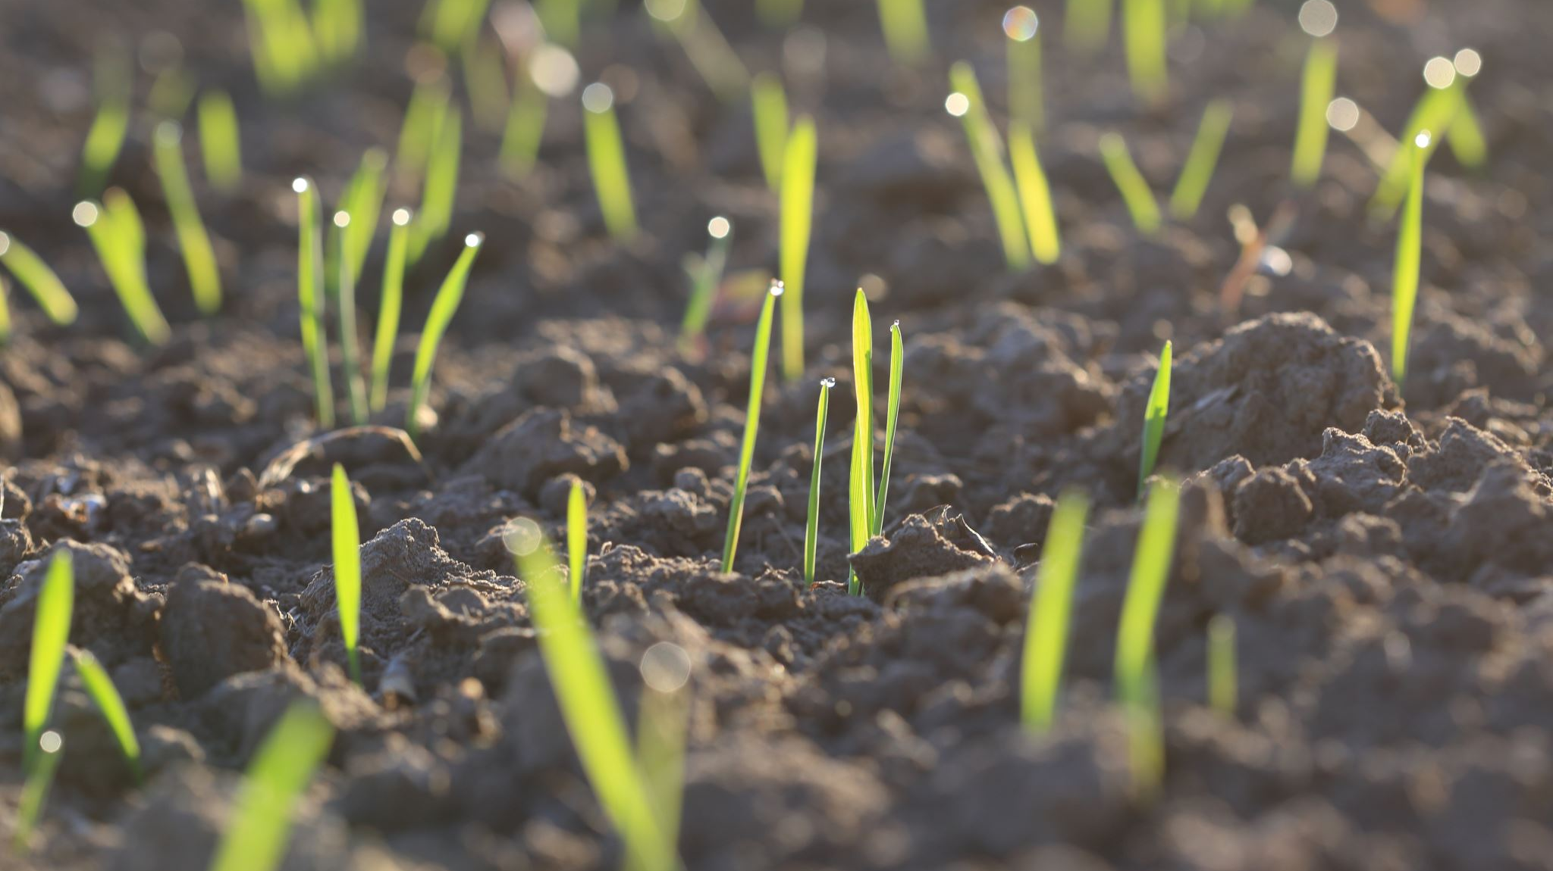
Introduction
Farmer's often need to perform irrigation manually, but checking soil moisture levels, temperature, and humidity is time-consuming and susceptible to human errors.
Some techniques start irrigation when soil moisture drops, but sudden increases can damage crops due to external factors.
Farmers should often work in the fields personally to carry out irrigation, but there are several circumstances in which they are unable to do so. such as measuring the temperature, humidity, and moisture content of the soil.
There is a high risk of human mistake in this labor-intensive operation. It is not always practicable to check these levels and maintain the level at regular intervals.

Slide 3
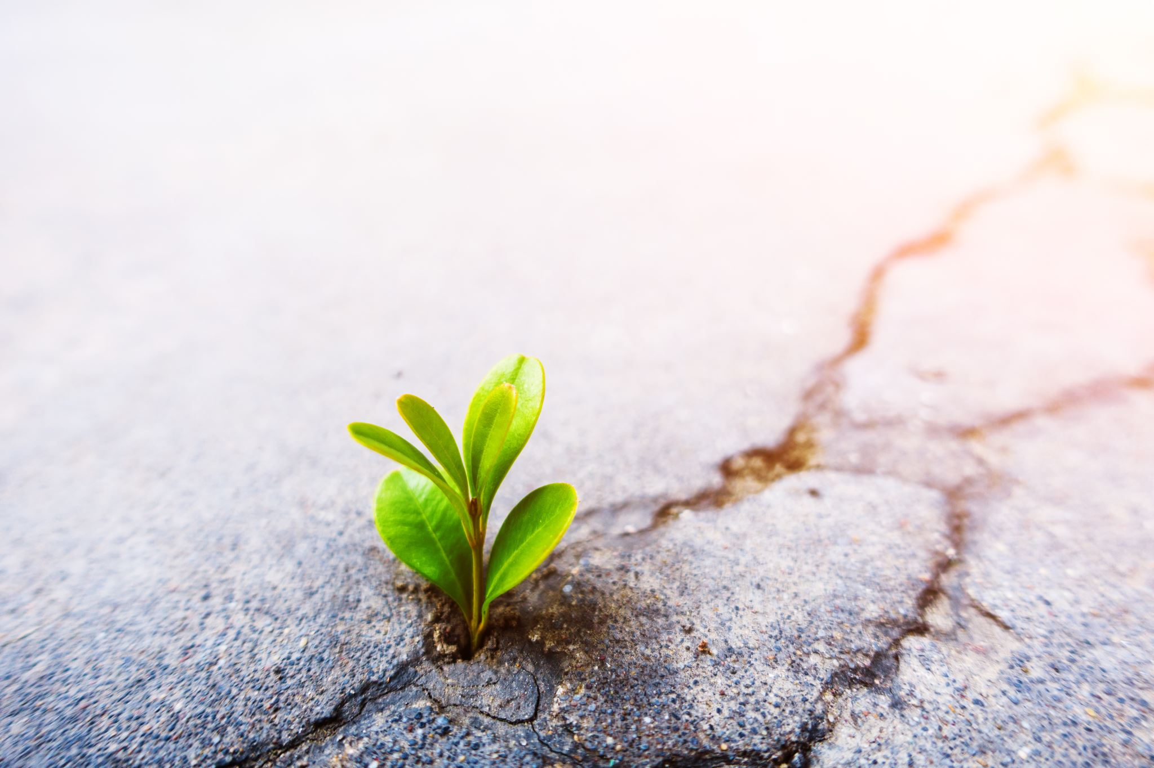
Motivation
Water is essential for any crop, and providing the right amount is key to achieving a good yield.
Ensuring crops receive the correct amount of water is crucial but can be challenging for humans to manage consistently.
Smart irrigation systems offer a one-time investment that can lower costs in the long run.
Over-irrigation can cause issues like erosion, nutrient leaching, and decreased soil fertility.
By utilizing technology, farmers gain access to detailed data about their fields, enabling better water management.
3

Slide 4
Problem Definition
In many cases, Farmer’s themselves should get into the field to perform irrigation but there are some situations where they themselves can’t do the things manually.
Such as checking soil moisture level, temperature, humidity.
This process is time consuming and there can be many human errors.
Checking these levels and maintaining the level at regular interval of times cannot be possible all the time.
There are some techniques where irrigation starts as soon as the soil moisture drops but, in that case when there is sudden increment in moisture level through external factor then crop maybe damaged.
Sri Vasavi

Slide 5
Proposed Solution
Our Proposed solution to develop the automated irrigation system. Farmer without actually getting into the farm and can access the information through mobile device.
We would like to implement this using Machine Learning and Internet of Things(IOT).
We calculate the moisture in the soil in timely basis
If the moisture level is less than the cutoff for certain time we take the automatic necessary irrigation action. We do this through the Formal Verification methods.
Every time there is a requirement of irrigation it is notified to farmer by storing the data in the cloud.
Sri Vasavi

Slide 6
Key Components
Smart Irrigation: Measure soil moisture, temperature, humidity, and other parameters in the field and start the irrigation.
Plant disease Prediction: Predict the disease of the plant based on the image.
Cloud Platform: Stores and processes data from sensors using machine learning models.
Formal Verification: Maintain the record of soil moisture level and cutoff, time interval to check the readings.
Sumanth Kumar

Slide 7
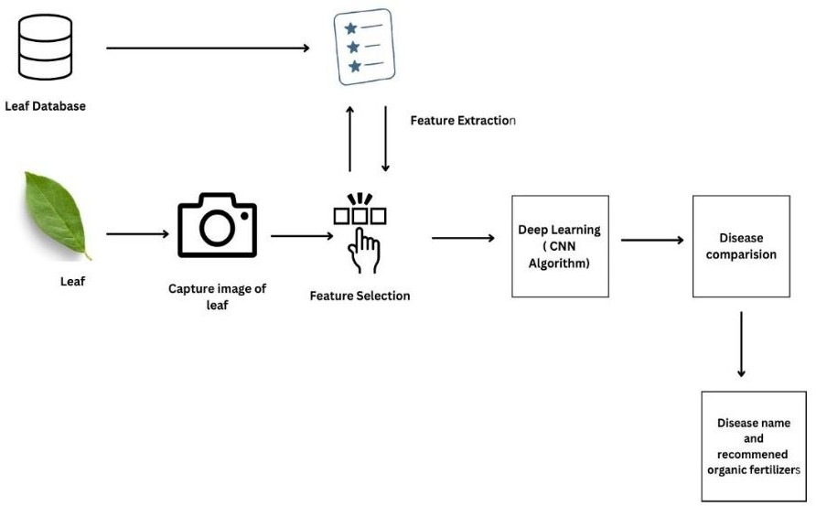
Process
Sumanth Kumar

Slide 8
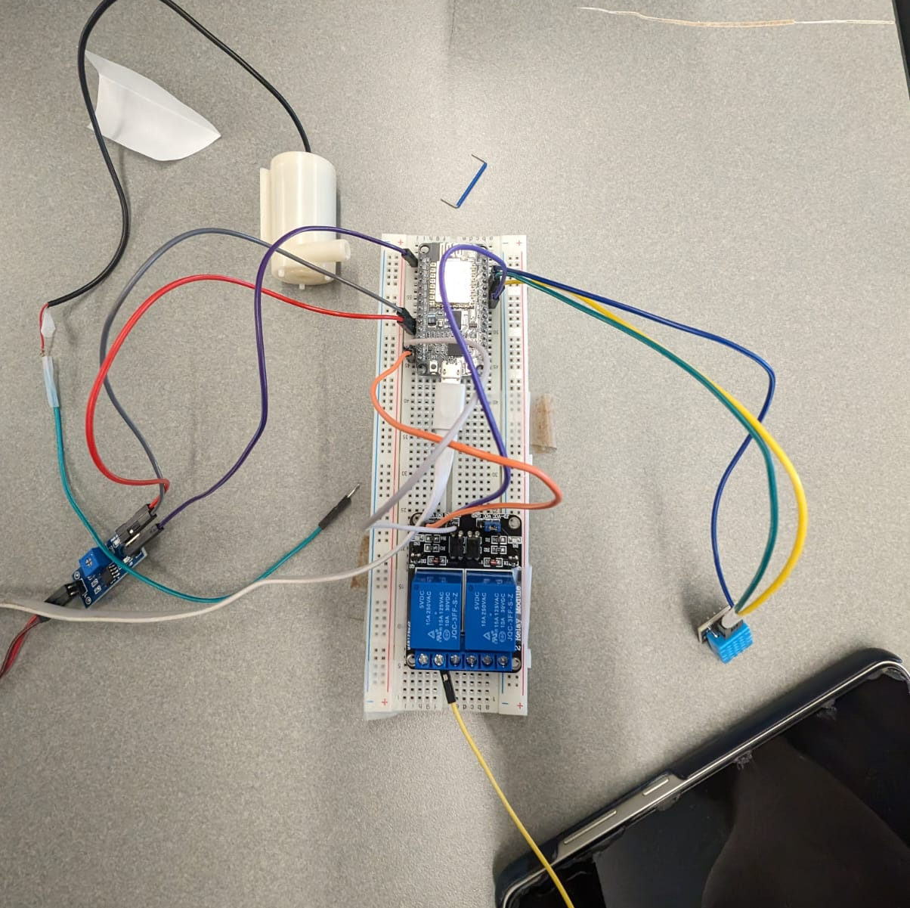
Demonstration

Slide 9
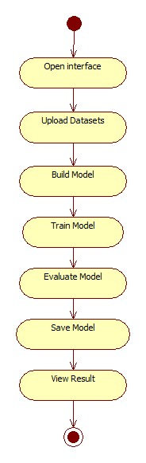
ACTIVITY DIAGRAM
Operational workflow of system.
Kaushik Ram
9

Slide 10
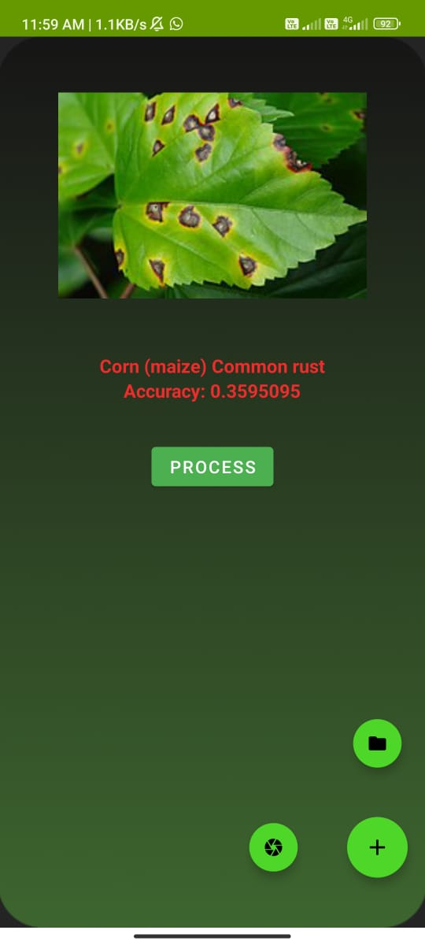
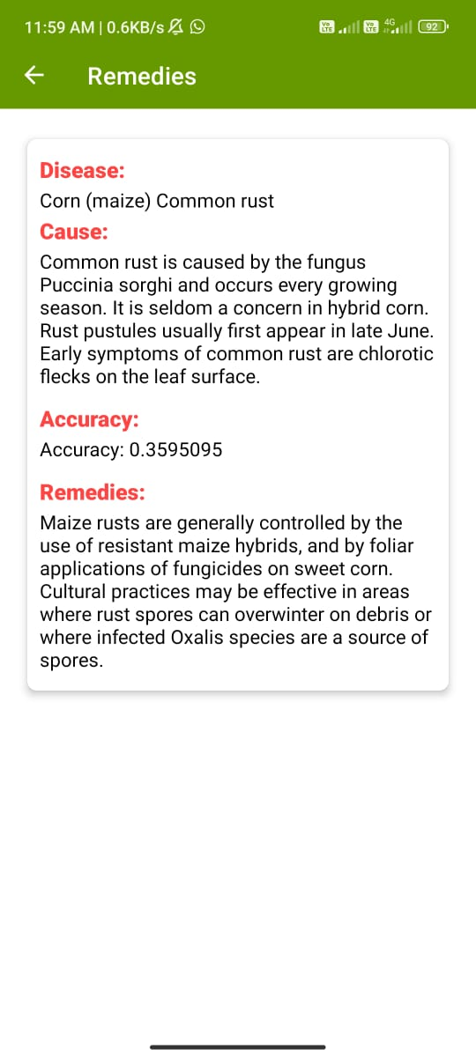
Expected Output
Hema Likhitha

Slide 11
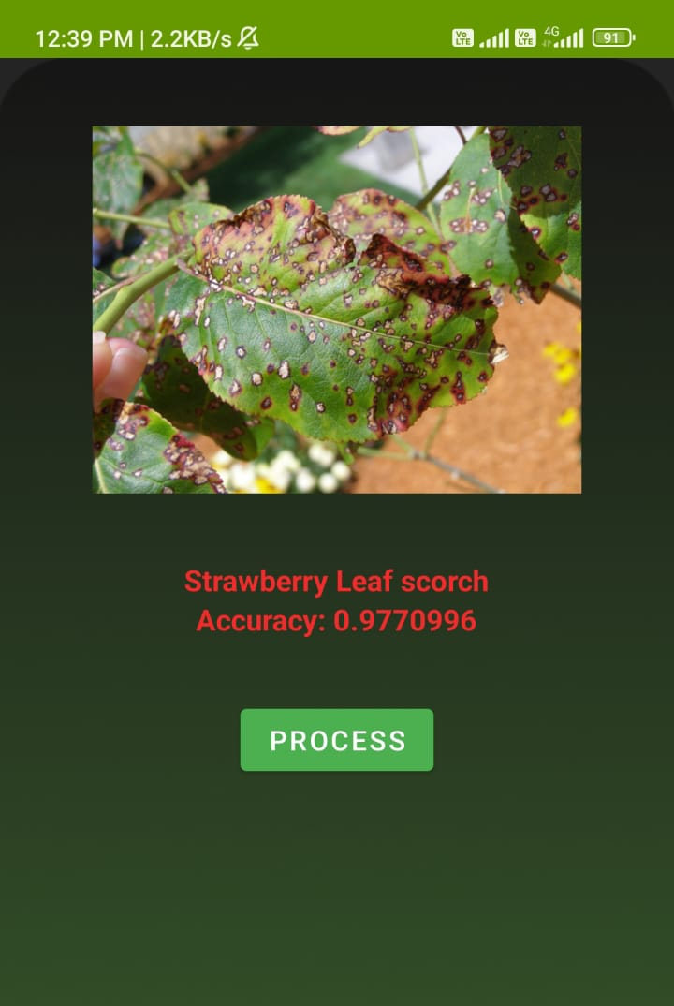
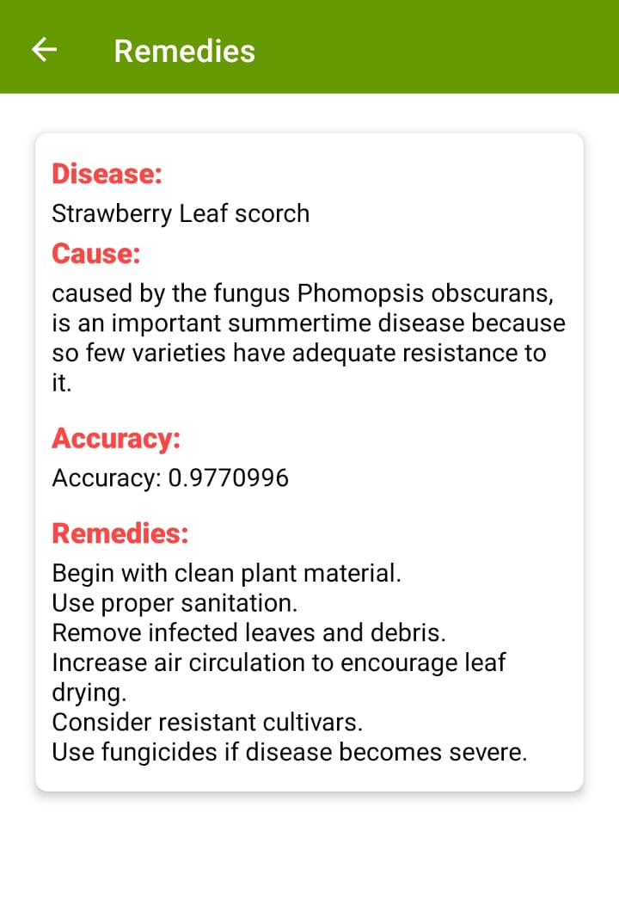
Expected Output
Hema Likhitha
11

Slide 12
Future Plan
In this semester and the following semester, we would like to implement, monitoring soil moisture level along with the temperature and humidity level.
In the following semester, we are going to implement Formal verification using ML methods.
We would also like to implement the Plant disease prediction using integrated camera.

Slide 13
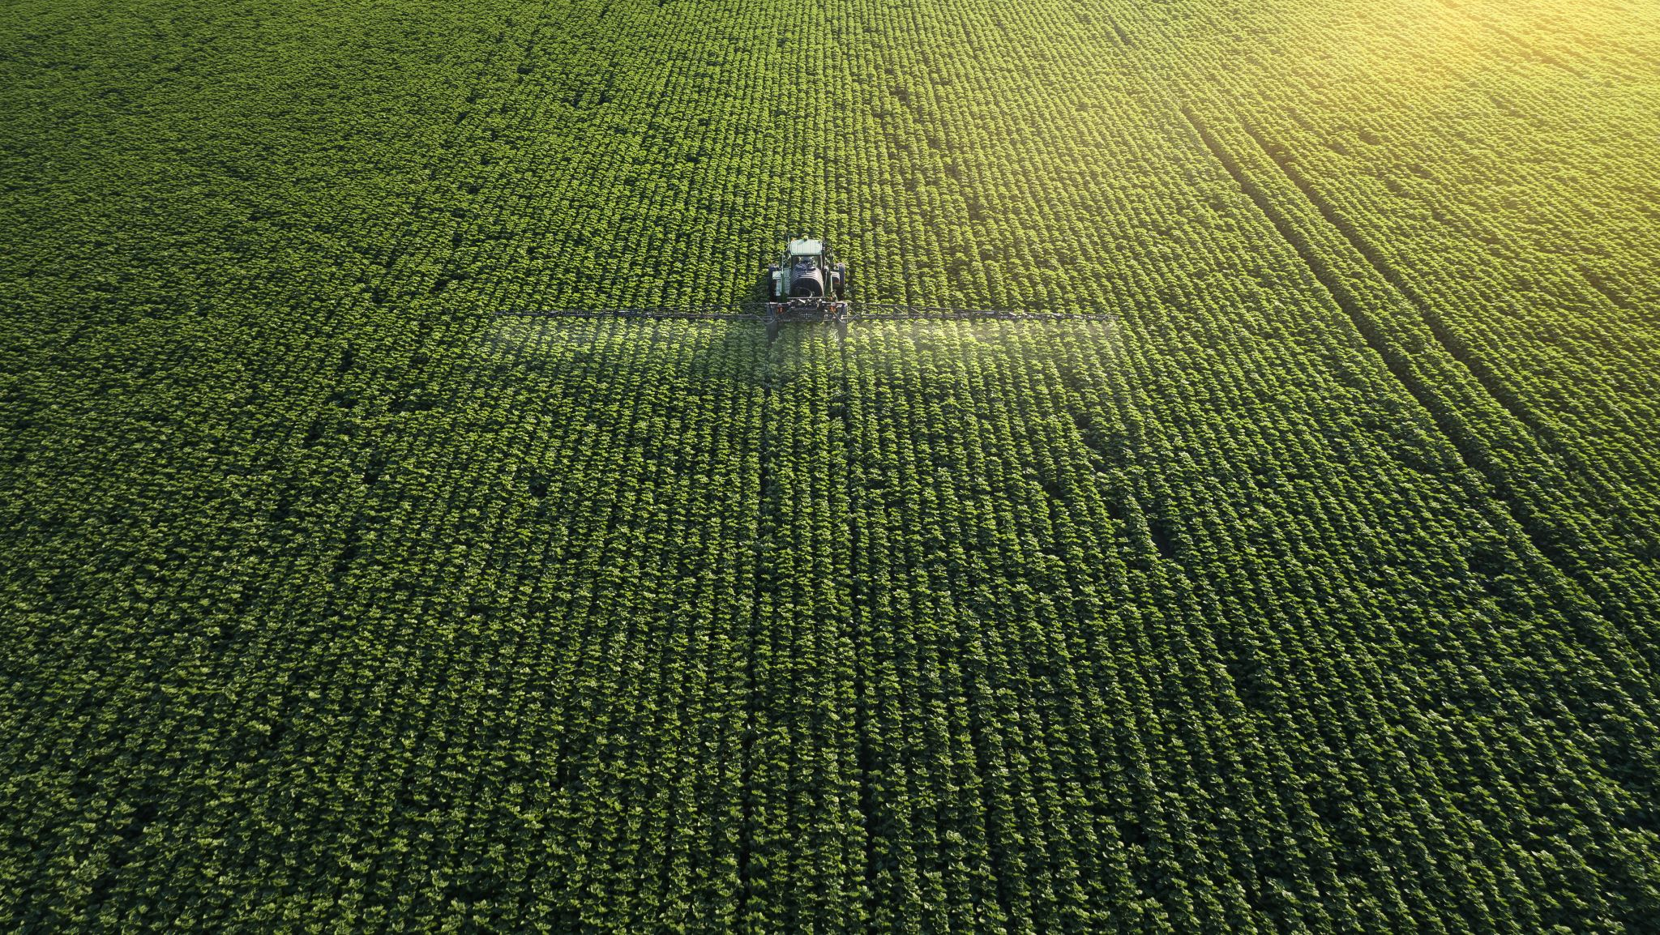
Conclusion
The Farmer’s Techie project brings IoT and ML into agriculture, leveraging modern technology to support farmers by enhancing two key areas: optimizing watering systems and early detection of crop diseases.
It employs IoT sensors, cloud-based ML algorithms, and automated irrigation to improve water efficiency and reduce crop diseases.
Techniques such as TensorFlow and CNNs are utilized for disease prediction, with future plans including formal verification to ensure error-free system efficiency.
This initiative demonstrates how technology can enhance farming practices and address agricultural challenges.
Varsha

Slide 14


Slide 15


