Slide 1

Vel Tech Rangarajan Dr. Sagunthala R&D Institute of Science and Technology
School of Computing
Department of Computer Science and Engineering
10211CS224 / FULL STACK APPLICATION DEVELOPMENT (JAVA)
PROJECT REVIEW : MILESTONE PROJECT – 1
Date: 23-03-2026
Student Event Registration Portal: A Cloud-Integrated Management System
SDG: SDG No – SDG 4 – Quality Education (Promoting effective management of educational events)
Presented By:
K.Kartikeya – VTU25637 – 23UECS1092.
Courses Handling Faculty:
Mrs. HemaMalini,M.E.,Ph.D., – Assistant Professor
(Senior Grade)

Slide 2
INTRODUCTION
Maximum 8 Lines –
The project is a centralized web platform for students to register for university events like Lavaza and Visai.
Traditional registration methods at universities often rely on fragmented paper forms or basic digital sheets.
This system is important because it automates data collection and ensures real-time updates for organizers.
The portal bridges the gap between event planners and the student body through a modern user interface.
It uses a serverless cloud architecture to handle high-traffic registration periods efficiently.
1

Slide 3
PROBLEM STATEMENT
In many educational institutions, including large-scale universities, existing event registration systems are not fully automated and continue to rely on fragmented manual work or basic spreadsheets. This traditional approach leads to significant inefficiency in managing high volumes of student data and completing registration tasks during peak periods for flagship events. Without a centralized cloud-based platform, there is a persistent risk of data redundancy, loss of student records, and an inability to track participation in real-time across technical, cultural, and academic domains. Consequently, there is a critical need for a simple, reliable, and automated web-based system to improve overall administrative performance, ensure data integrity, and provide a seamless experience for the student body

Slide 4
OBJECTIVE(S)
To design and develop a responsive web portal for seamless student event registration using HTML and CSS.
To implement a real-time cloud database using Firebase Firestore for secure and instant data storage.
1
2
3
4
5
6
7
8
9

Slide 5
PROPOSED SYSTEM
A cloud-based web application that automates the entire student registration lifecycle.
Uses Firestore as a flexible NoSQL database to store student IDs, emails, and event choices instantly.
Solves existing issues of manual data handling by providing a centralized digital database.
Offers high scalability to handle thousands of registrations for events like Hackathons and Alumni meets
Reduces the workload of campus administrators through automated record-keeping and timestamps.
1
2
3
4
5
6
7
8
9

Slide 6
PROPOSED SYSTEM ARCHITECTURE
Explain:
Input: Student details (Name, VTU ID, Email) and selected event from the dropdown menu.
Processing: JavaScript logic (app.js) captures form data and communicates with the Firebase SDK
Database: Firebase Firestore stores the registration records in a "vtu_event_registrations" collection.
Output: Instant "Registration Successful" alert and real-time data visibility for administrators.
1
2
3
4
5
6
7
8
9

Slide 7
WORKFLOW
Student Interaction: The user enters data (Name, ID, Email) into the Vel Tech themed frontend
Validation: JavaScript (app.js) checks if all fields are filled and the email format is correct.
Database Connection: The Firebase SDK establishes a secure link using the provided apiKey and projectId
Data Transmission: The addDoc function sends the JSON object containing student details to the cloud
Cloud Storage: Firebase Firestore receives the data and stores it in the vtu_event_registrations collection
Acknowledgement: The system returns a success Response (Document ID), and the frontend displays a "Registration Successful" alert to the student.
1
2
3
4
5
6
7
8
9

Slide 8
TECHNOLOGIES USED
Frontend:
HTML5, CSS3 (Premium UI with Glassmorphism), and JavaScript (ES6+).
Backend:
Firebase SDK (Serverless architecture).
Database:
Firebase Firestore (NoSQL Cloud Database).
Tools:
VS Code, Live Server Extension, and Firebase Console.
Hardware/Software Requirements:
Modern Web Browser (Chrome/Edge), Internet connection.
1
2
3
4
5
6
7
8
9

Slide 9
MODULE DESCRIPTION
1
Module 1: User Interface
A responsive form designed with Vel Tech branding for student data entry
Module 2: Firebase Integration
Establishes a secure connection between the web portal and the cloud database. .
Module 3: Data Management
Handles the submission, storage, and retrieval of student registration documents
Module 4: Event Filtering
Provides a categorized dropdown system for Flagship, Cultural, and Academic events.
2
3
4
5
6
7
8
9

Slide 10
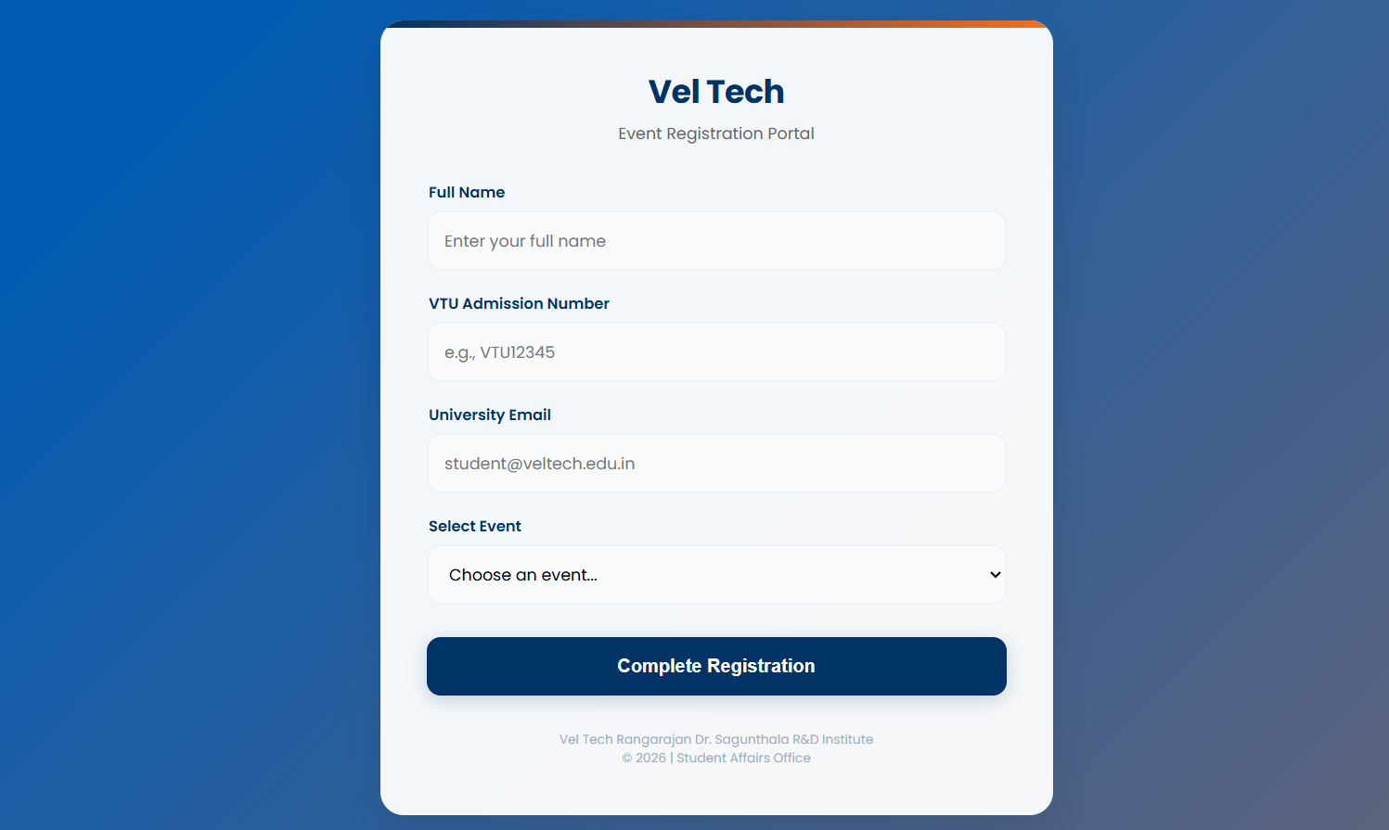
Home Page showing the Vel Tech themed registration card.
IMPLEMENTATION SCREENSHOTS
1
2
3
4
5
6
7
8
9

Slide 11
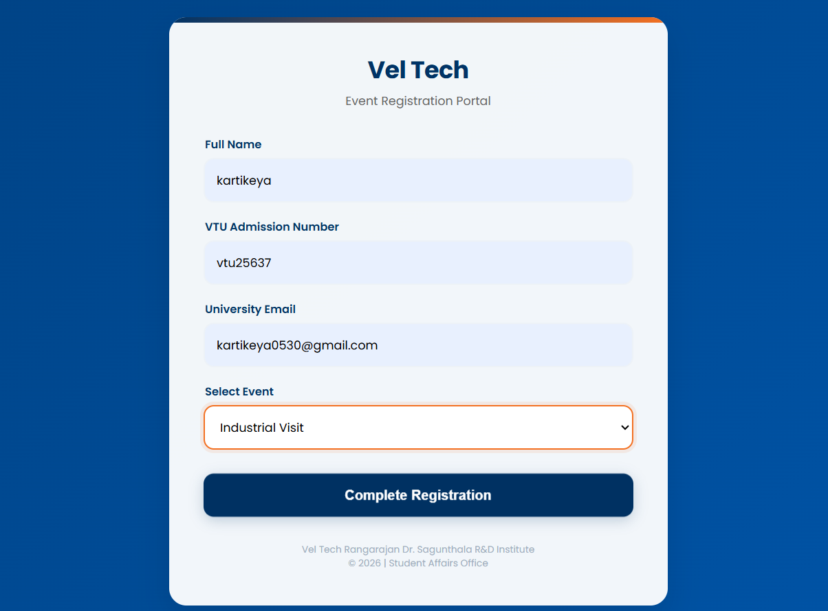
IMPLEMENTATION SCREENSHOTS
Industrial Visit Registration through student event Registration Portal
1
2
3
4
5
6
7
8(A)
9

Slide 12
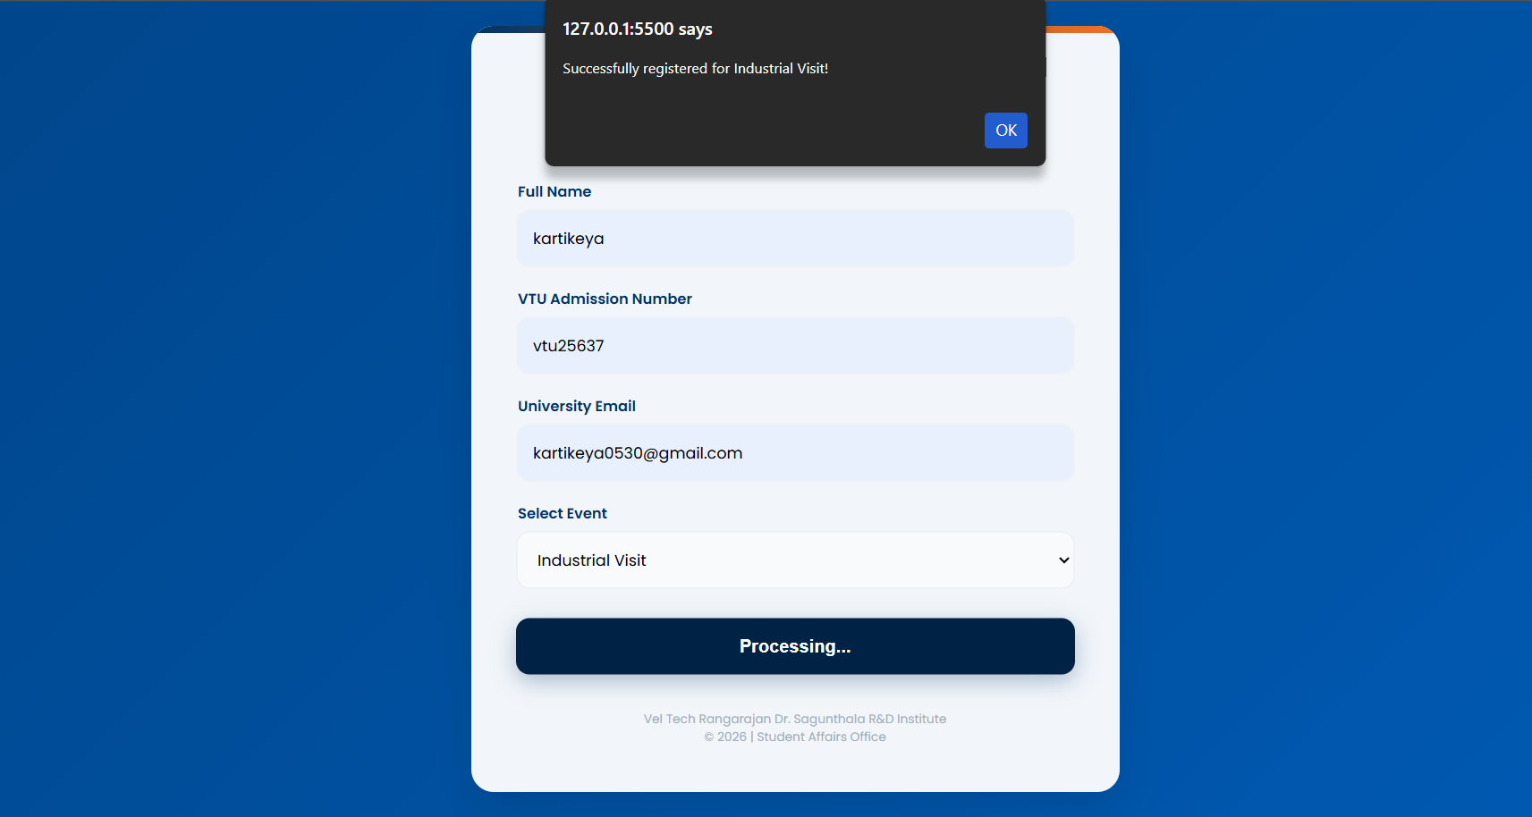
IMPLEMENTATION SCREENSHOTS
The "Success Alert" after a student clicks submit.
1
2
3
4
5
6
7
8(B)
9

Slide 13
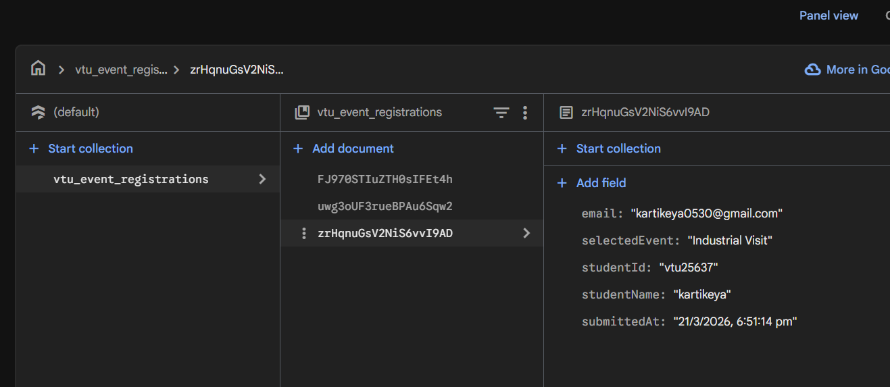
The Firebase Console showing the data actually stored in Firestore
IMPLEMENTATION SCREENSHOTS
1
2
3
4
5
6
7
8(C)
9

Slide 14
ADVANTAGES & LIMITATIONS
1
Advantages:
Real-time data syncing, highly responsive UI, and zero server maintenance cost (Serverless).
Limitations:
Requires an active internet connection for database submission.
2
3
4
5
6
7
8
9

Slide 15
Thank you

