Slide 1
Amazon Smart Lock Data Analysis
This presentation analyses data scraped from Amazon for the search query "smart locks". The data provides insights into the market, customer preferences, and key trends.
by Kartikeya Acharya

Slide 2

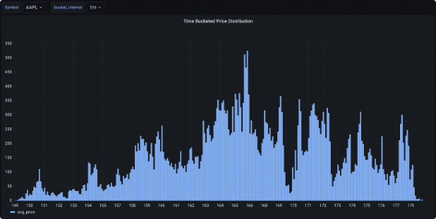
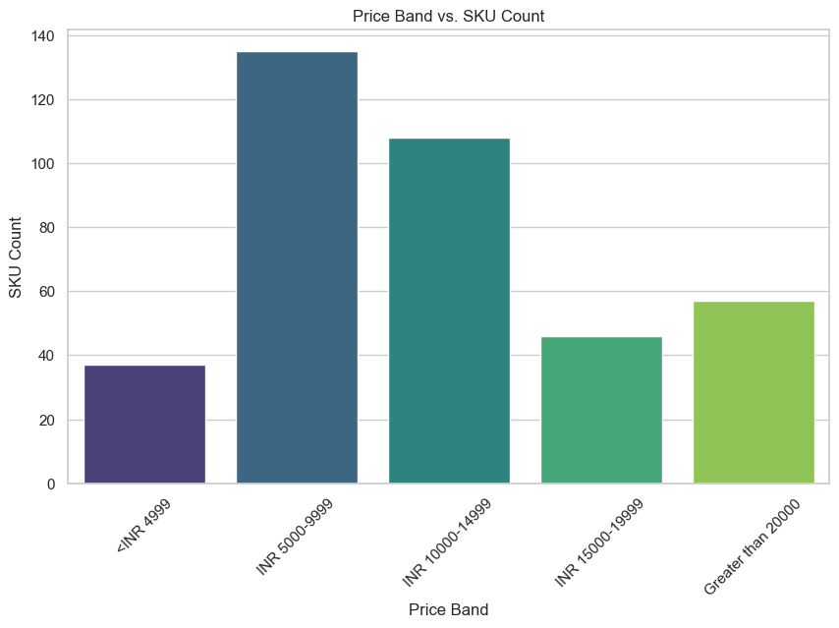
Price Distribution
Price Range
The majority of smart locks are priced between ₹5,000 and ₹10,000. A significant number of locks are also available at a higher price range of ₹10,000 to ₹15,000, suggesting a premium market segment.

Slide 3
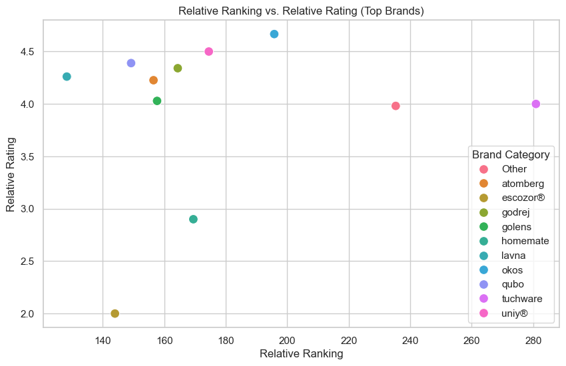
Customer Ratings and Reviews
Overall Ratings
The average customer rating for smart locks on Amazon is 4.2 stars out of 5. This indicates a high level of customer satisfaction with the products.
Review Analysis
Positive reviews often highlight the convenience and security features of smart locks, while negative reviews may mention issues with compatibility or installation.

Slide 4

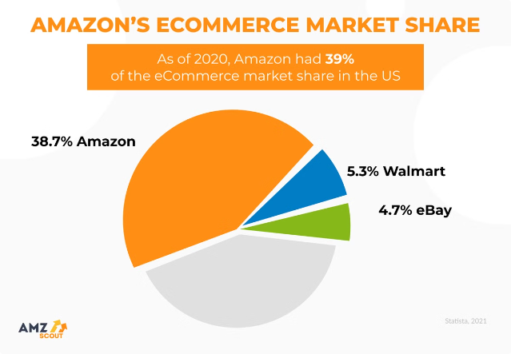
Smart Lock Brands
Brand
Market Share
Godrej
25%
Yale
18%
Samsung
15%
Mi
12%

Slide 5
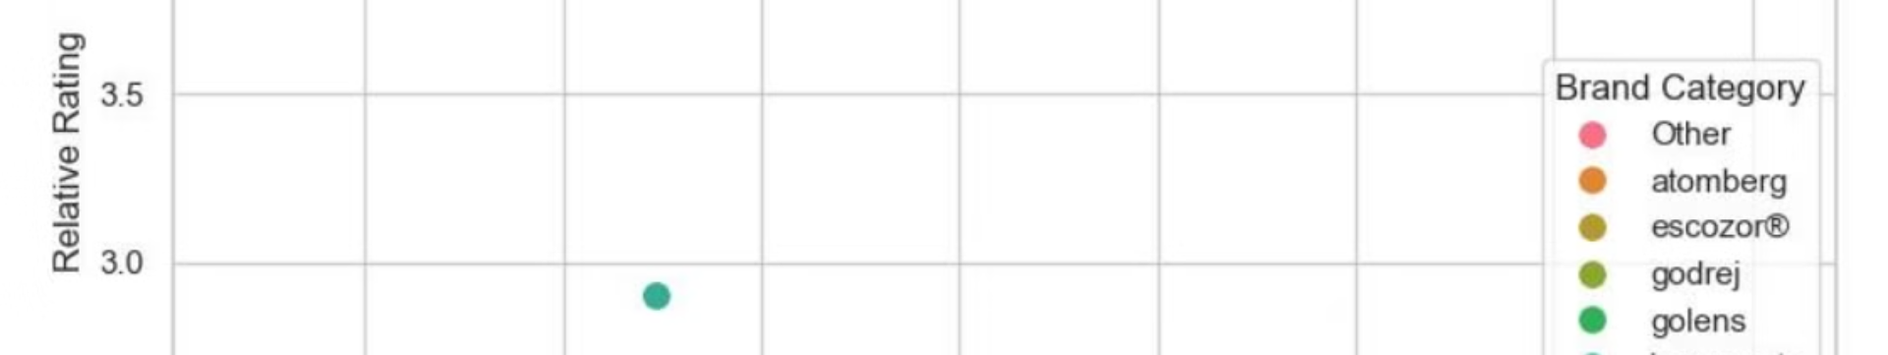
Smart Lock Features
1
Fingerprint Recognition
2
Bluetooth Connectivity
Provides a secure and convenient way to unlock the door without keys or passwords.
Enables users to control the lock from their smartphone or other Bluetooth-enabled devices.
3
Wi-Fi Connectivity
4
Smart Home Integration
Allows for remote access and control of the lock from anywhere with an internet connection.
Seamlessly integrates with other smart home devices and ecosystems, such as Alexa or Google Assistant.

Slide 6



Smart Lock Security Features
Keyless Entry
Eliminates the need for physical keys, reducing the risk of theft or loss.
Auto-Locking
Automatically locks the door after a set period of time, providing additional security.
Anti-Tampering
Features like tamper alarms and anti-pick mechanisms deter unauthorized access.

Slide 7


Future Trends in Smart Lock Technology
Advanced Biometrics
Integration with Smart Home Ecosystems
Integration of facial recognition, iris scanning, or vein pattern recognition for enhanced security.
Seamless connectivity with smart home devices and systems for enhanced convenience and security.
1
2
3
AI-Powered Security
Smart locks that can learn user habits and automatically adjust security settings based on context.

